Slide 1
Hadoop学习笔记
公共架构中心 林宏正

Slide 2
MapReduce+HDFS

Slide 3

HDFS架构
Notes:
http://hadoop.apache.org/docs/current/hadoop-project-dist/hadoop-hdfs/HdfsDesign.html

Slide 4
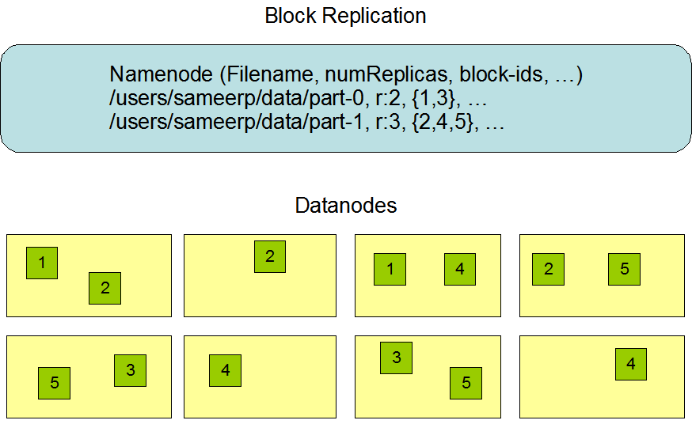
块复制

Slide 5
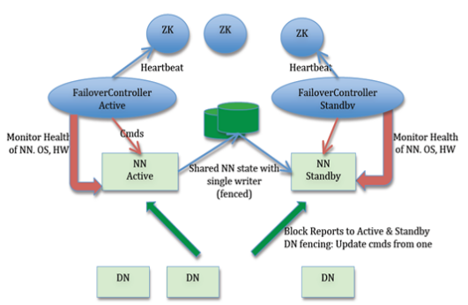
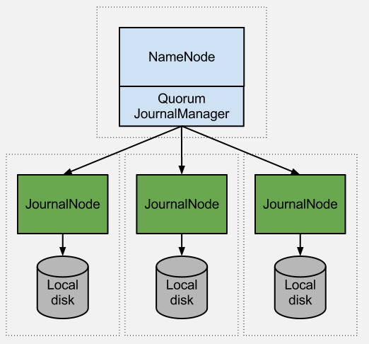
HDFS NameNode HA with QJM

Slide 6
HDFS NameNode HA with NFS

Slide 7
MapReduce

Slide 8
YARN
JobTracker 在 2.0 中已经被整合到 YARN ResourceManger 之中

