Slide 1
Apache Storm 1.0.2基础培训
林宏正
IT互联网部-公共架构中心

Slide 2
A
Storm简介
B
Storm core concepts
C
Storm原理
D
Storm开发

Slide 3
简介
Storm是一个分布式的实时数据处理系统
特点
分布式
可靠性(保证数据无丢失,at least once)
容错性
编程简单
支持多种语言
可扩展

Slide 4
应用场景
流数据处理 Storm可以用来处理源源不断流进来的消息，处理之后将结果写入到某个存储中去。
分布式RPC
由于storm的处理组件是分布式的，而且处理延迟极低，所以可以作为一个通用的分布式rpc框架来使用。

Slide 5
Storm core concepts
A first look
Topology
Data model
Spouts and bolts
Groupings
Parallelism
Trident
DRPC

Slide 6
A first look
Storm is distributed FP-like
processing of data streams.
Same idea, many machines.
(but there’s more of course)

Slide 7
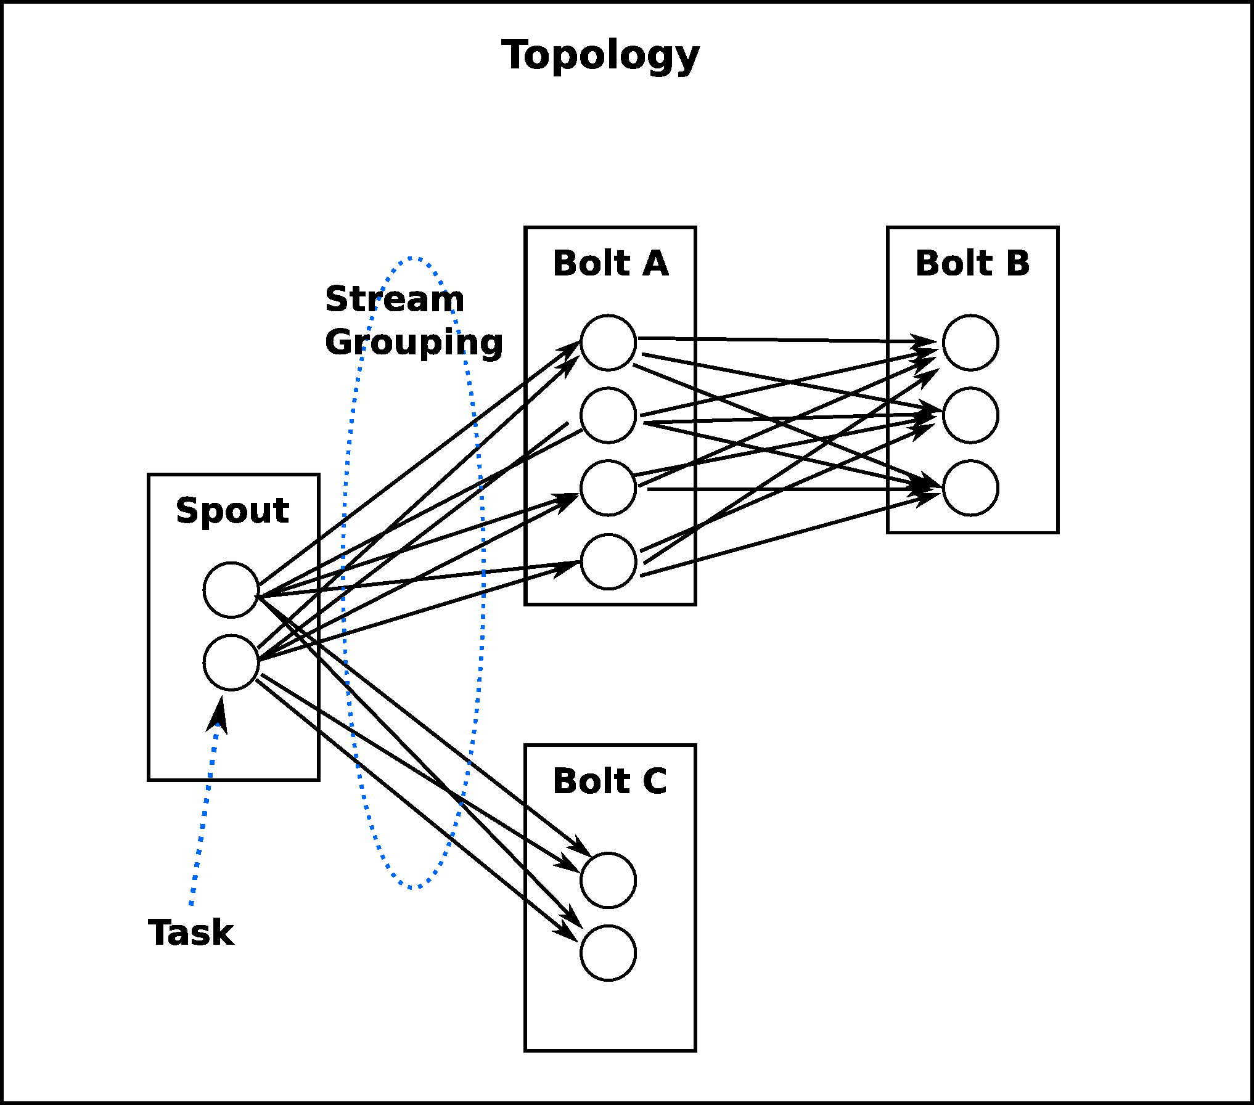
Topology
一个实时计算应用程序的逻辑在storm里面被封装到topology对象里面.

Slide 8
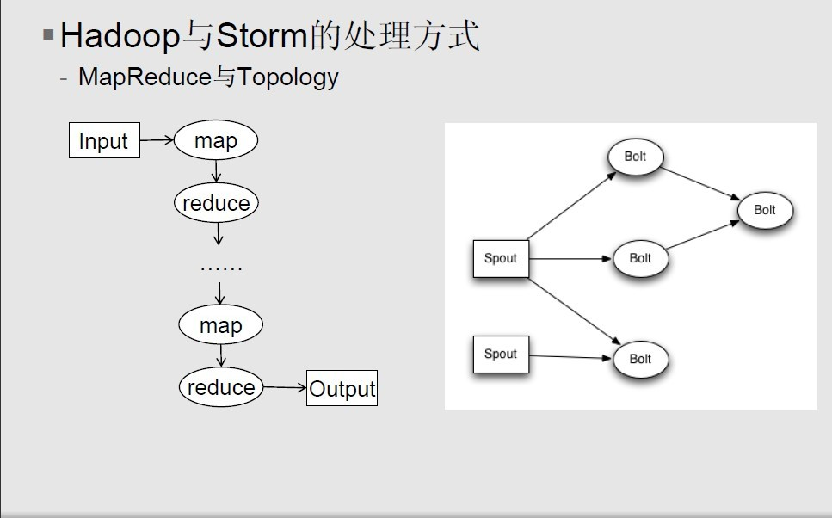
Topology
Executes on many machines like a MR job in Hadoop.
关键区别：
一个MapReduce Job最终总是会结束的， 然而一个storm的topoloy会一直运行( 除非你显式的杀死它)。

Slide 9
Topology
A topology in Storm wires data and functions via a DAG.

Slide 10
Topology
Spout 1
data
Spout 2

Slide 11
Topology
functions
Bolt 1
Bolt 4
Spout 1
Bolt 2
data
Spout 2
Bolt 3

Slide 12
Topology
functions
Bolt 1
Bolt 4
Spout 1
Bolt 2
data
DAG
Spout 2
Bolt 3

Slide 13
Relation of topologies to FP
f
h
Bolt 1
Bolt 4
data
Spout 1
Bolt 2
g
Spout 2
Bolt 3

Slide 14
Relation of topologies to FP
f
h
Bolt 1
Bolt 4
data
Spout 1
Bolt 2
g
DAG:
f(data)
g(data)
h( , )

Slide 15
Previous WordCount example in Storm
Remember?
(->> queries (map second) frequencies (sort-by val >) )
queries
f
g
h
Spout
Bolt 1
Bolt 2
Bolt 3

Slide 16
Storm core concepts
A first look
Topology
Data model
Spouts and bolts
Groupings
Parallelism
Trident
DRPC

Slide 17
Data model
Tuple = datum containing 1+ fields
(1.1.1.1, “foo.com”)
Values can be of any type such as Java primitive types, String, byte[].
Custom objects should provide their own Kryo serializer though.
Stream = unbounded sequence of tuples
...
(1.1.1.1, “foo.com”)
(2.2.2.2, “bar.net”)
(3.3.3.3, “foo.com”)
...

Slide 18
Storm core concepts
A first look
Topology
Data model
Spouts and bolts
Groupings
Parallelism

Slide 19
Spouts and bolts
Spout = source of data streams
Spout 1
Bolt 1
Can be “unreliable” (fire-and-forget) or “reliable” (can replay failed tuples).
Example: Connect to the Twitter API and emit a stream of decoded URLs.
Bolt = consumes 1+ streams and potentially produces new streams
Spout 1
Bolt 1
Bolt 2
Can do anything from running functions, filter tuples, joins, talk to DB, etc.
Complex stream transformations often require multiple steps and thus multiple bolts.

Slide 20
Storm core concepts
A first look
Topology
Data model
Spouts and bolts
Groupings
Parallelism
Trident
DRPC

Slide 21
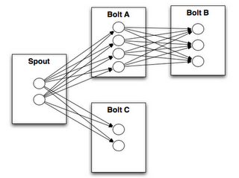
Stream groupings control the data flow in the DAG
Bolt A
Bolt B
Spout
Bolt C
Shuffle grouping = random; typically used to distribute load evenly to downstream bolts
Fields grouping = GROUP BY field(s)
All grouping = replicates stream across all the bolt’s tasks; use with care
Global grouping = stream goes to a single one of the bolt’s tasks; don’t overwhelm the target bolt!
Direct grouping = producer of the tuple decides which task of the consumer will receive the tuple
LocalOrShuffle = If the target bolt has one or more tasks in the same worker process, tuples will be shuffled to just those in-process tasks. Otherwise, same as normal shuffle.
Custom groupings are possible, too.

Slide 22
Storm core concepts
A first look
Topology
Data model
Spouts and bolts
Groupings
Parallelism – worker, executors, tasks
Trident
DRPC

Slide 23
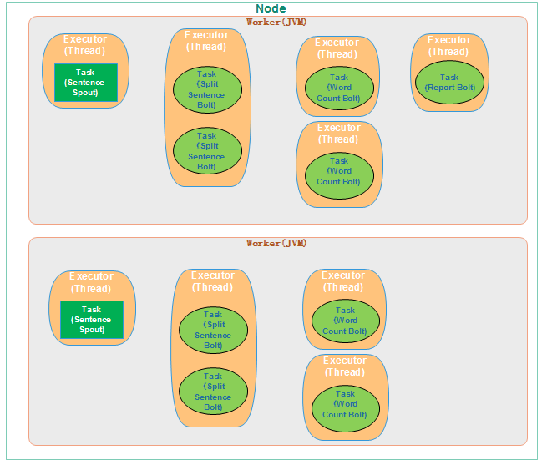
Parallelism – worker, executors, tasks

Slide 24
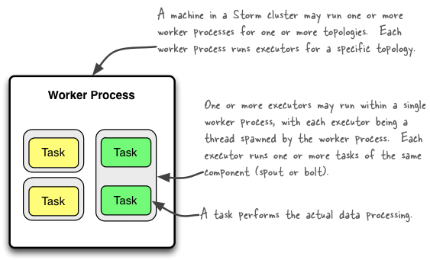
Worker processes vs. Executors vs. Tasks
Invariant: #threads ≤ #tasks
A worker process is either idle or being used by a single topology, and it is never
shared across topologies. The same applies to its child executors and tasks.
http://storm.incubator.apache.org/documentation/Understanding-the-parallelism-of-a-Storm-topology.html

Slide 25
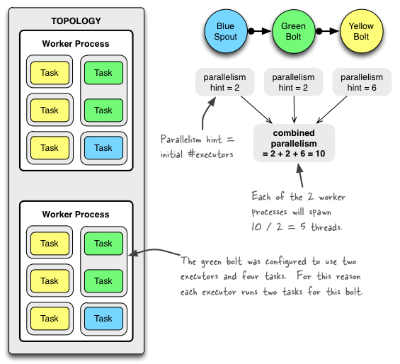
Example of a running topology

Slide 26
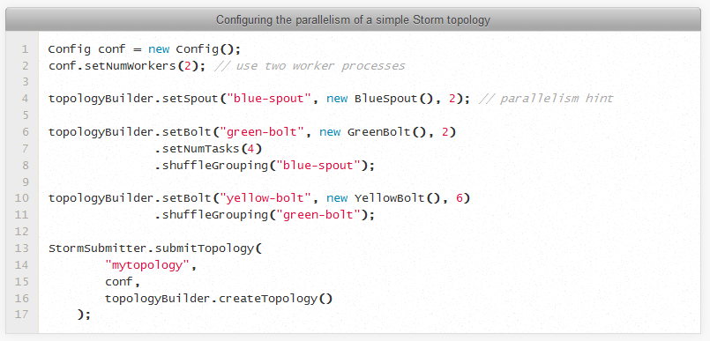
Code to configure this topology

Slide 27
Trident

Slide 28
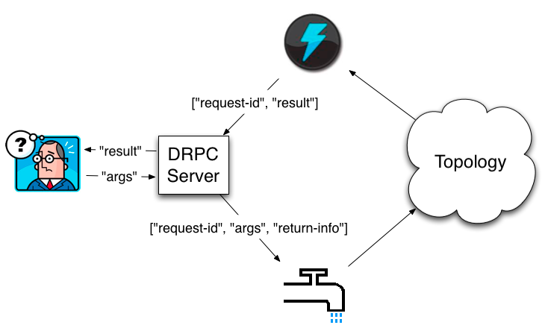
DRPC

Slide 29
Operating Storm
Storm architecture
Storm hardware specs
Deploying Storm
Monitoring Storm
Storm topologies
Storm itself
ZooKeeper
Ops-related references

Slide 30
Storm architecture
Supervisor
ZooKeeper
Supervisor
Nimbus
ZooKeeper
Supervisor
ZooKeeper
Supervisor
Supervisor
Hadoop v1 | Storm
JobTracker | Nimbus (only 1) (1.0.0之后支持多个) | distributes code around cluster assigns tasks to machines/supervisors failure monitoring is fail-fast and stateless (you can “kill -9” it)
TaskTracker | Supervisor (many) | listens for work assigned to its machine starts and stops worker processes as necessary based on Nimbus is fail-fast and stateless (you can “kill -9” it) shuts down worker processes with “kill -9”, too
MR job | Topology | processes messages forever (or until you kill it) a running topology consists of many worker processes spread across many machines

Slide 31
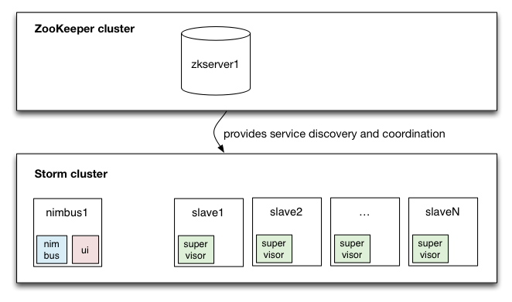
Storm architecture

Slide 32
Storm architecture: ZooKeeper
Storm requires ZooKeeper
0.9.2+ uses ZK 3.4.5
Storm typically puts less load on ZK than Kafka (but ZK is still a bottleneck), but caution: often you have many more Storm nodes than Kafka nodes
ZooKeeper
NOT used for message passing, which is done via Netty in 0.9
Used for coordination purposes, and to store state and statistics
Register + discover Supervisors, detect failed nodes, …
Example: To add a new Supervisor node, just start it.
This allows Storm’s components to be stateless. “kill -9” away!
Example: Supervisors/Nimbus can be restarted without affecting running topologies.
Used for heartbeats
Workers heartbeat the status of child executor threads to Nimbus via ZK.
Supervisor processes heartbeat their own status to Nimbus via ZK.
Stores recent task errors (deleted on topology shutdown)

Slide 33
Storm architecture: fault tolerance
What happens when Nimbus dies (master node)?
If Nimbus is run under process supervision as recommended (e.g. via supervisord), it will restart like nothing happened.
While Nimbus is down:
Existing topologies will continue to run, but you cannot submit new topologies.
Running worker processes will not be affected. Also, Supervisors will restart their (local) workers if needed. However, failed tasks will not be reassigned to other machines, as this is the responsibility of Nimbus.
What happens when a Supervisor dies (slave node)?
If Supervisor run under process supervision as recommended (e.g. via supervisord), will restart like nothing happened.
Running worker processes will not be affected.
What happens when a worker process dies?
It's parent Supervisor will restart it. If it continuously fails on startup and is unable to heartbeat to Nimbus, Nimbus will reassign the worker to another machine.

Slide 34
Storm hardware specs
ZooKeeper
Preferably use dedicated machines because ZK is a bottleneck for Storm
1 ZK instance per machine
Using VMs may work in some situations. Keep in mind other VMs or processes running on the shared host machine may impact ZK performance, particularly if they cause I/O load. (source)
I/O is a bottleneck for ZooKeeper
Put ZK storage on its own disk device
SSD’s dramatically improve performance
Normally, ZK will sync to disk on every write, and that causes two seeks (1x for the data, 1x for the data log). This may add up significantly when all the workers are heartbeating to ZK. (source)
Monitor I/O load on the ZK nodes
Preferably run ZK ensembles with nodes >= 3 in production environments so that you can tolerate the failure of 1 ZK server (incl. e.g. maintenance)

Slide 35
Storm hardware specs
Nimbus aka master node
Comparatively little load on Nimbus, so a medium-sized machine suffices
EC2 example: m1.xlarge @ $0.27/hour
Check monitoring stats to see if the machine can keep up

Slide 36
Storm hardware specs
Storm Supervisor aka slave nodes
Exact specs depend on anticipated usage – e.g. CPU heavy, I/O heavy, …
CPU heavy: e.g. machine learning
CPU light: e.g. rolling windows, pre-aggregation (here: get more RAM)
CPU cores
More is usually better – the more you have the more threads you can support (i.e. parallelism). And Storm potentially uses a lot of threads.
Memory
Highly specific to actual use case
Considerations: #workers (= JVMs) per node? Are you caching and/or holding in-memory state?
Network: 1GigE
Use bonded NICs or 10GigE if needed
EC2 examples: c1.xlarge @ $0.36/hour, c3.2xlarges @ $0.42/hour

Slide 37
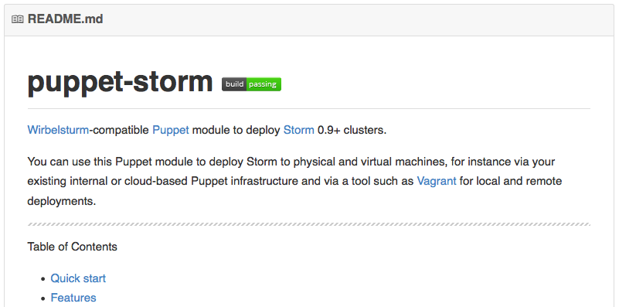
Deploying Storm
Puppet module
https://github.com/miguno/puppet-storm
Hiera-compatible, rspec tests, Travis CI setup (e.g. to test against multiple versions of Puppet and Ruby, Puppet style checker/lint, etc.)
RPM packaging script for RHEL 6
https://github.com/miguno/wirbelsturm-rpm-storm
Digitally signed by yum@michael-noll.com
RPM is built on a Wirbelsturm-managed build server
See later slides on Wirbelsturm for 1-click off-the-shelf cluster setups.

Slide 38
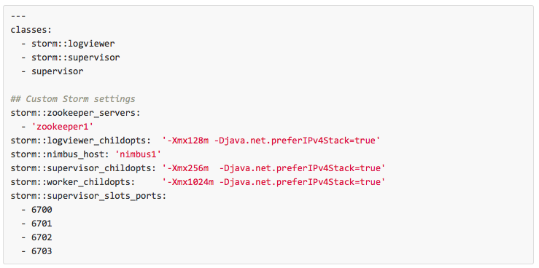
Deploying Storm
Hiera example for a Storm slave node

Slide 39
Operating Storm
Typical operations tasks include:
Monitoring topologies for P&S (“Don’t let our pipes blow up!”)
Tackling P&S in Storm is a joint Ops-Dev effort.
Adding or removing slave nodes, i.e. nodes that run Supervisors
Apps management: new topologies, swapping topologies, …
See Ops-related references at the end of this part

Slide 40
Storm security
Original design was not created with security in mind.
Security features are now being added, e.g. from Yahoo!’s fork.
State of security in Storm 0.9.x:
No authentication, no authorization.
No encryption of data in transit, i.e. between workers.
No access restrictions on data stored in ZooKeeper.
Arbitrary user code can be run on nodes if Nimbus’ Thrift port is not locked down.
This list goes on.
Further details plus recommendations on hardening Storm:
https://github.com/apache/incubator-storm/blob/master/SECURITY.md

Slide 41
Monitoring Storm
Storm UI
Use standard monitoring tools such as Graphite & friends
Graphite
https://github.com/miguno/puppet-graphite
Java API, also used by Kafka: http://metrics.codahale.com/
Consider Storm's built-in metrics feature
Collect logging files into a central place
Logstash/Kibana and friends
Helps with troubleshooting, debugging, etc. – notably if you can correlate logging data with numeric metrics

Slide 42
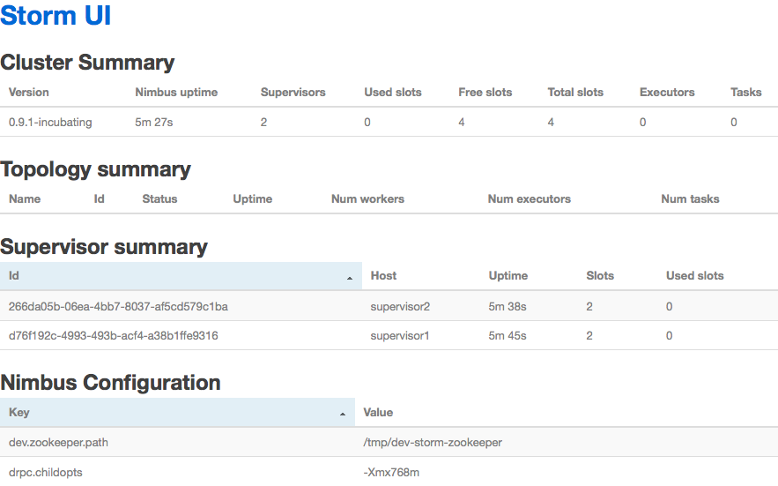
Monitoring Storm
Built-in Storm UI, listens on 8080/tcp by default
Storm REST API (new since in 0.9.2)
https://github.com/apache/incubator-storm/blob/master/STORM-UI-REST-API.md
Third-party tools
https://github.com/otoolep/stormkafkamon

Slide 43
Monitoring Storm topologies
Wait – why does the Storm UI report seemingly incorrect numbers?
Storm samples incoming tuples when computing statistics in order to increase performance.
Sample rate is configured via topology.stats.sample.rate.
0.05 is the default value
Here, Storm will pick a random event of the next 20 events in which to increase the metric count by 20. So if you have 20 tasks for that bolt, your stats could be off by +/- 380.
1.00 forces Storm to count everything exactly
This gives you accurate numbers at the cost of a big performance hit. For testing purposes however this is acceptable and often quite helpful.

Slide 44
Monitoring ZooKeeper
Ensemble (= cluster) availability
LinkedIn run 5-node ensembles = tolerates 2 dead
Twitter run 13-node ensembles = tolerates 6 dead
Latency of requests
Metric target is 0 ms when using SSD’s in ZooKeeper machines.
Why? Because SSD’s are so fast they typically bring down latency below ZK’s metric granularity (which is per-ms).
Outstanding requests
Metric target is 0.
Why? Because ZK processes all incoming requests serially. Non-zero values mean that requests are backing up.

Slide 45
Ops-related references
Storm documentation
http://storm.incubator.apache.org/documentation/Home.html
Storm FAQ
http://storm.incubator.apache.org/documentation/FAQ.html
Storm CLI
http://storm.incubator.apache.org/documentation/Command-line-client.html
Storm fault-tolerance
http://storm.incubator.apache.org/documentation/Fault-tolerance.html
Storm metrics
http://storm.incubator.apache.org/documentation/Metrics.html
http://www.michael-noll.com/blog/2013/11/06/sending-metrics-from-storm-to-graphite/
Storm tutorials
http://storm.incubator.apache.org/documentation/Tutorial.html
http://www.michael-noll.com/tutorials/running-multi-node-storm-cluster/

Slide 46
Storm Develop
Storm architecture
Storm hardware specs
Deploying Storm
Monitoring Storm
Storm topologies
Storm itself
ZooKeeper
Ops-related references

Slide 47
