Slide 1
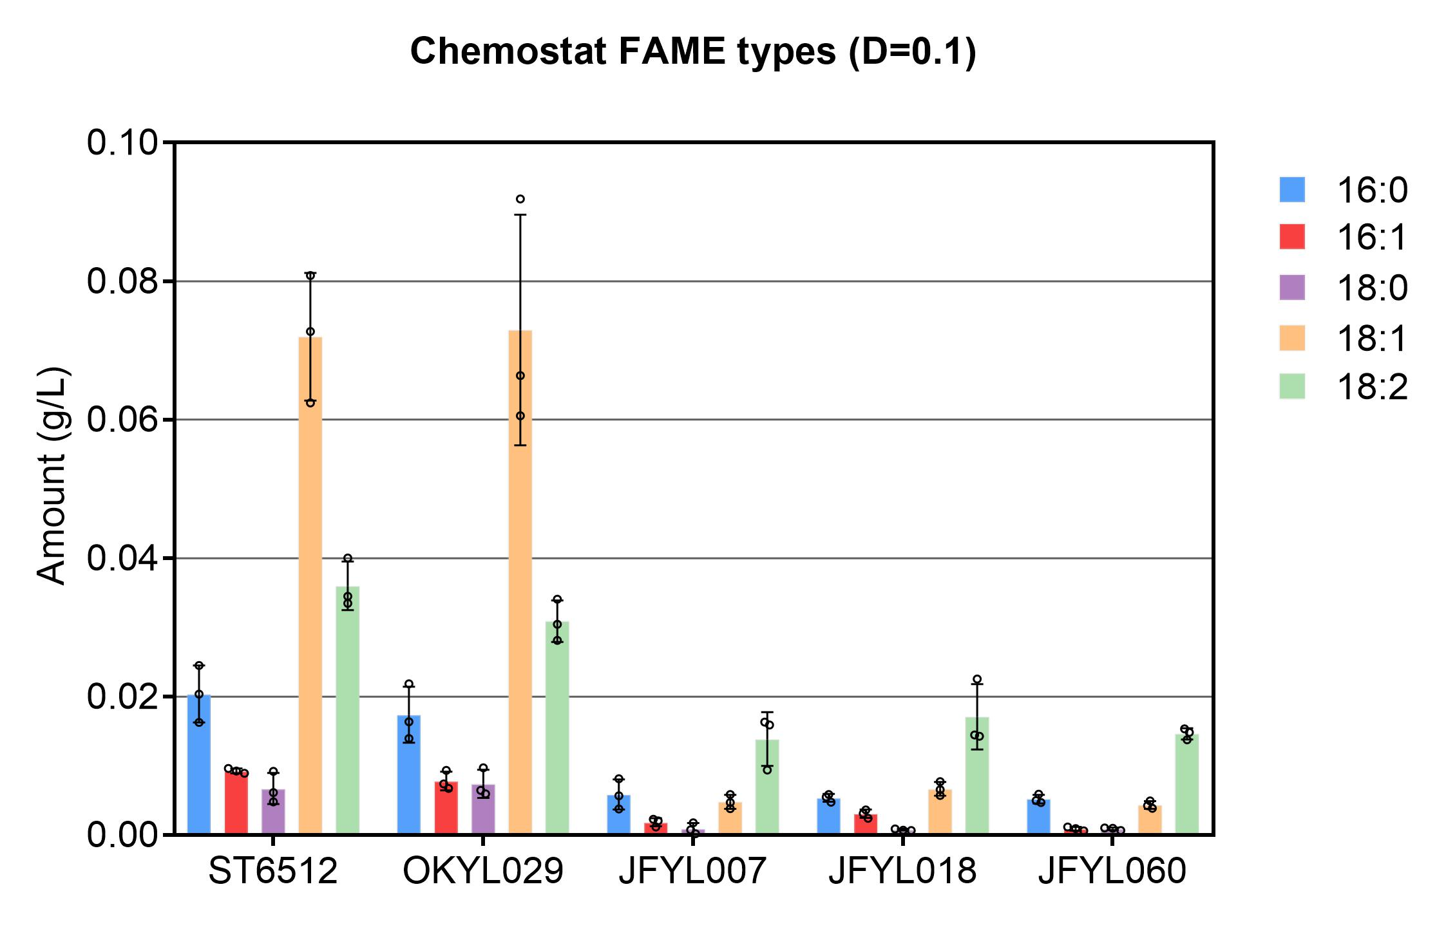
ST6512 | W29∆ku70::cas9
OKYL029 | W29∆ku70::cas9∆mhy1
JFYL007 | W29∆ku70::cas9∆mhy1∆ARE1∆LRO1∆DGA1∆DGA2
JFYL018 | W29∆ku70::cas9∆mhy1∆ARE1∆LRO1∆DGA1∆DGA2∆ICL1∆ICL2
JFYL060 | W29∆ku70::cas9∆mhy1∆ARE1∆LRO1∆DGA1∆DGA2∆ICL1∆ICL2, lntC3::pTef-AtCAD-Tpex20,pGPD-AtMTT-Tlip2

Slide 2
Chemostat
HPLC
Protein content
FAME
SPE (later work with Naghmeh)
Proteomics (Recieved result)
RNAseq (RNA extraction on Mar 4th and 8th)

