Slide 1
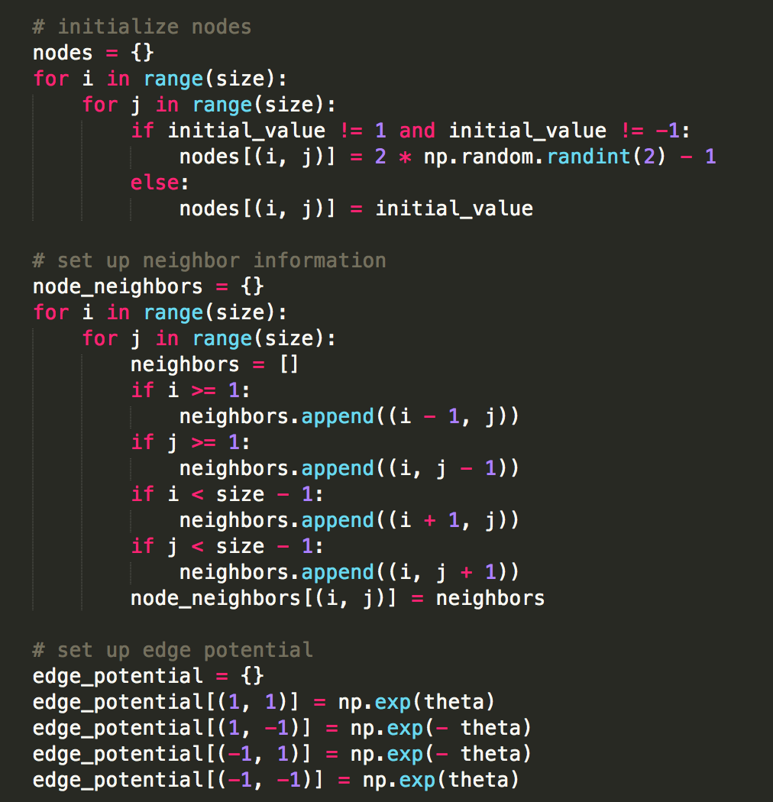
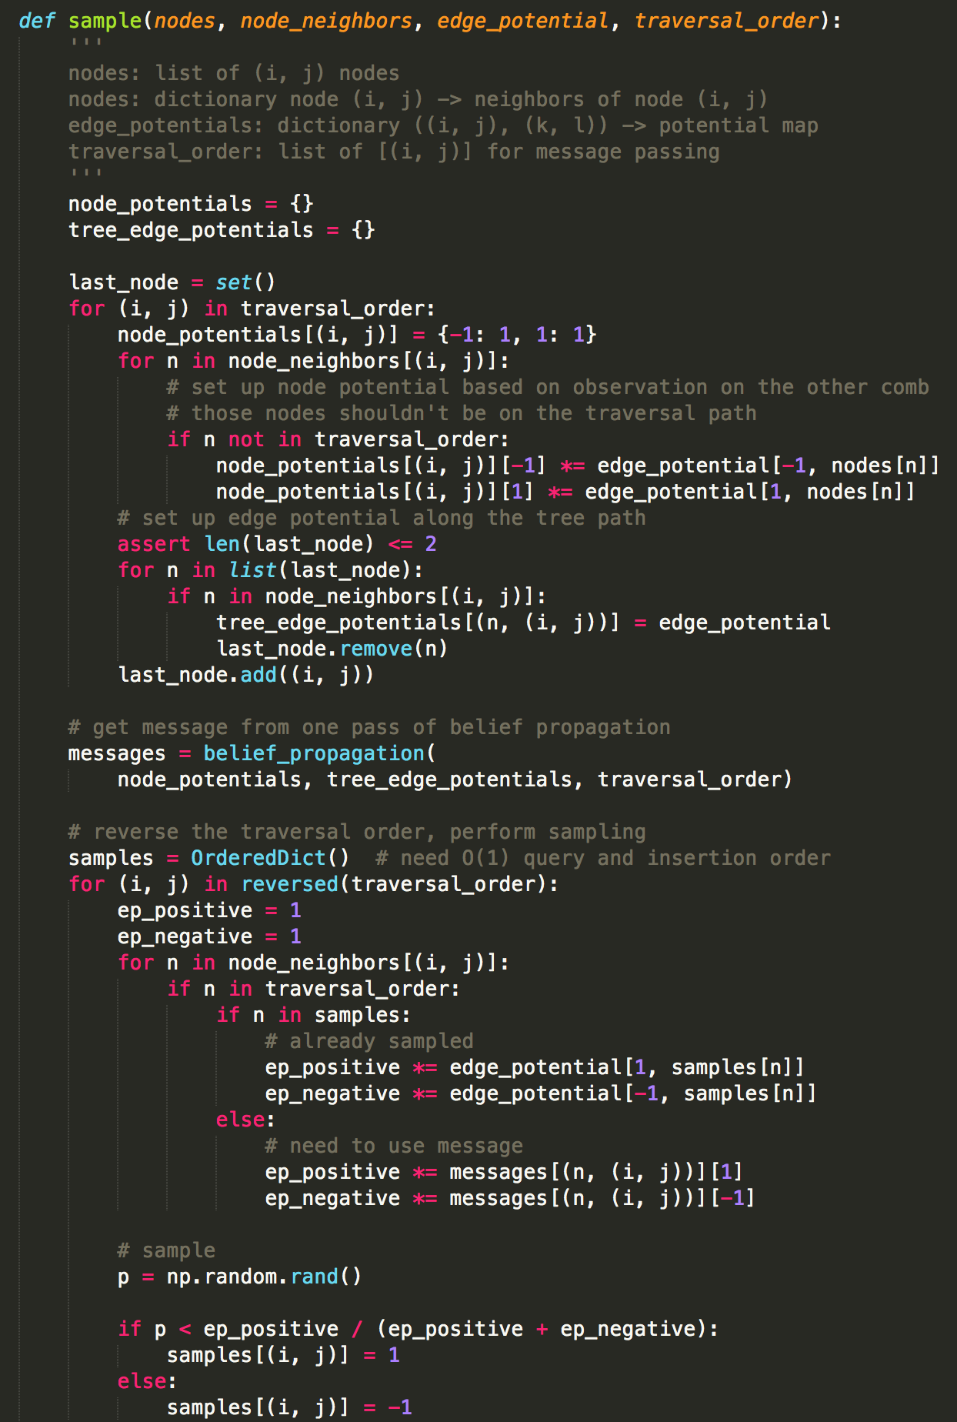
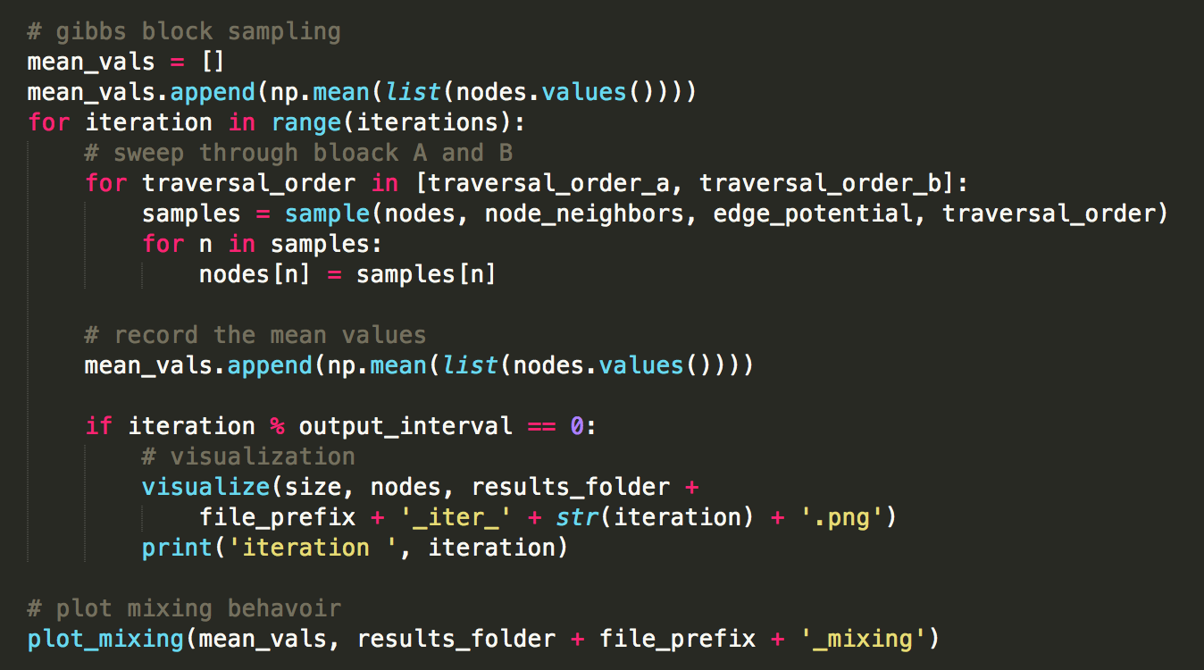
(a) Initialization
(b) Gibbs node sampler
(c) Sampling loop

Slide 2
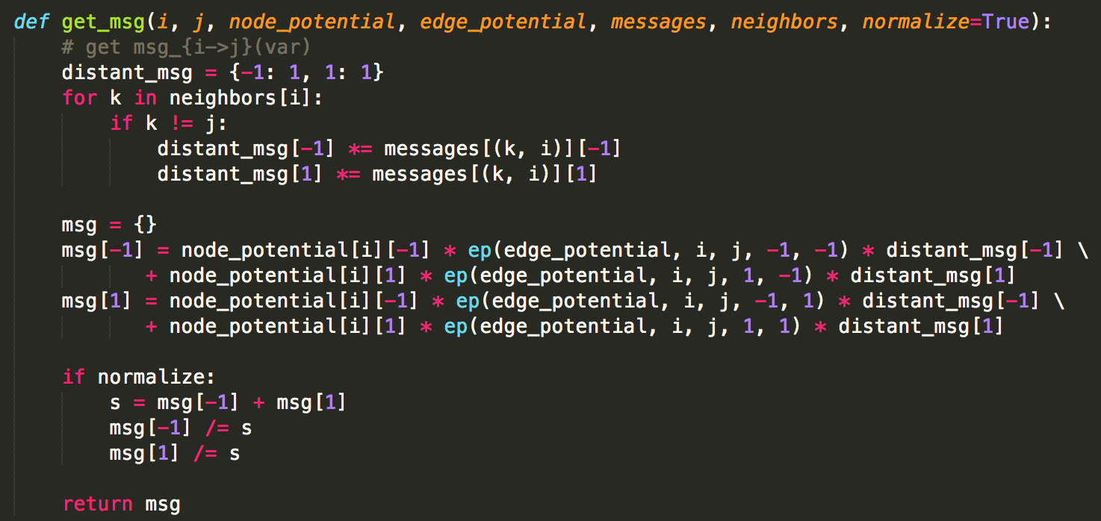
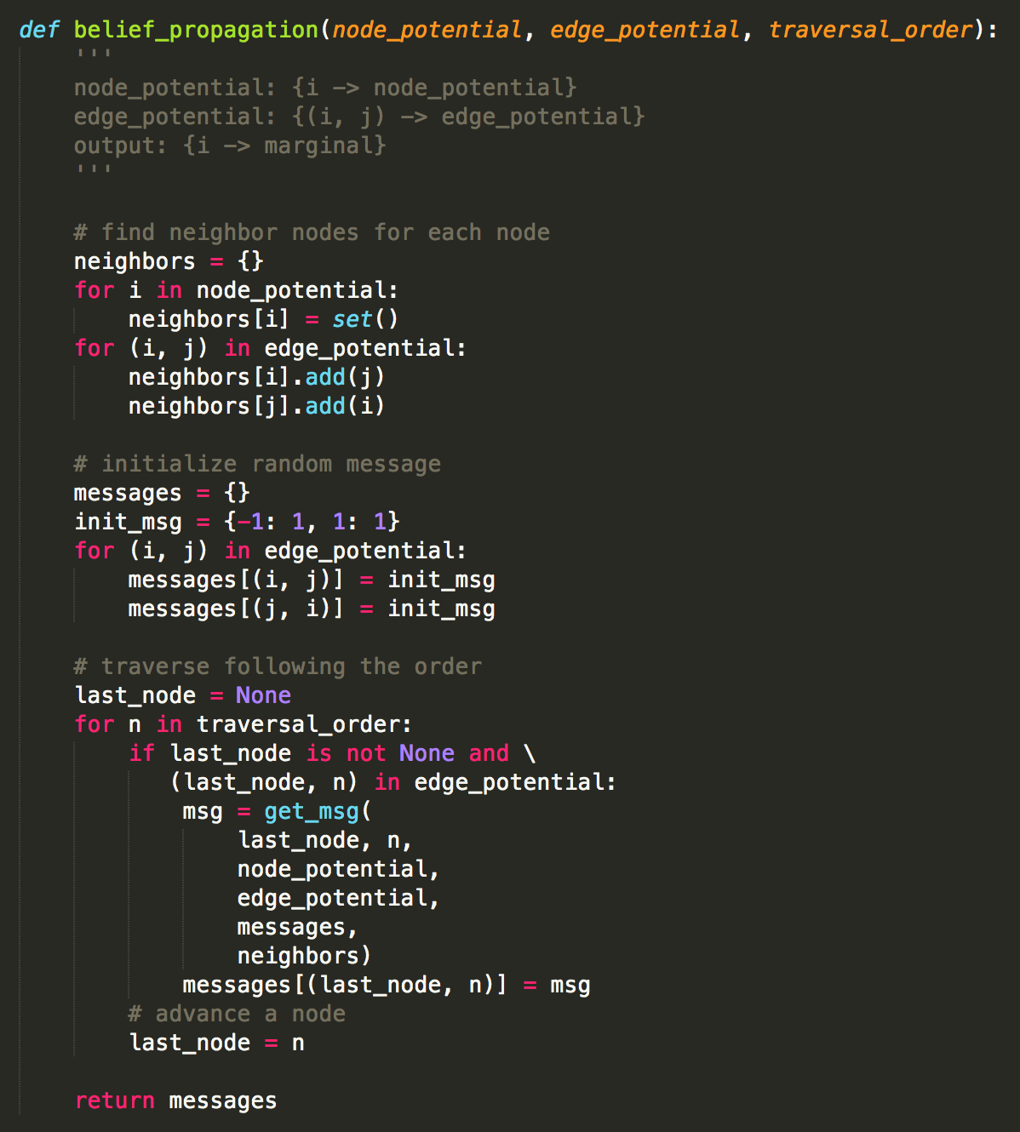
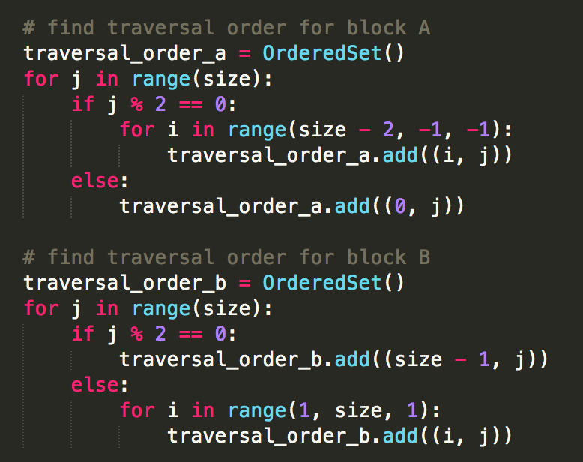
(d) Message update
(e) Serial block propagation
(g) Gibbs block sample
(f) Traversal order
(h) Sampling loop

Slide 3
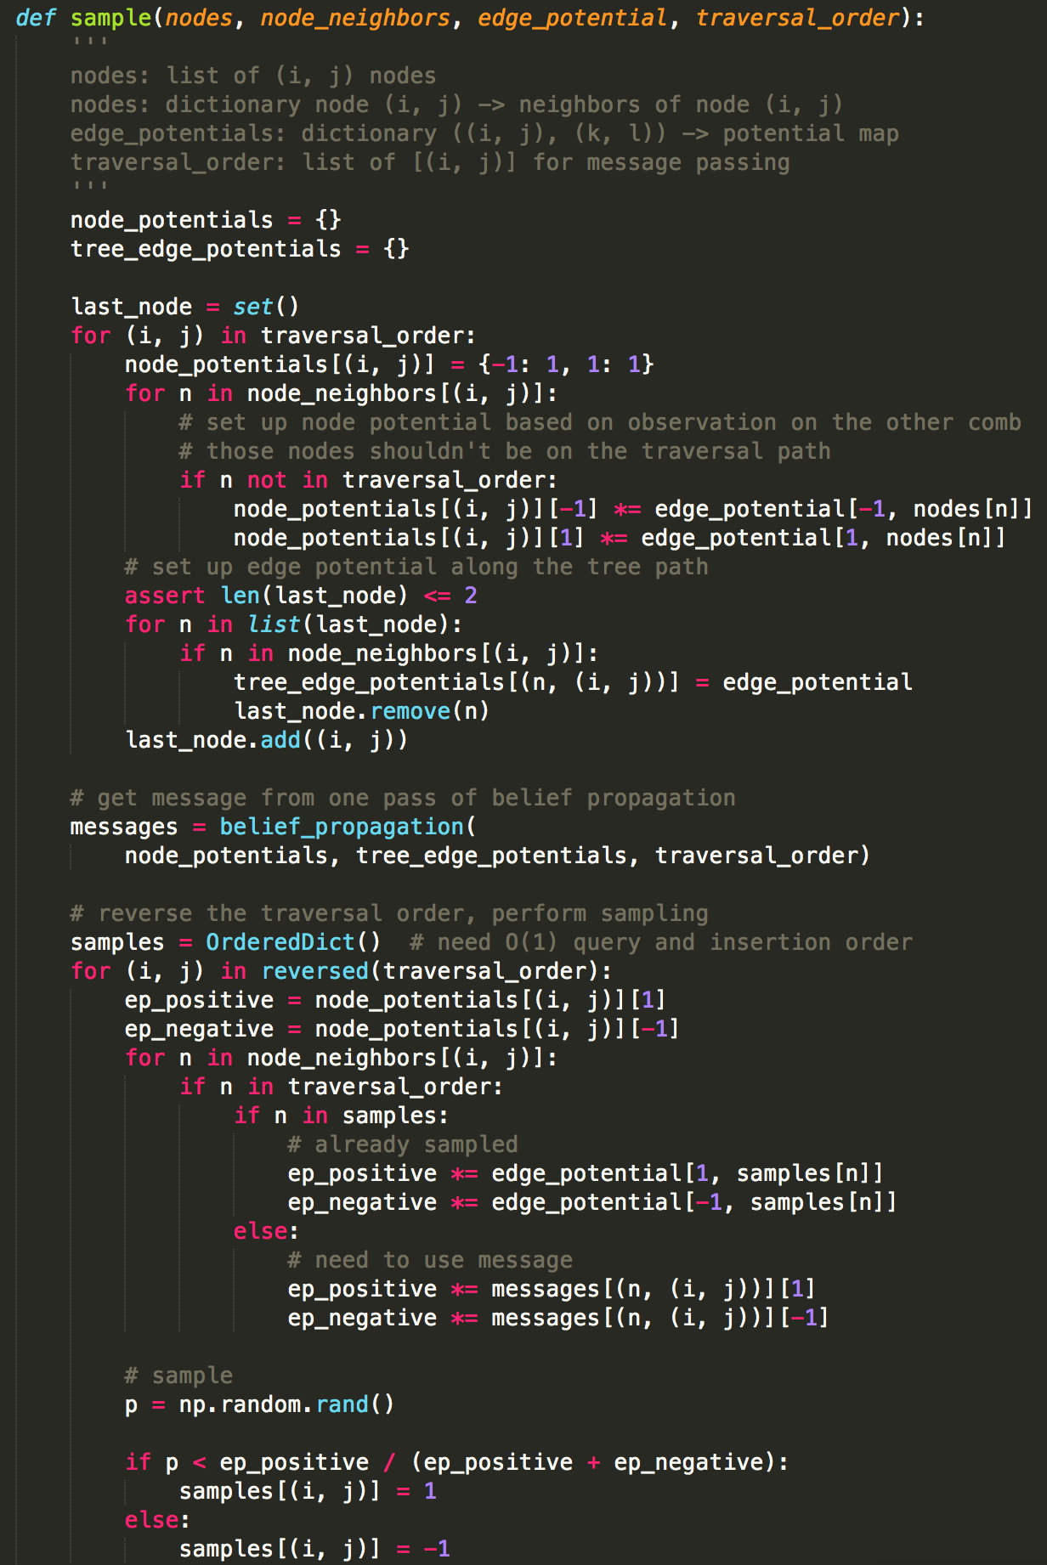
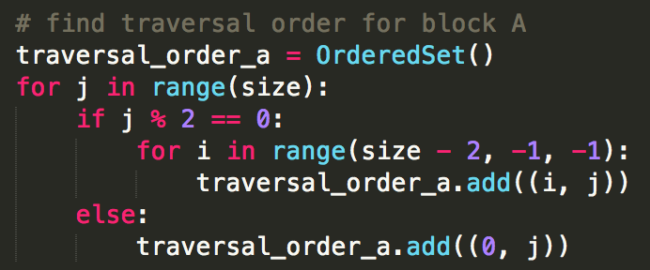
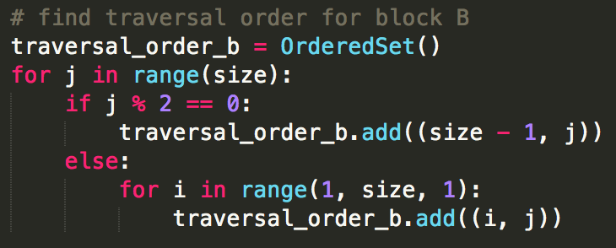
(a) Initialization
(c) Gibbs node sampling loop
(g) Gibbs block sample
(d) Message update
(b) Gibbs node sampler
(e) Serial belief propagation
(h) Gibbs block sampling loop
(f) Traversal order

