Slide 1
VOLUME CHANGE DETECTION DURING HEART SYSTOLE AND DIASTOLE

Slide 2
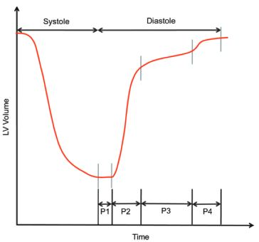
Problem Description
Detect volume change on Ultrasound images
Correspond the Ultrasound images with the ECG

Slide 3
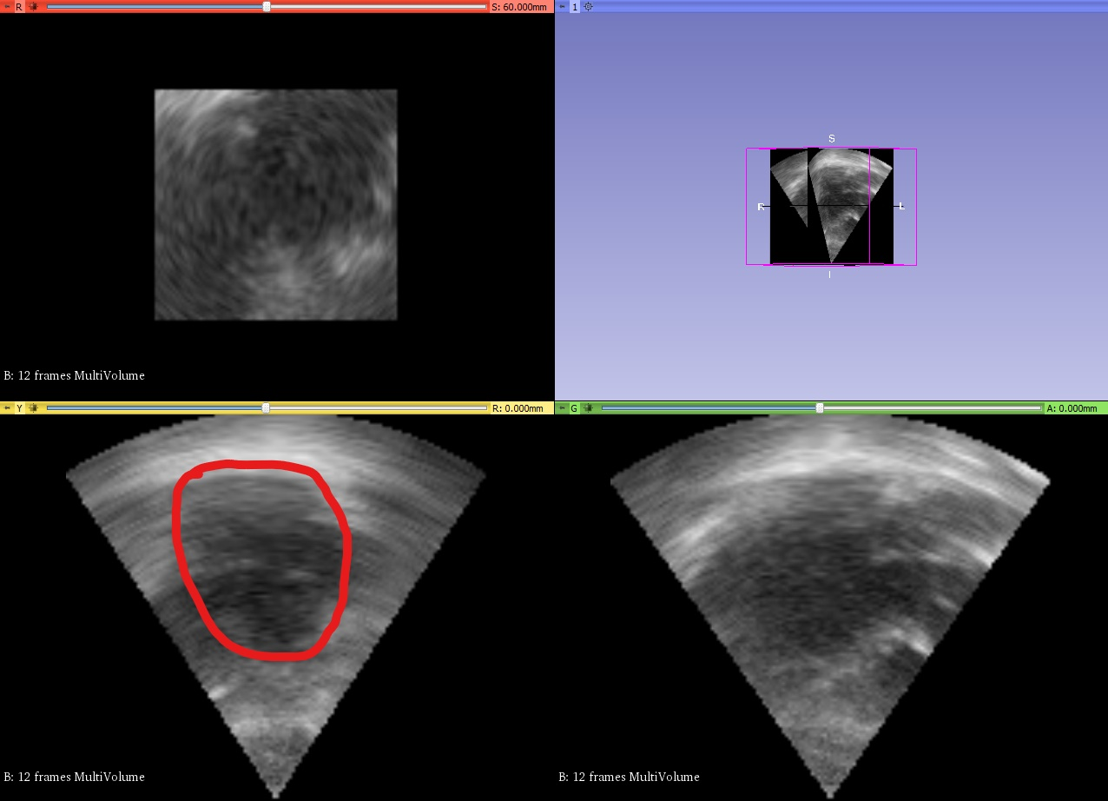
Visualization of Ultrasound Images

Slide 4
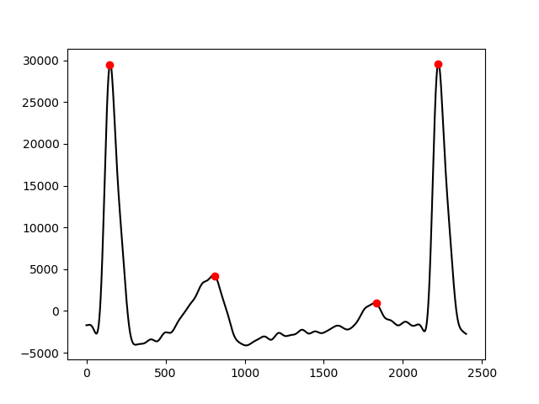
ECG Plot

Slide 5
Methods
3D U-Net for volume segmentation
Differential evolution optimization to detect P, QRS, T waves

