Slide 1
Behind the High Optimized AI Models - DeepSeek
Shuguang Liu
Apr 2025

Slide 2
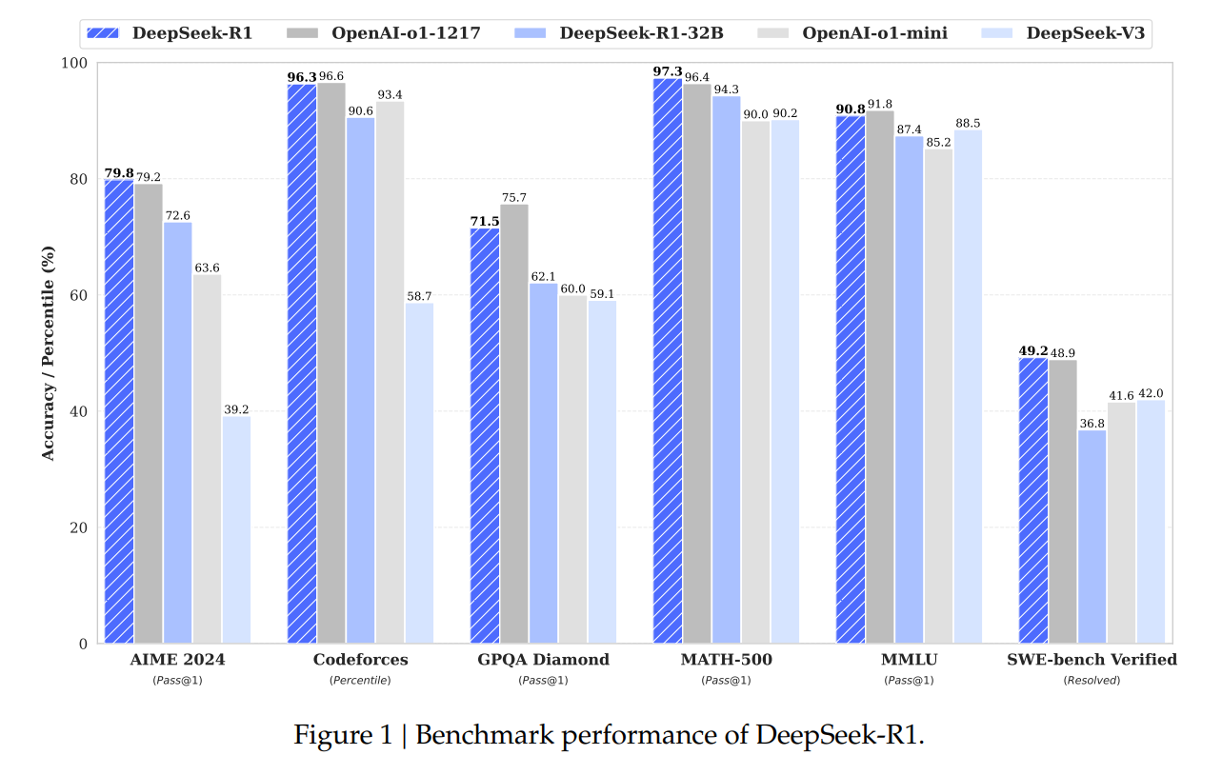
DeepSeek-R1 Performance
2501.12948
Model | #Total Params | #Activated Params | Context Length | Download
DeepSeek-R1-Zero | 671B | 37B | 128K | 🤗 HuggingFace
DeepSeek-R1 | 671B | 37B | 128K | 🤗 HuggingFace
Notes:
AIME 2024, America High School Olympic Math
Math500, Graduate level math problem set by OpenAI
Codeforces - Competition web, compared to human directly, Percentile
SWE-Bench Verified, Github, debug ability, give code and find bugs
GPQA Diamond -- 448 problems, PHD level, 65% even with PHD students
MMLU - All subject, human average

Slide 3
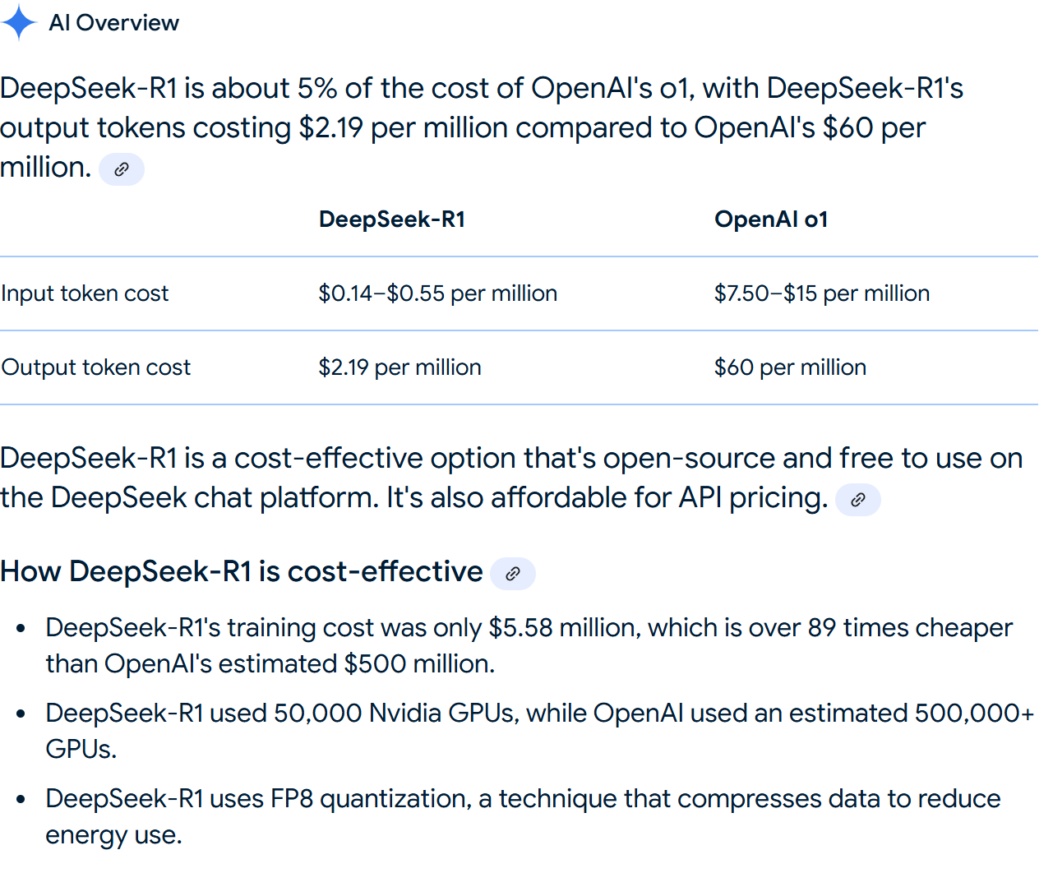













Slide 4
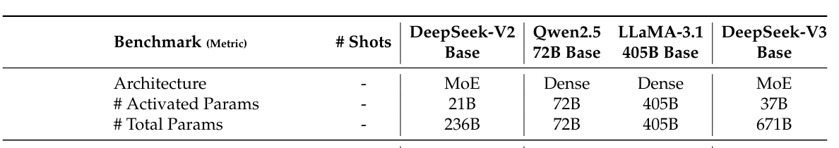
Model Size

Slide 5
Key technologies(DeepSeek V2, V3, R1)
Model Architecture
MLA, KV Cache optimization
DeepSeekMOE, Sparse MOE, more smaller experts + shared expert
Multi-token Prediction, Causal heads
Computation & Communication
FP8 optimization
Communication
Training
GRPO
Self Consistency, COT, Large Model distilled small model capability

Slide 6
Transformers KV Caching Explained | by João Lages | Medium

Slide 7
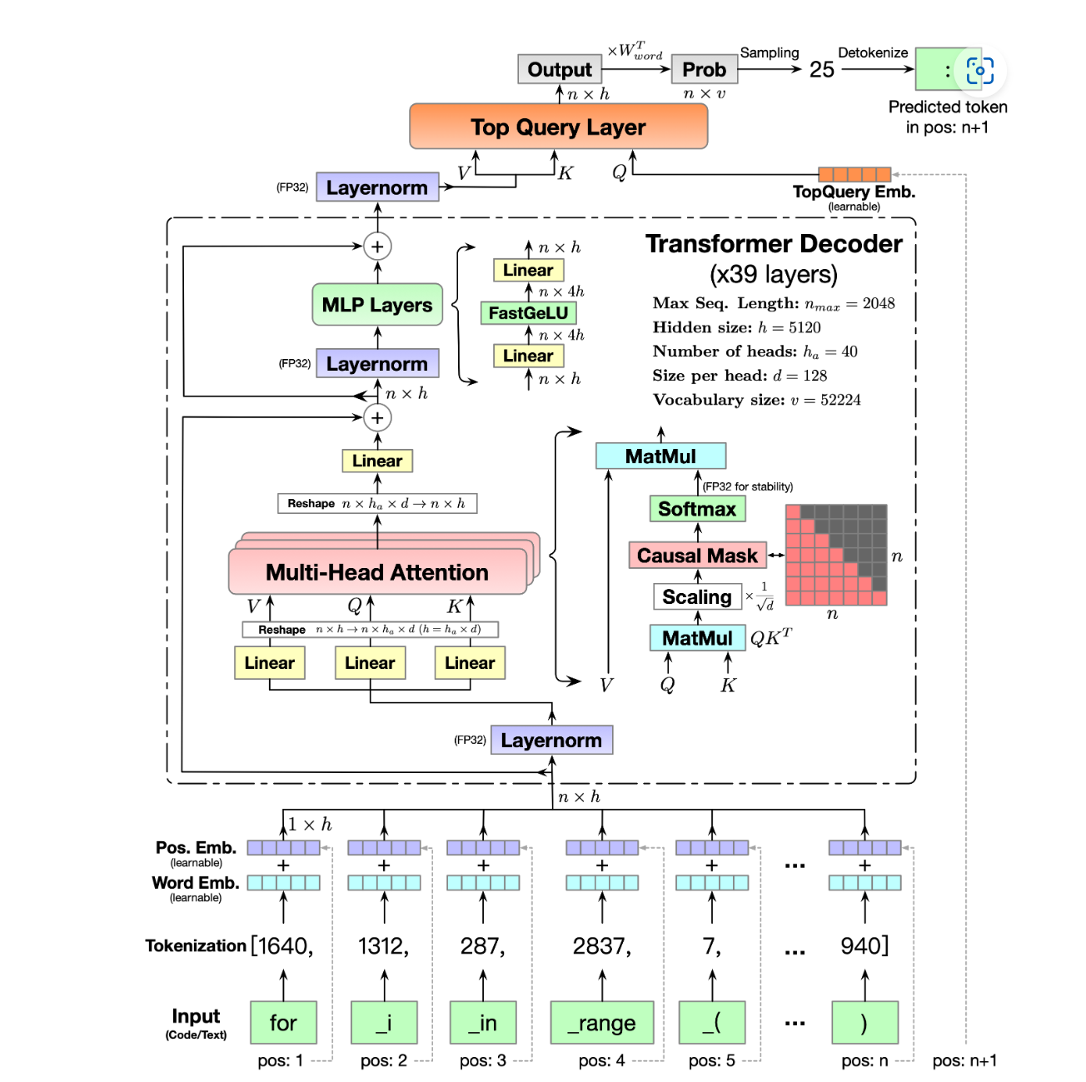
Transformer Decoder
CodeGeeX: 2303.17568

Slide 8
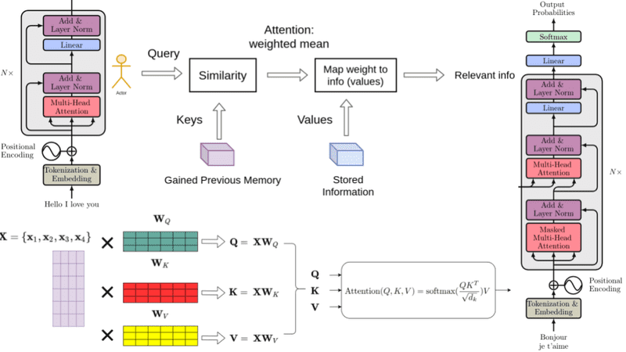

Slide 9
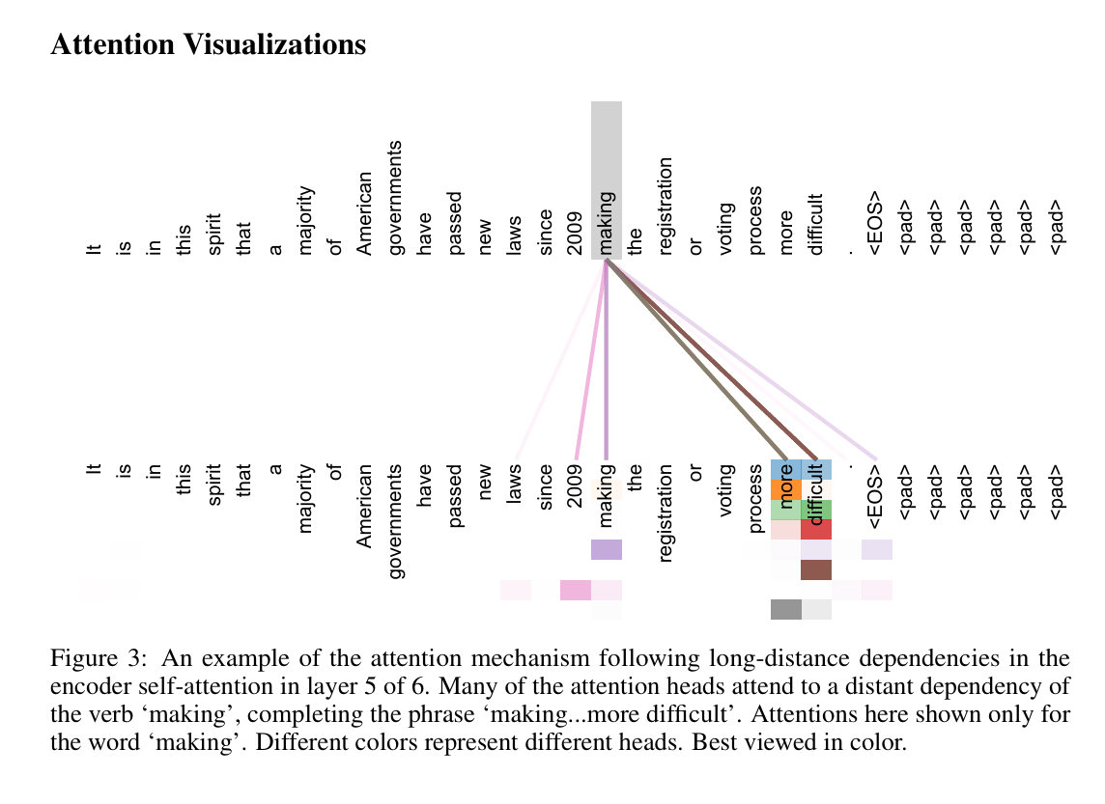
Multi-head Attentions learned the structures
Attention is All…1706.03762

Slide 10
Transformers KV Caching Explained | by João Lages | Medium

Slide 11
Transformers KV Caching Explained | by João Lages | Medium

Slide 12
KV Cache: computation → memory
For every token:
K, V will be cached
Qwen-72B-Chat:
L = 80
Num of Heads = 64
Dimension per Head = 128
KV Entries per token = 2 * L * NumHeads = 2 * 80 * 64 = 10240
Assume using BF16,
Memory per token = 10240 * 128 * 2 = 2.62 M

Slide 13
KV in Production Inference workload
Scenario1: Batch Size = 1, Sequence = 2048
Memory = 1token_mem * B * S = 5.366GB
Scenario2: Batch Size = 32, Sequence Lenth = 4096
Memory = 1 token_mem * B * S = 343.4GB
Model Memory = 2 * 72 = 144GB

Slide 14
How to optimize the KV cache usage
Training Stage Optimization
GQA, MQA,
MLA, Low Rank vector
Deploy Stage Optimization
Paged Attention, using additional mapping table to leverage discontinuous GPU memory
DistKV-LLM, paged attention over multi servers
ChunkAttention, reuse KV cache between different dialogs, mainly for Prefill
KV Cache to CPU memory
FlashMLA
Post training Optimization
Eviction, Static Policy(sliding window)
Quantization

Slide 15
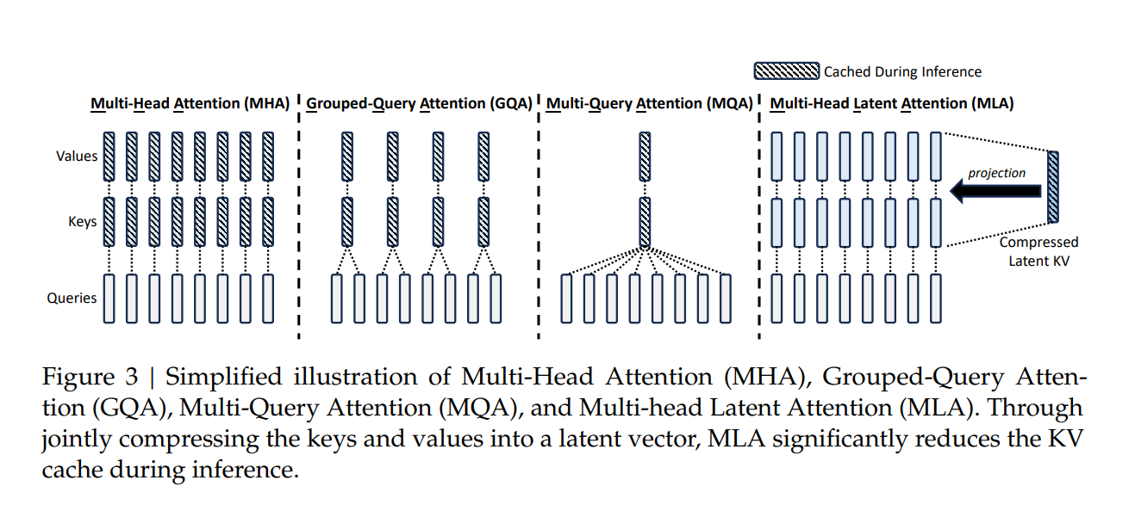
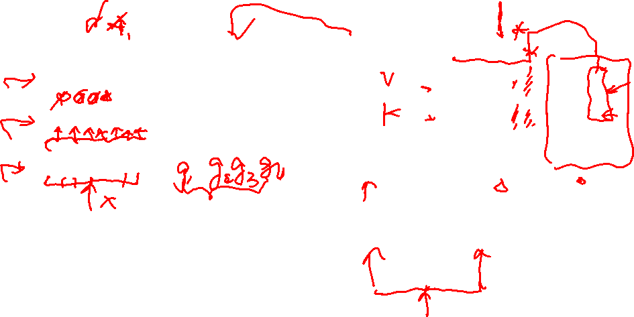
MHA, GQA, MQA, MLA
DeepSeek-V2 2405.04434

Slide 16
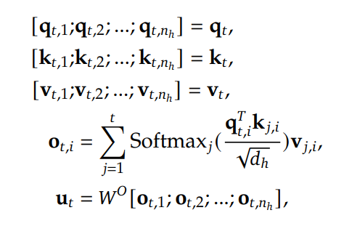
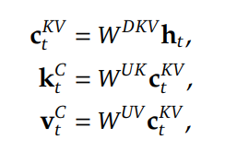
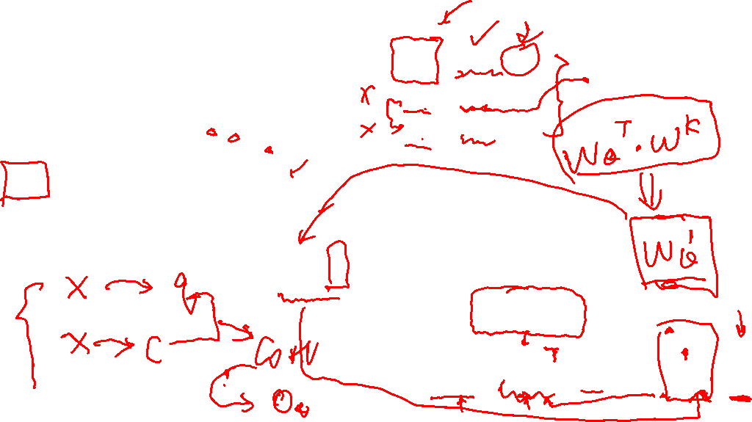




Without Positional information

Slide 17
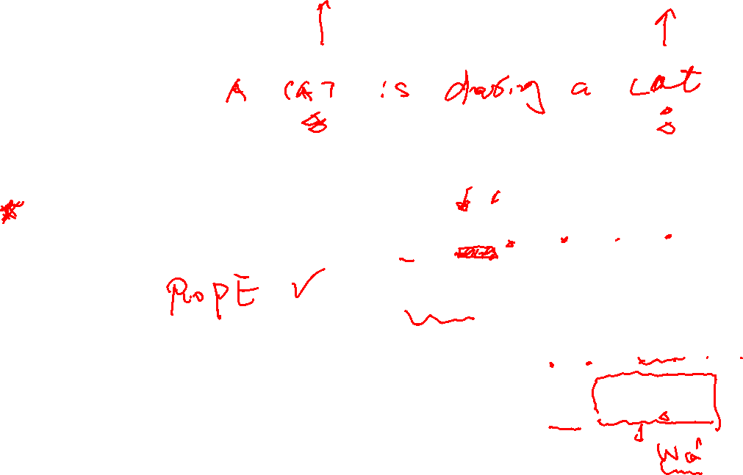
Seems perfect, but lose position information
Position Embedding
Absolute Position Embedding
Relative Position Embedding
Rotary Positional Embedding
ALiBi

Slide 18
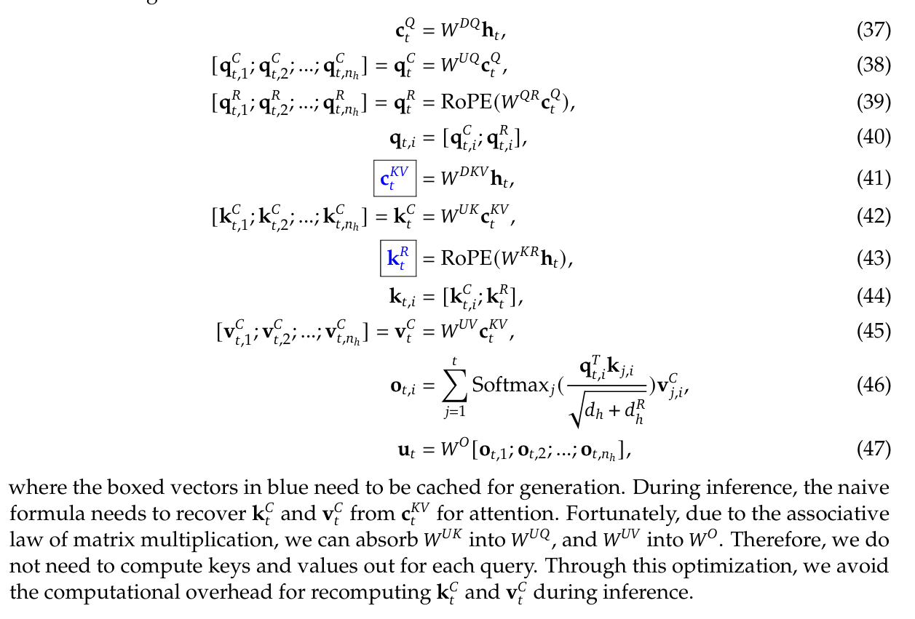
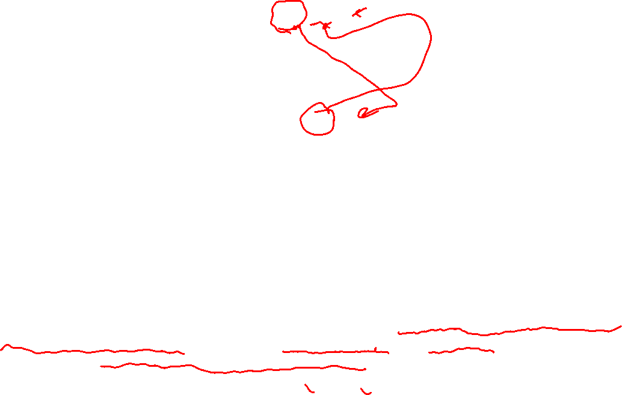
DeepSeek-V2 2405.04434

Slide 19
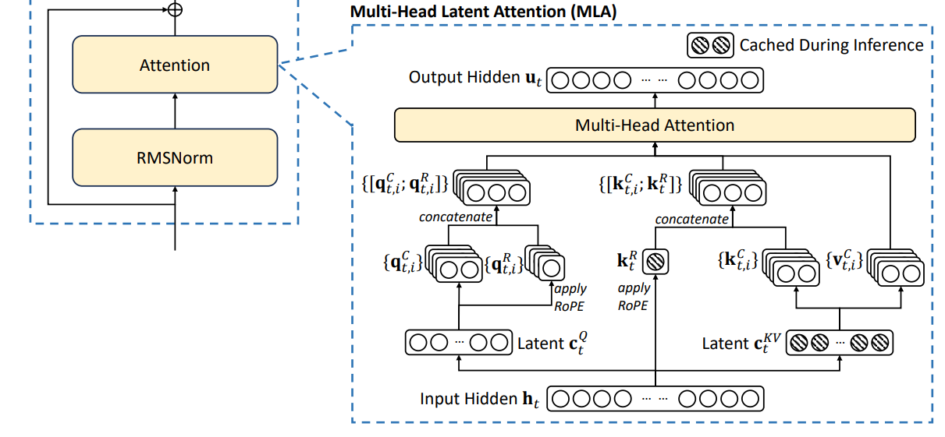
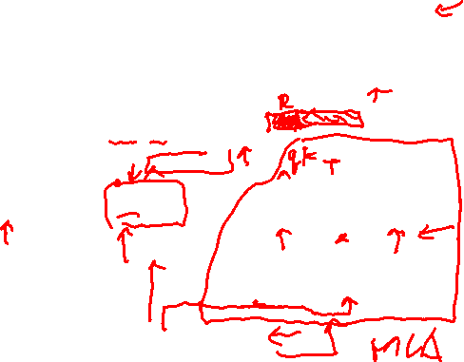
Multi Latent attention
DeepSeek-V3 Technical Report 2412.19437

Slide 20
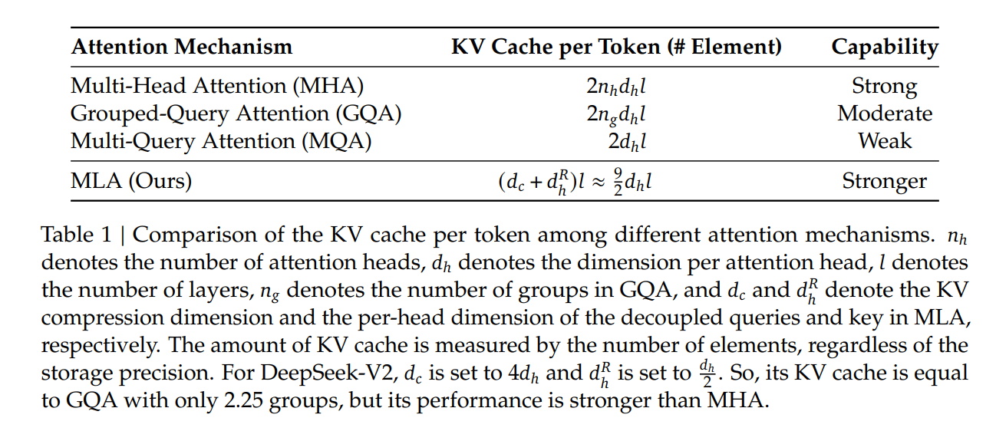
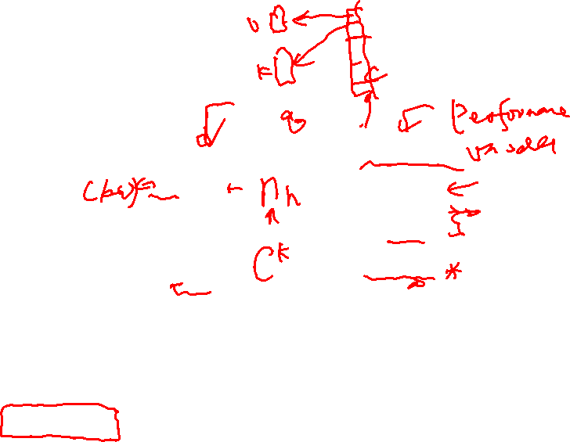
Resources and Capability

Slide 21
MOE an extensible to scale up LLM
Mixture of Experts is in FFN in transformer model
Memory of knowledge.
Scaling Law[N D C L] predicts loss given model size and dataset size in a power-law relationship
N: Size of the model
In most cases, the model's size is simply the number of parameters.
Dense Model vs MOE Models.
D: Size of the training dataset
The size of the training dataset is usually quantified by the number of data points within it.
Larger training datasets are typically preferred.
A small amount of high quality data suffices for FT, and more data does not necessarily improve performance.
C: Cost of training
Amortized hardware and energy cost to train frontier AI models over time
The cost is a function of several factors, including model size, training dataset size, the training algorithm complexity, and the computational resources available.
Performance
Ability to accurately predict the output given some input data.
Negative Log-Likelihood per token, Accuracy, Precision, Recall, F1 Score, MSE, MAE…
Notes:
This decrease in loss with scale often follows a power law: the loss drops substantially, but not linearly, with increases in data and model size. mpetition against other models, such as gameplay[8] or preference by a human judge.[9]
Negative log-likelihood per token (logarithm of perplexity) for language modeling;
Accuracy, precision, recall, and F1 score for classification tasks;
Mean squared error (MSE) or mean absolute error (MAE) for regression tasks;
Elo rating in a co

Slide 22
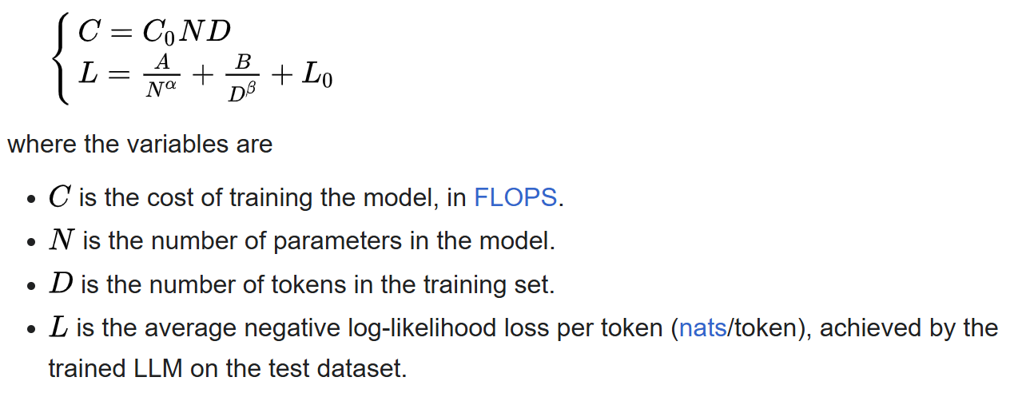
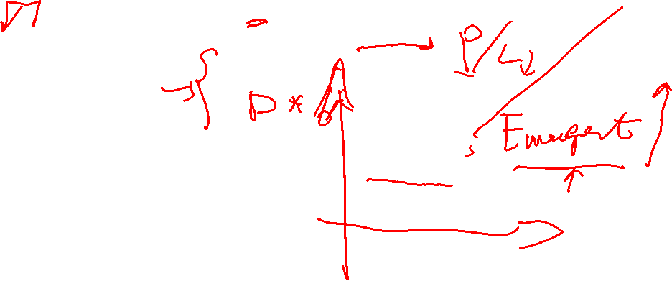
The Chinchilla Scaling Law: an Influential Example
Notes:
D is generally 20 times of the N,
D & N should be scaled in equal proportions, which is different from previous conclusion, N should increase more compared with D

Slide 23
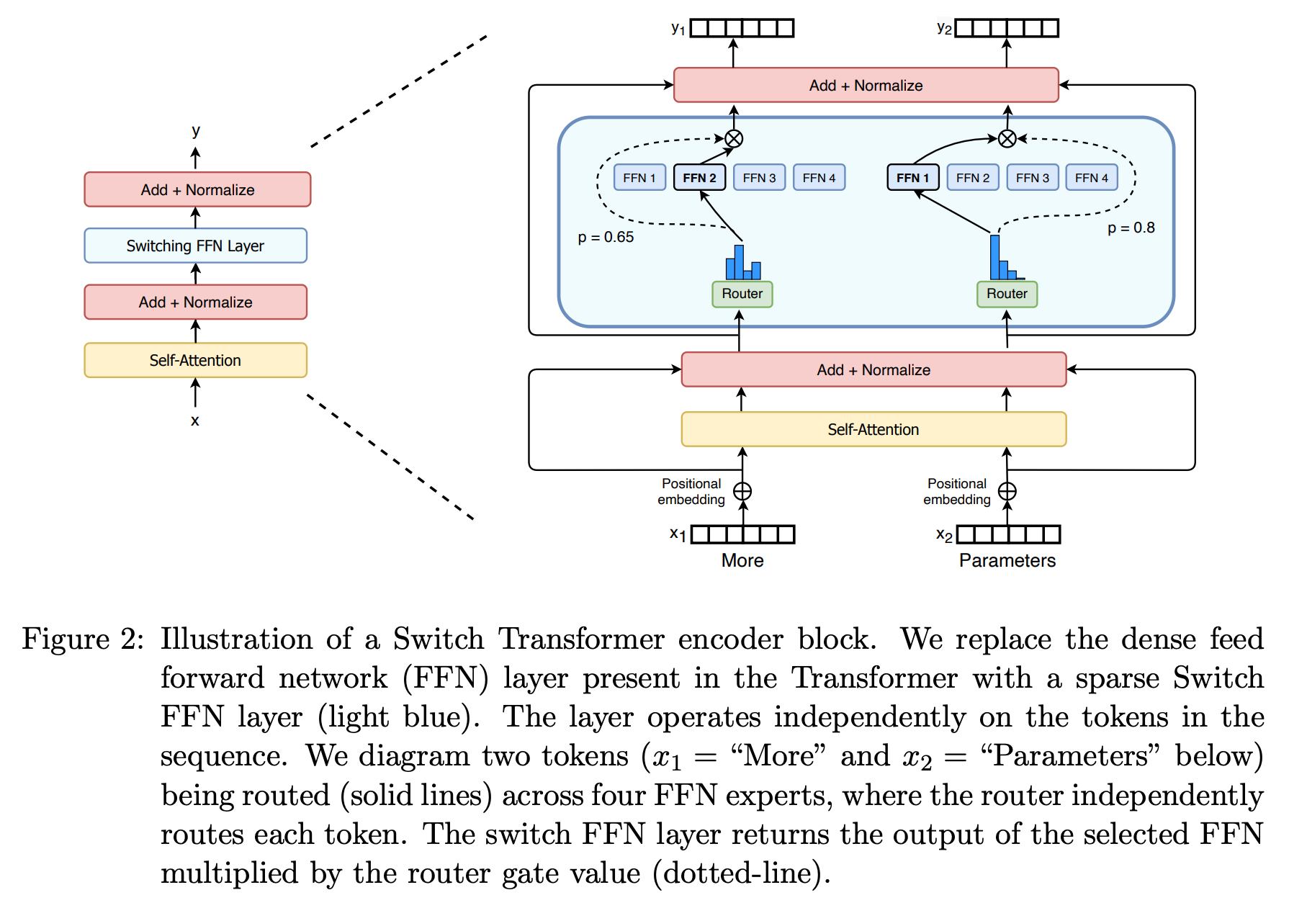
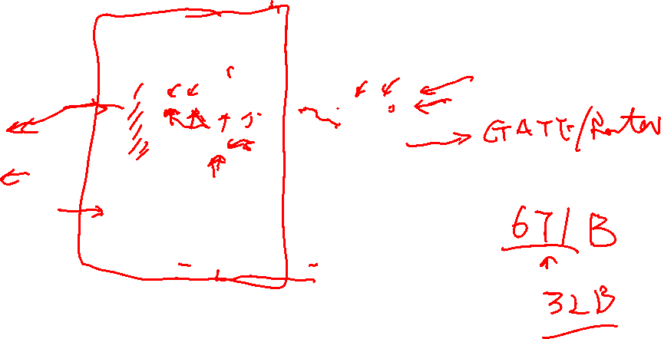
Standard Mixture of Experts Models

Slide 24
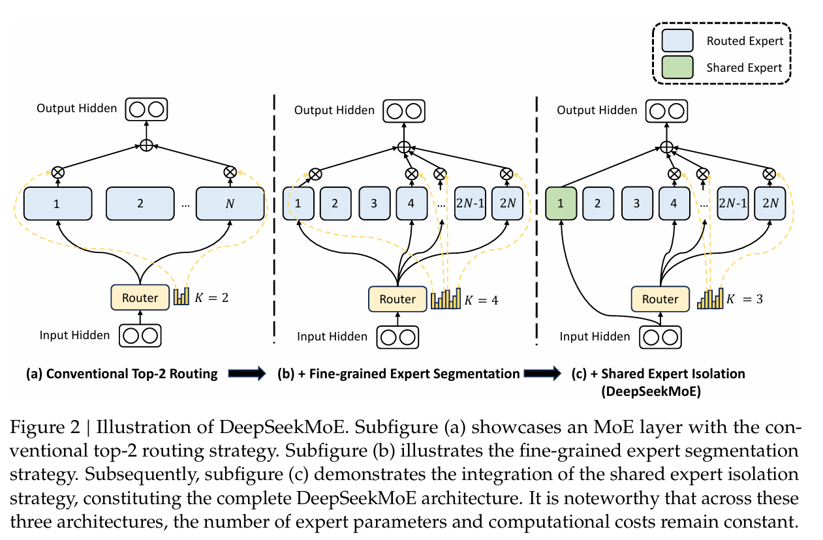
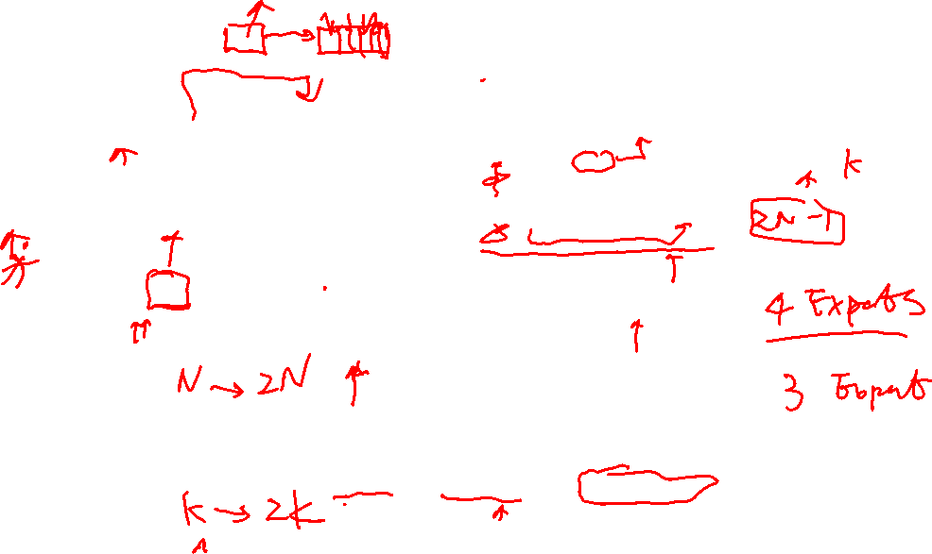
DeepSeekMOE

Slide 25
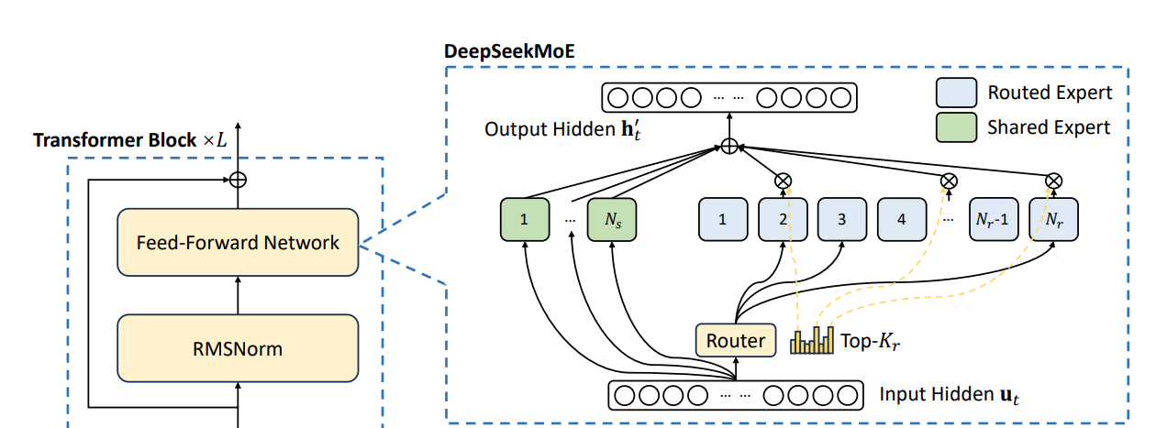
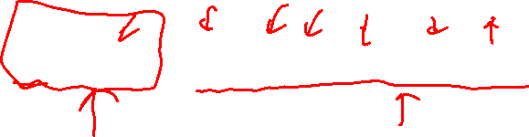
Key ideas from the DeepseekMOE
Fine-Grained Expert Segmentation
Shared Expert Isolation
Load Balancing
DeepSeek-V3 Technical Report 2412.19437

Slide 26
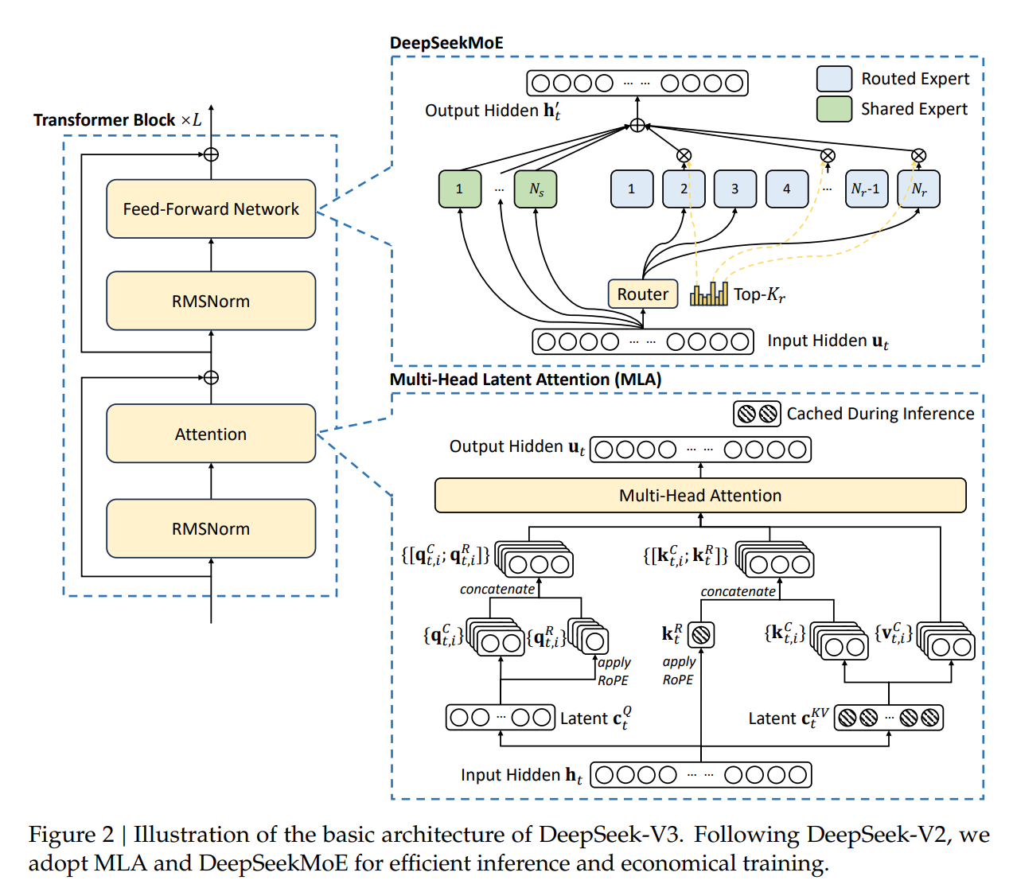

DeepSeek-V3 Technical Report 2412.19437

Slide 27
Four steps training for DeepSeek-R1
Cold Start with SFT
Thousands of cold-start data for fine tunning, CoT data
Readability, Potential
Reasoning oriented RL
Reasoning-intensive tasks such as coding, math, science and logic reasoning
Language consistency reward for language mixing
Rejection Sampling and Supervised Fine-tuning (2 epoch)
600k reasoning data + 200k non-reasoning data
RL for all scenarios
Notes:
Rejection Sampling： Converged model generate multiple answers while keep only the accepted ones, using DeepSeek V3 to judge

Slide 28
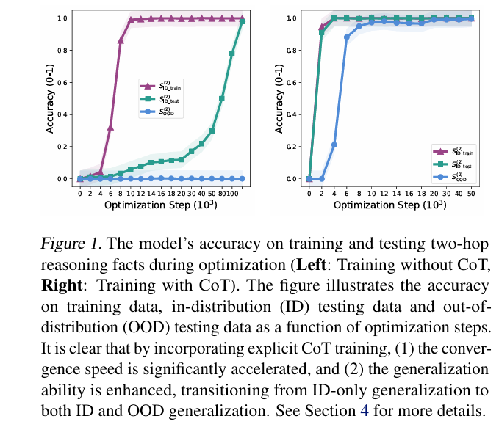
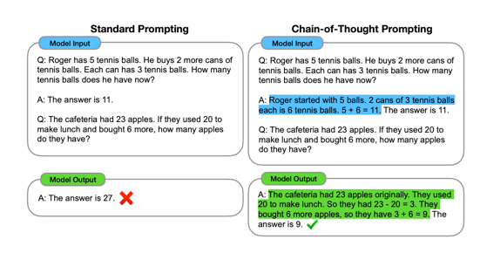
COT
Generalization
Efficiency – small amount of data
Explanation
Unveiling the Mechanisms of Explicit CoT Training: How Chain-of-Thought Enhances Reasoning Generalization

Slide 29
Attractive properties of CoT
Allow models to decompose multi-step problems into intermediate steps.
Provide an interpretable window into the behavior of the model
Can be used for tasks such as math, commonsense reasoning.
Chain-of-thought reasoning can be readily trained with
large off-the-shelf language models + CoT Sequences examples
DeepSeek-R1-Zero ‘s reasoning capabilities are promising, but with issues
Poor readability
Language mixing
Notes:
123. Experiments on three large language models show that chain-of-thought prompting improves performance on a range of arithmetic, commonsense, and symbolic reasoning tasks4

Slide 30
Why RL works
Significant enhancement upon the instruction tunning model
True: Boosted the correct response
False: improved the fundamental capabilities
More effective RL
Data Source
Algorithms, more robust algos against noisy reward signals
Reward Function

Slide 31
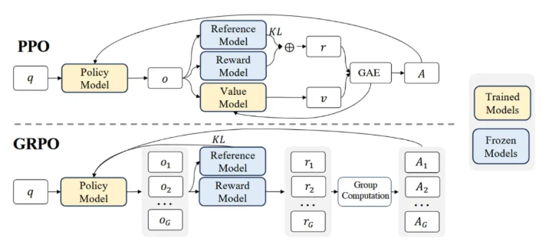
GRPO vs PPO
Policy learning
Group Relative Policy Optimization
Rule based reward vs PRM
Notes:
Generalized Advantage Estimation, GAE Reinformce through implicit Reards， PRM: Process-supervised Reward Model, ORM: outcome supervised reward models

Slide 32
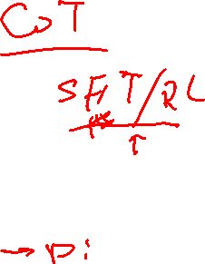
Download and run DeepSeek-R1 locally
Download SGLang docker image and run
$ docker run --gpus device=3 --shm-size 32g -v ~/.cache/huggingface:/root/.cache/huggingface -v ~/Exp:/root/Exp --ipc=host --network=host -it --name dsk lmsysorg/sglang bash
$ docker run --gpus device=6 --shm-size 32g -v ~/.cache/huggingface:/root/.cache/huggingface -v ~/Exp:/root/Exp --ipc=host --network=host -it --name dsk6 lmsysorg/sglang bash
Start DeepSeek-R1-Distill-Qwen-7B
$ python3 -m sglang.launch_server --model deepseek-ai/DeepSeek-R1-Distill-Qwen-7B --tp 1 --trust-remote-code --enable-dp-attention --host 0.0.0.0 --port 31000 --api-key 123
$ python3 -m sglang.launch_server --model deepseek-ai/DeepSeek-R1-Distill-Qwen-32B --tp 1 --trust-remote-code --enable-dp-attention --host 0.0.0.0 --port 30000 --api-key 123

Slide 33
Try the local deployment with SGLang
import openai
client = openai.Client(
base_url="http://127.0.0.1:30000/v1", api_key="123")
# Chat completion
response = client.chat.completions.create(
model="DeepSeek-R1-Distill-Qwen-32B",
messages=[
{"role": "system", "content": "You are a helpful AI assistant"},
{"role": "user", "content": "List 3 countries and their capitals."},
],
temperature=0,
max_tokens=64000,
)
print(response.choices[0].message.content)

Slide 34
Set up the Open-webui
Start Open-webui
docker pull ghcr.io/open-webui/open-webui:latest
docker run -d -p 30000:8080 --name web --env ENABLE_CHANNELS=true --env ENABLE_ADMIN_CHAT_ACCESS=true -v openweb:/app/backend/data ghcr.io/open-webui/open-webui
Admin→ Settings→ Connections
Bottom Left "Admin"
Choose "Admin Panel"
On the right, choose "Settings" Tab
In the Connections, Fill a new OpenAI API item http://10.0.0.4:30000/v1, the key, input “123”
In the Models, a running Model will be automatically showed up
Select the "DeepSeek-R1-Distill-Qwen-7B" model
Change the Visibility from private to Public
Save and update

Slide 35
Finetune with Llamafactory
Create a virtual Environment
$ python3 -m venv sft
$ source sft/bin/activate
Install Llama Factory
$ git clone --depth 1 https://github.com/hiyouga/LLaMA-Factory.git
$ cd LLaMA-Factory
$ pip install -e ".[torch,metrics]"

Slide 36
Data Format - COT + alpaca
[
{
"instruction": "Describe a process of making crepes.",
"input": "",
"output": “<think>…</think>\nThe car accelerated rapidly."
},
{
"instruction": "Paraphrase the sentence to remove the cliche.",
"input": "Time waits for no one.",
"output": “<think>…</think>No one can stop time from moving forward."
}
]

Slide 37
Distillation from DeepSeek-R1
Customized Dataset
Download the dataset NumiaMath CoT
$ git clone https://huggingface.co/datasets/AI-MO/NuminaMath-CoT
Use the question only, but generate the output by DeepSeek-R1
Process the data into Llamfactory SFT format
Existing dataset: Download the s1k dataset
$ git lfs install
$ git clone https://huggingface.co/datasets/simplescaling/s1K-1.1

Slide 38
Start the SFT process
Upload the dataset to llamafactory/data
$ upload the data in json format
$ modify dataset_Info.json
Start llama-factory webui
$ export GRADIO_SERVER_PORT=30000
$ CUDA_VISIBLE_DEVICES=1 llamafactory-cli webui

Slide 39
Verify the result
CUDA_VISIBLE_DEVICES=1 python3 ttt.py

Slide 40
Using command
llamafactory-cli train \ --stage sft \ --do_train True \ --model_name_or_path Qwen/Qwen2.5-Math-1.5B \ --preprocessing_num_workers 16 \ --finetuning_type full \ --template qwen \ --flash_attn auto \ --dataset_dir data \ --dataset s1k \ --cutoff_len 84489 \ --learning_rate 5e-05 \ --num_train_epochs 3.0 \ --max_samples 1000 \ --per_device_train_batch_size 1 \ --gradient_accumulation_steps 4 \ --lr_scheduler_type cosine \ --max_grad_norm 1.0 \ --logging_steps 5 \ --save_steps 100 \ --warmup_steps 0 \ --packing False \ --report_to none \ --output_dir saves/Qwen2.5-1.5B-Instruct/full/train_2025-03-12-19-04-10 \ --bf16 True \ --plot_loss True \ --trust_remote_code True \ --ddp_timeout 180000000 \ --include_num_input_tokens_seen True \ --optim adamw_torch \ --deepspeed cache/ds_z3_offload_config.json

Slide 41
DeepSeek-V4

Slide 42
Major Innovations
Improved Model Capability
mHC - Manifold-Constrained Hyper-Connections, upgraded residual connections
Enhanced Long-context Efficiency (Computation 3.7x lower, KV cache, 9,5x smaller)
CSA – Compressed Sparse Attention, compress KV cache along sequence (CSA → DSA) + HCA
HCA – More aggressive compression to KV cache but keep dense attention
Faster convergence and improved training stability
Muon - Better Optimizer for training

Slide 43
Infra Improvement
Fully overlap of computation/communication/memory access
A single fused kernel for MOE
Balance development productivity and running efficiency
TileLang, a domain-specific Language (DSL)
Ensure bitwise reproducibility across training and inference
Batch-invariant and deterministic kernel library
Reduced memory and computation
FP4 quantization aware training for MoE Expert Path and indexer QK path
Improved training framework
Autograd with tensor level checkpointing,
Hybrid ZeRO strategy for Muon optimizer.
Fused kernel for the mHC
Two-stage contextual parallelism to manage compressed attention
Efficient shared-prefix reuse for inference framework
Heterogeneous KV cache structure with on-disk storage strategies

Slide 44
Training Method
Pre-Training → Base Model
32T tokens vs 33T tokens, Flash is better than 3.2 with Base Model
Post Training → Production Model (Two stage paradigm)
Independent cultivation of domain specific experts
Base Model → SFT → RL (GRPO) → set of specialized experts.
Unified model consolidation via on-policy distillation
A student learning to optimize the reverse KL loss with teacher models.

Slide 45
MoE Changes
Affinity Score’s computation of activation function
Sigmoid → Sqrt
0.99 vs 0.01, (sigmoid) 2.1 vs 1.5(sqrt), not saturates quickly.
Load balancing, employ auxiliary-loss-free strategy, augumented by sequence-wise balance loss
Auxiliary loss → total_lass = main_loss + λ * load_balance_loss (too complex)
Constraint on the number of routing target node → parallelism strategy
(initial layers)Dense FFN → MoE with Hash routing

Slide 46
Residual handling

Slide 47
Residual, HC, and mHC
Residual Connection
Xn = Xn-1 + F(Xn-1)
HC (Expanded, it is scalar)
Xn = Wn1 * Xn-1 + Wn2 * Xn-2 + Cn-1F(Xn-1)
Xn = W^{n} X_{n} + Cn-1F (Xn-1) → Einstein note.
mHC
Xn = Manifold {Wn1 * Xn-1 + Wn2 * Xn-2 + F(Xn-1)}
Manifold is subject to a constraint

Slide 48
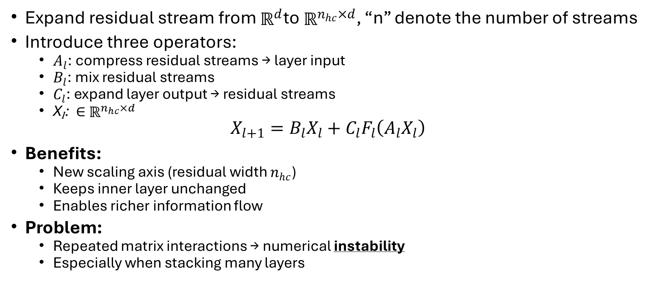
Standard Hyper-Connection HC
Expand residual stream from $ℝ^{d}$to $ℝ^{n_{hc}×d}$, “n” denote the number of streams
Introduce three operators:
$A_{l}$: compress residual streams → layer input
$B_{l}$: mix residual streams
$C_{l}$: expand layer output → residual streams
Xₗ: ∈ $ℝ^{n_{hc}×d}$
$$X_{l+1}=B_{l}X_{l}+C_{l}F_{l}\left(A_{l}X_{l}\right)$$
Benefits:
New scaling axis (residual width $n_{hc}$)
Keeps inner layer unchanged
Enables richer information flow
Problem:
Repeated matrix interactions → numerical instability
Especially when stacking many layers

Slide 49

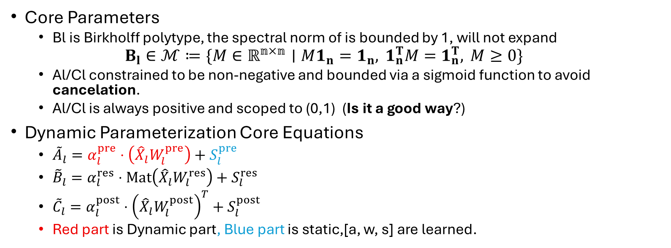
Manifold Hyper-Connection HC Parameters
Core Parameters
Bl is Birkholff polytype, the spectral norm of is bounded by 1, will not expand
$$B_{l}∈ℳ≔\{M∈ℝ^{𝕟×𝕟}∣M1_{n}=1_{n}, 1_{n}^{T}M=1_{n}^{T}, M≥0\}$$
Al/Cl constrained to be non-negative and bounded via a sigmoid function to avoid cancelation.
Al/Cl is always positive and scoped to (0,1) (Is it a good way?)
Dynamic Parameterization Core Equations
${\tilde{A}}_{l}=α_{l}^{pre}⋅\left({\hat{X}}_{l}W_{l}^{pre}\right)+S_{l}^{pre}$
${\tilde{B}}_{l}=α_{l}^{res}⋅Mat\left({\hat{X}}_{l}W_{l}^{res}\right)+S_{l}^{res}$
${\tilde{C}}_{l}=α_{l}^{post}⋅{\left({\hat{X}}_{l}W_{l}^{post}\right)}^{T}+S_{l}^{post}$
Red part is Dynamic part, Blue part is static,[a, w, s] are learned.

Slide 50


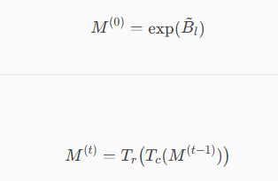
Manifold Hyper-Connection HC Parameters
Al, always be positive and bounded
Cl, always be positive and bounded
Bl, Sinkhorn-Knopp algo, max 20 iterations

Slide 51
Long context efficiency: Hybrid Attention

Slide 52
CSA and HCA
Interleaved hybrid configuration with CSA/HCA
CSA + DSA
Compress with CSA: m → 1
Select with DSA: Top k tokens from n/m
Attention with MQA: multi-query, single(topk) KV
HCA
Extreme Compress with HCA: m’ → 1 (m’ >> m)

Slide 53
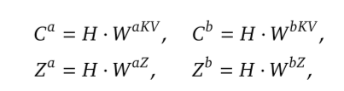
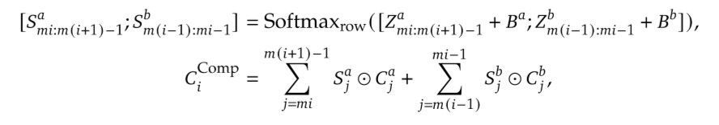
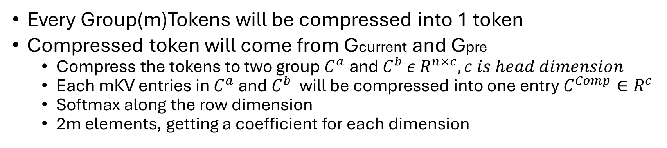
Compressed Sparse Attention
Every Group(m)Tokens will be compressed into 1 token
Compressed token will come from Gcurrent and Gpre
Compress the tokens to two group $C^{a}$ and $C^{b}$ $ε R^{n×c}, c is head dimension$
Each mKV entries in $C^{a}$ and $C^{b}$ will be compressed into one entry $C^{Comp}∈R^{c}$
Softmax along the row dimension
2m elements, getting a coefficient for each dimension
Is this the right design?

Slide 54
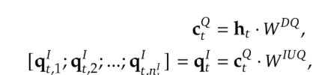
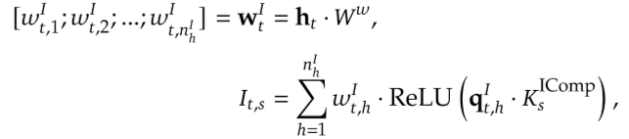


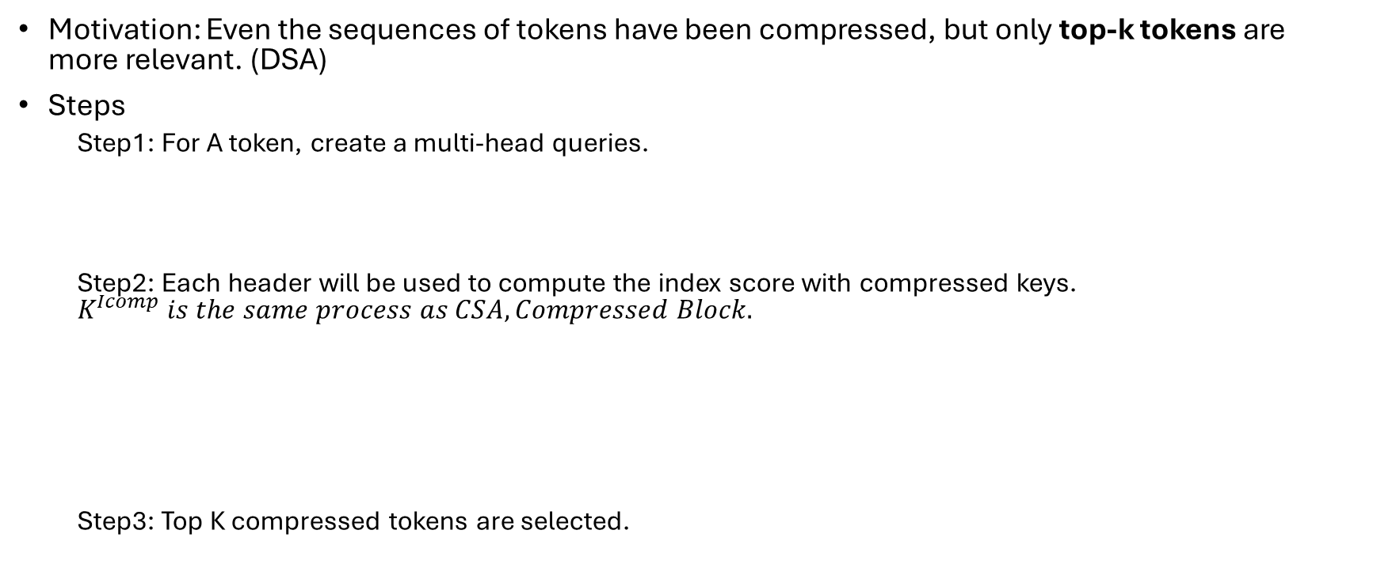
Deepseek Sparse Attention
Motivation: Even the sequences of tokens have been compressed, but only top-k tokens are more relevant. (DSA)
Steps
Step1: For A token, create a multi-head queries.
Step2: Each header will be used to compute the index score with compressed keys. $K^{Icomp} is the same process as CSA, Compressed Block.$
Step3: Top K compressed tokens are selected.

Slide 55


Shared Key-Value MQA
Produce the attention queries from latent vector $Ct^{Q}$
Perform MQA

Slide 56
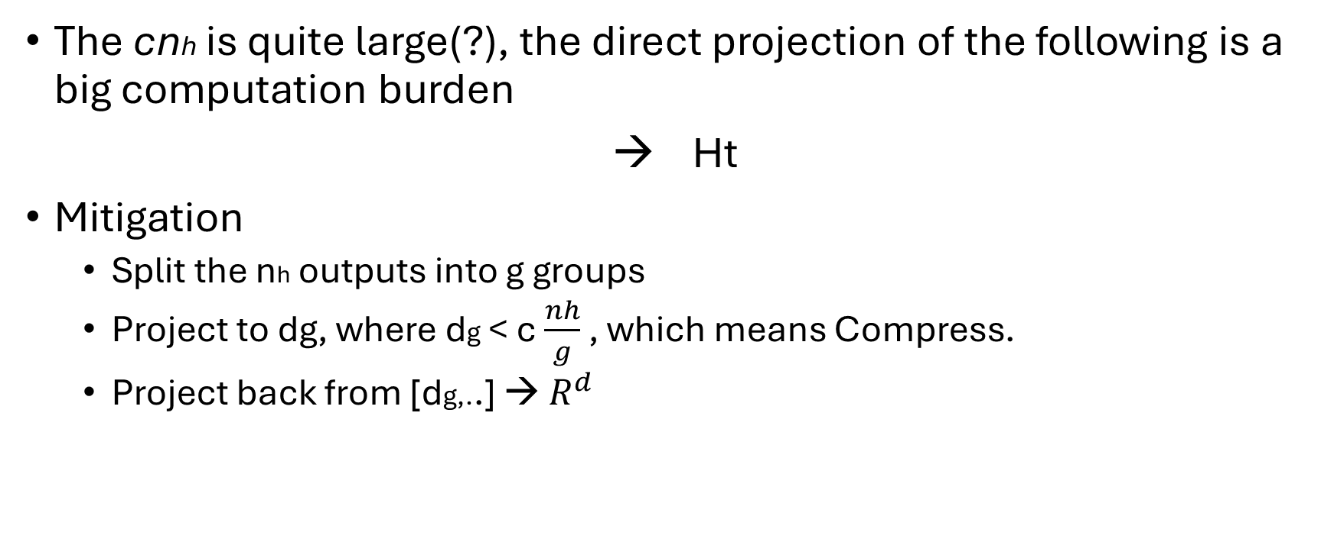
Grouped Output Projection
The cnh is quite large(?), the direct projection of the following is a big computation burden
→ Ht
Mitigation
Split the nh outputs into g groups
Project to dg, where dg < c $\frac{nh}{g}$ , which means Compress.
Project back from [dg,..] → $R^{d}$

Slide 57
Heavily Compressed Attention
Nearly the same as CSA except for Larger m’ and “No Overlap compression”
MQA
Same as before
Grouped Output Projection
Same as before

Slide 58

Attention Implementation Details
Query and KV entry normalization, an additional RMSNorm on the each head of Q and only head of KV before the core attention operation. → avoid exploding attention logits Why?
Partial Rotary Positional Embedding, partially apply RoPE to Q, KV and core attention output. To last 64 dimensions.
Additional Branch of Sliding Window Attention, making sure Qn could access the past Nwin of tokens.
Attention Sink, learnable sink logits {z1, z2, zh}, the attention sink make sure that total attention scores will be <= 1. specific to a head in a layer.
Precision optimizations
Mixed storage format for KV entries BF16 on RoPE, BF8 for left
FP4 for lighting indexer.
Smaller top-k for long context.

Slide 59
Optimizer -- Muon

Slide 60
Q&A

