Slide 1
Rideshare optimization
Hung Lo, Hans Lu, Chun-Hao Chen

Slide 2
Outline
Introduction
Chengdu
DiDi
Data
Feature
Model
Prediction
Discussion
Rideshare
GHG emissions
Notes:
This is the outline of our presentation. Begined with the introduction of Chengdu city, which is research objectives and DiDi company, which is the ridesharing company. And then, followed by our data resources, features of our report, modeling and prediction, and ended with discussion of rideshare and GHG emissions.

Slide 3
Introduction-Chengdu
Urban area of 1813 square kilometers
Population of 12160000
Ring road network
32nd worst traffic in the world

Slide 4
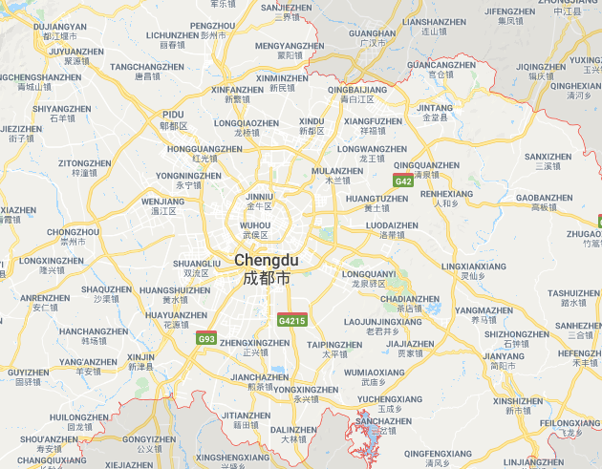
Map

Slide 5

Introduction-Didi
Originated in 2012
Provides many services
DiDi Taxi
DiDi Express
DiDi Premier
DiDi Designated Driving

Slide 6
Process
revision
Data collection
Featuring
Prediction
Optimization
Notes:
This is our process graphs. We followed steps by steps to get the optimal solutions. First, we collected the data. And followed by analyzing its features, predicting the models and finally making optimization. We try many times and find the answer we find is not the optimal solutions, We revised our prediction and analyze the featuring again until we find the optimal solutions. So within our works, we try hard on the central part of our process.

Slide 7

Data
Source
Transportation Data
Order
Time
Location
Notes:
The data is collected from the GAIA open dataset. The transport data includes three primary things, namely order, timing and geological coordination location. We mainly use these three things to analyze and predict the traffic patterns within the city of Chengdu.

Slide 8
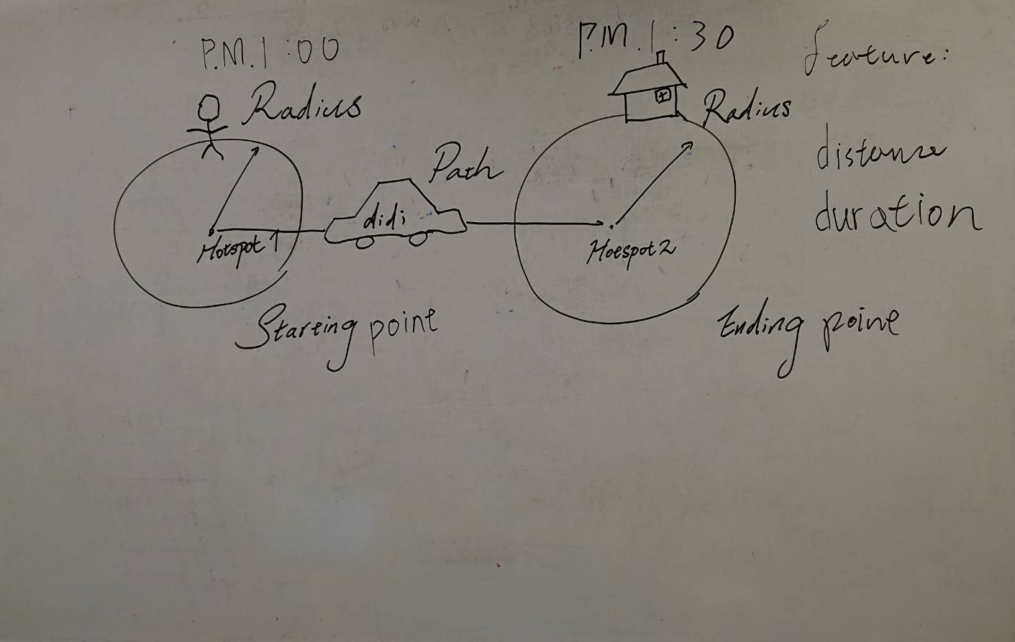
Feature
Notes:
And we mainly analyze the relationship of the radius of carsharing catchment area, rideshare percentage and systems total cost. So in the first place, we define the two points within the city of Chengdu are hotspots, that is tien-fu Square and the cape of good hope, which both serves large passengers. Then we analyze the feature of distance and duration of this path. But this may subjected to not only distance and duration of the path, but also the satisfactory factor of the passengers who walk longer. When the passengers walk longer to some degree, the system cost would be consrained. That is the optimal radius we want to find where minimum cost is.

Slide 9
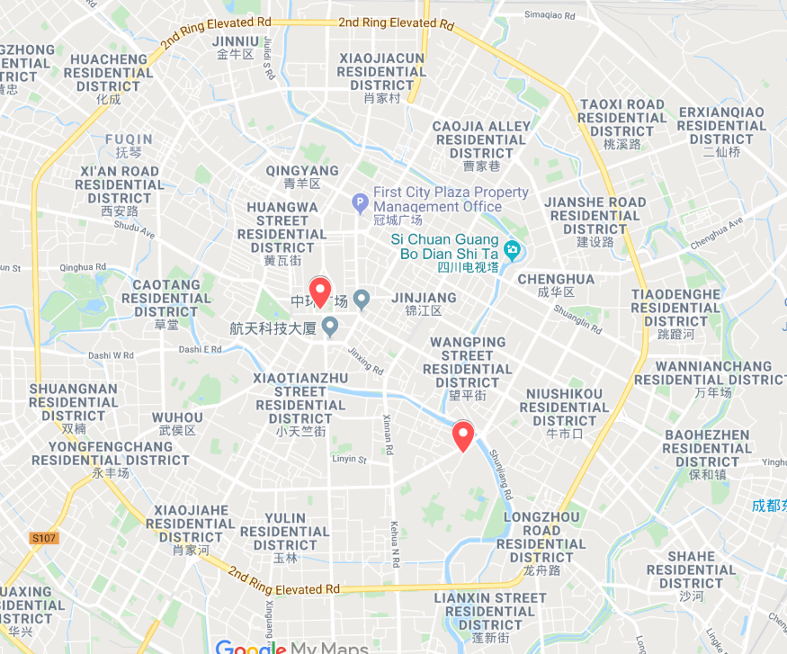
Feature- Hotspot
Notes:
And these are the two hotspots- Tian-Fu square and the cape of good hope.

Slide 10
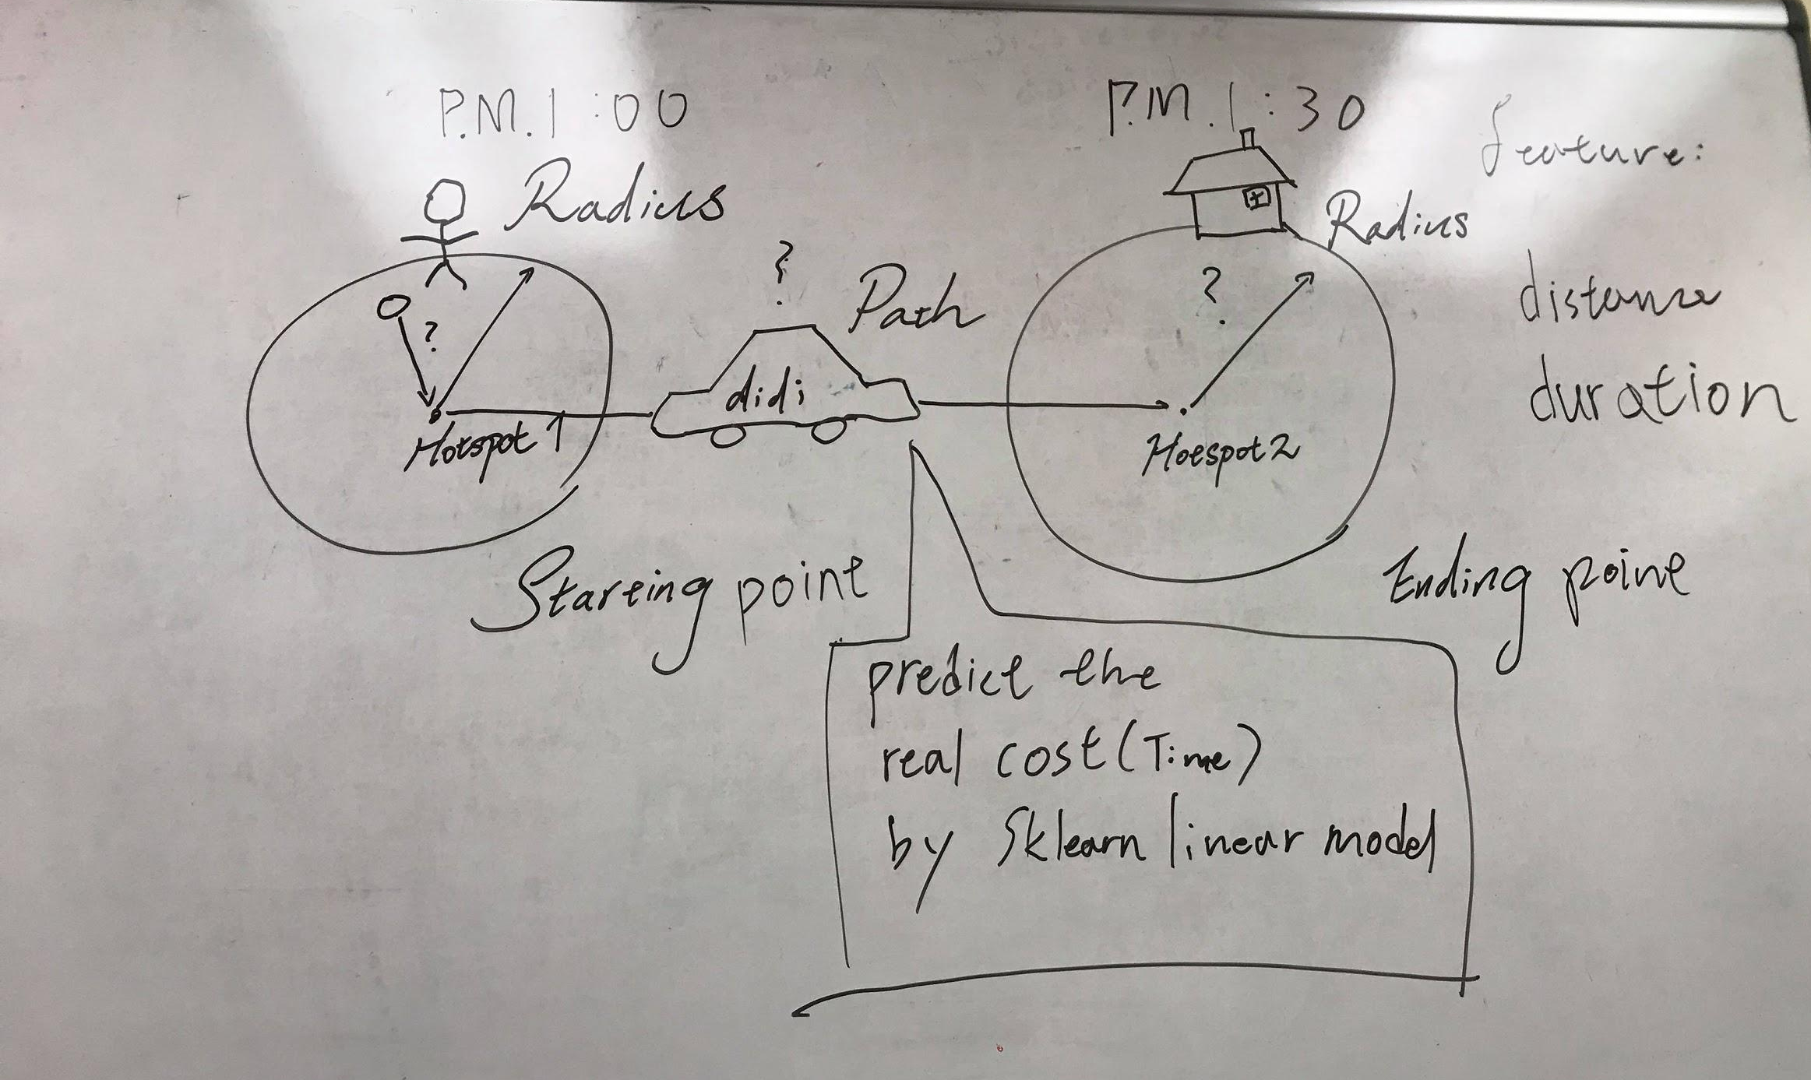
Prediction
Notes:
However, the real cost is required for getting the whole trip, we use 1102’s data to measure real cost of
We use linear model of sklearn to predict the real cost between each location. The variable will contain

Slide 11
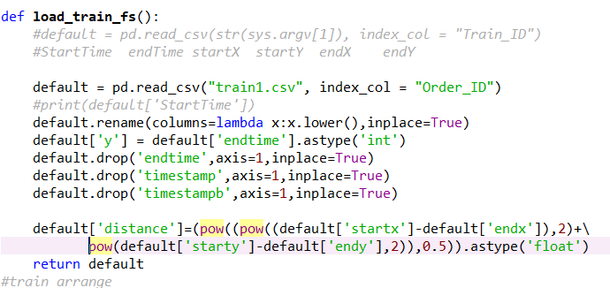
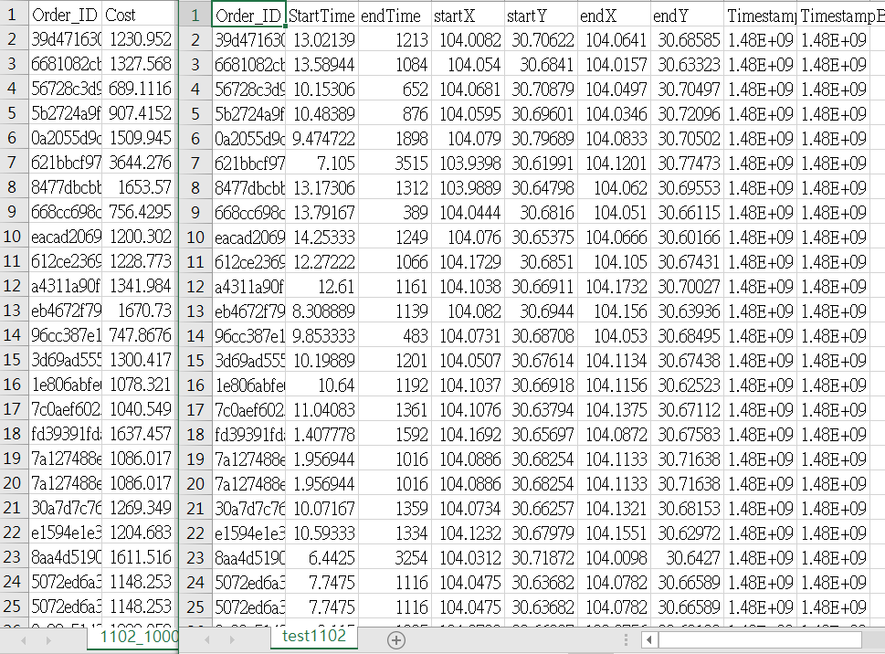
Output-prediction
Notes:
However, the real cost is required for getting the whole trip, we use 1102’s data to measure real cost of
We use linear model of sklearn to predict the real cost between each location. The variable will contain time duration and distance.

Slide 12
Output-prediction

Slide 13
Output-prediction

Slide 14
Model
Constraints:
A x = b (linear constraints)
l ≤ x ≤ u (bound constraints)
some or all xj must take integer values (integrality constraints)
Objectives:
Notes:
Mixed integer linear programming , the constrain leaner bound, integer values
First session is Vehicle cost with rideshare, Vcr is cost,
1- Rideshare discount means the number of the trips will decrease, for instance , if Rs is 0.5 means two passenger in one car, and the total number of trips will become 1 ,
The second is no rideshare
Third part is Satisfaction , distance close to R the rise
Final is Detour cost, so R rise the cost rise

Slide 15
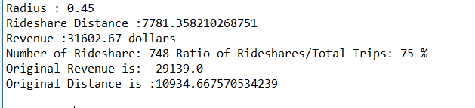
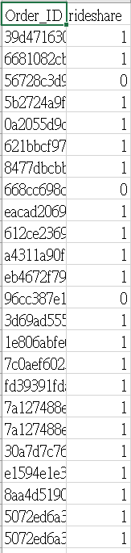
Outcome
Notes:
The outcome shows ideal Radius, Original Revenue and Total original distance. And after rideshare became 75% less than original total distance.
By changing weight, we found satisfaction cost will affect rideshare a lot.

Slide 16


Discussion
Rideshare is currently very limited
20% of Uber trips where UberPool is offered
37% of Lyft trips where Lyft Line is offered

Slide 17
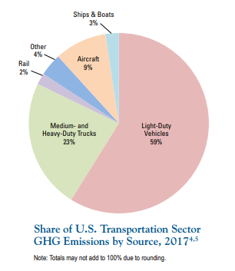
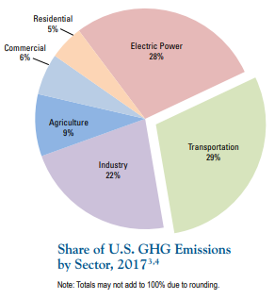
Discussion
Greenhouse gas emissions
Transportation sector responsible for 29% of American GHG emissions
Light vehicles makeup 59% of transportation GHG emissions

Slide 18

Thank You

