Slide 1

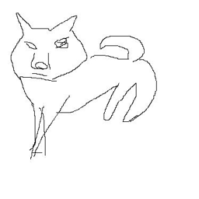
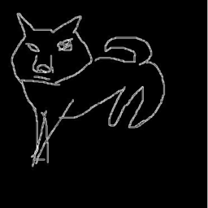
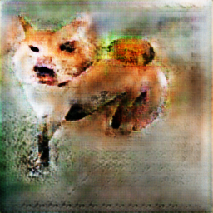
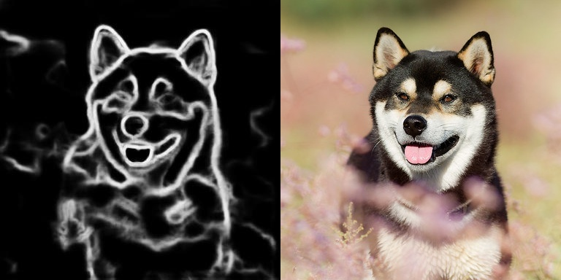
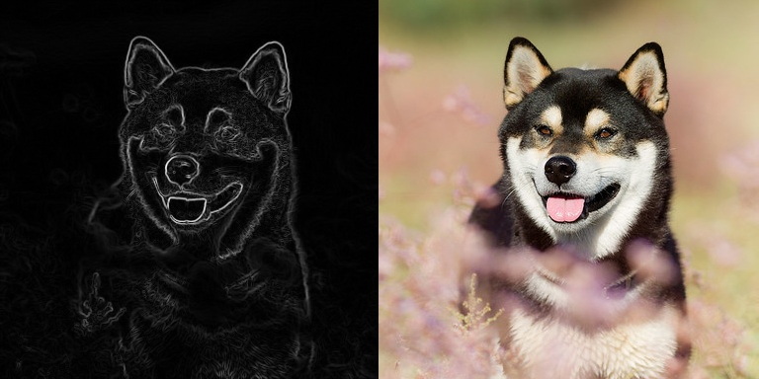
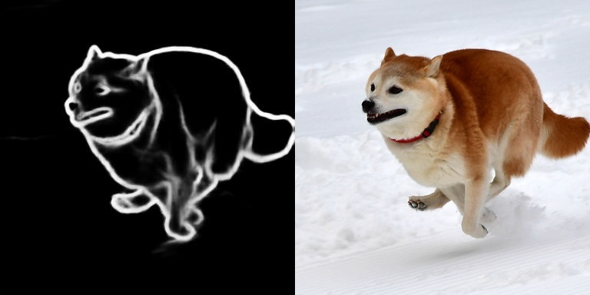
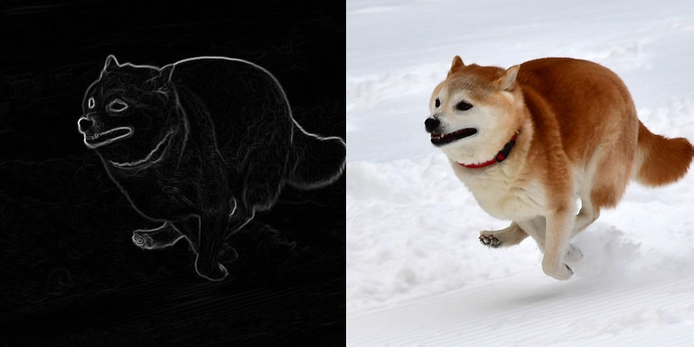
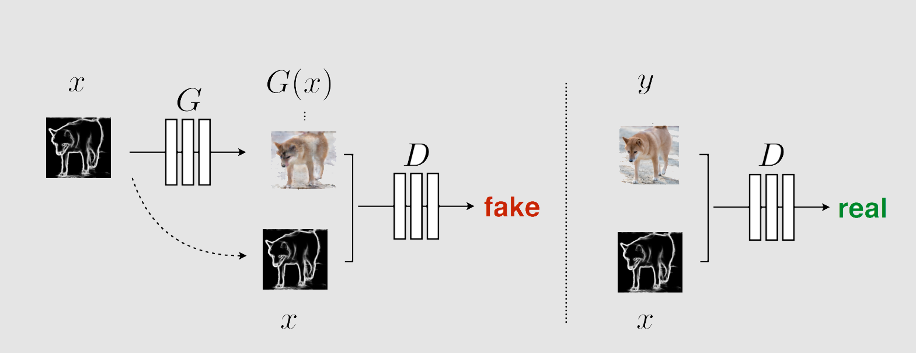
Dog GAN
Hung Lo, Shengjian Chen | Computer Vision CSE455 Autumn 2019 | University of Washington
Abstract
Featuring
Outcome
There are many constraints of gathering new data, so we want to compare
pix2pix
Another information
hed-edge edge original
Network structure
pix2pix structure:
Loss function
Discussion
Some information
Another information
References

