Slide 1
GoF Design Patterns
(Ch. 26)

Slide 2
GoF Design Patterns
Adapter
Factory
Singleton
Strategy
Composite
Façade
Observer (Publish-Subscribe)

Slide 3
Adapter Pattern (26.1)
Problem: How to resolve incompatible interfaces, or how to provide a stable interface to similar components with different interfaces.
Solution: Convert the original interface of a component into another interface, through an intermediate adapter object.
Note: the Adapter pattern is an application of Polymorphism

Slide 4
Adapter Pattern (26.1)
Example: POS needs to adapt several kinds of external third-party services: tax calculators, credit authorization services, inventory systems, accounting systems. Each has a different API which can’t be changed.

Slide 5
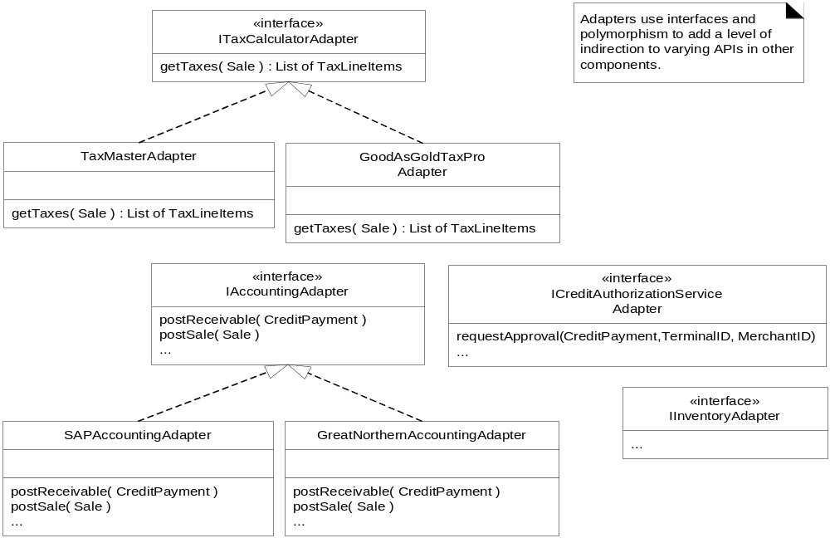
Fig. 26.1

Slide 6
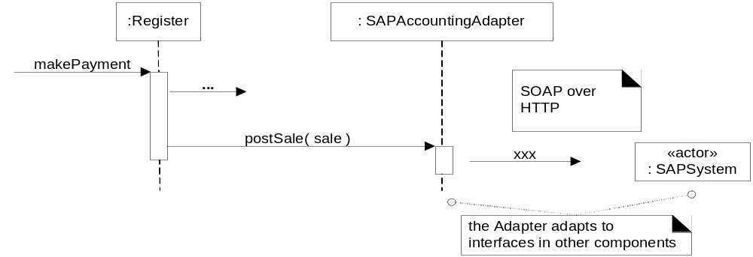
Fig. 26.2

Slide 7
Adapter Pattern (26.1)
Note: Adapter pattern follows GRASP principles: Polymorphism, Protected Variation, Indirection
See Fig. 26.3 for conceptual connection among GRASP principles and Adapter pattern

Slide 8
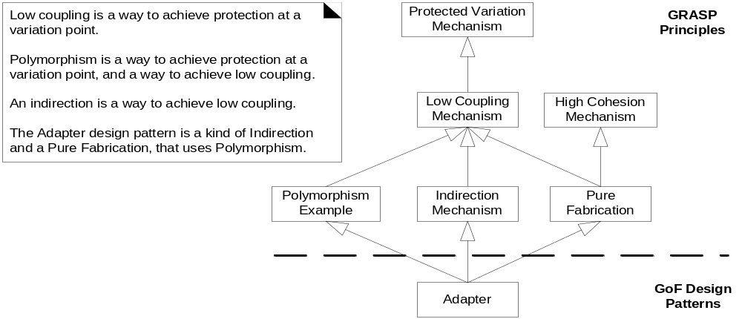
Fig. 26.3

Slide 9
Factory Pattern (26.4)
Problem: Who should be responsible for creating objects when there are special considerations such as complex creation logic, a desire to separate creation responsibilities for better cohesion, etc.?
Solution: Create a Pure Fabrication object called a Factory that handles the creation.

Slide 10
Factory Pattern (26.4)
Technically not a GoF pattern
A variation of GoF Abstract Factory pattern

Slide 11
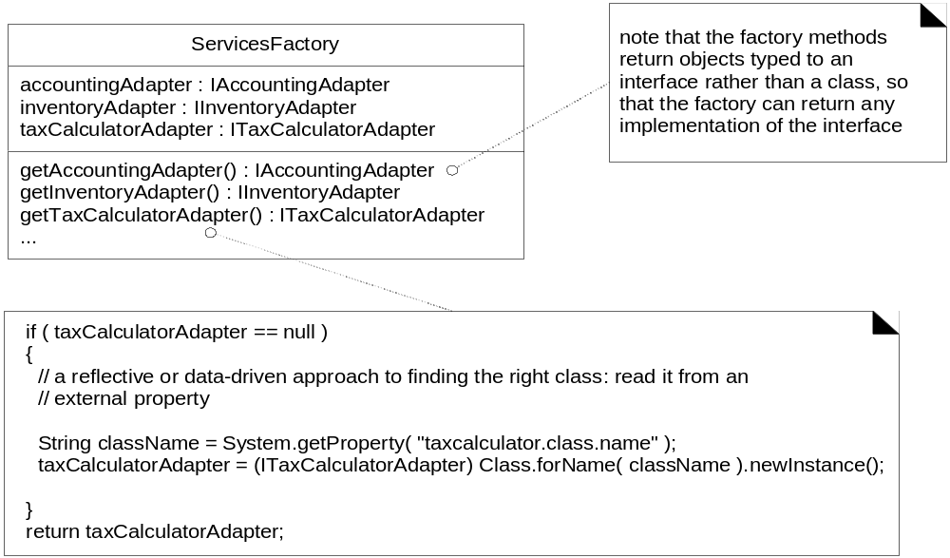
Fig. 26.5

Slide 12
Factory Pattern (26.4)
Note: In Fig. 26.5 the implementation of ServicesFactory illustrates data-driven design – a form of Protected Variation

Slide 13
Factory Pattern (26.4)
Idea: Define an object whose purpose is to create objects
Benefits:
  Separate the responsibility of complex creation into cohesive helper objects
  Can provide object caching (e.g. having only one random number generator)

Slide 14
Singleton Pattern (26.5)
Problem: Exactly one instance of a class is allowed. Objects need a global and single point of access.
Solution: Define a static method of the class that returns the singleton: getInstance()

Slide 15
Singleton Pattern (26.5)
Consider the factory and how it is accessed – who creates the factory?
  Only want one instance of the factory
  Methods may need to be called from various places => how to make single instance of the factory globally visible
Could pass the ServicesFactory instance around as a parameter whenever visibility is required or initialize all objects that need it with a permanent reference to it
Singleton – supports global visibility or a single access point to a single instance

Slide 16
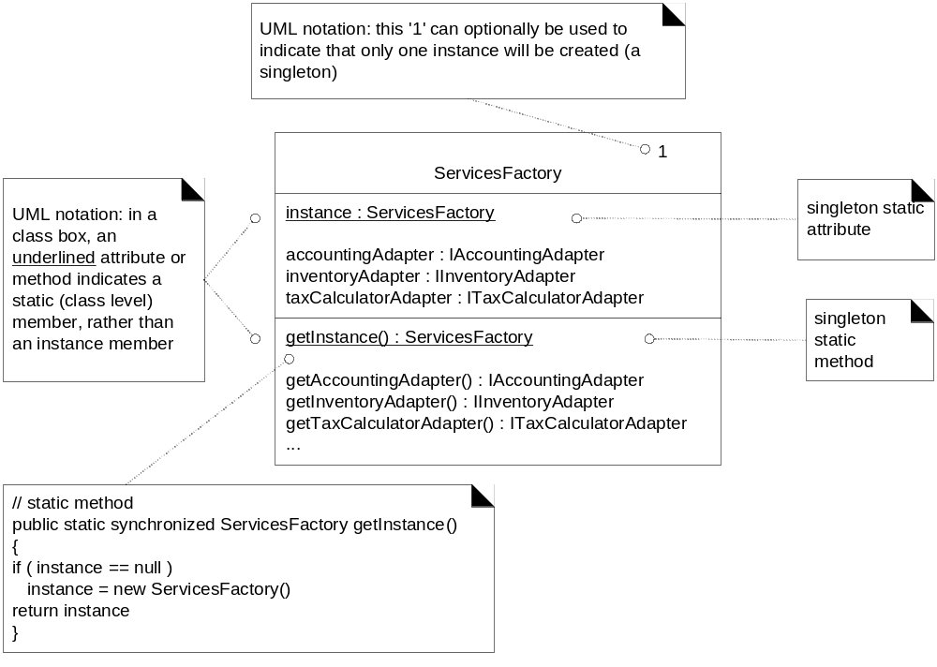
Fig. 26.6

Slide 17
Singleton Pattern (26.5)
Note: concurrency control in ServicesFactory – making getInstance() synchronized
Fig. 26.8 shows how Adapter, Factory, Singleton patterns are used in design

Slide 18
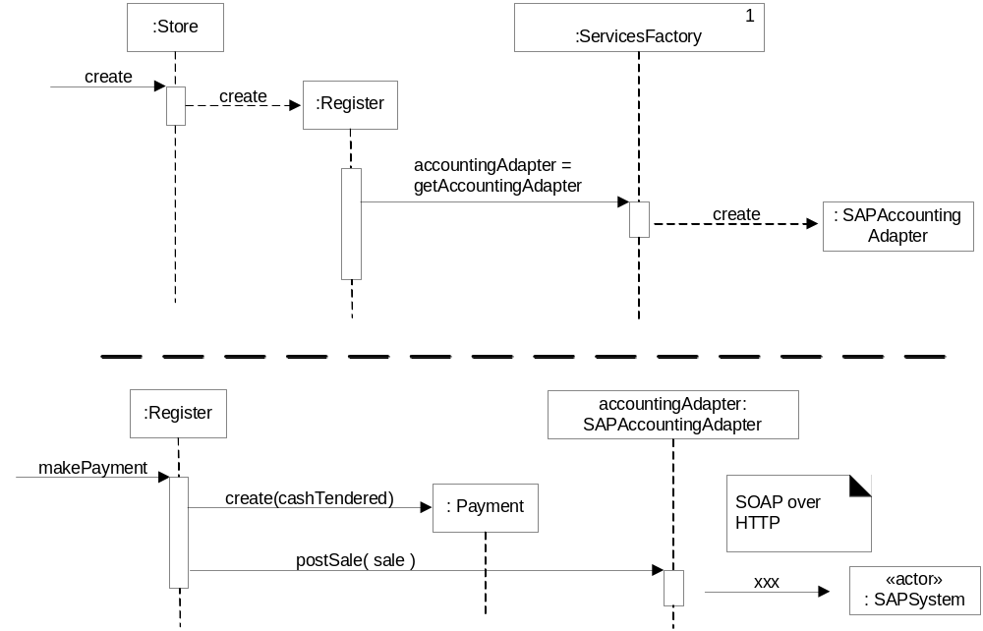
Fig. 26.8

Slide 19
Strategy Pattern (26.7)
Problem: How to design for varying but related algorithms or policies? How to design for the ability to change these algorithms or policies?
Solution: Define each algorithm/strategy in a separate class with a common interface

Slide 20
Strategy Pattern (26.7)
Example: How to provide more complex pricing logic, e.g. store-wide discount, senior citizen discount, employee discount, etc.
A pricing strategy for a sale can vary, how do we design for these varying pricing algorithms?

Slide 21
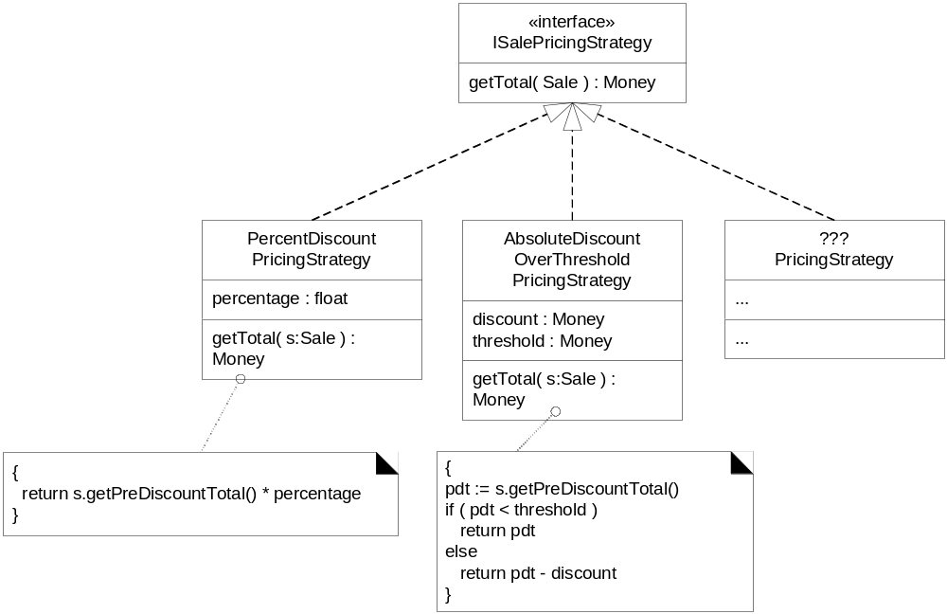
Fig. 26.9

Slide 22
Strategy Pattern (26.7)
Example: Create multiple SalePricingStrategy classes each with a polymorphic getTotal() operation
Note: each getTotal() operation takes a Sale object as a parameter so that the strategy object can find the pre-discount price from the Sale
The implementation of each getTotal() will differ
A strategy object is attached to a context object – the object to which it applies the algorithm, e.g. Sale

Slide 23
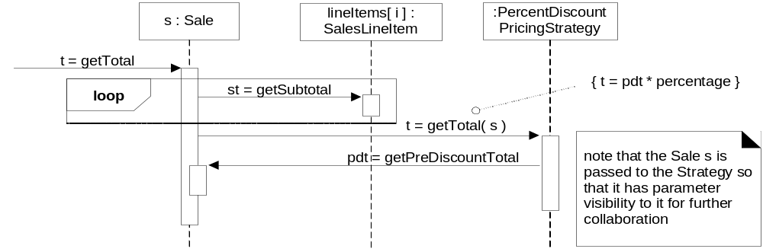
Fig. 26.10

Slide 24
Strategy Pattern (26.7)
Example:
  When a getTotal() message is sent to a Sale it delegates work to its strategy object
  It is common for the context object to pass a reference to itself to the strategy object so that the strategy object has parameter visibility to the context object

Slide 25
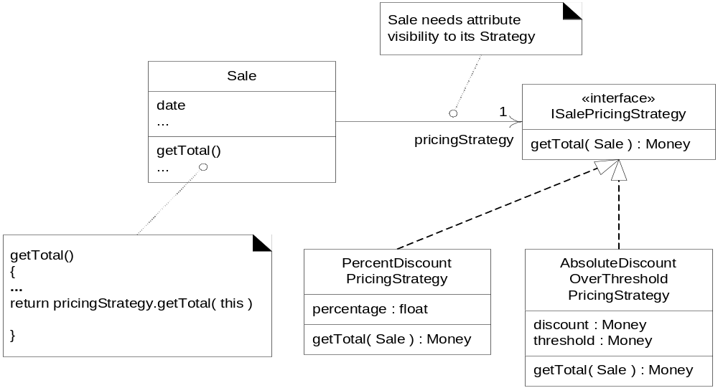
Fig. 26.11

Slide 26
Strategy Pattern (26.7)
Example: Who should create the strategy?
  Apply the Factory pattern: a PricingStrategyFactory
  The PricingStrategyFactory is a singleton and accessed via the Singleton pattern

Slide 27
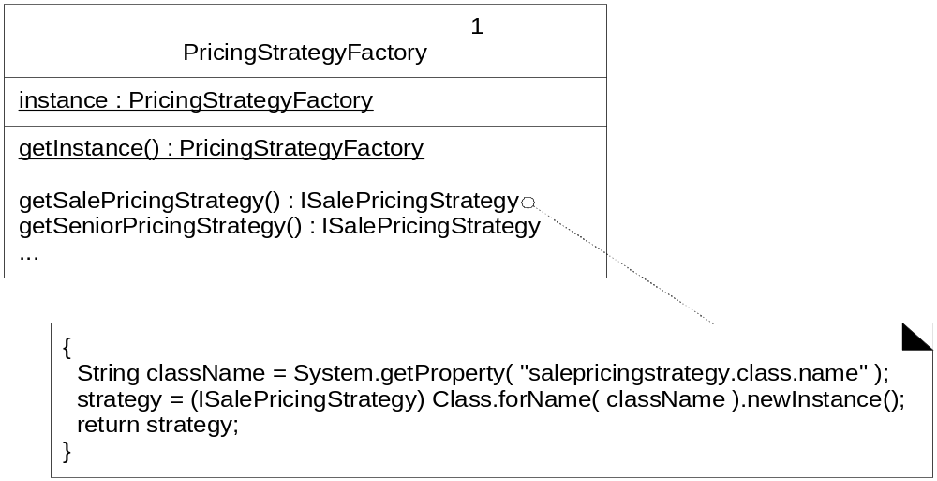
Fig. 26.12

Slide 28
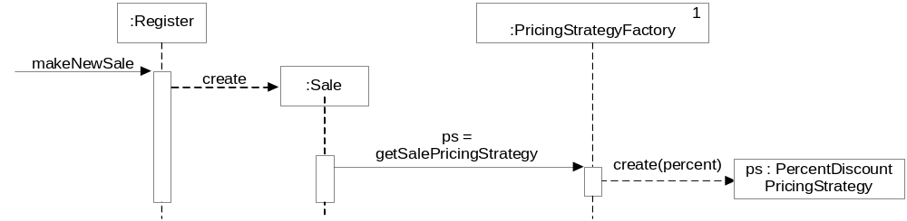
Fig. 26.13

Slide 29
Strategy Pattern (26.7)
Note:
  Strategy is based on Polymorphism and provides Protected Variation with respect to changing algorithms
  Strategies are often/usually created by a Factory

Slide 30
Composite Pattern (26.8)
Problem: How to treat a group or composition structure of objects the same way (polymorphically) as a non-composite (atomic) object?
Solution: Define classes for composite and atomic objects so that they implement the same interface.

Slide 31
Composite Pattern (26.8)
Design problem: How to handle multiple conflicting pricing policies?
Example:
  20% senior discount
  Preferred customer discount of 15% off sales over $400
  On Monday, there is a $50 off purchases over $500
  Buy one case of Darjeeling tea, get 15% discount off everything

Slide 32
Composite Pattern (26.8)
Example (cont.): Pricing strategies determined by
  Time period (Monday)
  Customer type (senior)
  Line item product (Darjeeling tea)
  In addition to pre-discount price
May have multiple co-existing strategies
Customer type and type of product may need to be known at time strategy is created (i.e. known by StrategyFactory)

Slide 33
Composite Pattern (26.8)
Example (cont.): Now how do we design so that the Sale object does not know if it is dealing with one or many pricing strategies and also offer a design for the conflict resolution
Composite pattern!

Slide 34
Composite Pattern (26.8)
Key feature:
  The composite object contains a list of inner objects and both the composite object and the inner objects implement the same interface

Slide 35
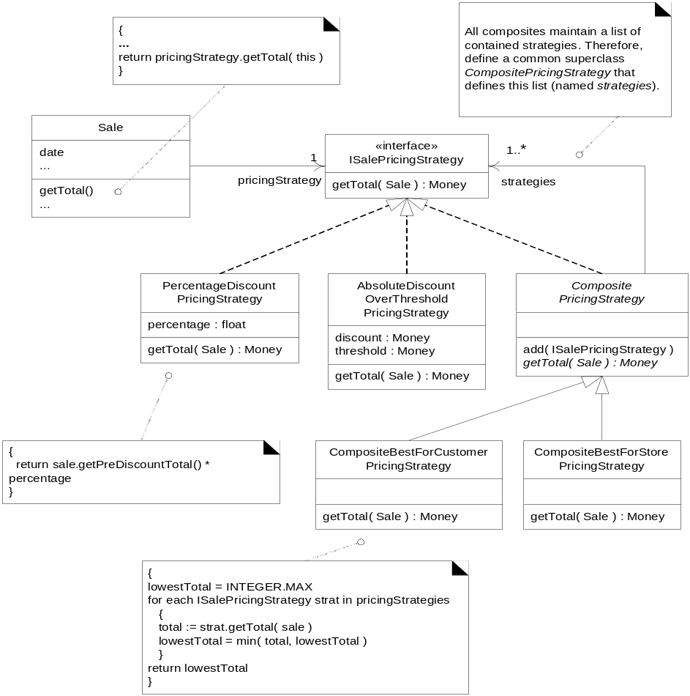
Fig. 26.14

Slide 36
Composite Pattern (26.8)
The Sale object treats a Composite Strategy that contains other strategies as any object that implements ISalePricingStrategy (i.e., calls its getTotal(s) operation)
See code pp. 455-456
Notation for abstract classes and abstract methods – see Fig. 26.16

Slide 37
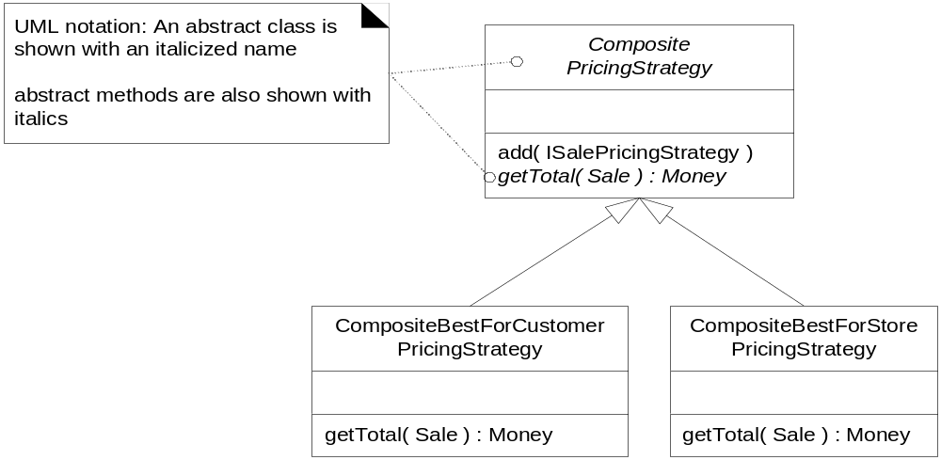
Fig. 26.16

Slide 38
Façade Pattern (26.9)
Problem: A common unified interface to a disparate set of implementations or interfaces – such as within a subsystem – is required. There may be undesirable coupling to many things in the subsystem, or the implementation of the subsystem may change. What to do?
Solution: Define a single point of contact to the subsystem – a façade that wraps the subsystem. This façade object presents a single unified interface and is responsible for collaborating with the subsystem components.

Slide 39
Façade Pattern (26.9)
A façade object serves as a “front-end” object that is the single point of entry for the services of a subsystem
Façade provides Protected Variation from changes in the implementation of the subsystem

Slide 40
Façade Pattern (26.9)
Example: A “rule engine” subsystem – responsible for evaluating a set of rules against an operation and indicating if any rules invalidate the operation
Example of a rule: If the sale is paid by a gift certificate, invalidate all payment types of change due back to the customer except for another gift certificate.
Also known as pluggable business rules

Slide 41
Façade Pattern (26.9)
Example (cont): Define a façade object to this subsystem: POSRuleEngineFacade
Calls to this façade placed near the start of methods that are points for pluggable rules, see code p. 462
The hidden subsystem could contain any number of rules

Slide 42
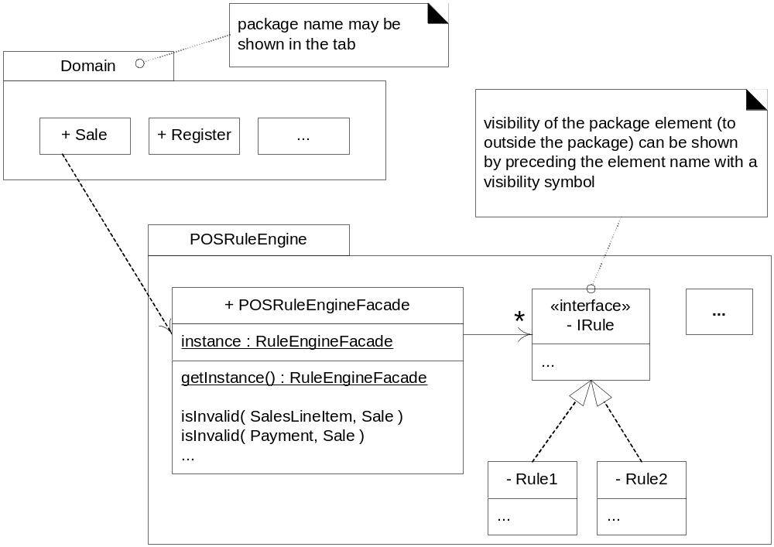
Fig. 26.20

Slide 43
Façade Pattern (26.9)
Notes:
  Façade is usually accessed via Singleton
  Similar to Adapter but Adapter applies to varying interfaces not hiding implementation of subsystem

Slide 44
Observer Pattern (26.10)
Also known as Publish-Subscribe Pattern
Problem: Different kinds of subscriber objects are interested in state changes or events of a publisher object and want to react in their own unique way when the publisher generates an event. The publisher wants to maintain low coupling to the subscribers.
Solution: Define a subscriber or listener interface. Subscribers implement the interface. The publisher can dynamically register subscribers who are interested in an event and notify them when an event occurs.

Slide 45
Observer Pattern (26.10)
Example: Want a GUI window to refresh (update) its display of sale total when the total changes
See Fig. 26.21

Slide 46
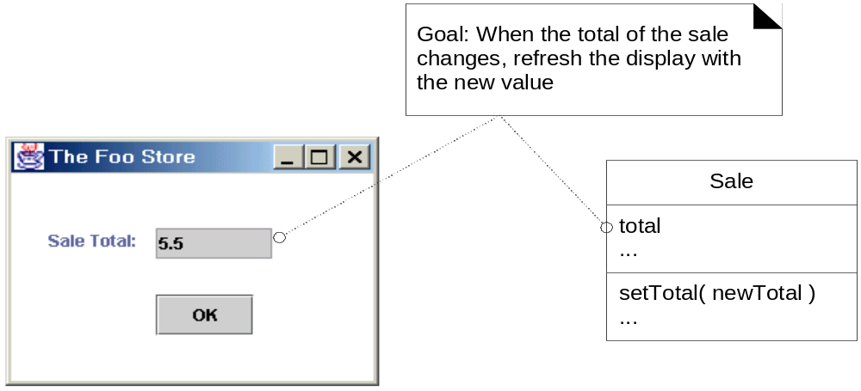
Fig. 26.21

Slide 47
Observer Pattern (26.10)
Example (cont):
Simple solution – when Sale changes its total the object sends a message to the window telling it to refresh its display
Problem – high coupling between domain objects and UI objects

Slide 48
Observer Pattern (26.10)
Example (cont):
Want to be able to easily replace UI objects or even add other UI objects that can be notified of this event
That is, want model-view separation
Model objects shouldn’t know about view objects => Protected Variations with respect to a changing user interface

Slide 49
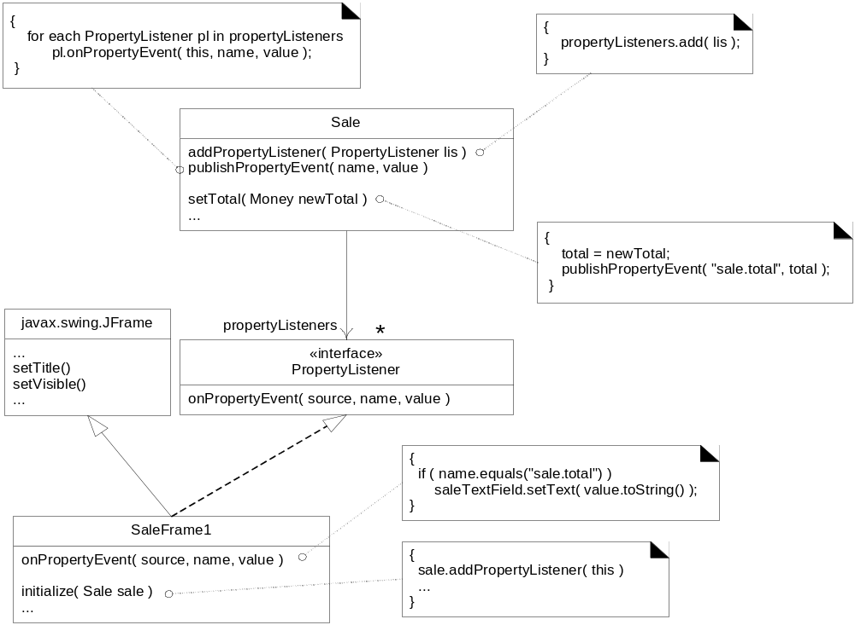
Fig. 26.22

Slide 50
Observer Pattern (26.10)
Steps (p. 465)
  Define an interface PropertyListener with operation onPropertyEvent
  Define window (SaleFrame1) to implement the interface
  When SaleFrame1 is initialized pass it the Sale instance from which it is displaying the total
  SaleFrame1 registers to the Sale instance for notification of “property events” via the addPropertyListener message
  Note that the Sale does not know about SaleFrame1 objects; it only knows about objects that implement the PropertyListener interface. (This lowers the coupling of the Sale to the window – the coupling is only to an interface, not to a GUI class.)
  The Sale instance is the publisher of “property events”. When the total changes, it iterates across all subscribing PropertyListeners, notifying each

Slide 51
Observer Pattern (26.10)
Notes:
  The SaleFrame1 object is the observer/subscriber/listener
  Sale is the publisher of property events
  Sale adds SaleFrame1 object to its list of PropertyListener subscribers – Fig. 26.23

Slide 52
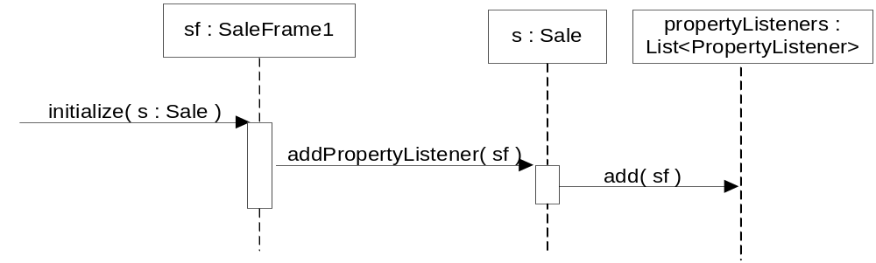
Fig. 26.23

Slide 53
Observer Pattern (26.10)
Notes:
  When the Sale total changes it iterates over all registered subscribers and sends the onPropertyEvent message to each – Figs. 26.24, 26.25

Slide 54
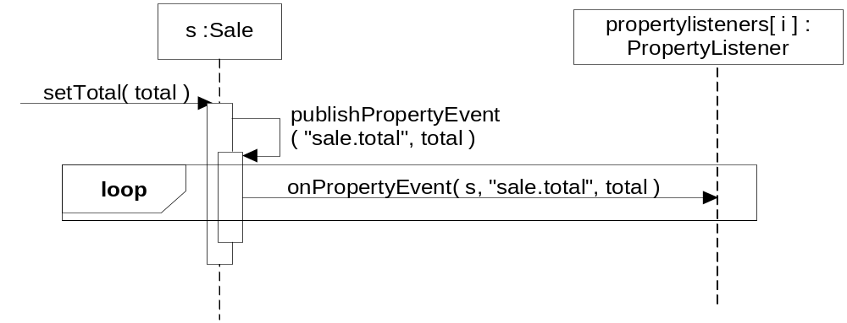
Fig. 26.24

Slide 55
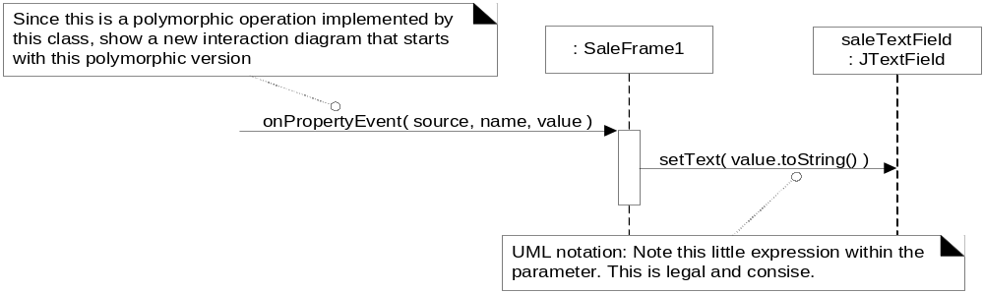
Fig. 26.25

Slide 56
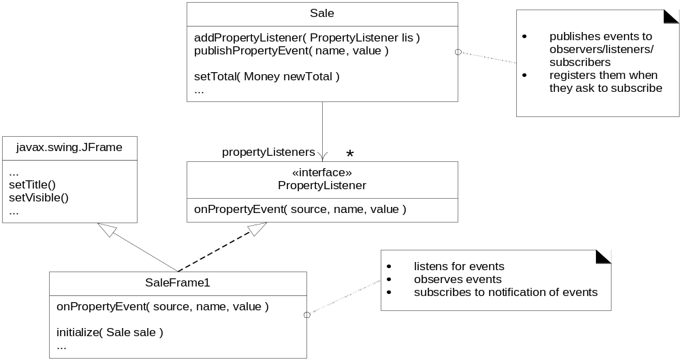
Fig. 26.26
Who is the observer, listener, subscriber, and publisher?

Slide 57
Observer Pattern (26.10)
Notes:
  Sale is coupled to view object but only loosely since it only knows subscribers as implementing the PropertyListener interface
  In Java this was called Delegation Event Model
Observer pattern is basis for GUI widget event handling in both Java (AWT & Swing) and .NET
Widgets are publishers of events, other objects can register as listeners

Slide 58
Observer Pattern (26.10)
Example of AlarmClock:
  AlarmClock is publisher of alarm events
  Different types of objects can register as listeners and react to same alarm event in their own ways

Slide 59
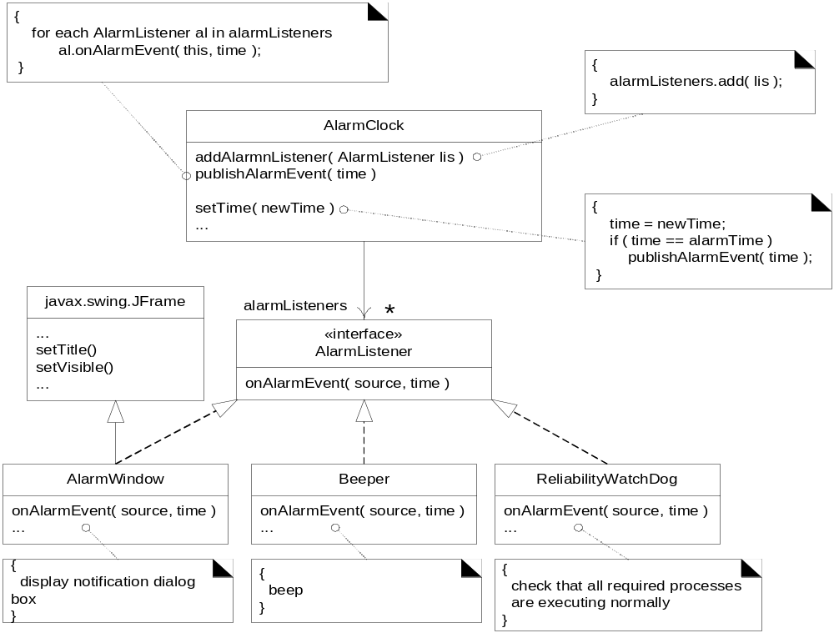
Fig. 26.27

