Slide 1
Postman

Slide 2
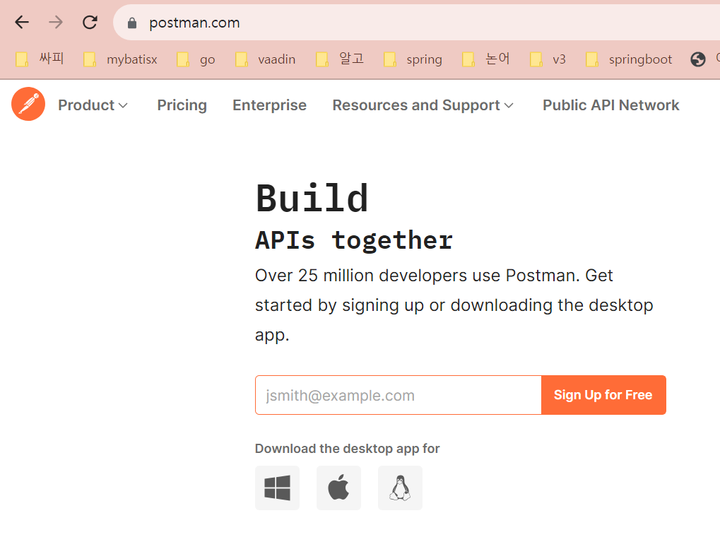
Postman
postman

Slide 3
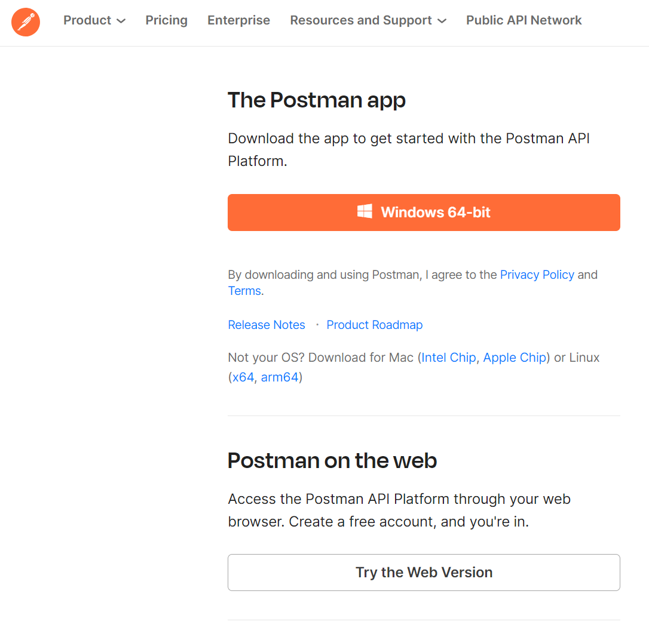
Postman
postman

Slide 4
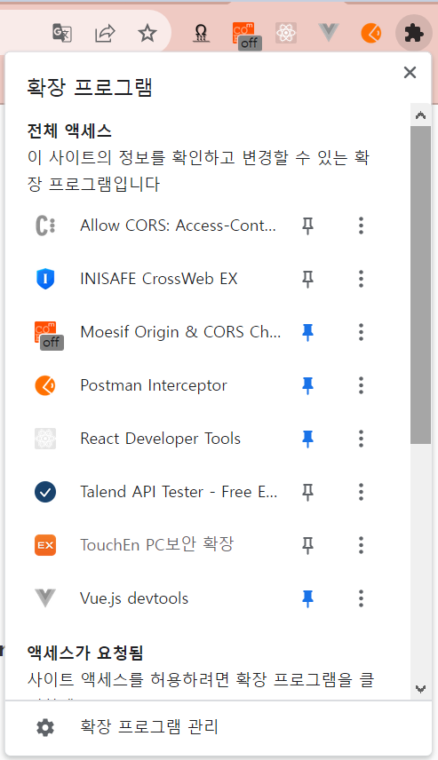
Postman
postman

Slide 5
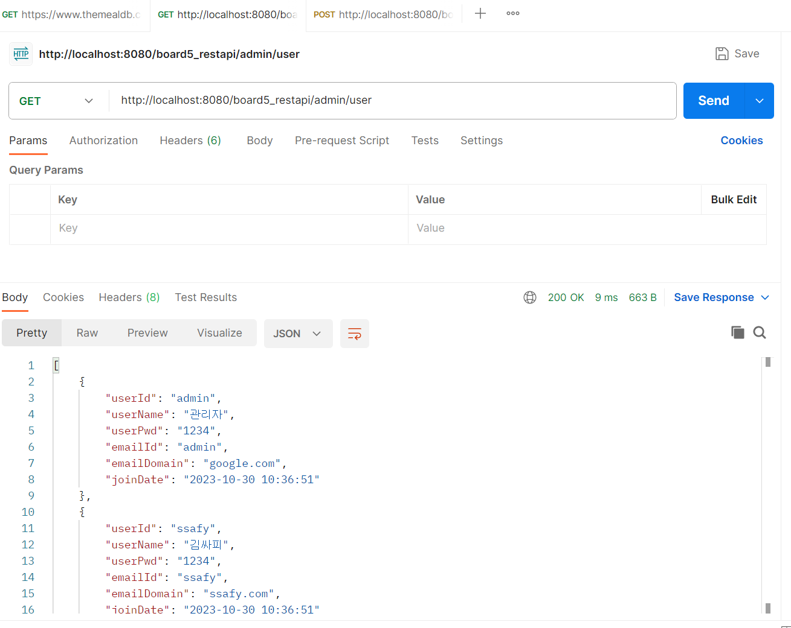
Postman
Get
http://localhost:8080/board5_restapi/admin/user

Slide 6
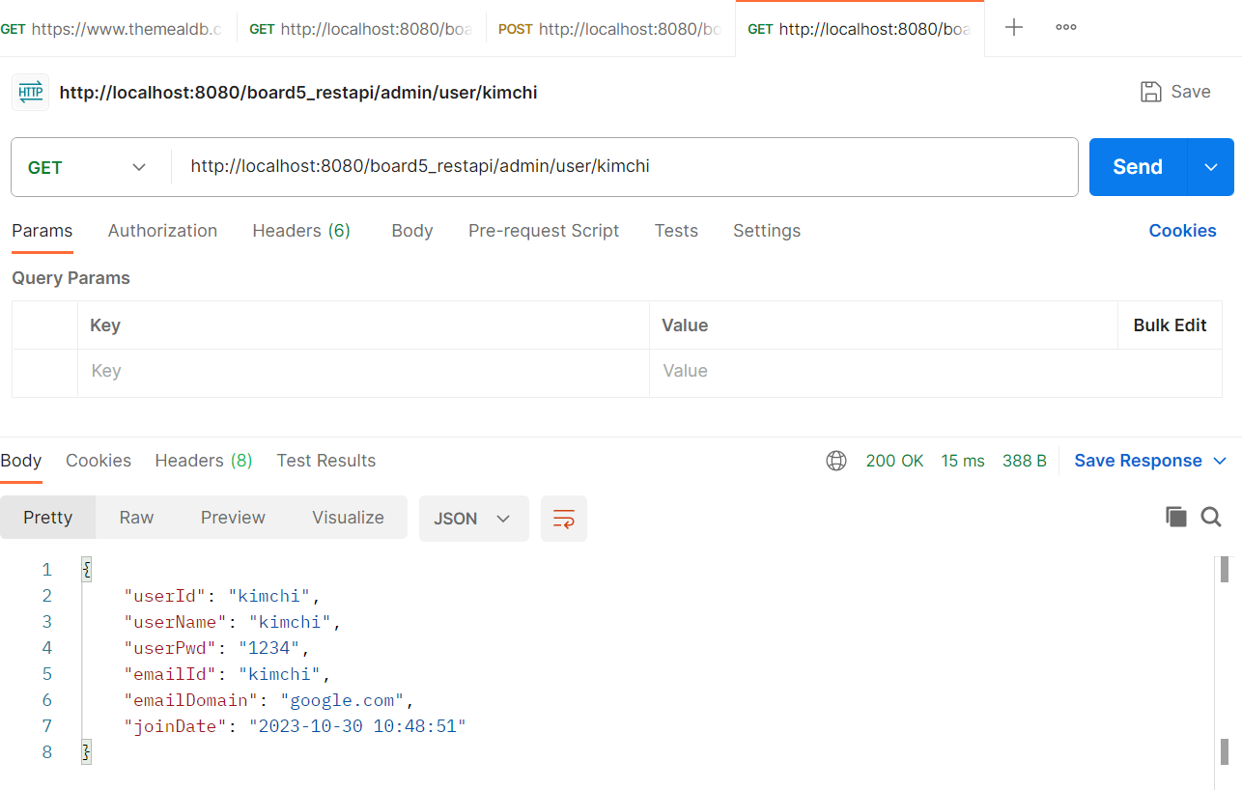
Postman
Get
http://localhost:8080/board5_restapi/admin/user/kimchi

Slide 7
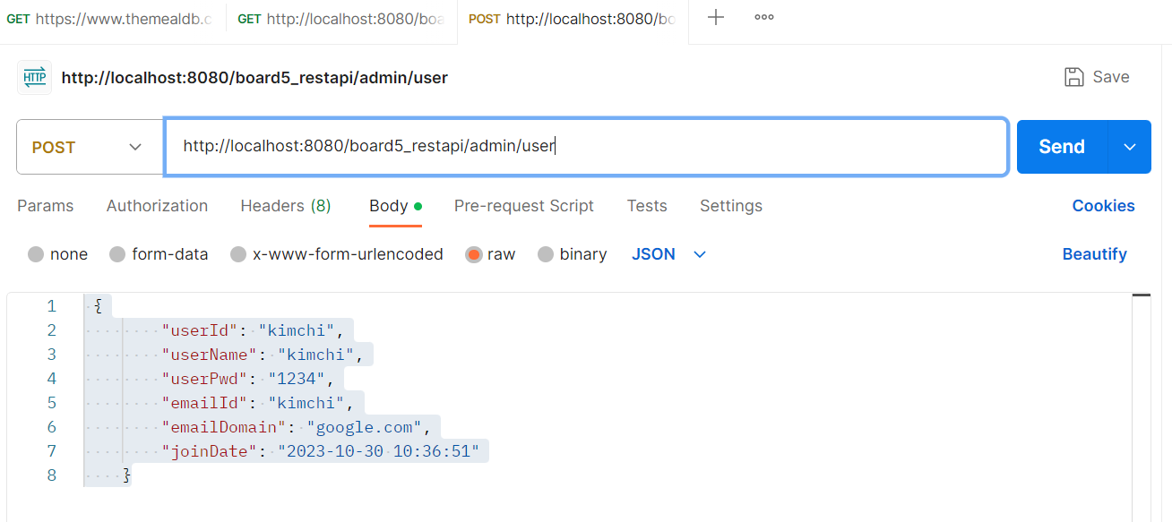
Postman
Post
http://localhost:8080/board5_restapi/admin/user

Slide 8
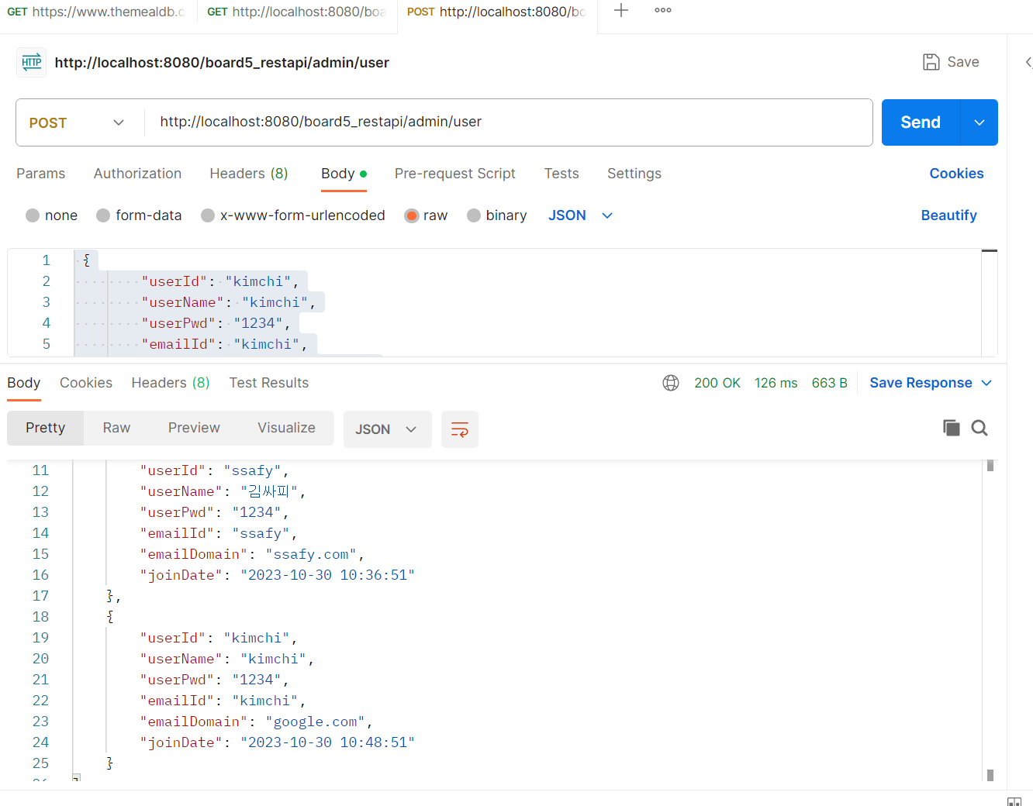
Postman
Post
http://localhost:8080/board5_restapi/admin/user
{
"userId": "kimchi",
"userName": "kimchi",
"userPwd": "1234",
"emailId": "kimchi",
"emailDomain": "google.com",
"joinDate": "2023-10-30 10:36:51"
}

Slide 9
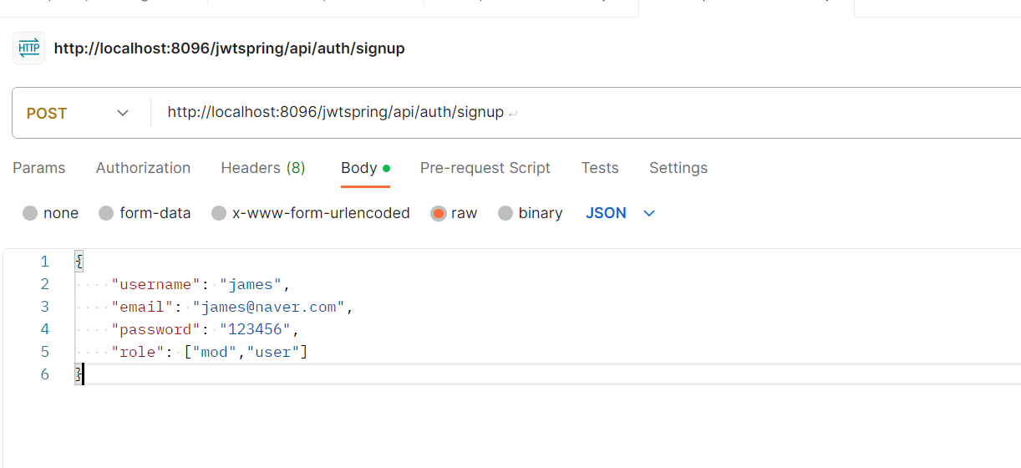
Postman
Post
http://localhost:8096/jwtspring/api/auth/signup
{
"username": "james",
"email": "james@naver.com",
"password": "123456",
"role": ["mod","user"]
}

Slide 10
Postman
Post
http://localhost:8080/board5_restapi/admin/user

Slide 11
Postman
Post
http://localhost:8080/board5_restapi/admin/user

Slide 12
Postman
Post
http://localhost:8080/board5_restapi/admin/user

Slide 13
Postman
Post
http://localhost:8080/board5_restapi/admin/user

Slide 14
Postman
Post
http://localhost:8080/board5_restapi/admin/user

