Slide 1
Overview of Query Evaluation
Chapter 12
Notes:
1
The slides for this text are organized into chapters. This lecture covers Chapter 13.
Chapter 1: Introduction to Database Systems
Chapter 2: The Entity-Relationship Model
Chapter 3: The Relational Model
Chapter 4 (Part A): Relational Algebra
Chapter 4 (Part B): Relational Calculus
Chapter 5: SQL: Queries, Programming, Triggers
Chapter 6: Query-by-Example (QBE)
Chapter 7: Storing Data: Disks and Files
Chapter 8: File Organizations and Indexing
Chapter 9: Tree-Structured Indexing
Chapter 10: Hash-Based Indexing
Chapter 11: External Sorting
Chapter 12 (Part A): Evaluation of Relational Operators
Chapter 12 (Part B): Evaluation of Relational Operators: Other Techniques
Chapter 13: Introduction to Query Optimization
Chapter 14: A Typical Relational Optimizer
Chapter 15: Schema Refinement and Normal Forms
Chapter 16 (Part A): Physical Database Design
Chapter 16 (Part B): Database Tuning
Chapter 17: Security
Chapter 18: Transaction Management Overview
Chapter 19: Concurrency Control
Chapter 20: Crash Recovery
Chapter 21: Parallel and Distributed Databases
Chapter 22: Internet Databases
Chapter 23: Decision Support
Chapter 24: Data Mining
Chapter 25: Object-Database Systems
Chapter 26: Spatial Data Management
Chapter 27: Deductive Databases
Chapter 28: Additional Topics

Slide 2
Overview of Query Evaluation
Plan: Tree of R.A. ops, with choice of alg for each op.
  Each operator typically implemented using a `pull’ interface: when an operator is `pulled’ for the next output tuples, it `pulls’ on its inputs and computes them.
Two main issues in query optimization:
  For a given query, what plans are considered?
    Algorithm to search plan space for cheapest (estimated) plan.
  How is the cost of a plan estimated?
Ideally: Want to find best plan. Practically: Avoid worst plans!
We will study the System R approach.
Notes:
2
‘Pull’ interface는 의미가 명확하지 않으나 whenever inputs are ready, operator compute the output. 의미로 해석. Pipelining을 통해 결과를 생성한다는 의미로 이해할 것.
뒷 부분의 예제들을 기반으로 설명할 것.

Slide 3
Some Common Techniques
Algorithms for evaluating relational operators use some simple ideas extensively:
  Indexing: Can use WHERE conditions to retrieve small set of tuples (selections, joins)
  Iteration: Sometimes, faster to scan all tuples even if there is an index. (And sometimes, we can scan the data entries in an index instead of the table itself.)
  Partitioning: By using sorting or hashing, we can partition the input tuples and replace an expensive operation by similar operations on smaller inputs.
* Watch for these techniques as we discuss query evaluation!

Slide 4
Statistics and Catalogs
Need information about the relations and indexes involved. Catalogs typically contain at least:
  # tuples (NTuples) and # pages (NPages) for each relation.
  # distinct key values (NKeys) and NPages for each index.
  Index height, low/high key values (Low/High) for each tree index.
Catalogs updated periodically.
  Updating whenever data changes is too expensive; lots of approximation anyway, so slight inconsistency ok.
More detailed information (e.g., histograms of the values in some field) are sometimes stored.
Notes:
8
통계정보 뒤에 다시 정의되고 있음.
MySQL의 optimizer: 비용 기반의 옵티마이저, 대략 레코드 건수, unique 키 값 정도를 사용
------------------------------------------------------------------
테이블의 통계 정보 commands의 예
-------------------------
Select * from information_schema.statistics where table_schema = 'employees';
show table status from employees;
show table status like ‘titles';
show index from titles;
Mysql의 ANALYZE 명령어는 통계 정보 수집
--------------------------------
analyze table customers;

Slide 5
Access Paths
An access path is a method of retrieving tuples:
  File scan, or index that matches a selection (in the query)
A tree index matches (a conjunction of) terms that involve only attributes in a prefix of the search key.
  E.g., Tree index on <a, b, c> matches the selection a=5 AND b=3, and a=5 AND b>6, but not b=3.
A hash index matches (a conjunction of) terms that has a term attribute = value for every attribute in the search key of the index.
  E.g., Hash index on <a, b, c> matches a=5 AND b=3 AND c=5; but it does not match b=3, or a=5 AND b=3, or a>5 AND b=3 AND c=5.
Notes:
13
Access Path란 where 절의 조건에 적용 가능한 index의 선택을 의미. 없는 경우는 table scan.

Slide 6
A Note on Complex Selections
(day<8/9/94 AND rname=‘Paul’) OR bid=5 OR sid=3
Selection conditions are first converted to conjunctive normal form (CNF):
(day<8/9/94 OR bid=5 OR sid=3 ) AND (rname=‘Paul’ OR bid=5 OR sid=3)
We only discuss case with no ORs; see text if you are curious about the general case.
Notes:
13

Slide 7
One Approach to Selections
Find the most selective access path, retrieve tuples using it, and apply any remaining terms that don’t match the index:
  Most selective access path: An index or file scan that we estimate will require the fewest page I/Os.
  Terms that match this index reduce the number of tuples retrieved; other terms are used to discard some retrieved tuples, but do not affect number of tuples/pages fetched.
  Consider day<8/9/94 AND bid=5 AND sid=3. A B+ tree index on day can be used; then, bid=5 and sid=3 must be checked for each retrieved tuple. Similarly, a hash index on <bid, sid> could be used; day<8/9/94 must then be checked.
Notes:
14
Select문의 plan을 정하는 첫 번째 단계는 어떤 Access Path를 사용할 것인가에 의해 결정.
Where 절의 조건이 하나만 있는 경우는 simple. 두 개 이상 있는 경우는 selectivity에 의해 결정

Slide 8
Using an Index for Selections
Cost depends on #qualifying tuples, and clustering.
  Cost of finding qualifying data entries (typically small) plus cost of retrieving records (could be large w/o clustering).
  In example, assuming uniform distribution of names, about 10% of tuples qualify (100 pages, 10000 tuples). With a clustered index, cost is little more than 100 I/Os; if unclustered, upto 10000 I/Os!
SELECT *
FROM Reserves R
WHERE R.rname < ‘C%’
Notes:
12
Assume that
Reserves: a tuple is 40 byte long. A page can hold 100 tuples. 1000 pages.
Sailors: a tuple is 50 byte long. A page can hold 80 tuples. 500 pages.

Slide 9
Projection
SELECT DISTINCT
R.sid, R.bid
FROM Reserves R
The expensive part is removing duplicates.
  SQL systems don’t remove duplicates unless the keyword DISTINCT is specified in a query.
Sorting Approach: Sort on <sid, bid> and remove duplicates. (Can optimize this by dropping unwanted information while sorting.)
Hashing Approach: Hash on <sid, bid> to create partitions. Load partitions into memory one at a time, build in-memory hash structure, and eliminate duplicates.
If there is an index with both R.sid and R.bid in the search key, may be cheaper to sort data entries!
Notes:
16

Slide 10
Join: Index Nested Loops
foreach tuple r in R do
foreach tuple s in S where r_{i} == s_{j} do
add <r, s> to result
If there is an index on the join column of one relation (say S), can make it the inner and exploit the index.
  Cost: M + ( (M*p_{R}) * cost of finding matching S tuples)
For each R tuple, cost of probing S index is about 1.2 for hash index, 2-4 for B+ tree. Cost of then finding S tuples (assuming Alt. (2) or (3) for data entries) depends on clustering.
  Clustered index: 1 I/O (typical), unclustered: upto 1 I/O per matching S tuple.
Notes:
2-4 for B+ Tree: 통계의 IHeight(T)가 probing 비용을 의미
SQL Server join 참고 자료:
블로그 전체: http://blogs.msdn.com/b/craigfr/
Nested Loop join : http://blogs.msdn.com/b/craigfr/archive/2006/07/26/nested-loops-join.aspx
Loop Join : http://blogs.msdn.com/b/craigfr/archive/2006/08/03/merge-join.aspx
Hash Join : http://blogs.msdn.com/b/craigfr/archive/2006/08/10/687630.aspx

Slide 11
Examples of Index Nested Loops
Hash-index (Alt. 2) on sid of Sailors (as inner):
  Scan Reserves: 1000 page I/Os, 100*1000 tuples.
  For each Reserves tuple: 1.2 I/Os to get data entry in index, plus 1 I/O to get (the exactly one) matching Sailors tuple. Total: 220,000 I/Os.
Hash-index (Alt. 2) on sid of Reserves (as inner):
  Scan Sailors: 500 page I/Os, 80*500 tuples.
  For each Sailors tuple: 1.2 I/Os to find index page with data entries, plus cost of retrieving matching Reserves tuples. Assuming uniform distribution, 2.5 reservations per sailor (100,000 / 40,000). Cost of retrieving them is 1 or 2.5 I/Os depending on whether the index is clustered.
Notes:
8
첫 번째: 1000 + 1000*100*(1.2 + 1): 1.2는 데이터 엔트리 접근 비용 + 1은 데이터 페이지 접근 비용
두 번째: 500 + 500 * 80 * (1.2 + 1) 또는 (1.2 + 2.5)

Slide 12

Join: Sort-Merge (R S)
i=j
Sort R and S on the join column, then scan them to do a ``merge’’ (on join col.), and output result tuples.
  Advance scan of R until current R-tuple >= current S tuple, then advance scan of S until current S-tuple >= current R tuple; do this until current R tuple = current S tuple.
  At this point, all R tuples with same value in Ri (current R group) and all S tuples with same value in Sj (current S group) match; output <r, s> for all pairs of such tuples.
  Then resume scanning R and S.
R is scanned once; each S group is scanned once per matching R tuple. (Multiple scans of an S group are likely to find needed pages in buffer.)
Notes:
11

Slide 13
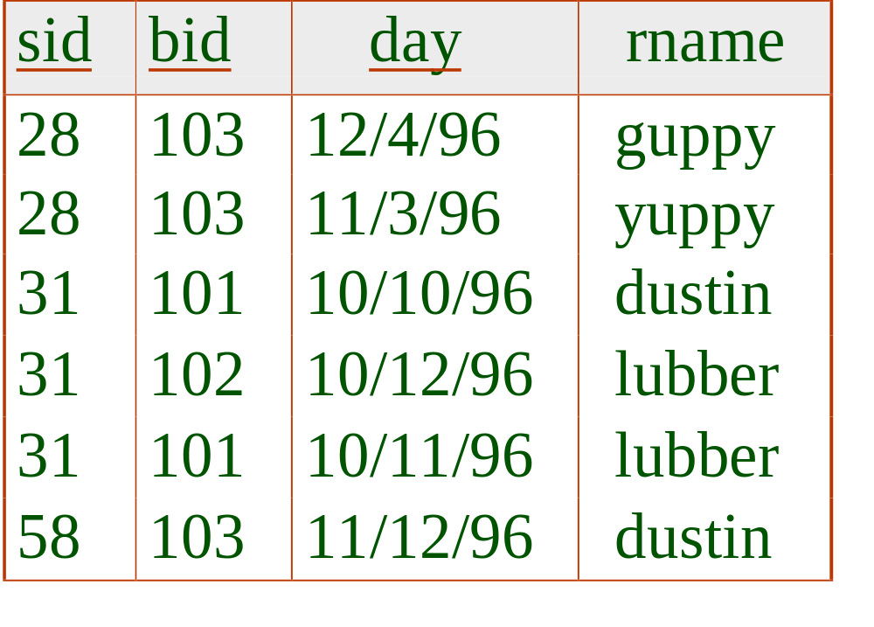
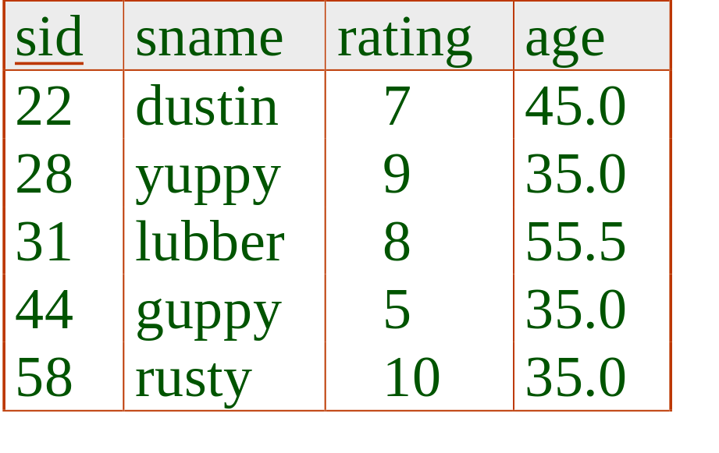
Example of Sort-Merge Join
Cost: M log M + N log N + (M+N)
  The cost of scanning, M+N, could be M*N (very unlikely!)
With 35, 100 or 300 buffer pages, both Reserves and Sailors can be sorted in 2 passes; total join cost: 7500.
Notes:
12
소팅비용 = 2N*(#of Passes)
2*1000*2 + 2*500*2 + (1000 + 500) = 4000 + 2000 + 1500 = 7500

Slide 14
Highlights of System R Optimizer
Impact:
  Most widely used currently; works well for < 10 joins.
Cost estimation: Approximate art at best.
  Statistics, maintained in system catalogs, used to estimate cost of operations and result sizes.
  Considers combination of CPU and I/O costs.
Plan Space: Too large, must be pruned.
  Only the space of left-deep plans is considered.
    Left-deep plans allow output of each operator to be pipelined into the next operator without storing it in a temporary relation.
  Cartesian products avoided.
Notes:
2

Slide 15
Cost Estimation
For each plan considered, must estimate cost:
  Must estimate cost of each operation in plan tree.
    Depends on input cardinalities.
    We’ve already discussed how to estimate the cost of operations (sequential scan, index scan, joins, etc.)
  Must also estimate size of result for each operation in tree!
    Use information about the input relations.
    For selections and joins, assume independence of predicates.
Notes:
8
Cost of plan = sum of costs of each op.
Plan consists of three parts: (1) reading input tables, (2) writing intermediate tables, (3) sorting and filtering output tuples.
Pipelined plan의 경우 (1) 불필요, 아닌 경우 (2)가 중요해짐. 이때 결과의 크기 추정이 필수적임.

Slide 16
Size Estimation and Reduction Factors
SELECT attribute list
FROM relation list
WHERE term1 AND ... AND termk
Consider a query block:
Maximum # tuples in result is the product of the cardinalities of relations in the FROM clause.
Reduction factor (RF) associated with each term reflects the impact of the term in reducing result size. Result cardinality = Max # tuples * product of all RF’s.
  Implicit assumption that terms are independent!
  Term col=value has RF 1/NKeys(I), given index I on col
  Term col1=col2 has RF 1/MAX(NKeys(I1), NKeys(I2))
  Term col>value has RF (High(I)-value)/(High(I)-Low(I))
Notes:
9
책의 page 400 참조, page 484참조
다음 예제 참조
select count(*) from orders; -- 327
select count(*) from orders where customerNumber = 201; -- 3
select count(distinct customerNumber) from orders; -- 327/99 = 3.3
2. 다음 예제 참조
select count(productcode) from orderDetails; -- 2997
select count(productcode) from products; -- 110
select count(*) from orderDetails, products; -- 329670 = 2997 * 110
select count(distinct productcode) from orderDetails; -- 109
select count(distinct productcode) from products; -- 110
select count(*) from orderDetails od, products p where od.productcode = p.productcode; -- 2997
3. 다음 예제 참조
select count(*) from orders where customerNumber > 300; -- 132
select Max(customerNumber), Min(customerNumber) from orders; -- 497, 103
-- (497 - 300)/(497 - 103) = 0.5
-- 327 * 0.5 = 163 ~ 132보다 크지만 근차시 사용 가능.

Slide 17
Cost Estimates for Single-Relation Plans
Index I on primary key matches selection:
  Cost is Height(I)+1 for a B+ tree, about 1.2 for hash index.
Clustered index I matching one or more selects:
  (NPages(I)+NPages(R)) * product of RF’s of matching selects.
Non-clustered index I matching one or more selects:
  (NPages(I)+NTuples(R)) * product of RF’s of matching selects.
Sequential scan of file:
  NPages(R).
Note: Typically, no duplicate elimination on projections! (Exception: Done on answers if user says DISTINCT.)
Notes:
13
본 내용은 15장(query optimization의 ppt)에서 발췌해 왔음. -- 일단 책에 관련 설명이 없음. 따라서 matching select는 하나만 있다고 가정하고 설명.
Clustered/Unclustered index의 경우, probing 비용은 무시하고 있음.

Slide 18
Example
SELECT S.sid
FROM Sailors S
WHERE S.rating=8
If we have an index on rating:
  (1/NKeys(I)) * NTuples(R) = (1/10) * 40000 tuples retrieved.
  Clustered index: (1/NKeys(I)) * (NPages(I)+NPages(R)) = (1/10) * (50+500) pages are retrieved. (This is the cost.)
  Unclustered index: (1/NKeys(I)) * (NPages(I)+NTuples(R)) = (1/10) * (50+40000) pages are retrieved.
If we have an index on sid:
  Would have to retrieve all tuples/pages. With a clustered index, the cost is 50+500, with unclustered index, 50+40000.
Doing a file scan:
  We retrieve all file pages (500).
Notes:
14
본 내용은 15장(query optimization의 ppt)에서 발췌해 왔음.
Index on sid의 경우: 반환 내용이 sid이므로 각 sid에 대해 조건을 만족하는지 확인할 수는 있음. 이 경우의 비용.
(1) RF을 통한 결과 크기 계산 : RF = (1/10), 크기 계산: (1/10) * 40000 = 40000 tuples
Clustered Index를 통한 비용 계산 : (1/10) * (50 + 500) = 55
Unclustered Index를 통한 비용 계산 : (1/10) * (50 + 40000) = 4005
(2) sid에 대한 index 있을 때, 즉 matching select가 없는 경우
Clustered Index를 통한 비용. RF = 1 따라서 (50 + 500)
Unclustered Index를 통한 비용. RF = 1 따라서 (50 + 40000)
(3) 위의 경우는 file scan이 정답

Slide 19
Schema for Examples
Sailors (sid: integer, sname: string, rating: integer, age: real)
Reserves (sid: integer, bid: integer, day: dates, rname: string)
Similar to old schema; rname added for variations.
Reserves:
  Each tuple is 40 bytes long, 100 tuples per page, 1000 pages.
Sailors:
  Each tuple is 50 bytes long, 80 tuples per page, 500 pages.
Notes:
3

Slide 20
Motivating Example
RA Tree:
sname
bid=100
rating > 5
SELECT S.sname
FROM Reserves R, Sailors S
WHERE R.sid=S.sid AND
R.bid=100 AND S.rating>5
sid=sid
Cost: 500+500*1000 I/Os
By no means the worst plan!
Misses several opportunities: selections could have been `pushed’ earlier, no use is made of any available indexes, etc.
Goal of optimization: To find more efficient plans that compute the same answer.
Reserves
Sailors
Plan:
(On-the-fly)
sname
bid=100
rating > 5
(On-the-fly)
(Simple Nested Loops)
sid=sid
Reserves
Sailors
Notes:
4
Simple Nested Loop Join
-------------------
Reserve를 Outer로 할 경우: 1000 + 1000 * 500 = 501,000
Sailor를 Outer로 할 경우 : 500 + 500 * 1000 = 500,500

Slide 21
Alternative Plans 1
(No Indexes)
(On-the-fly)
sname
(Sort-Merge Join)
sid=sid
(Scan;
(Scan;
write to
bid=100
rating > 5
write to
temp T1)
temp T2)
Main difference: push selects.
With 5 buffers, cost of plan:
  Scan Reserves (1000) + write temp T1 (10 pages, if we have 100 boats, uniform distribution).
  Scan Sailors (500) + write temp T2 (250 pages, if we have 10 ratings).
  Sort T1 (2*2*10), sort T2 (2*3*250), merge (10+250)
  Total: 3560 page I/Os.
If we used BNL join, join cost = 10+4*250, total cost = 2770.
If we `push’ projections, T1 has only sid, T2 only sid and sname:
  T1 fits in 3 pages, cost of BNL drops to under 250 pages, total < 2000.
Reserves
Sailors
Notes:
5
Sort T1 : Pass 0: 10/5 = 2 sorted runs of 5 pages, Pass 1: 2/4 = 1 run of 10 pages 따라서 2 passes.
따라서 비용: 2*2*10=40
Sort T2 : Pass 0 : 250/5 = 50 sorted runs of 5 pages, Pass 1; 50/4 = 13 sorted runs of 20 pages,
Pass 2: 13/4 = 4 sorted runs of 80 pages, Pass 3: 4/4 = 1 sorted runs of 250 pages
따라서 비용: 2*4*250일듯. 공식으로 계산해도 3이 아니라 4
전체비용 = (1000 + 10 + 500 + 250) + (2*2*10 + 2*4*250) + (10 + 250) = 1760 + 2040 + 260 = 4060 (500 차이가 남)
BNL의 경우, 블락 사이즈 = 5 – 1(input for inner) - 1(output), 10/(5-2)= 4, 10 + 4*250, total = (1000 + 10) + (500 + 250) + (10 + 4*250) = 2770
If project is pushed and T1 fits in 3 pages,
(1000 + 3) + (500 + 250) + 3 + 1*250 = 1753 + 253 = 2006

Slide 22
Alternative Plans 2
With Indexes
sname
(On-the-fly)
rating > 5
(On-the-fly)
With clustered index on bid of Reserves, we get 100,000/100 = 1000 tuples on 1000/100 = 10 pages.
INL with pipelining (outer is not materialized).
(Index Nested Loops,
sid=sid
with pipelining )
(Use hash
Sailors
index; do
bid=100
not write
result to
temp)
Reserves
  Projecting out unnecessary fields from outer doesn’t help.
Join column sid is a key for Sailors.
  At most one matching tuple, unclustered index on sid OK.
Decision not to push rating>5 before the join is based on
availability of sid index on Sailors.
Cost: Selection of Reserves tuples (10 I/Os); for each,
must get matching Sailors tuple (1000*1.2); total 1210 I/Os.
Notes:
6
clustered index on bid of reserves + primary key sid of sailors 을 사용
마지막 비용 계산에 data page 레벨에서의 읽기 비용이 추가되어야 함. 10 + (1000 * 1.2) = 1210 IO

Slide 23
Summary
There are several alternative evaluation algorithms for each relational operator.
A query is evaluated by converting it to a tree of operators and evaluating the operators in the tree.
Must understand query optimization in order to fully understand the performance impact of a given database design (relations, indexes) on a workload (set of queries).
Two parts to optimizing a query:
  Consider a set of alternative plans.
    Must prune search space; typically, left-deep plans only.
  Must estimate cost of each plan that is considered.
    Must estimate size of result and cost for each plan node.
    Key issues: Statistics, indexes, operator implementations.
Notes:
19

