Slide 1
External Sorting
Chapter 13
Notes:
1
The slides for this text are organized into chapters. This lecture covers Chapter 11.
Chapter 1: Introduction to Database Systems
Chapter 2: The Entity-Relationship Model
Chapter 3: The Relational Model
Chapter 4 (Part A): Relational Algebra
Chapter 4 (Part B): Relational Calculus
Chapter 5: SQL: Queries, Programming, Triggers
Chapter 6: Query-by-Example (QBE)
Chapter 7: Storing Data: Disks and Files
Chapter 8: File Organizations and Indexing
Chapter 9: Tree-Structured Indexing
Chapter 10: Hash-Based Indexing
Chapter 11: External Sorting
Chapter 12 (Part A): Evaluation of Relational Operators
Chapter 12 (Part B): Evaluation of Relational Operators: Other Techniques
Chapter 13: Introduction to Query Optimization
Chapter 14: A Typical Relational Optimizer
Chapter 15: Schema Refinement and Normal Forms
Chapter 16 (Part A): Physical Database Design
Chapter 16 (Part B): Database Tuning
Chapter 17: Security
Chapter 18: Transaction Management Overview
Chapter 19: Concurrency Control
Chapter 20: Crash Recovery
Chapter 21: Parallel and Distributed Databases
Chapter 22: Internet Databases
Chapter 23: Decision Support
Chapter 24: Data Mining
Chapter 25: Object-Database Systems
Chapter 26: Spatial Data Management
Chapter 27: Deductive Databases
Chapter 28: Additional Topics

Slide 2
Why Sort?
A classic problem in computer science!
Data requested in sorted order
  e.g., find students in increasing gpa order
Sorting is first step in bulk loading B+ tree index.
Sorting useful for eliminating duplicate copies in a collection of records (Why?)
Sort-merge join algorithm involves sorting.
Problem: sort 1Gb of data with 1Mb of RAM.
  why not virtual memory?
Notes:
4
MySQL에 filesort 이 존재. 읽어보게 할 것. 다음 참조
https://dev.mysql.com/doc/refman/5.7/en/order-by-optimization.html

Slide 3
2-Way Sort: Requires 3 Buffers
Pass 1: Read a page, sort it, write it.
  only one buffer page is used
Pass 2, 3, …, etc.:
  three buffer pages used.
INPUT 1
OUTPUT
INPUT 2
Main memory buffers
Disk
Disk
Notes:
5
위에서 Pass 1은 다음 페이지 그림에서 Pass 0에 해당됨. Pass 0로 설명하는 것도 괜찮음.

Slide 4
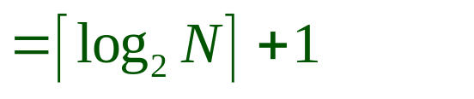
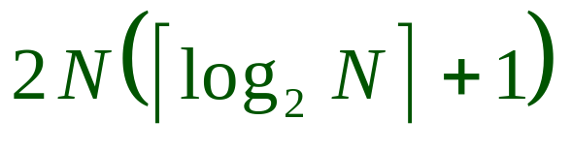
Two-Way External Merge Sort
Each pass we read + write each page in file.
N pages in the file => the number of passes
So toal cost is:
Idea: Divide and conquer: sort subfiles and merge
3,4
6,2
9,4
8,7
5,6
3,1
2
Input file
PASS 0
3,4
2,6
4,9
7,8
5,6
1,3
2
1-page runs
PASS 1
2,3
4,7
1,3
2-page runs
4,6
8,9
5,6
2
PASS 2
2,3
4,4
1,2
4-page runs
6,7
3,5
8,9
6
PASS 3
1,2
2,3
3,4
8-page runs
4,5
6,6
7,8
9
Notes:
6
2N… 에서 2는 Read+ Write를 의미
Run의 정의: sorted sub file을 의미

Slide 5
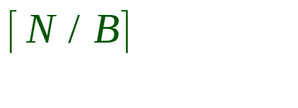
General External Merge Sort
More than 3 buffer pages. How can we utilize them?
To sort a file with N pages using B buffer pages:
  Pass 0: use B buffer pages. Produce sorted runs of B pages each.
  Pass 2, …, etc.: merge B-1 runs.
INPUT 1
. . .
INPUT 2
. . .
. . .
OUTPUT
INPUT B-1
Disk
Disk
B Main memory buffers
Notes:
7
패스0에선 모든 버퍼 페이지들을 사용하여 소팅을 함. 즉 B개의 페이지씩 소팅이 됨. 따라서 N/B 개의 run이 생겨남.

Slide 6
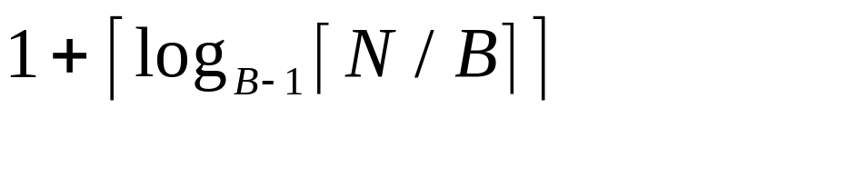
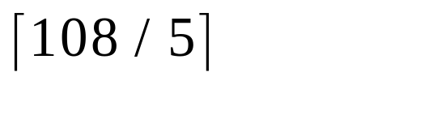
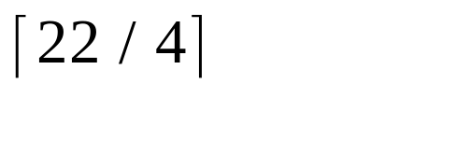
Cost of External Merge Sort
Number of passes:
Cost = 2N * (# of passes)
E.g., with 5 buffer pages, to sort 108 page file:
  Pass 0: = 22 sorted runs of 5 pages each (last run is only 3 pages)
  Pass 1: = 6 sorted runs of 20 pages each (last run is only 8 pages)
  Pass 2: 2 sorted runs, 80 pages and 28 pages
  Pass 3: Sorted file of 108 pages
Notes:
8
Total cost = 2*108*4 = 864

Slide 7
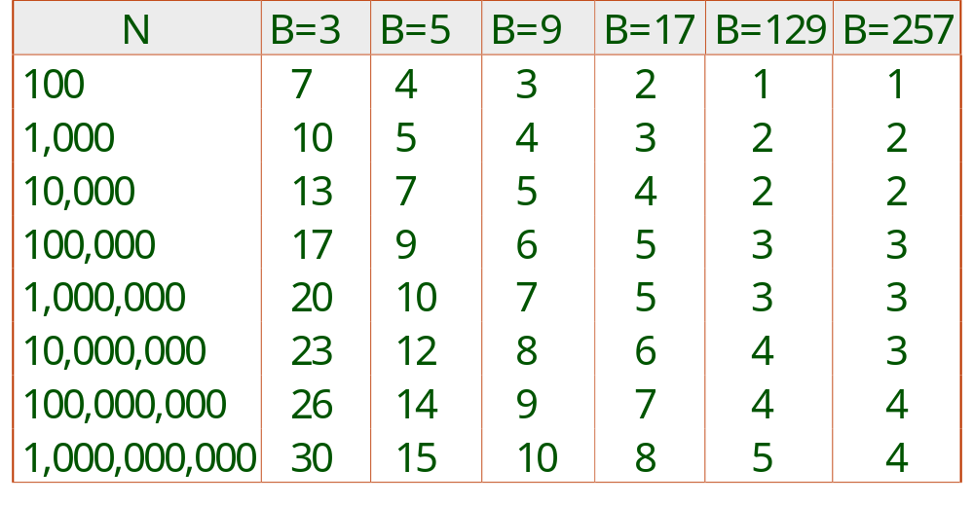
Number of Passes of External Sort
Notes:
9
로그계산기: mwultong.blogspot.com/2008/01/2-log-calc.html

Slide 8
Internal Sort Algorithm
Quicksort is a fast way to sort in memory.
An alternative is “tournament sort” (a.k.a. “heapsort”)
  Top: Read in B blocks
  Output: move smallest record to output buffer
  Read in a new record r
  insert r into “heap”
  if r not smallest, then GOTO Output
  else remove r from “heap”
  output “heap” in order; GOTO Top
Notes:
10

Slide 9
More on Heapsort
Fact: average length of a run in heapsort is 2B
  The “snowplow” analogy
Worst-Case:
  What is min length of a run?
  How does this arise?
Best-Case:
  What is max length of a run?
  How does this arise?
Quicksort is faster, but ...
B

Slide 10
I/O for External Merge Sort
… longer runs often means fewer passes!
Actually, do I/O a page at a time
In fact, read a block of pages sequentially!
Suggests we should make each buffer (input/output) be a block of pages.
  But this will reduce fan-out during merge passes!
  In practice, most files still sorted in 2-3 passes.

Slide 11
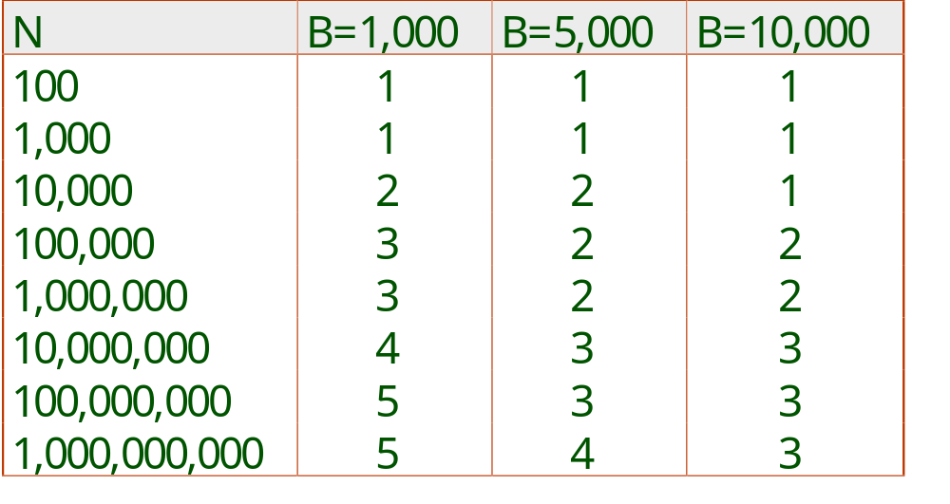
Number of Passes of Optimized Sort
Block size = 32, initial pass produces runs of size 2B.
Notes:
13
Block size is assumed to have 32 pages.

Slide 12
Double Buffering
To reduce wait time for I/O request to complete, can prefetch into `shadow block’.
  Potentially, more passes; in practice, most files still sorted in 2-3 passes.
INPUT 1
INPUT 1'
INPUT 2
OUTPUT
INPUT 2'
OUTPUT'
b
Disk
INPUT k
block size
Disk
INPUT k'
B main memory buffers, k-way merge
Notes:
Input block의 tuples들이 다 사용되면 다음 input이 이루어질 때까지 멈추게 됨. Output도 마찬가지.

Slide 13
Sorting Records!
Sorting has become a blood sport!
  Parallel sorting is the name of the game ...
Datamation: Sort 1M records of size 100 bytes
  Typical DBMS: 15 minutes
  World record: 3.5 seconds
    12-CPU SGI machine, 96 disks, 2GB of RAM
New benchmarks proposed:
  Minute Sort: How many can you sort in 1 minute?
  Dollar Sort: How many can you sort for $1.00?

Slide 14
Using B+ Trees for Sorting
Scenario: Table to be sorted has B+ tree index on sorting column(s).
Idea: Can retrieve records in order by traversing leaf pages.
Is this a good idea?
Cases to consider:
  B+ tree is clustered Good idea!
  B+ tree is not clustered Could be a very bad idea!
Notes:
15

Slide 15
Clustered B+ Tree Used for Sorting
Cost: root to the left-most leaf, then retrieve all leaf pages (Alternative 1)
If Alternative 2 is used? Additional cost of retrieving data records: each page fetched just once.
Index
(Directs search)
Data Entries
("Sequence set")
Data Records
Always better than external sorting!
Notes:
16

Slide 16
Unclustered B+ Tree Used for Sorting
Alternative (2) for data entries; each data entry contains rid of a data record. In general, one I/O per data record!
Index
(Directs search)
Data Entries
("Sequence set")
Data Records
Notes:
17

Slide 17
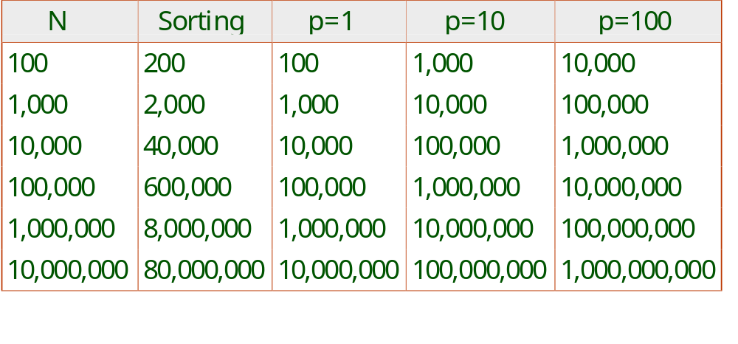
External Sorting vs. Unclustered Index
p: # of records per page
B=1,000 and block size=32 for sorting
p=100 is the more realistic value.
Notes:
18

Slide 18
Summary
External sorting is important; DBMS may dedicate part of buffer pool for sorting!
External merge sort minimizes disk I/O cost:
  Pass 0: Produces sorted runs of size B (# buffer pages). Later passes: merge runs.
  # of runs merged at a time depends on B, and block size.
  Larger block size means less I/O cost per page.
  Larger block size means smaller # runs merged.
  In practice, # of runs rarely more than 2 or 3.
Notes:
19

Slide 19
Summary, cont.
Choice of internal sort algorithm may matter:
  Quicksort: Quick!
  Heap/tournament sort: slower (2x), longer runs
The best sorts are wildly fast:
  Despite 40+ years of research, we’re still improving!
Clustered B+ tree is good for sorting; unclustered tree is usually very bad.

