Slide 1
Evaluation of Relational Operations
Chapter 14, Part A (Joins)
Notes:
1
The slides for this text are organized into chapters. This lecture covers the first part of Chapter 14, focusing on algorithms for evaluating the join operation. The set of slides labeled “Chapter 14, Part B” covers the remainder of Chapter 14.
This chapter should be covered after Chapter 8, which provides an overview of storage and indexing. At the instructor’s discretion, it can also be omitted without loss of continuity in other parts of the text. (In particular, Chapter 20 can be covered without covering this chapter, though this material gives more insight into the workings of a DBMS.)
This chapter is most appropriate for a course with an implementation emphasis, and is a candidate for omission in a course with an applications emphasis.

Slide 2
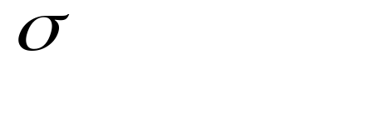
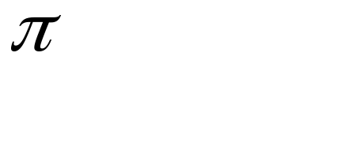



Relational Operations
We will consider how to implement:
  Selection ( ) Selects a subset of rows from relation.
  Projection ( ) Deletes unwanted columns from relation.
  Join ( ) Allows us to combine two relations.
  Set-difference ( ) Tuples in reln. 1, but not in reln. 2.
  Union ( ) Tuples in reln. 1 and in reln. 2.
  Aggregation (SUM, MIN, etc.) and GROUP BY
Since each op returns a relation, ops can be composed! After we cover the operations, we will discuss how to optimize queries formed by composing them.
Notes:
3

Slide 3
Schema for Examples
Sailors (sid: integer, sname: string, rating: integer, age: real)
Reserves (sid: integer, bid: integer, day: dates, rname: string)
Similar to old schema; rname added for variations.
Reserves:
  Each tuple is 40 bytes long, 100 tuples per page, 1000 pages.
Sailors:
  Each tuple is 50 bytes long, 80 tuples per page, 500 pages.
Notes:
4

Slide 4


Equality Joins With One Join Column
SELECT *
FROM Reserves R1, Sailors S1
WHERE R1.sid=S1.sid
In algebra: R S. Common! Must be carefully optimized. R S is large; so, R S followed by a selection is inefficient.
Assume: M tuples in R, p_{R} tuples per page, N tuples in S, p_{S} tuples per page.
  In our examples, R is Reserves and S is Sailors.
We will consider more complex join conditions later.
Cost metric: # of I/Os. We will ignore output costs.
Notes:
5

Slide 5
Simple Nested Loops Join
foreach tuple r in R do
foreach tuple s in S do
if r_{i} == s_{j} then add <r, s> to result
For each tuple in the outer relation R, we scan the entire inner relation S.
  Cost: M + p_{R} * M * N = 1000 + 100*1000*500 I/Os.
Page-oriented Nested Loops join: For each page of R, get each page of S, and write out matching pairs of tuples <r, s>, where r is in R-page and S is in S-page.
  Cost: M + M*N = 1000 + 1000*500
  If smaller relation (S) is outer, cost = 500 + 500*1000
Notes:
6
Page-oriented Nested Loops join: 3개의 버퍼 페이지들이 사용된다고 가정하면 될 듯.

Slide 6
Index Nested Loops Join
foreach tuple r in R do
foreach tuple s in S where r_{i} == s_{j} do
add <r, s> to result
If there is an index on the join column of one relation (say S), can make it the inner and exploit the index.
  Cost: M + ( (M*p_{R}) * cost of finding matching S tuples)
For each R tuple, cost of probing S index is about 1.2 for hash index, 2-4 for B+ tree. Cost of then finding S tuples (assuming Alt. (2) or (3) for data entries) depends on clustering.
  Clustered index: 1 I/O (typical), unclustered: upto 1 I/O per matching S tuple.

Slide 7
Examples of Index Nested Loops
Hash-index (Alt. 2) on sid of Sailors (as inner):
  Scan Reserves: 1000 page I/Os, 100*1000 tuples.
  For each Reserves tuple: 1.2 I/Os to get data entry in index, plus 1 I/O to get (the exactly one) matching Sailors tuple. Total: 220,000 I/Os.
Hash-index (Alt. 2) on sid of Reserves (as inner):
  Scan Sailors: 500 page I/Os, 80*500 tuples.
  For each Sailors tuple: 1.2 I/Os to find index page with data entries, plus cost of retrieving matching Reserves tuples. Assuming uniform distribution, 2.5 reservations per sailor (100,000 / 40,000). Cost of retrieving them is 1 or 2.5 I/Os depending on whether the index is clustered.
Notes:
8

Slide 8
Block Nested Loops Join
Use one page as an input buffer for scanning the inner S, one page as the output buffer, and use all remaining pages to hold ``block’’ of outer R.
  For each matching tuple r in R-block, s in S-page, add <r, s> to result. Then read next R-block, scan S, etc.
R & S
Join Result
Hash table for block of R
(k < B-1 pages)
. . .
. . .
. . .
Input buffer for S
Output buffer
Notes:
9

Slide 9
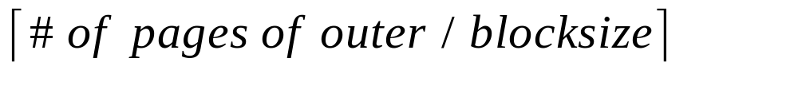
Examples of Block Nested Loops
Cost: Scan of outer + #outer blocks * scan of inner
  #outer blocks =
With Reserves (R) as outer, and 100 pages of R:
  Cost of scanning R is 1000 I/Os; a total of 10 blocks.
  Per block of R, we scan Sailors (S); 10*500 I/Os.
  If space for just 90 pages of R, we would scan S 12 times.
With 100-page block of Sailors as outer:
  Cost of scanning S is 500 I/Os; a total of 5 blocks.
  Per block of S, we scan Reserves; 5*1000 I/Os.
With sequential reads considered, analysis changes: may be best to divide buffers evenly between R and S.
Notes:
With Reserve as Outer: Block size = 100 pages로 가정

Slide 10

Sort-Merge Join (R S)
i=j
Sort R and S on the join column, then scan them to do a ``merge’’ (on join col.), and output result tuples.
  Advance scan of R until current R-tuple >= current S tuple, then advance scan of S until current S-tuple >= current R tuple; do this until current R tuple = current S tuple.
  At this point, all R tuples with same value in Ri (current R group) and all S tuples with same value in Sj (current S group) match; output <r, s> for all pairs of such tuples.
  Then resume scanning R and S.
R is scanned once; each S group is scanned once per matching R tuple. (Multiple scans of an S group are likely to find needed pages in buffer.)
Notes:
11

Slide 11
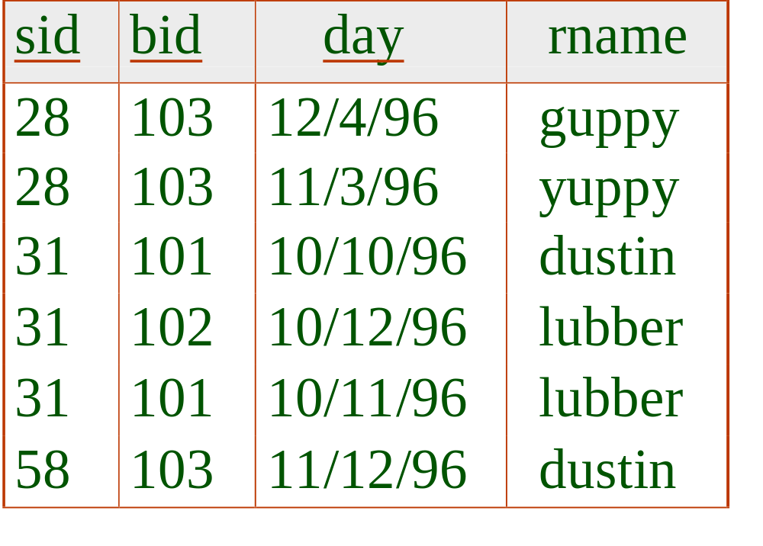
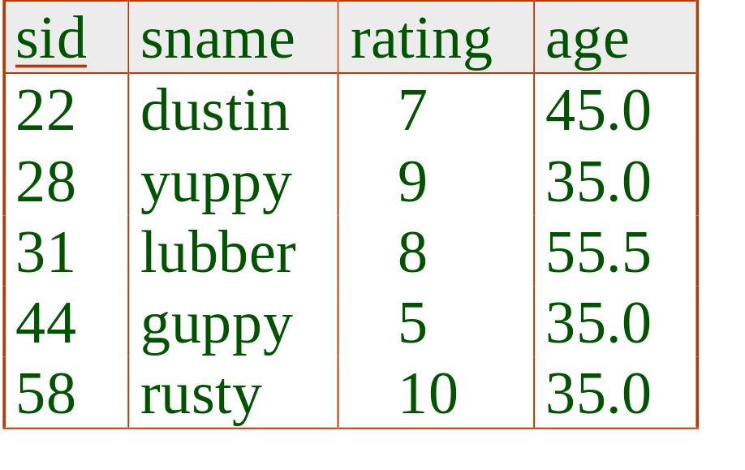
Example of Sort-Merge Join
Cost: M log M + N log N + (M+N)
  The cost of scanning, M+N, could be M*N (very unlikely!)
With 35, 100 or 300 buffer pages, both Reserves and Sailors can be sorted in 2 passes; total join cost: 7500.
(BNL cost: 2500 to 15000 I/Os)
Notes:
12
Merge 비용만 고려하면 대개 M + N

Slide 12
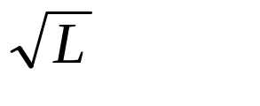
Refinement of Sort-Merge Join
We can combine the merging phases in the sorting of R and S with the merging required for the join.
  With B > , where L is the size of the larger relation, using the sorting refinement that produces runs of length 2B in Pass 0, #runs of each relation is < B/2.
  Allocate 1 page per run of each relation, and `merge’ while checking the join condition.
  Cost: read+write each relation in Pass 0 + read each relation in (only) merging pass (+ writing of result tuples).
  In example, cost goes down from 7500 to 4500 I/Os.
In practice, cost of sort-merge join, like the cost of external sorting, is linear.
Notes:
13

Slide 13
Hash-Join
Original
Relation
OUTPUT
Partitions
1
Partition both relations using hash fn h: R tuples in partition i will only match S tuples in partition i.
1
INPUT
2
hash
function
h
2
. . .
B-1
B-1
Disk
B main memory buffers
Disk
Partitions
of R & S
Join Result
Read in a partition of R, hash it using h2 (<> h!). Scan matching partition of S, search for matches.
Hash table for partition
Ri (k < B-1 pages)
hash
fn
h2
h2
Input buffer
for Si
Output
buffer
Disk
B main memory buffers
Disk
Notes:
14

Slide 14
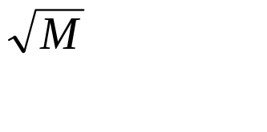
Observations on Hash-Join
#partitions k < B-1 (why?), and B-2 > size of largest partition to be held in memory. Assuming uniformly sized partitions, and maximizing k, we get:
  k= B-1, and M/(B-1) < B-2, i.e., B must be >
If we build an in-memory hash table to speed up the matching of tuples, a little more memory is needed.
If the hash function does not partition uniformly, one or more R partitions may not fit in memory. Can apply hash-join technique recursively to do the join of this R-partition with corresponding S-partition.
Notes:
15

Slide 15
Cost of Hash-Join
In partitioning phase, read+write both relns; 2(M+N). In matching phase, read both relns; M+N I/Os.
In our running example, this is a total of 4500 I/Os.
Sort-Merge Join vs. Hash Join:
  Given a minimum amount of memory (what is this, for each?) both have a cost of 3(M+N) I/Os. Hash Join superior on this count if relation sizes differ greatly. Also, Hash Join shown to be highly parallelizable.
  Sort-Merge less sensitive to data skew; result is sorted.
Notes:
16

Slide 16
General Join Conditions
Equalities over several attributes (e.g., R.sid=S.sid AND R.rname=S.sname):
  For Index NL, build index on <sid, sname> (if S is inner); or use existing indexes on sid or sname.
  For Sort-Merge and Hash Join, sort/partition on combination of the two join columns.
Inequality conditions (e.g., R.rname < S.sname):
  For Index NL, need (clustered!) B+ tree index.
    Range probes on inner; # matches likely to be much higher than for equality joins.
  Hash Join, Sort Merge Join not applicable.
  Block NL quite likely to be the best join method here.

