Slide 1
Relational Algebra
Chapter 4, Part A
Notes:
1
The slides for this text are organized into chapters. This lecture covers relational algebra, from Chapter 4. The relational calculus part can be found in Chapter 4, Part B.
Examples are used extensively. The text and chapter exercises contain numerous additional examples, and I often ask students to do several of these as assignments.
This material is important for two reasons:
It is a foundation for SQL. This is an important reason to cover algebra in detail, but the discussion of SQL in the book does NOT depend on a detailed understanding of algebra. Instructors who prefer to explain the basic algebra operators and skip the discussion of how to write a wide range of queries in algebra can safely do so.
It is a foundation for query processing. Students need to know what each operator does, and how they can be composed in queries. Again, it is possible to skip a detailed discussion of how to write complex queries in algebra, and this is left to the instructor’s discretion.

Slide 2
Relational Query Languages
Query languages: Allow manipulation and retrieval of data from a database.
Relational model supports simple, powerful QLs:
  Strong formal foundation based on logic.
  Allows for much optimization.
Query Languages != programming languages!
  QLs not expected to be “Turing complete”.
  QLs not intended to be used for complex calculations.
  QLs support easy, efficient access to large data sets.
Notes:
2

Slide 3
Formal Relational Query Languages
Two mathematical Query Languages form the basis for “real” languages (e.g. SQL), and for implementation:
  Relational Algebra: More operational, very useful for representing execution plans.
  Relational Calculus: Lets users describe what they want, rather than how to compute it. (Non-operational, declarative.)

Slide 4
Preliminaries
A query is applied to relation instances, and the result of a query is also a relation instance.
  Schemas of input relations for a query are fixed (but query will run regardless of instance!)
  The schema for the result of a given query is also fixed! Determined by definition of query language constructs.
Positional vs. named-field notation:
  Positional notation easier for formal definitions, named-field notation more readable.
  Both used in SQL
Notes:
4

Slide 5
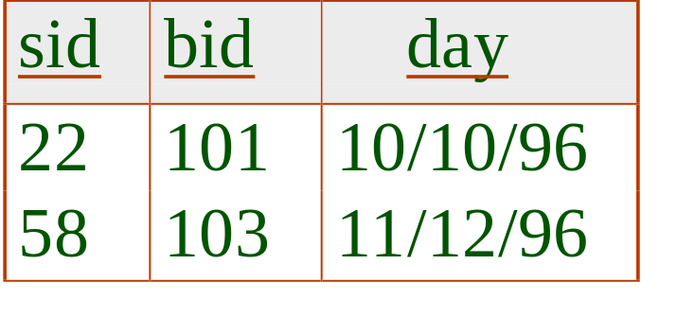
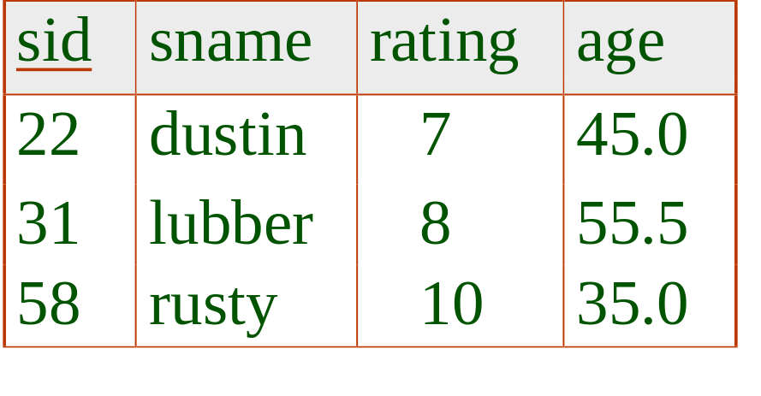
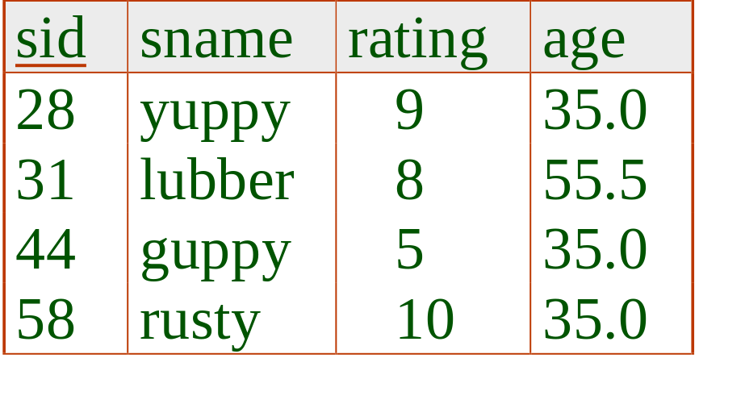
Example Instances
R1
“Sailors” and “Reserves” relations for our examples.
We’ll use positional or named field notation, assume that names of fields in query results are `inherited’ from names of fields in query input relations.
S1
S2
Notes:
5
책의 스키마를 보여줄 것: p101

Slide 6
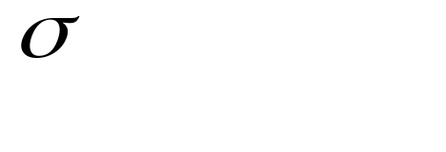
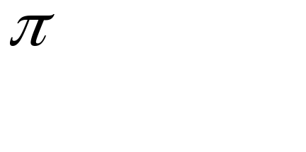



Relational Algebra
Basic operations:
  Selection ( ) Selects a subset of rows from relation.
  Projection ( ) Deletes unwanted columns from relation.
  Cross-product ( ) Allows us to combine two relations.
  Set-difference ( ) Tuples in reln. 1, but not in reln. 2.
  Union ( ) Tuples in reln. 1 and in reln. 2.
Additional operations:
  Intersection, join, division, renaming: Not essential, but (very!) useful.
Since each operation returns a relation, operations can be composed! (Algebra is “closed”.)
Notes:
6

Slide 7
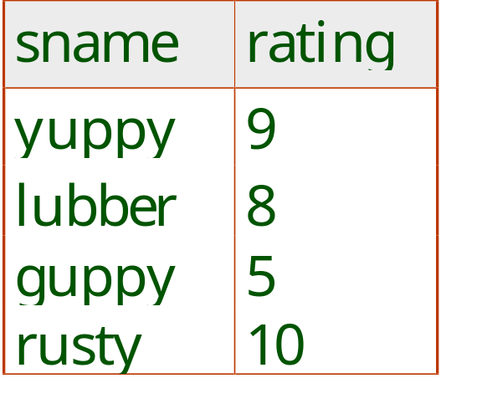
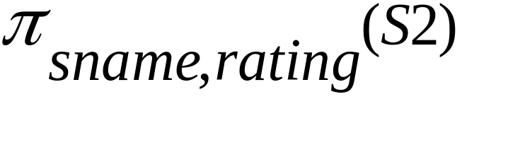
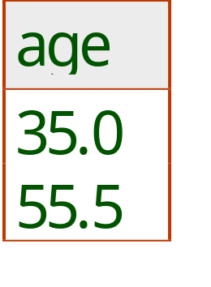
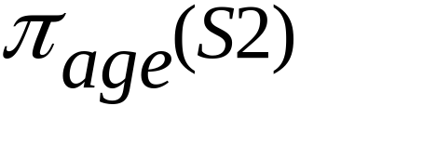
Projection
Deletes attributes that are not in projection list.
Schema of result contains exactly the fields in the projection list, with the same names that they had in the (only) input relation.
Projection operator has to eliminate duplicates! (Why??)
  Note: real systems typically don’t do duplicate elimination unless the user explicitly asks for it. (Why not?)
Notes:
7

Slide 8
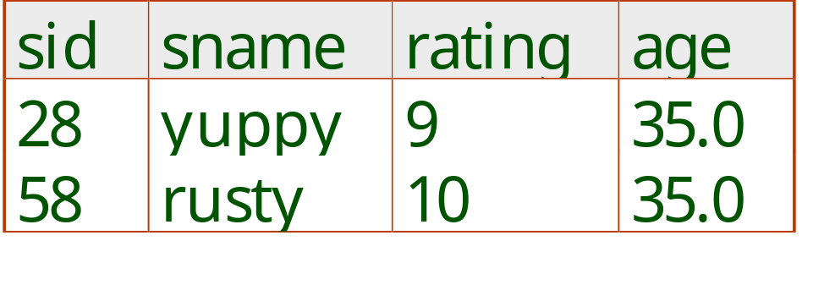
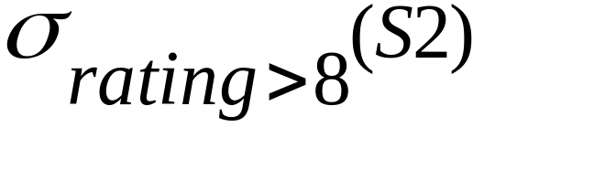
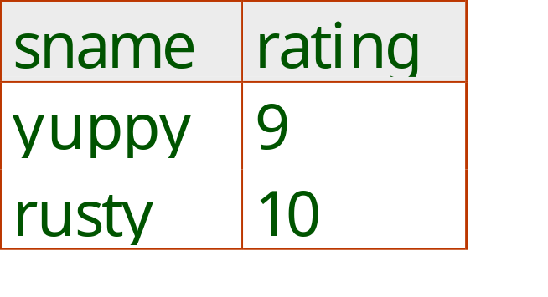
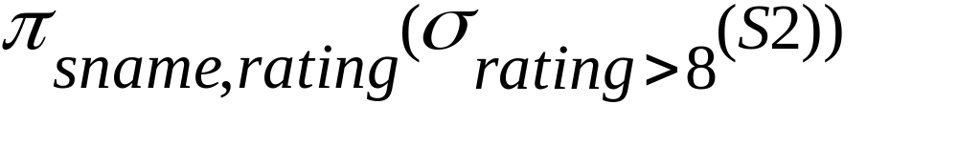
Selection
Selects rows that satisfy selection condition.
No duplicates in result! (Why?)
Schema of result identical to schema of (only) input relation.
Result relation can be the input for another relational algebra operation! (Operator composition.)
Notes:
8

Slide 9
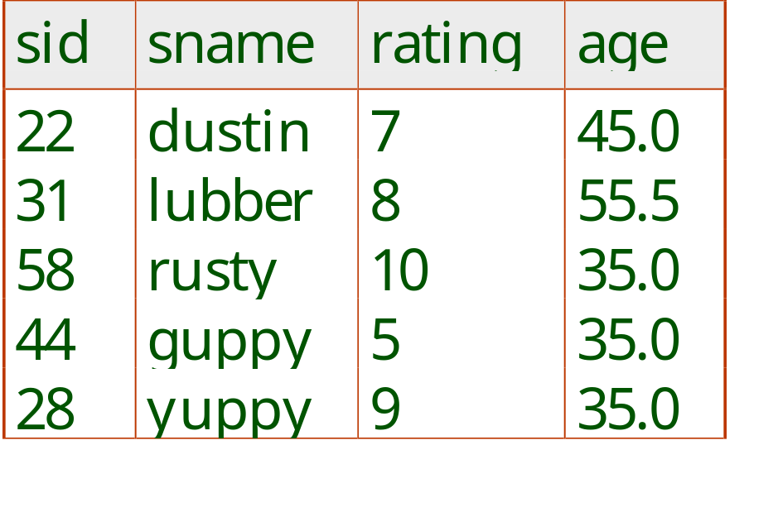
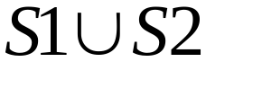
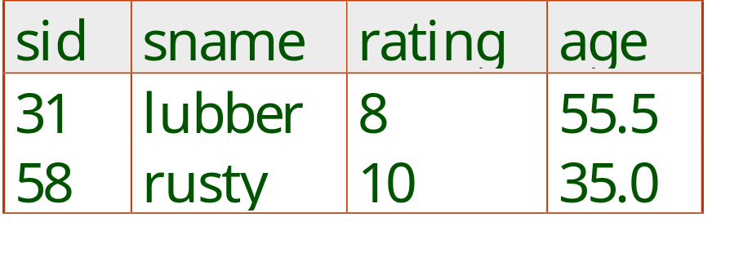
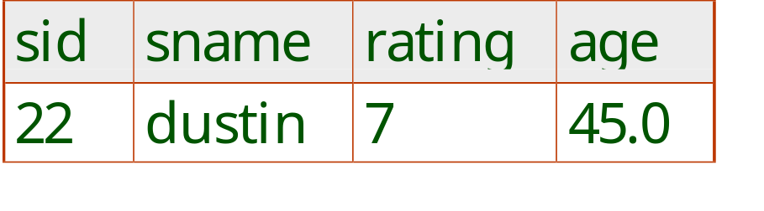

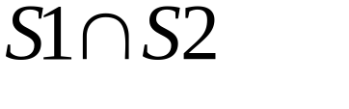
Union, Intersection, Set-Difference
All of these operations take two input relations, which must be union-compatible:
  Same number of fields.
  `Corresponding’ fields have the same type.
What is the schema of result?
Notes:
9

Slide 10
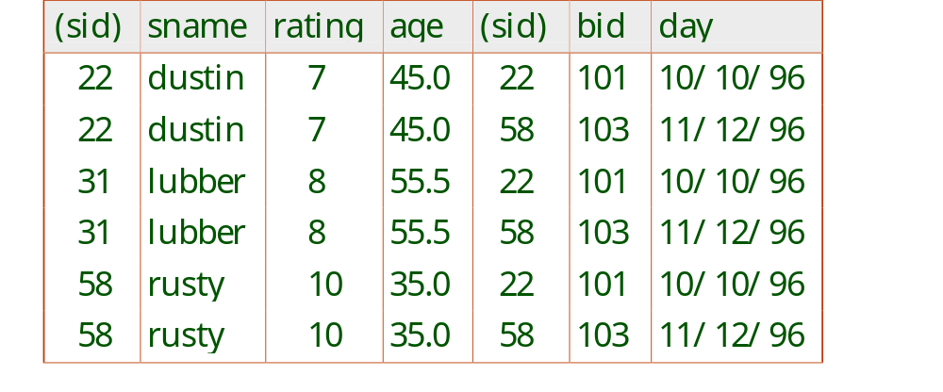
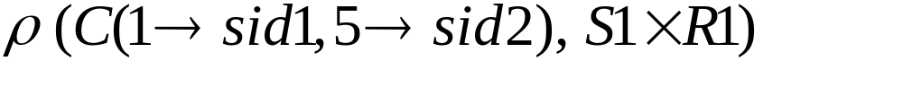
Cross-Product
Each row of S1 is paired with each row of R1.
Result schema has one field per field of S1 and R1, with field names `inherited’ if possible.
  Conflict: Both S1 and R1 have a field called sid.
Renaming operator:
Notes:
10
위의 Renaming Operator : S1 X R1의 결과를 C로 변환. 단 첫번째 field명 → sid1 …. Etc.

Slide 11
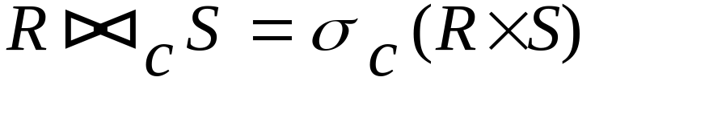
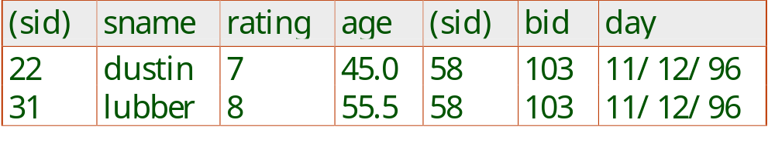
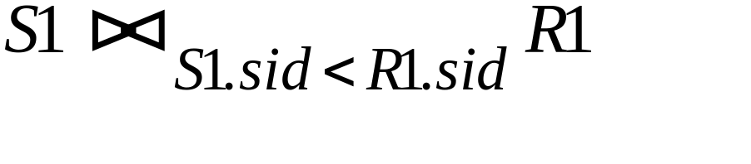
Joins
Condition Join:
Result schema same as that of cross-product.
Fewer tuples than cross-product, might be able to compute more efficiently
Sometimes called a theta-join.
Notes:
11

Slide 12
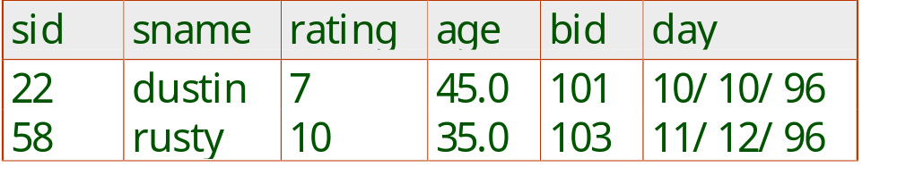
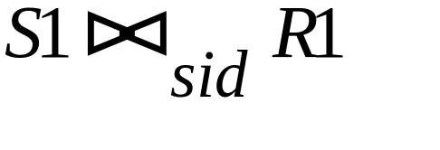
Joins
Equi-Join: A special case of condition join where the condition c contains only equalities.
Result schema similar to cross-product, but only one copy of fields for which equality is specified.
Natural Join: Equijoin on all common fields.
Notes:
12
Natural Join with no common attributes == Cross Product

Slide 13
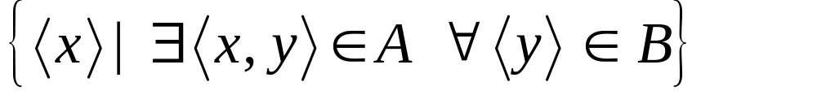

Division
Not supported as a primitive operator, but useful for expressing queries like: Find sailors who have reserved all boats.
Let A have 2 fields, x and y; B have only field y:
  A/B =
  i.e., A/B contains all x tuples (sailors) such that for every y tuple (boat) in B, there is an xy tuple in A.
  Or: If the set of y values (boats) associated with an x value (sailor) in A contains all y values in B, the x value is in A/B.
In general, x and y can be any lists of fields; y is the list of fields in B, and x y is the list of fields of A.
Notes:
13

Slide 14
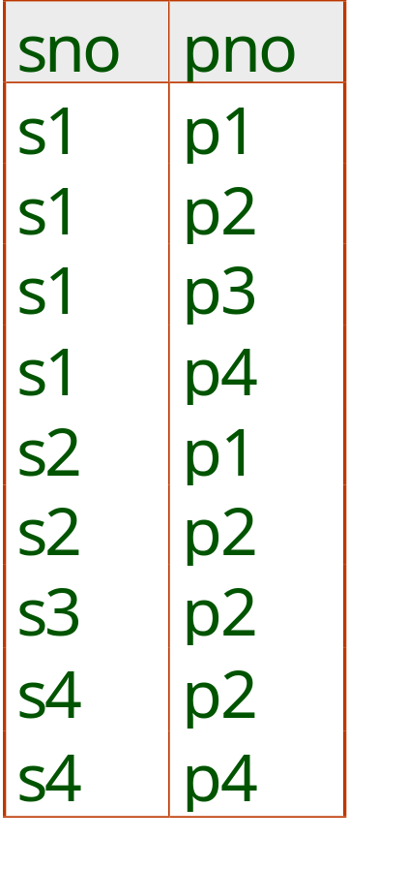
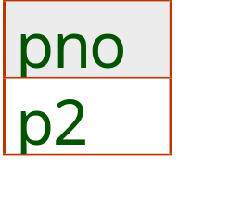
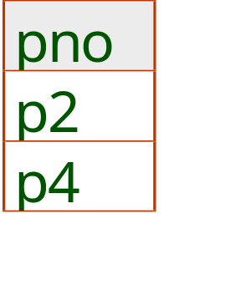
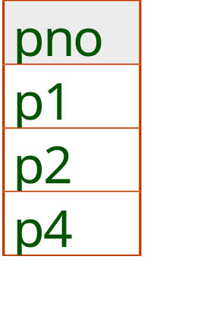
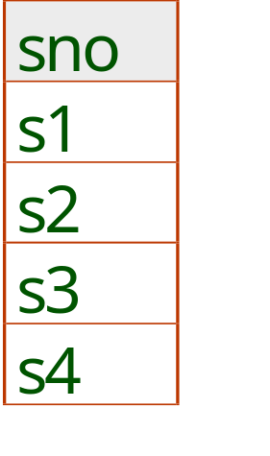
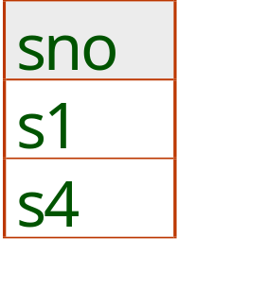
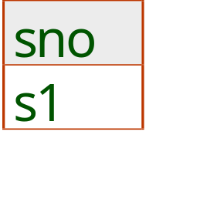
Examples of Division A/B
B1
B2
B3
A
A/B1
A/B2
A/B3
Notes:
14

Slide 15
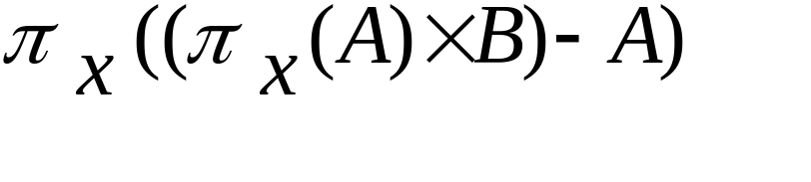
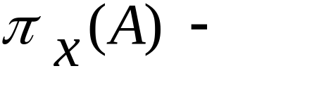
Expressing A/B Using Basic Operators
Division is not essential op; just a useful shorthand.
  (Also true of joins, but joins are so common that systems implement joins specially.)
Idea: For A/B, compute all x values that are not `disqualified’ by some y value in B.
  x value is disqualified if by attaching y value from B, we obtain an xy tuple that is not in A.
  Disqualified x values:
A/B:
all disqualified tuples
Notes:
15

Slide 16
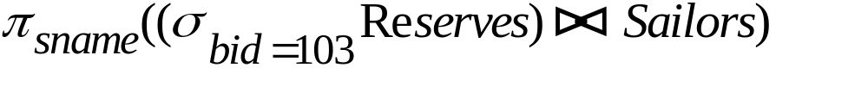
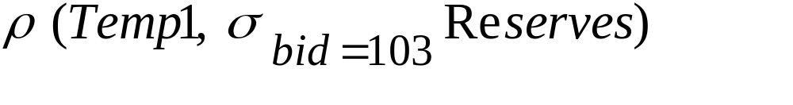
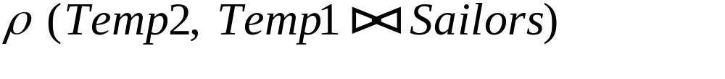
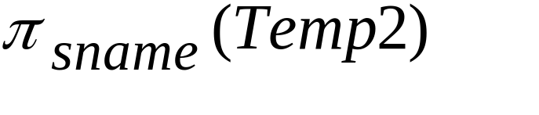
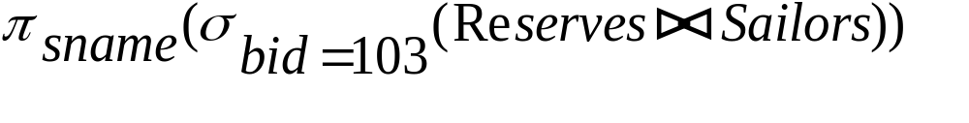
Find names of sailors who’ve reserved boat #103
Solution 1:
Solution 2:
Solution 3:
Notes:
16

Slide 17
Find names of sailors who’ve reserved a red boat
Information about boat color only available in Boats; so need an extra join:
A more efficient solution:
A query optimizer can find this, given the first solution!
Notes:
17
책의 예제도 추가적으로 설명할 것. 학생들에게 직접 만들어 보도록 유도.

Slide 18
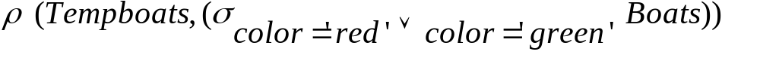
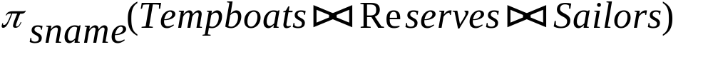


Find sailors who’ve reserved a red or a green boat
Can identify all red or green boats, then find sailors who’ve reserved one of these boats:
Can also define Tempboats using union! (How?)
What happens if is replaced by in this query?
Notes:
18

Slide 19
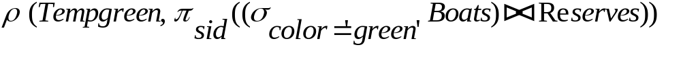
Find sailors who’ve reserved a red and a green boat
Previous approach won’t work! Must identify sailors who’ve reserved red boats, sailors who’ve reserved green boats, then find the intersection (note that sid is a key for Sailors):
Notes:
19

Slide 20
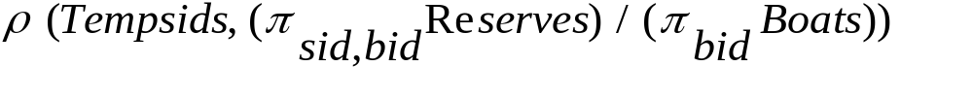
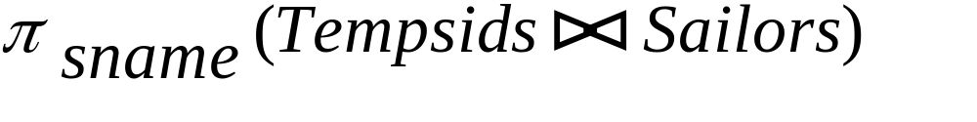
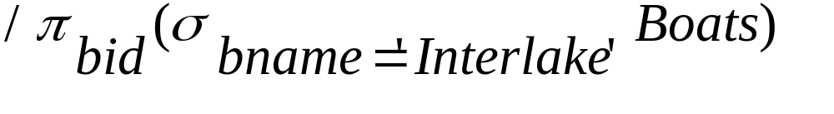
Find the names of sailors who’ve reserved all boats
Uses division; schemas of the input relations to / must be carefully chosen:
To find sailors who’ve reserved all ‘Interlake’ boats:
.....
Notes:
20

Slide 21
Summary
The relational model has rigorously defined query languages that are simple and powerful.
Relational algebra is more operational; useful as internal representation for query evaluation plans.
Several ways of expressing a given query; a query optimizer should choose the most efficient version.

