Slide 1
Overview of Storage and Indexing
Chapter 8
“How index-learning turns no student pale
Yet holds the eel of science by the tail.”
-- Alexander Pope (1688-1744)
Notes:
1
The slides for this text are organized into chapters. This lecture covers Chapter 8.
Chapter 1: Introduction to Database Systems
Chapter 2: The Entity-Relationship Model
Chapter 3: The Relational Model
Chapter 4 (Part A): Relational Algebra
Chapter 4 (Part B): Relational Calculus
Chapter 5: SQL: Queries, Programming, Triggers
Chapter 6: Query-by-Example (QBE)
Chapter 7: Storing Data: Disks and Files
Chapter 8: File Organizations and Indexing
Chapter 9: Tree-Structured Indexing
Chapter 10: Hash-Based Indexing
Chapter 11: External Sorting
Chapter 12 (Part A): Evaluation of Relational Operators
Chapter 12 (Part B): Evaluation of Relational Operators: Other Techniques
Chapter 13: Introduction to Query Optimization
Chapter 14: A Typical Relational Optimizer
Chapter 15: Schema Refinement and Normal Forms
Chapter 16 (Part A): Physical Database Design
Chapter 16 (Part B): Database Tuning
Chapter 17: Security
Chapter 18: Transaction Management Overview
Chapter 19: Concurrency Control
Chapter 20: Crash Recovery
Chapter 21: Parallel and Distributed Databases
Chapter 22: Internet Databases
Chapter 23: Decision Support
Chapter 24: Data Mining
Chapter 25: Object-Database Systems
Chapter 26: Spatial Data Management
Chapter 27: Deductive Databases
Chapter 28: Additional Topics

Slide 2
Data on External Storage
Disks: Can retrieve random page at fixed cost
  But reading several consecutive pages is much cheaper than reading them in random order
Tapes: Can only read pages in sequence
  Cheaper than disks; used for archival storage
File organization: Method of arranging a file of records on external storage.
  Record id (rid) is sufficient to physically locate record
  Indexes are data structures that allow us to find the record ids of records with given values in index search key fields
Architecture: Buffer manager stages pages from external storage to main memory buffer pool. File and index layers make calls to the buffer manager.
Notes:
Disk 설명: 9장 ppt의 4-7참조
SSD 정보 포함해야.
http://www.versiondaily.com/ssd-advantages-disadvantages-solid-state-drive/
SSD vs Hard disk 검색, image 검색도 도움이 됨.
InnoDB page Structure : https://dev.mysql.com/doc/internals/en/innodb-page-structure.html
Page : 16KB, 가장 보편적인 leaf page만 고려

Slide 3
Alternative File Organizations
Many alternatives exist, each ideal for some situations, and not so good in others:
  Heap (random order) files: Suitable when typical access is a file scan retrieving all records.
  Sorted Files: Best if records must be retrieved in some order, or only a `range’ of records is needed.
  Indexes: Data structures to organize records via trees or hashing.
    Like sorted files, they speed up searches for a subset of records, based on values in certain (“search key”) fields
    Updates are much faster than in sorted files.
Heap Index File 검색 후 이미지 확인해서 예제 보일 것.
Notes:
2
Heap Index File 검색 후 이미지 확인해서 예제 보일 것.

Slide 4
Indexes
An index on a file speeds up selections on the search key fields for the index.
  Any subset of the fields of a relation can be the search key for an index on the relation.
  Search key is not the same as key (minimal set of fields that uniquely identify a record in a relation).
An index contains a collection of data entries, and supports efficient retrieval of all data entries k* with a given key value k.
Notes:
7
Data entry의 정의: data entry k* contains enough information to locate (one or more) data records with search key k.

Slide 5
Alternatives for Data Entry k* in Index
Three alternatives:
  Data record with key value k
  <k, rid of data record with search key value k>
  <k, list of rids of data records with search key k>
Choice of alternative for data entries is orthogonal to the indexing technique used to locate data entries with a given key value k.
  Examples of indexing techniques: B+ trees, hash-based structures
  Typically, index contains auxiliary information that directs searches to the desired data entries
Notes:
8
Wiki: hash table 검색. Phone book의 예제를 사용.

Slide 6
Alternatives for Data Entries (Contd.)
Alternative 1:
  If this is used, index structure is a file organization for data records (instead of a Heap file or sorted file).
  At most one index on a given collection of data records can use Alternative 1. (Otherwise, data records are duplicated, leading to redundant storage and potential inconsistency.)
  If data records are very large, # of pages containing data entries is high. Implies size of auxiliary information in the index is also large, typically.
Notes:
9

Slide 7
Alternatives for Data Entries (Contd.)
Alternatives 2 and 3:
  Data entries typically much smaller than data records. So, better than Alternative 1 with large data records, especially if search keys are small. (Portion of index structure used to direct search, which depends on size of data entries, is much smaller than with Alternative 1.)
  Alternative 3 more compact than Alternative 2, but leads to variable sized data entries even if search keys are of fixed length.
Notes:
10

Slide 8
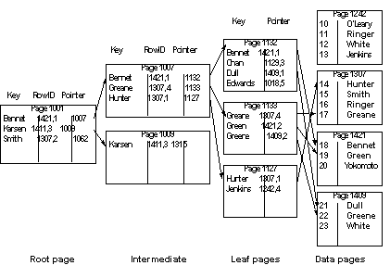

Example of Non clustered index

Slide 9
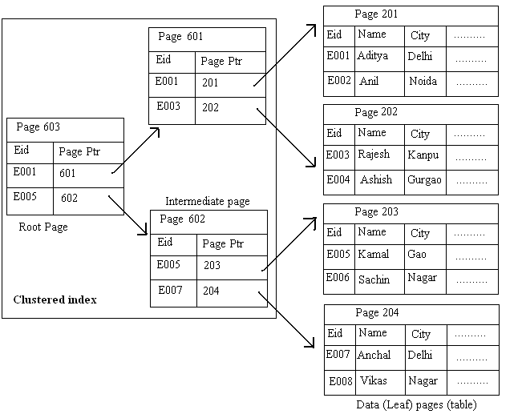
Example of Clustered index

Slide 10
Index Classification
Primary vs. secondary: If search key contains primary key, then called primary index.
  Unique index: Search key contains a candidate key.
Clustered vs. unclustered: If order of data records is the same as, or `close to’, order of data entries, then called clustered index.
  Alternative 1 implies clustered; in practice, clustered also implies Alternative 1 (since sorted files are rare).
  A file can be clustered on at most one search key.
  Cost of retrieving data records through index varies greatly based on whether index is clustered or not!
Notes:
11

Slide 11
Clustered vs. Unclustered Index
Suppose that Alternative (2) is used for data entries, and that the data records are stored in a Heap file.
  To build clustered index, first sort the Heap file (with some free space on each page for future inserts).
  Overflow pages may be needed for inserts. (Thus, order of data recs is `close to’, but not identical to, the sort order.)
Index entries
UNCLUSTERED
CLUSTERED
direct search for
data entries
Data entries
Data entries
(Index File)
(Data file)
Data Records
Data Records
Notes:
12

Slide 12
Hash-Based Indexes
Good for equality selections.
    Index is a collection of buckets. Bucket = primary page plus zero or more overflow pages.
    Hashing function h: h(r) = bucket in which record r belongs. h looks at the search key fields of r.
If Alternative (1) is used, the buckets contain the data records; otherwise, they contain <key, rid> or <key, rid-list> pairs.
Notes:
2
책의 그림이 괜찮음. Hash index 구글링 후 image에서 위의 내용 설명할 것.
http://slideplayer.com/7950645/25/images/53/Example+of+Hash+Index+hash+index+on+instructor%2C+on+attribute+ID.jpg

Slide 13
B+ Tree Indexes
Non-leaf
Pages
Leaf
Pages
Leaf pages contain data entries, and are chained (prev & next)
Non-leaf pages contain index entries and direct searches:
index entry
P
K
P
K
P
K
P
m
0
1
1
2
2
m
Notes:
4
B+ tree visualization 프로그램 있음.
https://www.cs.usfca.edu/~galles/visualization/BPlusTree.html

Slide 14
Example B+ Tree
Root
17
Entries <= 17
Entries > 17
5
13
27
30
2*
3*
5*
7*
8*
14*
16*
22*
24*
27*
29*
33*
34*
38*
39*
Find 28*? 29*? All > 15* and < 30*
Insert/delete: Find data entry in leaf, then change it. Need to adjust parent sometimes.
  And change sometimes bubbles up the tree
Notes:
15

Slide 15
Cost Model for Our Analysis
We ignore CPU costs, for simplicity:
  B: The number of data pages
  R: Number of records per page
  D: (Average) time to read or write disk page
  Measuring number of page I/O’s ignores gains of pre-fetching a sequence of pages; thus, even I/O cost is only approximated.
  Average-case analysis; based on several simplistic assumptions.
  Good enough to show the overall trends!
Notes:
3

Slide 16
Comparing File Organizations
Heap files (random order; insert at eof)
Sorted files, sorted on <age, sal>
Clustered B+ tree file, Alternative (1), search key <age, sal>
Heap file with unclustered B + tree index on search key <age, sal>
Heap file with unclustered hash index on search key <age, sal>

Slide 17
Operations to Compare
Scan: Fetch all records from disk
Equality search
Range selection
Insert a record
Delete a record

Slide 18
Assumptions in Our Analysis
Heap Files:
  Equality selection on key; exactly one match.
Sorted Files:
  Files compacted after deletions.
Indexes:
  Alt (2), (3): data entry size = 10% size of record
  Hash: No overflow buckets.
    80% page occupancy => File size = 1.25 data size
  Tree: 67% occupancy (this is typical).
    Implies file size = 1.5 data size
Notes:
4
Alt (2), (3) : data entry size = 10% size of record 의 의미: 페이지 당 data entry 수가 페이지 당 data record의 수의 10배.

Slide 19
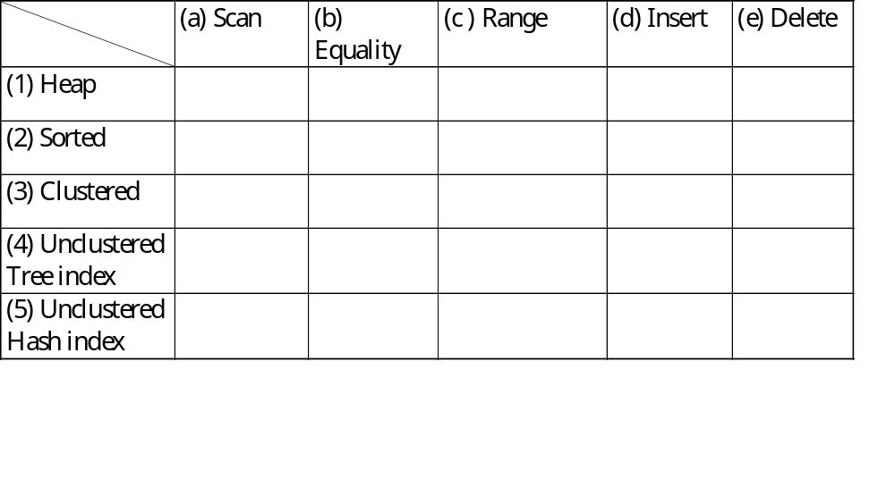
Cost of Operations
Several assumptions underlie these (rough) estimates!
Notes:
5

Slide 20
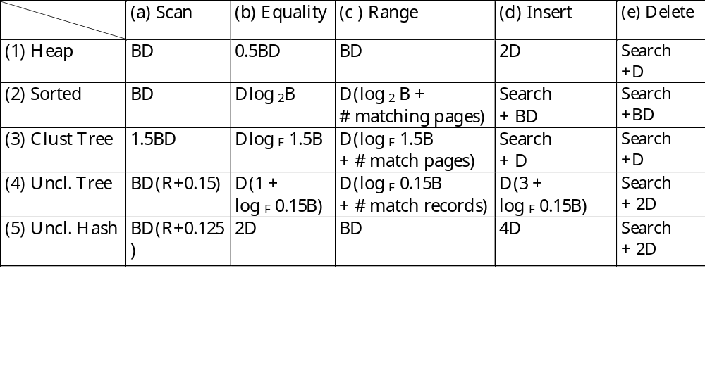
Cost of Operations
Several assumptions underlie these (rough) estimates!
Notes:
5
위의 ppt 내용의 일부 수치는 책의 설명에 기초해서 수정했음.
(4)(a) = (모든 data entry page 읽는 비용) + (모든 data entry에 대해 data page read cost) = (# of data entry pages) + RB*D
= (# of data records * 1.5 / 10R ) * D + RB*D
= (전체 data entry의 수 / 페이지 당 data entry의 수)
= (BR * 0.15 / R)*D + RB* D = 0.15BD + RBD // *1.5 → 0.5 만큼 빈 엔트리 가정, 10R → 페이지 당 레코드 수가 10배로 증가
(4)(b) 트리 검색 비용 + 데이터 페이지 접근 비용 = logF(데이터 엔트리 페이지 수) * D + D = logF(BR*1.5/10R) * D + D
(4)(d) 트리 검색 비용 + 데이터 페이지 접근 비용 + 데이터 페이지 write 비용 + 데이터 entry 페이지 write 비용
(4)(e)의 Search 비용 = (4)(b)의 Equality Selection 비용
(5)(a) (모든 data entry 페이지 읽는 비용) + (모든 data entry에 대해 data page 읽는 비용) = (BR*1.25/10R)*D + BR*D
==========================================================================================
**** 계산 설명 후 그림으로 정리할 것.
Range(더미?) 연산에서는 clus tree가 최고 (unclud tree는 records를 매칭시키는데 엄청 많기 때문에 문제)
Hash 는 equalit가 제일 좋고, uncluster tree에서는

Slide 21
Understanding the Workload
For each query in the workload:
  Which relations does it access?
  Which attributes are retrieved?
  Which attributes are involved in selection/join conditions? How selective are these conditions likely to be?
For each update in the workload:
  Which attributes are involved in selection/join conditions? How selective are these conditions likely to be?
  The type of update (INSERT/DELETE/UPDATE), and the attributes that are affected.
Notes:
11
Workload : 다양한 정의들이 가능, 이를 통해 무엇을 얻고자 하는가가 중요.
the true workload of a database can be analyzed by determining the number of queries executed by the database in a given period of time, or the average number of queries being executed at a particular instant of time.
Simply, the workload would be all of the SQL statements that have been submitted to the instance to work on.

Slide 22
Choice of Indexes
What indexes should we create?
  Which relations should have indexes? What field(s) should be the search key? Should we build several indexes?
For each index, what kind of an index should it be?
  Clustered? Hash/tree?
Notes:
12

Slide 23
Choice of Indexes (Contd.)
One approach: Consider the most important queries in turn. Consider the best plan using the current indexes, and see if a better plan is possible with an additional index. If so, create it.
  Obviously, this implies that we must understand how a DBMS evaluates queries and creates query evaluation plans!
  For now, we discuss simple 1-table queries.
Before creating an index, must also consider the impact on updates in the workload!
  Trade-off: Indexes can make queries go faster, updates slower. Require disk space, too.
Notes:
13

Slide 24
Index Selection Guidelines
Attributes in WHERE clause are candidates for index keys.
  Exact match condition suggests hash index.
  Range query suggests tree index.
    Clustering is especially useful for range queries; can also help on equality queries if there are many duplicates.
Multi-attribute search keys should be considered when a WHERE clause contains several conditions.
  Order of attributes is important for range queries.
  Such indexes can sometimes enable index-only strategies for important queries.
    For index-only strategies, clustering is not important!
Try to choose indexes that benefit as many queries as possible. Since only one index can be clustered per relation, choose it based on important queries that would benefit the most from clustering.
Notes:
14

Slide 25
Examples of Clustered Indexes
SELECT E.dno
FROM Emp E
WHERE E.age>40
B+ tree index on E.age can be used to get qualifying tuples.
  How selective is the condition?
  Is the index clustered?
Consider the GROUP BY query.
  If many tuples have E.age > 10, using E.age index and sorting the retrieved tuples may be costly.
  Clustered E.dno index may be better!
Equality queries and duplicates:
  Clustering on E.hobby helps!
SELECT E.dno, COUNT (*)
FROM Emp E
WHERE E.age>10
GROUP BY E.dno
SELECT E.dno
FROM Emp E
WHERE E.hobby=Stamps
Notes:
18
일반적인 이슈
===========
클러스터드 인덱스 – sorted file보다는 낫지만 유지비용이 큼. 삽입, 삭제 시 순서를 유지해야 함.
클러스터드 인덱스에 대해 Rid를 통한 접근 구현의 경우. 레코드의 이동 등의 이유로 Rid의 변경은 다른 인덱스들에도 반영되어야.
예제1
======
Age > 40 조건의 레코드들이 많지 않다면 의미 있을 수. 많을 경우, scan이 나을 수.
많지 않은 경우는 clustered 여부를 고려해야. 가령 10%라 해도, unclustered인 경우 비용이 더 클 수도. 10%인 경우 Clustered라면 대략 스캔의 10%의 비용
예제2
======
실행계획 예상해보면, age > 10, 후 sorting 그리고 각 그룹 마다 count하는 정도
Age에 대한 인덱스는 별 도움이 되지 않을 듯. 대부분이 조건을 만족.
Group by의 효과는 tree index 또는 hashing으로 처리 가능
그러나 uncl. index는 data page의 접근을 통해 age > 0을 평가해야 하므로 비용이 클 수도.
따라서 dno에 clustered index를 사용하는 것도 최적. Alt1)을 전제 Data record들에 직접 접근이 가능하므로 age > 10 인 경우만을 count하면 됨.
만일 age >0 이 매우 selective하다면 이에 대해 unclust/clust. index를 고려할 수도.
예제3
======
Stamps가 취미인 경우, 많은 중복이 예상. 따라서 unclustered index 보다는 scan이 나을 듯.
Clustered index는 가능.
만일 eid = 552와 같은 조건으로 변경된다면, unclustered index가 답.
예제4
======
- 예제2에서 age >10이 없다면, 추천인덱스는? Dno에 대한 hash 또는 unclustered index로도 충분. 인덱스에 모든 정보가 있음.
------------------------------------------------------------------
우선 Northwind의 Orders와 Order Details의 인덱스 구성을 확인할 것.
-- Clustered Index 사용 예
Select CustomerID From Orders Where OrderID >= 11000
-- 다음 query는 어떤 인덱스를 사용할까?
Select CustomerID From Orders
-- group by 사용 예
select OrderId, count(*) from [Order Details] where Quantity < 5 group by OrderId
-- 가장 주문 빈도가 많았던 제품에 대한 조회: 두 실행계획의 차이는?
select * from [order details] where productid = 59
select orderid from [order details] where productid = 59

Slide 26
Indexes with Composite Search Keys
Composite Search Keys: Search on a combination of fields.
  Equality query: Every field value is equal to a constant value. E.g. wrt <sal,age> index:
    age=20 and sal =75
  Range query: Some field value is not a constant. E.g.:
    age =20; or age=20 and sal > 10
Data entries in index sorted by search key to support range queries.
  Lexicographic order, or
  Spatial order.
Examples of composite key
indexes using lexicographic order.
11,80
11
12,10
12
12,20
name
age
sal
12
13,75
bob
12
10
13
<age, sal>
cal
11
80
<age>
joe
12
20
10,12
sue
13
75
10
20,12
Data records
sorted by name
20
75,13
75
80,11
80
<sal, age>
<sal>
Data entries in index
sorted by <sal,age>
Data entries
sorted by <sal>
Notes:
13
Equality query: <sal, age> 또는 <age, sal> are fine. They could be hash index, too.
Range query: age = 20,

Slide 27
Composite Search Keys
To retrieve Emp records with age=30 AND sal=4000, an index on <age,sal> would be better than an index on age or an index on sal.
  Choice of index key orthogonal to clustering etc.
If condition is: 20<age<30 AND 3000<sal<5000:
  Clustered tree index on <age,sal> or <sal,age> is best.
If condition is: age=30 AND 3000<sal<5000:
  Clustered <age,sal> index much better than <sal,age> index!
Composite indexes are larger, updated more often.
Notes:
20
계속 인덱스 예제
다음 두 queries의 실행계획의 차이
-- select OrderID from Orders where EmployeeID = 4
-- select * from Orders where EmployeeID = 4

Slide 28
Index-Only Plans
SELECT D.mgr
FROM Dept D, Emp E
WHERE D.dno=E.dno
<E.dno>
A number of queries can be answered without retrieving any tuples from one or more of the relations involved if a suitable index is available.
SELECT D.mgr, E.eid
FROM Dept D, Emp E
WHERE D.dno=E.dno
<E.dno,E.eid>
Tree index!
SELECT E.dno, COUNT(*)
FROM Emp E
GROUP BY E.dno
<E.dno>
SELECT E.dno, MIN(E.sal)
FROM Emp E
GROUP BY E.dno
<E.dno,E.sal>
Tree index!
<E. age,E.sal>
or
<E.sal, E.age>
SELECT AVG(E.sal)
FROM Emp E
WHERE E.age=25 AND
E.sal BETWEEN 3000 AND 5000
Tree!
Notes:
21
Dept의 경우 테이블의 사이즈가 작을 것으로 사료. Emp의 데이터 페이지 검색이 필요 없이 E.dno의 검색 키를 갖는 인덱스로 충분
E.dno와 E.eid를 키로 갖는 index entries들을 많을 것으로 사료. Eid는 employee에 유니크하지만 dno는 다수의 employee에 존재. 따라서 하나의 키가 다수의 data enties에 대응. Tree Index일 필요. Hash index라면 동일 dno이나 다른 eid 값의 경우 다른 data entry 페이지에 존재할 수도 worst case eid 개수 만큼의 페이지 접근이 필요
3.

Slide 29
Index-Only Plans (Contd.)
Index-only plans are possible if the key is <dno,age> or we have a tree index with key <age,dno>
  Which is better?
  What if we consider the second query?
SELECT E.dno, COUNT (*)
FROM Emp E
WHERE E.age=30
GROUP BY E.dno
SELECT E.dno, COUNT (*)
FROM Emp E
WHERE E.age>30
GROUP BY E.dno
Notes:
Query 1: index on <age, dno> will be better. <age, dno>의 사용 시 age = 30인 Data entry들을 발견. 이때 이들 data entry들은 이미 dno로 정렬됨.
만일 index on <dno, age>를 사용한다면 data entry 페이지들은 dno를 우선으로 정렬되어 있으나 동일한 dno의 경우 age =300인 것들을 추출해야함.
전체 data entry page들을 읽어야 함.
Query 2: <age, dno>의 사용 시 age > 30인 data entry 페이지들이 순차적으로 발견됨. 이때 각각의 age 값에 대해 dno로 정렬된 data entry들이 반복. 따라서 추가적인
정렬이 필요할 듯(아니면 반복 read가 필요)
<dno, age>의 사용 시 data entry 페이지들이 dno로 정렬됨. 따라서 각 dno에 대해 age > 30을 찾아서 count하면 됨. 이 과정이 다음 dno에 대해 반복. 한번의
순차적인 read로 가능할 듯.

Slide 30
Summary
Many alternative file organizations exist, each appropriate in some situation.
If selection queries are frequent, sorting the file or building an index is important.
  Hash-based indexes only good for equality search.
  Sorted files and tree-based indexes best for range search; also good for equality search. (Files rarely kept sorted in practice; B+ tree index is better.)
Index is a collection of data entries plus a way to quickly find entries with given key values.
Notes:
14

Slide 31
Summary (Contd.)
Data entries can be actual data records, <key, rid> pairs, or <key, rid-list> pairs.
  Choice orthogonal to indexing technique used to locate data entries with a given key value.
Can have several indexes on a given file of data records, each with a different search key.
Indexes can be classified as clustered vs. unclustered, primary vs. secondary, and dense vs. sparse. Differences have important consequences for utility/performance.
Notes:
15

Slide 32
Summary (Contd.)
Understanding the nature of the workload for the application, and the performance goals, is essential to developing a good design.
  What are the important queries and updates? What attributes/relations are involved?
Indexes must be chosen to speed up important queries (and perhaps some updates!).
  Index maintenance overhead on updates to key fields.
  Choose indexes that can help many queries, if possible.
  Build indexes to support index-only strategies.
  Clustering is an important decision; only one index on a given relation can be clustered!
  Order of fields in composite index key can be important.

