Slide 1
Storing Data: Disks and Files
Chapter 7
“Yea, from the table of my memory
I’ll wipe away all trivial fond records.”
-- Shakespeare, Hamlet
Notes:
1
The slides for this text are organized into chapters. This lecture covers Chapter 7.
Chapter 1: Introduction to Database Systems
Chapter 2: The Entity-Relationship Model
Chapter 3: The Relational Model
Chapter 4 (Part A): Relational Algebra
Chapter 4 (Part B): Relational Calculus
Chapter 5: SQL: Queries, Programming, Triggers
Chapter 6: Query-by-Example (QBE)
Chapter 7: Storing Data: Disks and Files
Chapter 8: File Organizations and Indexing
Chapter 9: Tree-Structured Indexing
Chapter 10: Hash-Based Indexing
Chapter 11: External Sorting
Chapter 12 (Part A): Evaluation of Relational Operators
Chapter 12 (Part B): Evaluation of Relational Operators: Other Techniques
Chapter 13: Introduction to Query Optimization
Chapter 14: A Typical Relational Optimizer
Chapter 15: Schema Refinement and Normal Forms
Chapter 16 (Part A): Physical Database Design
Chapter 16 (Part B): Database Tuning
Chapter 17: Security
Chapter 18: Transaction Management Overview
Chapter 19: Concurrency Control
Chapter 20: Crash Recovery
Chapter 21: Parallel and Distributed Databases
Chapter 22: Internet Databases
Chapter 23: Decision Support
Chapter 24: Data Mining
Chapter 25: Object-Database Systems
Chapter 26: Spatial Data Management
Chapter 27: Deductive Databases
Chapter 28: Additional Topics

Slide 2
Disks and Files
DBMS stores information on (“hard”) disks.
This has major implications for DBMS design!
  READ: transfer data from disk to main memory (RAM).
  WRITE: transfer data from RAM to disk.
  Both are high-cost operations, relative to in-memory operations, so must be planned carefully!

Slide 3
Why Not Store Everything in Main Memory?
Costs too much. $1000 will buy you either 128MB of RAM or 7.5GB of disk today.
Main memory is volatile. We want data to be saved between runs. (Obviously!)
Typical storage hierarchy:
  Main memory (RAM) for currently used data.
  Disk for the main database (secondary storage).
  Tapes for archiving older versions of the data (tertiary storage).
Notes:
19

Slide 4
Disks
Secondary storage device of choice.
Main advantage over tapes: random access vs. sequential.
Data is stored and retrieved in units called disk blocks or pages.
Unlike RAM, time to retrieve a disk page varies depending upon location on disk.
  Therefore, relative placement of pages on disk has major impact on DBMS performance!
Notes:
20

Slide 5
Components of a Disk
Spindle
Disk head
Tracks
The platters spin (say, 90rps).
The arm assembly is moved in or out to position a head on a desired track. Tracks under heads make a cylinder (imaginary!).
Sector
Arm movement
Platters
Only one head reads/writes at any one time.
Arm assembly
Block size is a multiple of sector size (which is fixed).
Notes:
21

Slide 6
Accessing a Disk Page
Time to access (read/write) a disk block:
  seek time (moving arms to position disk head on track)
  rotational delay (waiting for block to rotate under head)
  transfer time (actually moving data to/from disk surface)
Seek time and rotational delay dominate.
  Seek time varies from about 1 to 20msec
  Rotational delay varies from 0 to 10msec
  Transfer rate is about 1msec per 4KB page
Key to lower I/O cost: reduce seek/rotation delays! Hardware vs. software solutions?
Notes:
22

Slide 7
Arranging Pages on Disk
`Next’ block concept:
  blocks on same track, followed by
  blocks on same cylinder, followed by
  blocks on adjacent cylinder
Blocks in a file should be arranged sequentially on disk (by `next’), to minimize seek and rotational delay.
For a sequential scan, pre-fetching several pages at a time is a big win!
Notes:
23

Slide 8
RAID
Disk Array: Arrangement of several disks that gives abstraction of a single, large disk.
Goals: Increase performance and reliability.
Two main techniques:
  Data striping: Data is partitioned; size of a partition is called the striping unit. Partitions are distributed over several disks.
  Redundancy: More disks => more failures. Redundant information allows reconstruction of data if a disk fails.

Slide 9
RAID Levels
Level 0: No redundancy
Level 1: Mirrored (two identical copies)
  Each disk has a mirror image (check disk)
  Parallel reads, a write involves two disks.
  Maximum transfer rate = transfer rate of one disk
Level 0+1: Striping and Mirroring
  Parallel reads, a write involves two disks.
  Maximum transfer rate = aggregate bandwidth

Slide 10
RAID Levels (Contd.)
Level 3: Bit-Interleaved Parity
  Striping Unit: One bit. One check disk.
  Each read and write request involves all disks; disk array can process one request at a time.
Level 4: Block-Interleaved Parity
  Striping Unit: One disk block. One check disk.
  Parallel reads possible for small requests, large requests can utilize full bandwidth
  Writes involve modified block and check disk
Level 5: Block-Interleaved Distributed Parity
  Similar to RAID Level 4, but parity blocks are distributed over all disks

Slide 11
Structure of a DBMS
These layers
must consider
concurrency
control and
recovery
A typical DBMS has a layered architecture.
The figure does not show the concurrency control and recovery components.
This is one of several possible architectures; each system has its own variations.
Query Optimization
and Execution
Relational Operators
Files and Access Methods
Buffer Management
Disk Space Management
DB
Notes:
22
1장의 ppt 내용의 일부 화면.

Slide 12
Disk Space Management
Lowest layer of DBMS software manages space on disk.
Higher levels call upon this layer to:
  allocate/de-allocate a page
  read/write a page
Request for a sequence of pages must be satisfied by allocating the pages sequentially on disk! Higher levels don’t need to know how this is done, or how free space is managed.
Notes:
24

Slide 13
Buffer Management in a DBMS
Page Requests from Higher Levels
BUFFER POOL
disk page
free frame
MAIN MEMORY
DISK
choice of frame dictated
by replacement policy
DB
Data must be in RAM for DBMS to operate on it!
Table of <frame#, pageid> pairs is maintained.
Notes:
4
다음 사이트 참조할 것(파일 다운로드했음).
https://michael.bouvy.net/blog/en/2015/01/18/understanding-mysql-innodb-buffer-pool-size/
위의 사이트에서 보이는 주요 query 문들을 사용해서 classicmodels DB의 주요 테이블을 select한 후 결과를 보일 것. Orderdetails의 사용해야 할 듯.
다음 query 활용: select table_name as Table_Name,Block_id,page_Number from information_schema.INNODB_BUFFER_PAGE order by table_name;

Slide 14
When a Page is Requested ...
If requested page is not in pool:
  Choose a frame for replacement
  If frame is dirty, write it to disk
  Read requested page into chosen frame
Pin the page and return its address.
If requests can be predicted (e.g., sequential scans)
pages can be pre-fetched several pages at a time!
Notes:
5

Slide 15
More on Buffer Management
Requestor of page must unpin it, and indicate whether page has been modified:
  dirty bit is used for this.
Page in pool may be requested many times,
  a pin count is used. A page is a candidate for replacement iff pin count = 0.
CC & recovery may entail additional I/O when a frame is chosen for replacement. (Write-Ahead Log protocol; more later.)
Notes:
6

Slide 16
Buffer Replacement Policy
Frame is chosen for replacement by a replacement policy:
  Least-recently-used (LRU), Clock, MRU etc.
Policy can have big impact on # of I/O’s; depends on the access pattern.
Sequential flooding: Nasty situation caused by LRU + repeated sequential scans.
  # buffer frames < # pages in file means each page request causes an I/O. MRU much better in this situation (but not in all situations, of course).
Notes:
7

Slide 17
DBMS vs. OS File System
OS does disk space & buffer mgmt: why not let OS manage these tasks?
Differences in OS support: portability issues
Some limitations, e.g., files can’t span disks.
Buffer management in DBMS requires ability to:
  pin a page in buffer pool, force a page to disk (important for implementing CC & recovery),
  adjust replacement policy, and pre-fetch pages based on access patterns in typical DB operations.
Notes:
8

Slide 18
Record Formats: Fixed Length
F1
F2
F3
F4
L1
L2
L3
L4
Base address (B)
Address = B+L1+L2
Information about field types same for all records in a file; stored in system catalogs.
Finding i’th field requires scan of record.
Notes:
9
두번째 설명은 뒷 장의 윗 부분에 관한 내용.

Slide 19
Record Formats: Variable Length
Two alternative formats (# fields is fixed):
F1 F2 F3 F4
4
$
$
$
$
Fields Delimited by Special Symbols
Field
Count
F1 F2 F3 F4
Array of Field Offsets
Second offers direct access to i’th field, efficient storage
of nulls (special don’t know value); small directory overhead.
Notes:
10
일부 가변길이 필드의 값이 변경되어 커질 경우, 필드의 shift가 필요
수정된 레코드가 free space에 맞지 않는 경우는 다른 페이지에 저장되어야. 이때 rid 문제가 발생 따라서 forward address가 저장될 수 있어야.
가변 길이 레코드 형식(아래쪽)이 고정 길이 레코드에도 사용됨.

Slide 20
Page Formats: Fixed Length Records
Slot 1
Slot 1
Slot 2
Slot 2
. . .
Free
Space
. . .
Slot N
Slot N
Slot M
N
1
. . .
0
1
1
M
number
of records
M ... 3 2 1
number
of slots
PACKED
UNPACKED, BITMAP
Record id = <page id, slot #>. In first alternative, moving records for free space management changes rid; may not be acceptable.
Notes:
11
Packed의 경우: 삭제 시 마지막 레코드를 삭제 위치로 이동. 문제점: 외부 참조되는 경우, 처리가 곤란. 즉 rid가 변경됨.
Unpacked, BitMap의 경우: 삭제 시 bitmap의 해당 비트를 0으로 설정.
대개의 경우 file level의 정보들도 포함:예) next page 정보 …

Slide 21
Page Formats: Variable Length Records
Rid = (i,N)
Page i
Rid = (i,2)
Rid = (i,1)
20
16
24
N
Pointer
to start
of free
space
N . . . 2 1
# slots
SLOT DIRECTORY
Can move records on page without changing rid; so, attractive for fixed-length records too.
Notes:
12
Variable length인 경우, page를 fixed length of slots들로 구분할 수 없음. – insert 시 어떤 경우 공간 낭비, 또는 삽입 불가능
Slot directory의 entry = <record offset, record length>. 경우에 따라 length 정보는 해당 record에서도 표현 가능
Deletion sets offset to -1.
삭제된 레코드를 위한 slot은 당장 삭제는 곤란 → 후속 레코드들의 slot number가 변경되기 때문.
삽입 시 slot directory를 scan해야. 삭제된 record의 slot 발견 시 이를 사용할 수 있음.

Slide 22
From other source
Record structure in MySQL
    https://dev.mysql.com/doc/internals/en/innodb-record-structure.html
    https://blog.jcole.us/2013/01/10/the-physical-structure-of-records-in-innodb
Page structure in MySQL
    https://dev.mysql.com/doc/internals/en/innodb-page-structure.html
    https://blog.jcole.us/2013/01/07/the-physical-structure-of-innodb-index-pages/
    한글버전: http://mysqldba.tistory.com/107
Notes:
수업시간에 사용할 자료:
Record structure의 경우: 첫번째 아티클, 두번째 아티클 약간의 차이가 있음.
Page structure의 경우: 두번째 아티클이 괜찮은 듯

Slide 23
Files of Records
Page or block is OK when doing I/O, but higher levels of DBMS operate on records, and files of records.
FILE: A collection of pages, each containing a collection of records. Must support:
  insert/delete/modify record
  read a particular record (specified using record id)
  scan all records (possibly with some conditions on the records to be retrieved)
Notes:
13

Slide 24
Unordered (Heap) Files
Simplest file structure contains records in no particular order.
As file grows and shrinks, disk pages are allocated and de-allocated.
To support record level operations, we must:
  keep track of the pages in a file
  keep track of free space on pages
  keep track of the records on a page
There are many alternatives for keeping track of this.
Notes:
14
Heap file의 기본 Op: create/destroy file, insert, delete with rid, get record with rid, scan.
이를 위해 위의 3가지 정보들(pages, free space, records)이 필요.

Slide 25
Heap File Implemented as a List
Data
Page
Data
Page
Data
Page
Full Pages
Header
Page
Data
Page
Data
Page
Data
Page
Pages with
Free Space
The header page id and Heap file name must be stored someplace.
Each page contains 2 `pointers’ plus data.
Notes:
15
DBMS는 특정 위치에 <heap_file_name, page_1_addr>로 구성된 테이블을 관리,
각각의 heap file은 그 first page를 header page로 표현. 위의 pointer는 page id.
새로운 page가 필요하면 disk space manager에 요청. 그리고 Pages with Free space에 추가.
단점: 가변 길이 레코드의 경우 대부분의 page에 free space가 존재.
새로운 record 삽입 시 충분한 free space의 page를 찾아야

Slide 26
Heap File Using a Page Directory
Data
Page 1
Header
Page
Data
Page 2
Data
Page N
DIRECTORY
The entry for a page can include the number of free bytes on the page.
The directory is a collection of pages; linked list implementation is just one alternative.
  Much smaller than linked list of all HF pages!
Notes:
16

Slide 27
System Catalogs
For each index:
  structure (e.g., B+ tree) and search key fields
For each relation:
  name, file name, file structure (e.g., Heap file)
  attribute name and type, for each attribute
  index name, for each index
  integrity constraints
For each view:
  view name and definition
Plus statistics, authorization, buffer pool size, etc.
Catalogs are themselves stored as relations!
Notes:
18

Slide 28
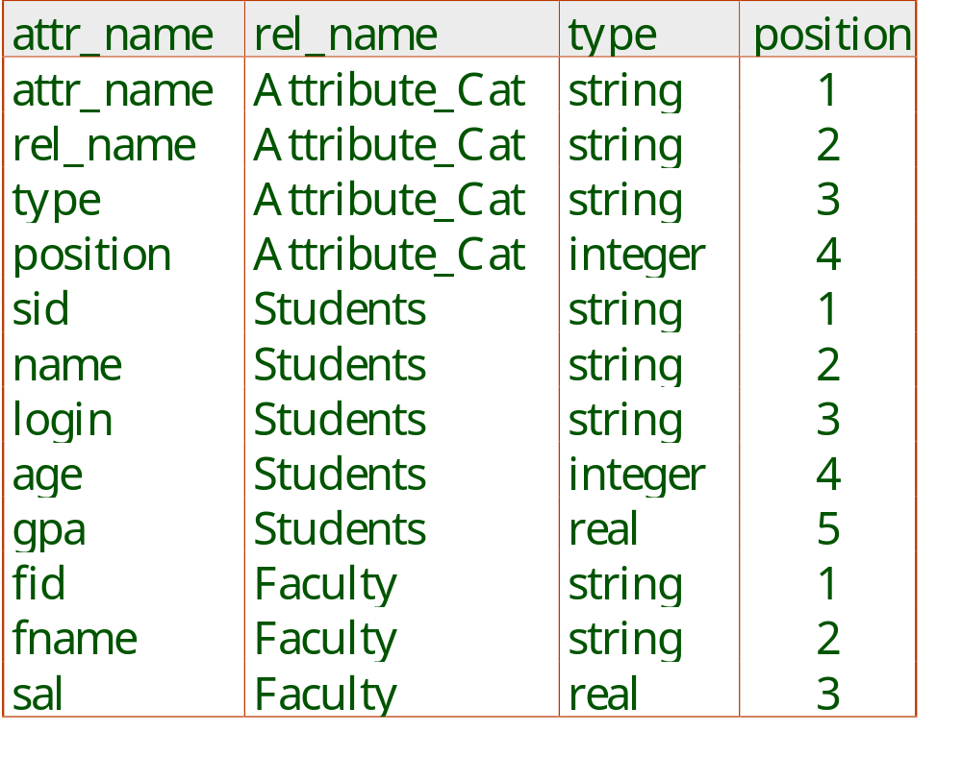
Attr_Cat(attr_name, rel_name, type, position)
Notes:
19

Slide 29
System Catalogs – SQL Server
System Tables
  Should NOT be changed by directly by users.
  Three categories:
    Instance level, Database level, inside MSDB
    http://thomaslarock.com/sql-server-system-tables/
System Views
  Catalog Views – recommended by MS
  ISO standard definition for Information schema
  … and so on. Consult with the following:
    http://msdn.microsoft.com/en-us/library/ms177862.aspx
Notes:
18
Catalog views를 사용할 것을 추천. System tables은 직접 사용하지 말아야 함.

Slide 30
Summary
Disks provide cheap, non-volatile storage.
  Random access, but cost depends on location of page on disk; important to arrange data sequentially to minimize seek and rotation delays.
Buffer manager brings pages into RAM.
  Page stays in RAM until released by requestor.
  Written to disk when frame chosen for replacement (which is sometime after requestor releases the page).
  Choice of frame to replace based on replacement policy.
  Tries to pre-fetch several pages at a time.
Notes:
20

Slide 31
Summary (Contd.)
DBMS vs. OS File Support
  DBMS needs features not found in many OS’s, e.g., forcing a page to disk, controlling the order of page writes to disk, files spanning disks, ability to control pre-fetching and page replacement policy based on predictable access patterns, etc.
Variable length record format with field offset directory offers support for direct access to i’th field and null values.
Slotted page format supports variable length records and allows records to move on page.
Notes:
21

Slide 32
Summary (Contd.)
File layer keeps track of pages in a file, and supports abstraction of a collection of records.
  Pages with free space identified using linked list or directory structure (similar to how pages in file are kept track of).
Indexes support efficient retrieval of records based on the values in some fields.
Catalog relations store information about relations, indexes and views. (Information that is common to all records in a given collection.)
Notes:
22

