Slide 1
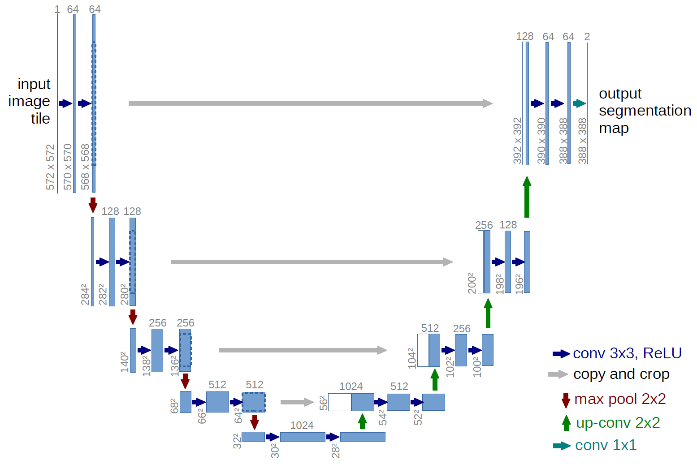
What is U-Net?
U-Net is a fully convolutional network (FCN) that does image segmentation. Its goal is to predict each pixel's class.
U-Net is modified from FCNs in a way where segmentation is more accurate, especially in medical imaging.

Slide 2
How does it work?
3 Components:
Downsampling
Bottleneck
Upsampling
U-Net essentially doubles the feature channels during each convolution during downsampling, and upsamples back to a segmented image.
The correlations from the feature channels are copied over to upsampling.

Slide 3
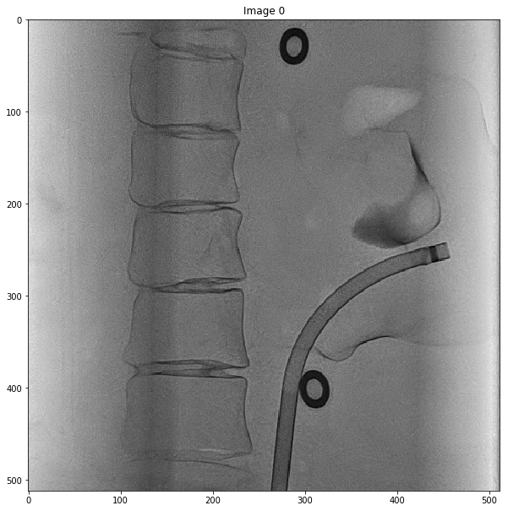
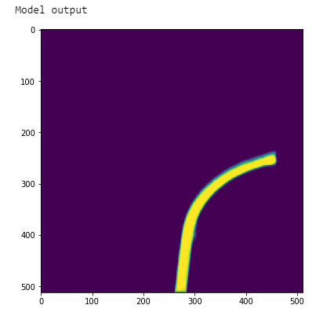
How does it work?
3 Components:
Downsampling
Bottleneck
Upsampling
U-Net essentially doubles the feature channels during each convolution during downsampling, and upsamples back to a segmented image.
The correlations from the feature channels are copied over to upsampling.

Slide 4
Advantages of U-Net
Factors correlations between pixels, giving the segmentation process a sense of localization & context.
Preferred method for bio-medical applications
Trained end-to-end
Trainable with a small dataset

Slide 5
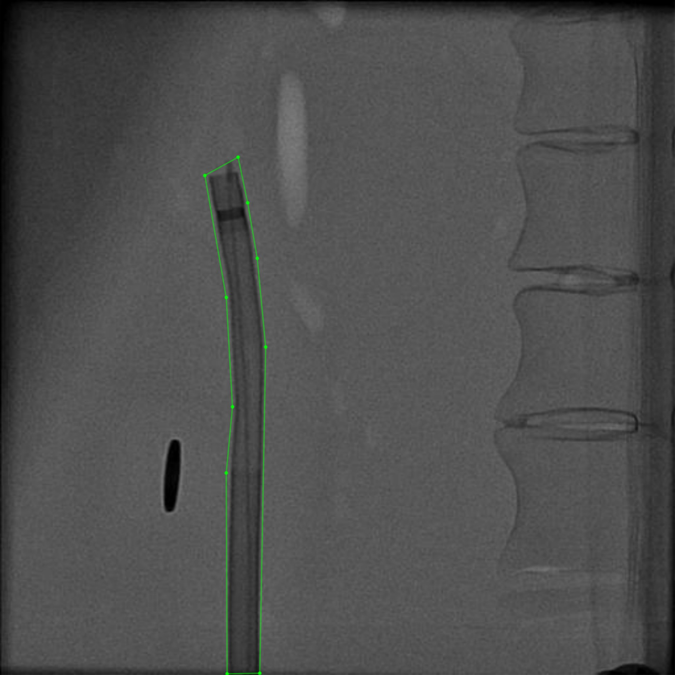
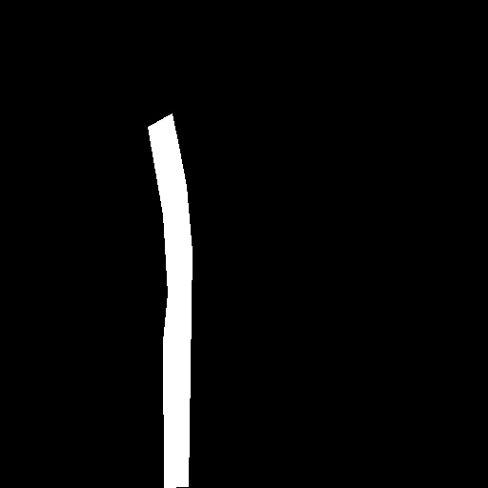
Methodology: Catheter Detection
Label Dataset and Create Masks of Pictures
Train Dataset on U-Net
Model Output (visual and model file)
Uses of the Model File
GUI that reads in videos detect catheters
Sync positions of detected pixels to cartesian coordinates in AR applications

