Slide 1
Klokan
Design Overview
Jan Horešovský

Slide 2
Evaluation
Klokan C++ library has an API method which returns an array of answers extracted from an answer sheet image
This method is small enough to be run in a task
The task can also handle counting the score based on arrays of correct and extracted answers
Also, such a task would be isolated, so it would be able to run in parallel with others

Slide 3
Evaluation - Infrastructure
A batch of all input data (KlokanBatch) is passed to a thread where scheduling takes place
Individual tasks are extracted from the batch and fed to the Evaluate() function
Evaluate() is part of the Evaluator object which owns the parameters of the evaluation
Evaluate() is performed inside a .NET Task<Result> which returns a result object
Each result object is self-contained and can be saved into the database without any knowledge of the input data

Slide 4
Evaluation – Progress Dialog
A dialog window showing progress is displayed during the evaluation
The progress dialog has a thread-safe method IncrementProgressBarValue()
The total number of tasks is passed to the dialog before the evaluation starts
It has a number of methods for safe label updates from non-UI threads
It owns a CancellationTokenSource and handles cancellations
Cancelled tasks normally finish running, only new ones are not planned
Database operations can also be cancelled, in this case this is already implemented by the database framework

Slide 5
Evaluation – Evaluate() Interface
The evaluation function receives:
  An array of correct answers
  Filename of the image
  Category name
  Year
And returns (as one object):
  An array of correct answers
  An array of extracted answers
  Student number
  Score
  Filename of the image
  Category name
  Year
  Error (if true, the rest of the return values is disregarded)
Greyed out parameters are returned to ensure independence of the result object

Slide 6
Evaluation – C++ Interface
Evaluate() calls ExtractAnswers() which prepares data structures for the native call and performs the call
Answers are passed as pointers to sequential arrays
Image is passed as a filename string
Parameters are passed in a strictly laid out struct
There is one pointer to a bool error flag to communicate whether the evaluation has succeeded or not

Slide 7
Database
The database should be a single file containing all evaluation data, so that it is easy to make backups and transfer the data to a different machine
Klokan is a stand-alone program where each user has their own data stored locally, so there is no need for concurrency or huge capacity

Slide 8
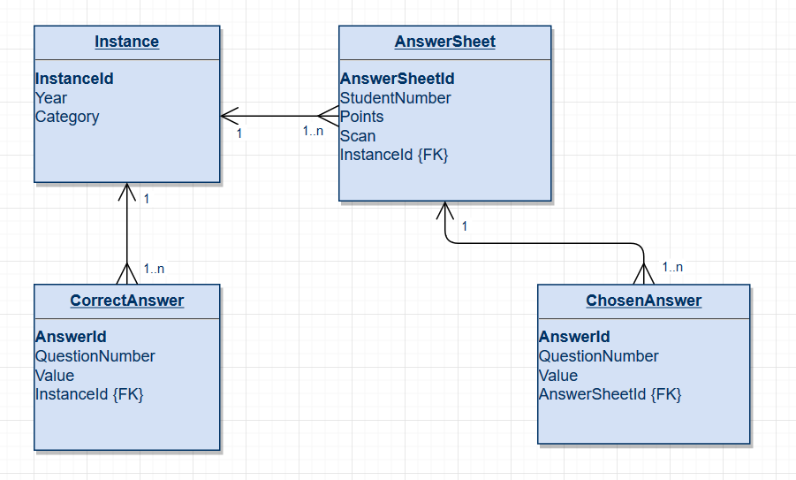
Database - Details
An SQLite database is used

Slide 9
Test Module
The test module should provide a way of measuring the correctness of the image recognition algorithm
It should also allow the user to fine-tune the parameters according to their needs
There needs to be a way of running the evaluation on stored images multiple times

Slide 10
Test Module - Design
Images are passed to the native code as arrays of bytes (there is an alternative for that in the C++ library), so they can be loaded from the database
There is no notion of categories or years, so it has its own result object and also its own database layout

Slide 11
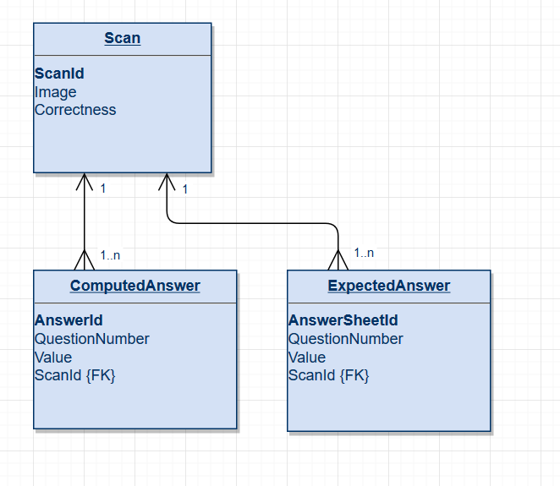
Test Module - Database

