Slide 1
Cornerstone City Church Peninsula Plus Community Hoo Are Ya
9th June 2024

Slide 2
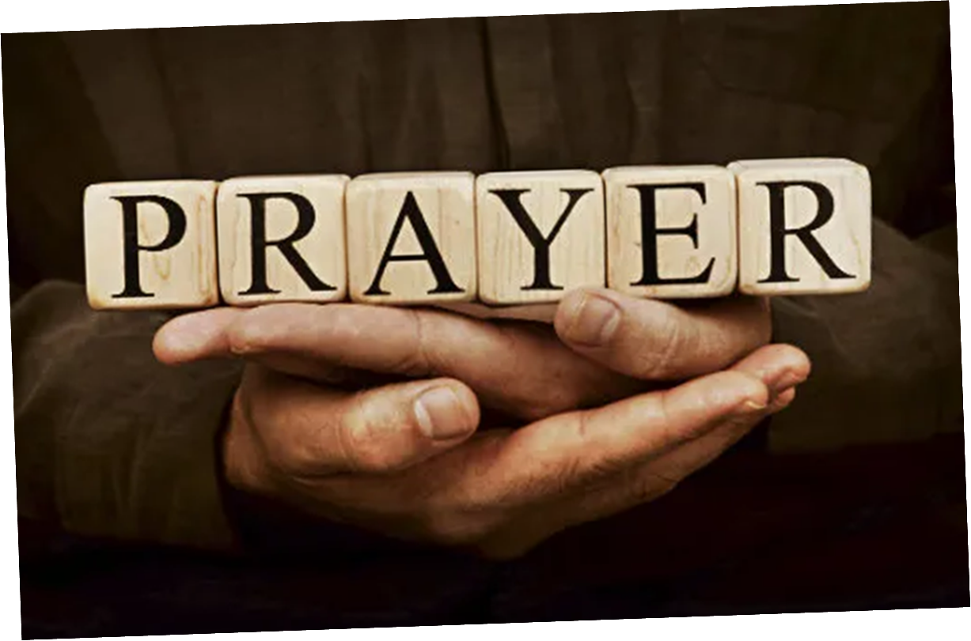

Slide 3


Slide 4
Great Big God
CCLI Song # 3373437
Jo Hemming | Nigel Hemming
© 2001 Vineyard Songs (UK/Eire) (Admin. by Integrity Music Ltd)
For use solely with the SongSelect® Terms of Use. All rights reserved. www.ccli.com
CCLI Licence No. 33265

Slide 5
1/2
Our God is a great big God
Our God is a great big God
Our God is a great big God
And He holds us in His hands

Slide 6
2/2
He's higher than a skyscraper
And He's deeper than a submarine
He's wider than the universe
And beyond my wildest dreams
And He's known me and He's loved me
Since before the world began
How wonderful to be a part of
God's amazing plan

Slide 7
I reach Up High
CCLI Song # 1075387
Judy Bailey
© 1993 Song Solutions Daybreak (Admin. by Song Solutions www.songsolutions.org)
For use solely with the SongSelect® Terms of Use. All rights reserved. www.ccli.com
CCLI Licence No. 33265

Slide 8
1/3
I reach up high I touch the ground
I stomp my feet and turn around
I've got to (woo woo) Praise the Lord
I jump and dance with all my might
I might look funny but that's alright
I've got to (woo woo)
Praise my Lord

Slide 9
2/3
I'll do anything just for my God
'Cause He's done ev'rything for me
It doesn't matter who is looking on
Jesus is the person that I want to please

Slide 10
3/3
May my whole life be a song of praise
To worship God in ev'ry way
In this song the actions praise His name
I want my actions ev'ry day to do the same

Slide 11
Praise
CCLI Song # 7213077
© Brandon Lake MusicFor Humans PublishingMaverick City PublishingCapitol CMG GenesisCapitol CMG ParagonHousefires SoundsWriter's Roof PublishingMusic by Elevation Worship Publishing
For use solely with the SongSelect® Terms of Use. All rights reserved. www.ccli.com
Note: Reproduction of this sheet music requires a CCLI Music Reproduction Licence. Please report all copies.
CCLI Licence No. 33265

Slide 12
1/12
Let everything that has breath
Praise the Lord
Praise the Lord

Slide 13
2/12
I’ll praise in the valley
Praise on the mountain
I’ll praise when I’m sure
Praise when I’m doubting

Slide 14
3/12
I’ll praise when outnumbered
Praise when surrounded
'Cause praise is the water
My enemies drown in

Slide 15
4/12
As long as I’m breathing
I’ve got a reason to Praise the Lord oh my soul
Praise the Lord oh my soul

Slide 16
5/12
I’ll praise when I feel it
And I’ll praise when I don’t
I’ll praise 'cause I know
You’re still in control

Slide 17
6/12
'Cause my praise is a weapon
It’s more than a sound
My praise is the shout
That brings Jericho down

Slide 18
7/12
As long as I’m breathing
I’ve got a reason to Praise the Lord oh my soul
Praise the Lord oh my soul

Slide 19
8/12
I won’t be quiet
My God is alive
How could I keep it inside
Praise the Lord oh my soul

Slide 20
9/12
I’ll praise 'cause You’re sovereign
Praise 'cause You reign
Praise 'cause You rose and defeated the grave
I’ll praise 'cause You’re faithful
Praise 'cause You’re true
Praise 'cause there’s nobody greater than You

Slide 21
10/12
Praise the Lord oh my soul
Praise the Lord oh my soul
Praise the Lord oh my soul
Praise the Lord oh my soul
I won’t be quiet
My God is alive
How could I keep it inside

Slide 22
1 1/12
I won’t be quiet
My God is alive
How could I keep it inside
I won’t be quiet
My God is alive
How could I keep it inside
Praise the Lord oh my soul

Slide 23
12/12
Let everything that has breath
Praise the Lord
Praise the Lord

Slide 24
You Are Good
CCLI Song # 3383788
Israel Houghton
© 2001 Integrity's Praise! Music (Admin. by Integrity Music)
Sound Of The New Breed (Admin. by Integrity Music)
For use solely with the SongSelect® Terms of Use. All rights reserved. www.ccli.com
CCLI Licence No. 33265

Slide 25
1/3
Lord You are good And Your mercy endureth forever Lord You are good And Your mercy endureth forever People from every nation and tongue From generation to generation

Slide 26
2/3
We worship You Hallelujah hallelujah We worship You for who You are We worship You Hallelujah hallelujah We worship You for who You are For You are good

Slide 27
3/3
You are good all the time All the time You are good You are good all the time All the time You are good

Slide 28
Days Of Elijah
CCLI Song # 1537904
Robin Mark
© 1996 Song Solutions Daybreak (Admin. by Song Solutions www.songsolutions.org)
For use solely with the SongSelect® Terms of Use. All rights reserved. www.ccli.com
CCLI Licence No. 33265

Slide 29
1/8
These are the days of Elijah
Declaring the Word of the Lord
And these are the days
Of Your servant Moses
Righteousness being restored

Slide 30
2/8
And though these are days
Of great trials
Of famine and darkness and sword
Still we are the voice
In the desert crying
Prepare ye the way of the Lord

Slide 31
3/8
Behold He comes, riding on the clouds
Shining like the sun, at the trumpet call
So lift your voice, it's the year of Jubilee
And out of Zion's hill
Salvation comes

Slide 32
4/8
And these are the days of Ezekiel
The dry bones becoming as flesh
And these are the days
Of Your servant David
Rebuilding a temple of praise

Slide 33
5/8
And these are the days of the harvest
The fields are as white in the world
And we are the labourers
In Your vineyard
Declaring the Word of the Lord

Slide 34
6/8
These are the days of Rebekah,
Who trusted the word of the Lord.
And these are the days of your servant Deborah,
Who led forth your people in war.

Slide 35
7/8
These are the days of Queen Esther,
Who rescued God’s people through faith.
And these are the days of your prophet Huldah,
Who renewed the temple of praise.

Slide 36
8/8
There is no god like Jehovah
There is no god like Jehovah
There is no god like Je-ho-vah

Slide 38


Slide 39
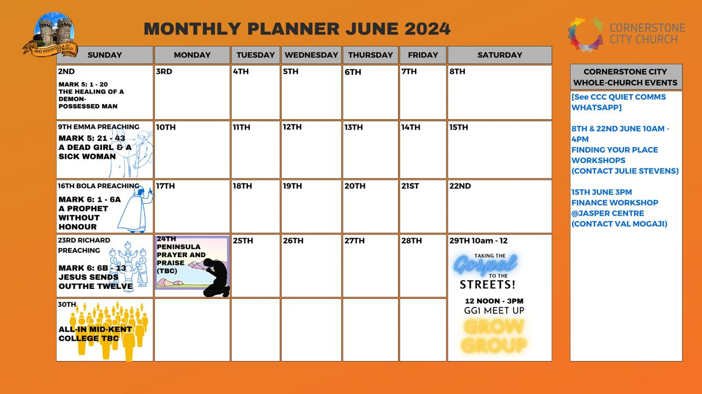

Slide 40


Slide 41


Slide 42
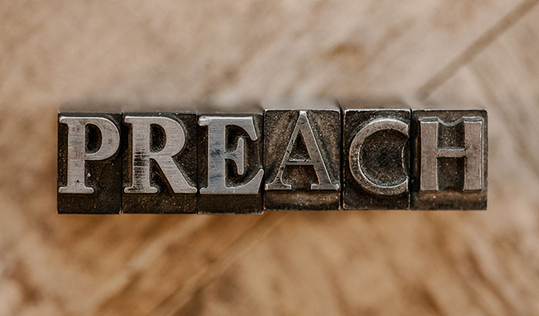

Slide 43
In Christ Alone
CCLI Song # 3350395
Keith Getty | Stuart Townend
© 2001 Thankyou Music (Admin. by Integrity Music Ltd)
For use solely with the SongSelect® Terms of Use. All rights reserved. www.ccli.com
CCLI Licence No. 33265

Slide 44
1/4
In Christ alone my hope is found
He is my light my strength my song
This Cornerstone this solid Ground
Firm through the fiercest drought and storm
What heights of love what depths of peace
When fears are stilled when strivings cease
My Comforter my All in All
Here in the love of Christ I stand

Slide 45
2/4
In Christ alone who took on flesh
Fullness of God in helpless babe
This gift of love and righteousness
Scorned by the ones He came to save
Till on that cross as Jesus died
The wrath of God was satisfied
For every sin on Him was laid
Here in the death of Christ I live

Slide 46
3/4
There in the ground His body lay
Light of the world by darkness slain
Then bursting forth in glorious Day
Up from the grave He rose again
And as He stands in victory
Sin's curse has lost its grip on me
For I am His and He is mine
Bought with the precious blood of Christ

Slide 47
4/4
No guilt in life no fear in death
This is the power of Christ in me
From life's first cry to final breath
Jesus commands my destiny
No power of hell no scheme of man
Can ever pluck me from His hand
Till He returns or calls me home
Here in the power of Christ I'll stand

Slide 48
2 Corinthians 14 May the grace of the Lord Jesus Christ, and the love of God, and the fellowship of the Holy Spirit be with you all

