Slide 1
Cornerstone City Church
Peninsula Plus Community
Hoo Are Ya
20th September 2026

Slide 2


Slide 3
The Joy
CCLI Song # 7209419
Andrew Holt | Mitch Wong
© 2023 Andrew Holt Music Publishing; TBCO Publishing; A Wong Made Write Publishing; Integrity's Praise! Music
For use solely with the SongSelect® Terms of Use. All rights reserved. www.ccli.com
CCLI Licence No. 33265

Slide 4
1/10
This is the day You made
So I’ll rejoice and be glad
Rejoice and be glad in it
This is where I believe
That You are more than enough
More than enough for me

Slide 5
2/10
You are faithful to Your promise
You are strong when I am weak
When I’m standing in Your presence
I have everything I need

Slide 6
3/10
The joy of the Lord
The joy of the Lord is my strength
The joy of the Lord
The joy of the Lord is my strength
O my soul bless His Name
All that is within me say
The joy of the Lord
The joy of the Lord is my strength

Slide 7
4/10
Jesus come what may
You are worthy of all
Worthy of all my praise

Slide 8
5/10
You are faithful to Your promise
You are strong when I am weak
When I’m standing in Your presence
I have everything I need

Slide 9
6/10
The joy of the Lord
The joy of the Lord is my strength
The joy of the Lord
The joy of the Lord is my strength
O my soul bless His Name
All that is within me say
The joy of the Lord
The joy of the Lord is my strength

Slide 10
7/10
Let it rise up like a river
Overflowing Holy Spirit
Let it pour out with no limit
Overflowing Holy Spirit
(REPEAT)

Slide 11
8/10
The joy of the Lord
The joy of the Lord is my strength
The joy of the Lord
The joy of the Lord is my strength
O my soul bless His Name
All that is within me say
The joy of the Lord
The joy of the Lord is my strength

Slide 12
9/10
I've got the joy
I've got the joy
I've got the joy
It's the joy of the Lord
It's the joy of the Lord

Slide 13
10/10
O my soul bless His Name
All that is within me say
O my soul bless His Name
All that is within me say
O my soul bless His Name
All that is within me say
The joy of the Lord
The joy of the Lord is my strength

Slide 14
I know That I Know
CCLI Song # 7242526
Alexander Pappas | Andrew Holt | Austin Davis
© 2025 A.L.K.D. Music; Andrew Holt Music Publishing; Capitol CMG Paragon; TBCO Publishing; City and Vine Music Publishing International
For use solely with the SongSelect® Terms of Use. All rights reserved. www.ccli.com

Slide 15
1/9
You’ve been good good for all my life
So nothing could ever change my mind
You never break Your promise
You’re constant in all You do
Yours is the way the truth the life
That I will choose

Slide 16
2/9
Oh I know that I know
You won’t ever let me go
Every low every high
You are faithful all the time
I’ve tasted and I’ve seen
You've been so so good to me
God I know that I know

Slide 17
3/9
You're faithful all the time oh
You're faithful all the time oh

Slide 18
4/9
I won’t look to the left or right
And I will keep heaven in my sight
No I will not be shaken
And nothing is moving me
I’ve got a faith that's sure of things
I cannot see

Slide 19
5/9
Oh I know that I know
You won’t ever let me go
Every low every high
You are faithful all the time
I’ve tasted and I’ve seen
You've been so so good to me
God I know that I know

Slide 20
6/9
You're faithful all the time oh
You're faithful all the time oh

Slide 21
7/9
I won’t stand on words of man
God I’ll stand on Yours instead
All of my hope all of my faith
All of it’s in Your name
And the world cannot deny
All that You’ve done in my life
All of my days all of my praise
All to lift Jesus' name

Slide 22
8/9
Oh I know that I know
You won’t ever let me go
Every low every high
You are faithful all the time
(REPEAT)

Slide 23
9/9
I’ve tasted and I’ve seen
You've been so so good to me
God I know that I know
You're faithful all the time oh
You're faithful all the time oh
You're faithful all the time oh
You're faithful all the time oh
Faithful all the time

Slide 25
Break Every Chain
CCLI Song # 5910977
Will Reagan
© 2009 United Pursuit Music (Admin. by Capitol CMG Publishing)
For use solely with the SongSelect® Terms of Use. All rights reserved. www.ccli.com
CCLI Licence No. 33265

Slide 26
1/2
There is power in the name of Jesus
There is power in the name of Jesus
There is power in the name of Jesus
To break every chain
Break every chain
Break every chain

Slide 27
2/2
I hear the chains falling
(REPEAT)

Slide 28
1/1
My chains are gone I've been set free
My God my Savior has ransomed me
And like a flood His mercy rains
Unending love amazing grace

Slide 29
Amazing Grace
(My Chains Are Gone)
CCLI Song # 4768151
Chris Tomlin | John Newton | Louie Giglio
© 2006 Rising Springs Music; Vamos Publishing; worshiptogether.com songs
For use solely with the SongSelect® Terms of Use. All rights reserved. www.ccli.com
CCLI Licence No. 33265

Slide 30
1/7
Amazing grace how sweet the sound
That saved a wretch like me
I once was lost but now I'm found
Was blind but now I see

Slide 31
2/7
'Twas grace that taught my heart to fear
And grace my fears relieved
How precious did that grace appear
The hour I first believed

Slide 32
3/7
My chains are gone I've been set free
My God my Savior has ransomed me
And like a flood His mercy rains
Unending love amazing grace

Slide 33
4/7
The Lord has promised good to me
His word my hope secures
He will my shield and portion be
As long as life endures

Slide 34
5/7
My chains are gone I've been set free
My God my Savior has ransomed me
And like a flood His mercy rains
Unending love amazing grace

Slide 35
6/7
The earth shall soon dissolve like snow
The sun forbear to shine
But God who called me here below
Will be forever mine
Will be forever mine
You are forever mine

Slide 36
7/7
My chains are gone I've been set free
My God my Savior has ransomed me
And like a flood His mercy rains
Unending love amazing grace

Slide 38
Shout To The Lord
CCLI Song # 1406918
Darlene Zschech
© 1993 Wondrous Worship (Admin. by Song Solutions www.songsolutions.org)
For use solely with the SongSelect® Terms of Use. All rights reserved. www.ccli.com
CCLI Licence No. 33265

Slide 39
1/4
My Jesus my Saviour
Lord there is none like You
All of my days I want to praise
The wonders of Your mighty love

Slide 40
2/4
My comfort my shelter
Tower of refuge and strength
Let every breath all that I am
Never cease to worship You

Slide 41
3/4
Shout to the Lord
All the earth let us sing
Power and majesty
Praise to the King
Mountains bow down
And the seas will roar
At the sound of Your name

Slide 42
4/4
I sing for joy
At the work of Your hands
Forever I'll love You
Forever I'll stand
Nothing compares to the promise
I have in You

Slide 43


Slide 44
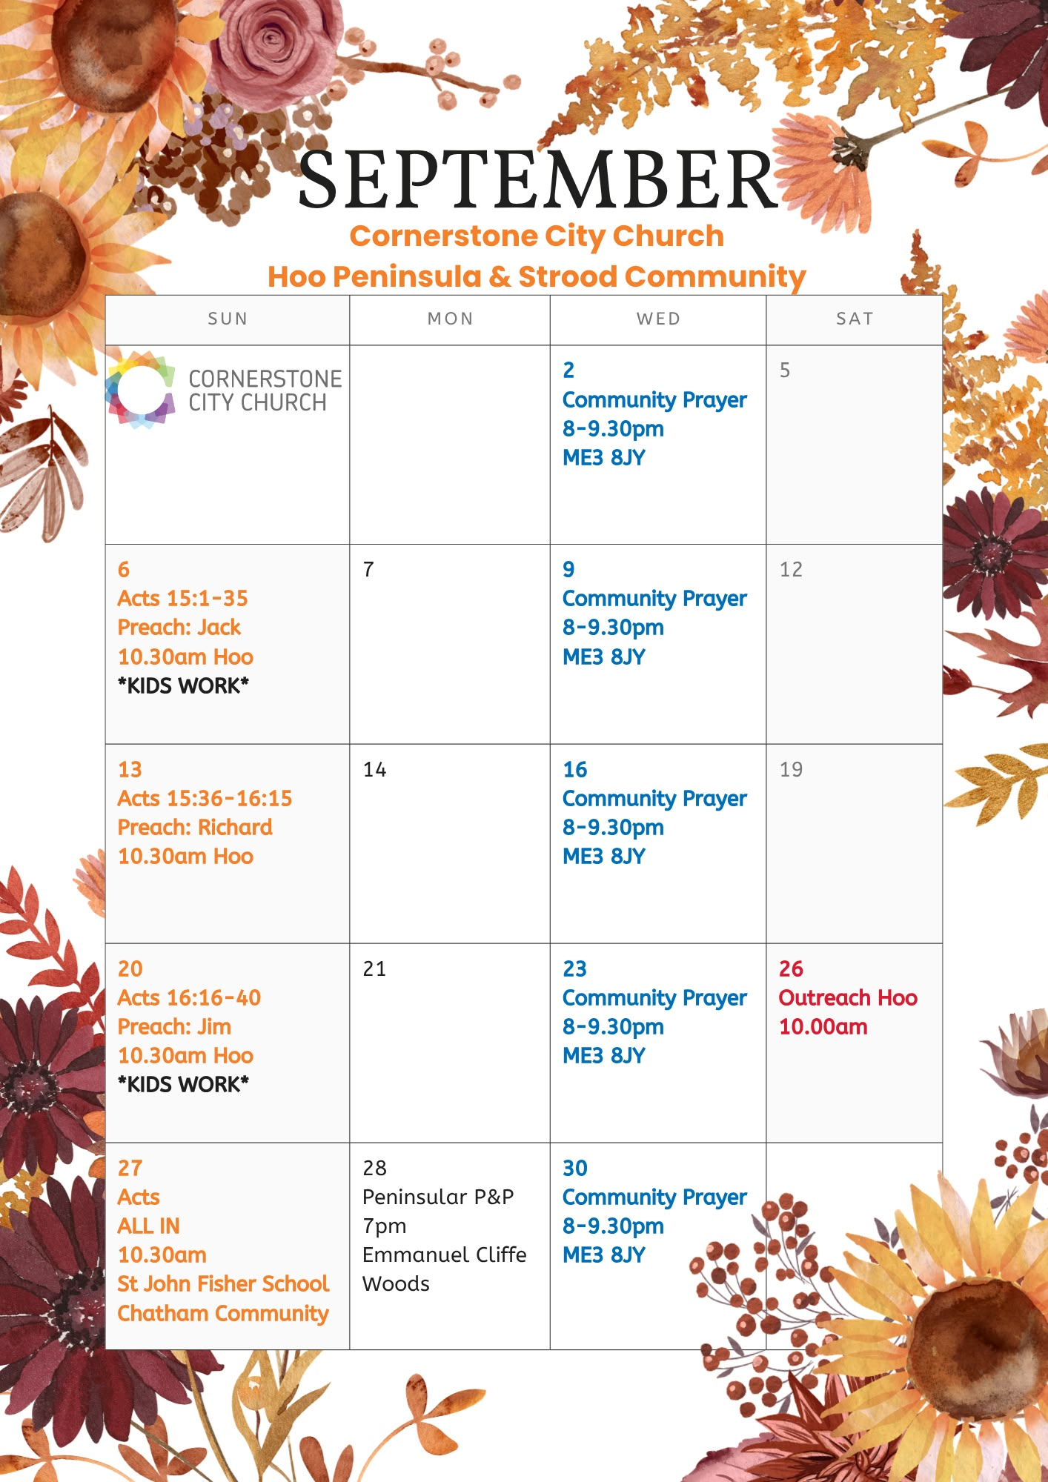

Slide 45


Slide 46


Slide 47


Slide 48
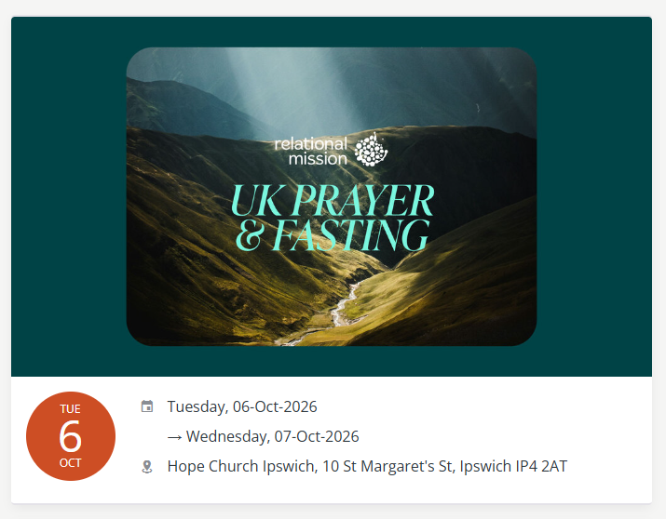

Slide 49
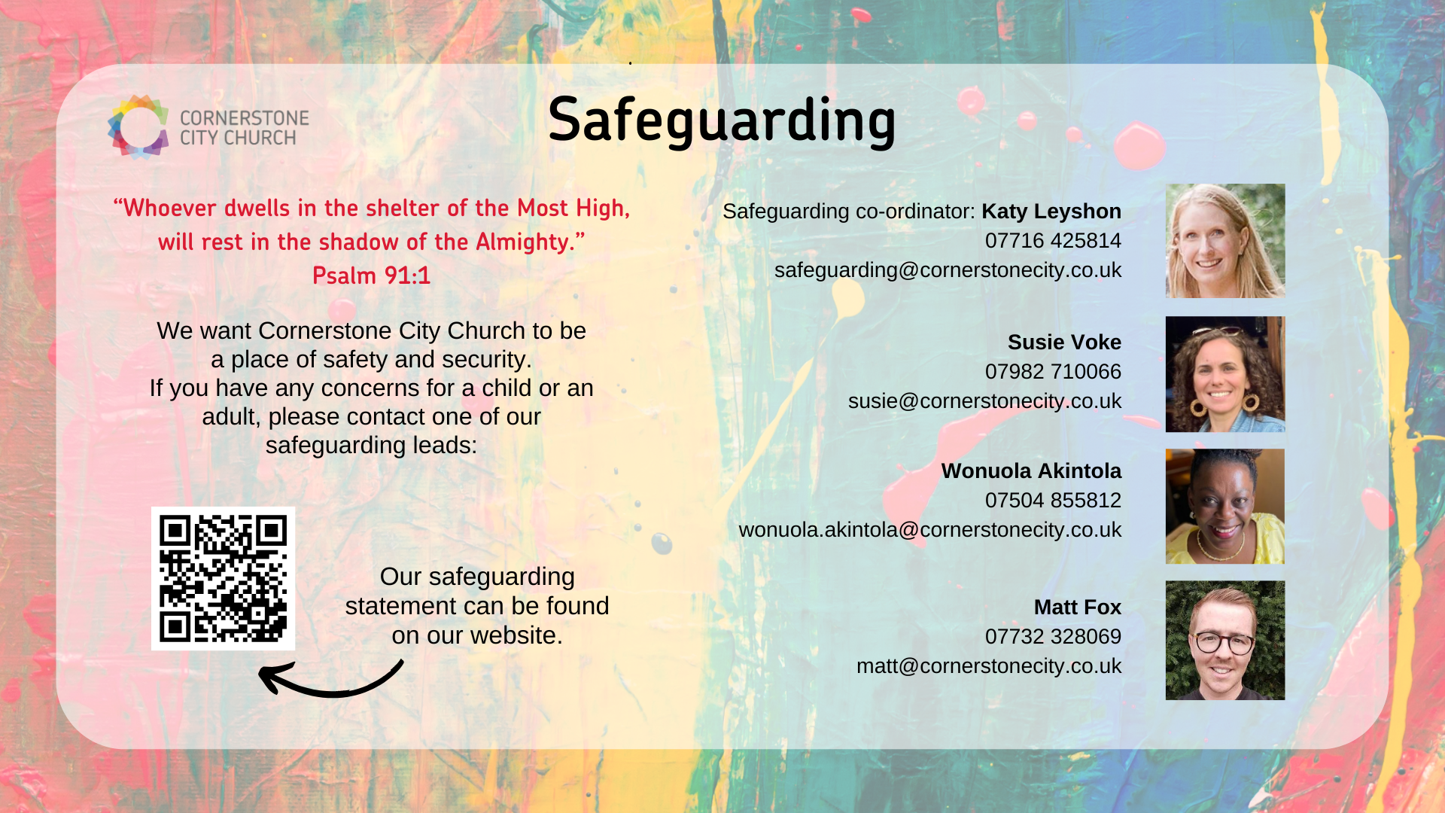

Slide 50
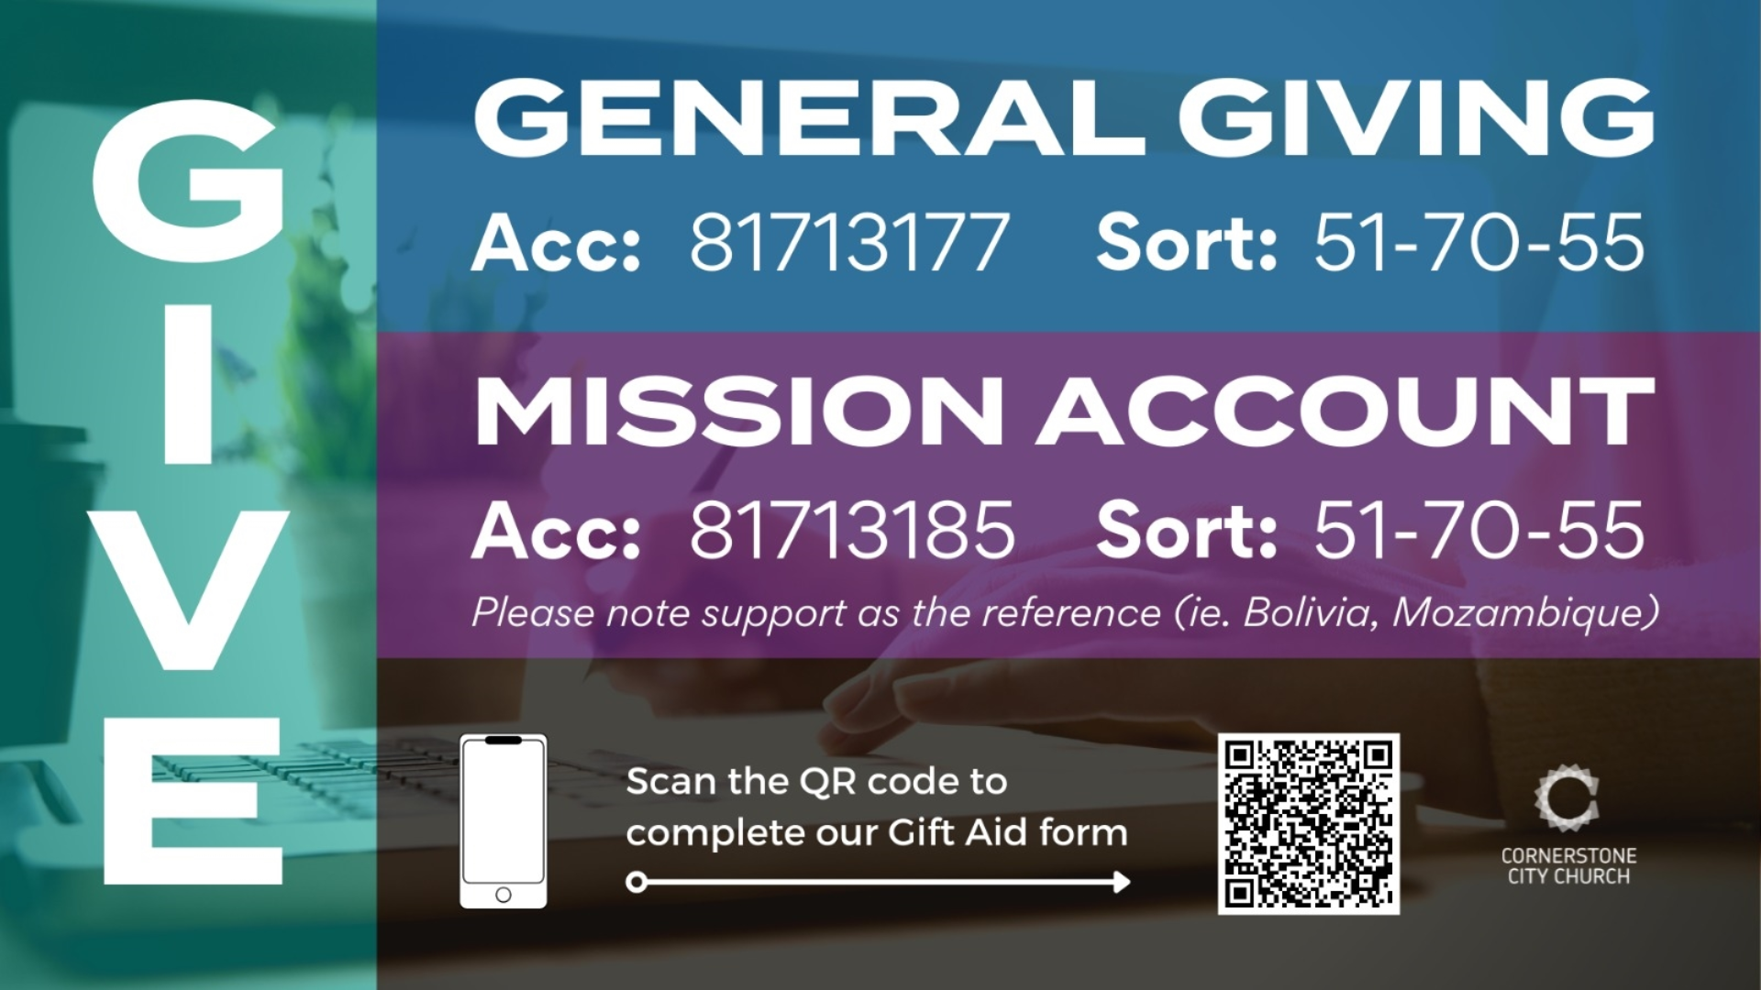

Slide 51


Slide 52
2 Corinthians 14
May the grace of the Lord Jesus Christ, and the love of God, and the fellowship of the Holy Spirit be with us all.
And….
Surely goodness and mercy shall follow us all the days of our lives, and we shall dwell in the house of the Lord forever.

Slide 53
Amen!

