Slide 1
Cornerstone City Church Peninsula Plus Community Hoo Are Ya
17th November 2024

Slide 2
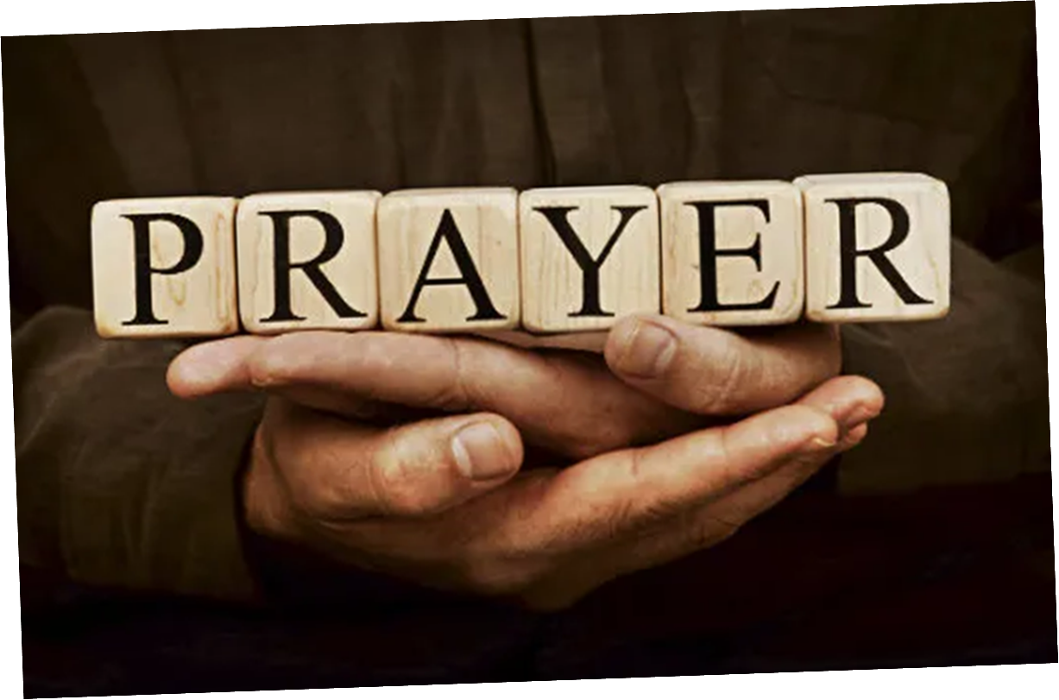

Slide 3
I’m So Blessed
CCLI Song # 7167000
Jonathan Smith | Logan Cain | Madison Cain | Matthew West | Taylor Cain
© All Essential Music; Be Essential Songs; Cashagamble Jet Music; Logan Cain Music; Madison Cain Music; Taylor Cain Music; Combustion Five; Third Story House Music
For use solely with the SongSelect® Terms of Use. All rights reserved. www.ccli.com
CCLI Licence No. 33265

Slide 4
1/6
I’m so blessed hallelujah I’m blessed
I’m so blessed hallelujah I’m blessed

Slide 5
2/6
Trouble knocking at my door today
I ain’t gonna let it in
Worry wanna steal my joy away
I ain’t gonna let it win

Slide 6
3/6
On my best day I’m a child of God
On my worst day I’m a child of God
Oh everyday is a good day
You’re the reason why

Slide 7
4/6
I’m so blessed I’m so blessed
Got this heartbeat in my chest
No it doesn’t matter about the rest
If I got You Lord I’m so blessed

Slide 8
5/6
When I count the problems that I see
Hope looks all but gone
But when I count the ways You’re good to me
You got me counting all day long

Slide 9
6/6
I’m so blessed hallelujah I’m blessed
I’m so blessed hallelujah I’m blessed
No it doesn’t matter about the rest
If I got You Lord hallelujah I’m blessed

Slide 10
Lord I lift Your Name On High
CCLI Song # 117947
Rick Founds
© 1989 Universal Music - Brentwood Benson Publishing
For use solely with the SongSelect® Terms of Use. All rights reserved. www.ccli.com
CCLI Licence No. 33265

Slide 11
1/2
Verse
Lord I lift Your name on high
Lord I love to sing Your praises
I'm so glad You're in my life
I'm so glad You came to save us

Slide 12
2/2
Chorus
You came from heaven to earth
To show the way
From the earth to the cross
My debt to pay
From the cross to the grave
From the grave to the sky
Lord I lift Your name on high

Slide 14
Christ is Enough
CCLI Song # 6514035
Jonas Myrin | Reuben Morgan
© 2012 Hillsong MP Songs; Hillsong Music Publishing Australia
For use solely with the SongSelect® Terms of Use. All rights reserved. www.ccli.com
CCLI License # 33265

Slide 15
1/4
Christ is my reward and all of my devotion
Now there's nothing in this world
That could ever satisfy
Through every trial my soul will sing
No turning back I've been set free

Slide 16
2/4
Christ is enough for me
Christ is enough for me
Everything I need is in You
Everything I need

Slide 17
3/4
Christ my all in all the joy of my salvation
And this hope will never fail
Heaven is our home
Through every storm my soul will sing
Jesus is here to God be the glory

Slide 18
4/4
I have decided to follow Jesus
No turning back no turning back The cross before me the world behind me
No turning back no turning back

Slide 20
Healer CCLI Song # 4873981
Mike Guglielmucci
© 2007 Planetshakers Ministries Int. Inc.
For use solely with the SongSelect® Terms of Use. All rights reserved. www.ccli.com
CCLI Licence No. 33265

Slide 21
1/6
Verse
You hold my every moment
You calm my raging seas
You walk with me through fire
And heal all my disease

Slide 22
2/6
Pre-Chorus
I trust in You
I trust in You

Slide 23
3/6
Chorus
I believe You're my healer
I believe You are all I need
I believe You're my portion
I believe You're more than enough for me
Jesus You're all I need

Slide 24
4/6
Bridge
Nothing is impossible for You
Nothing is impossible
Nothing is impossible for You
You hold my world in Your hands
(REPEAT)

Slide 25
5/6
Chorus
I believe You're my healer
I believe You are all I need
I believe You're my portion
I believe You're more than enough for me
Jesus You're all I need

Slide 26
6/6
Interlude
More than enough for me
Jesus You're all I need
(REPEAT)

Slide 27
None But Jesus CCLI Song # 4726186
Brooke Ligertwood
© 2005 Hillsong Music Publishing Australia
For use solely with the SongSelect® Terms of Use. All rights reserved. www.ccli.com
CCLI Licence No. 33265

Slide 28
1/6
Verse 1
In the quiet in the stillness
I know that You are God
In the secret of Your presence
I know there I am restored
When You call I won't refuse
Each new day again I'll choose

Slide 29
2/6
Chorus
There is no one else for me
None but Jesus
Crucified to set me free
Now I live to bring Him praise

Slide 30
3/6
Verse 2
In the chaos in confusion
I know You're sovereign still
In the moment of my weakness
You give me grace to do Your will
When You call I won't delay
This my song through all my days

Slide 31
4/6
Chorus
There is no one else for me
None but Jesus
Crucified to set me free
Now I live to bring Him praise

Slide 32
5/6
Bridge
All my delight is in You Lord
All of my hope
All of my strength
All my delight is in You Lord
Forevermore

Slide 33
6/6
Chorus
There is no one else for me
None but Jesus
Crucified to set me free
Now I live to bring Him praise

Slide 34


Slide 35


Slide 36
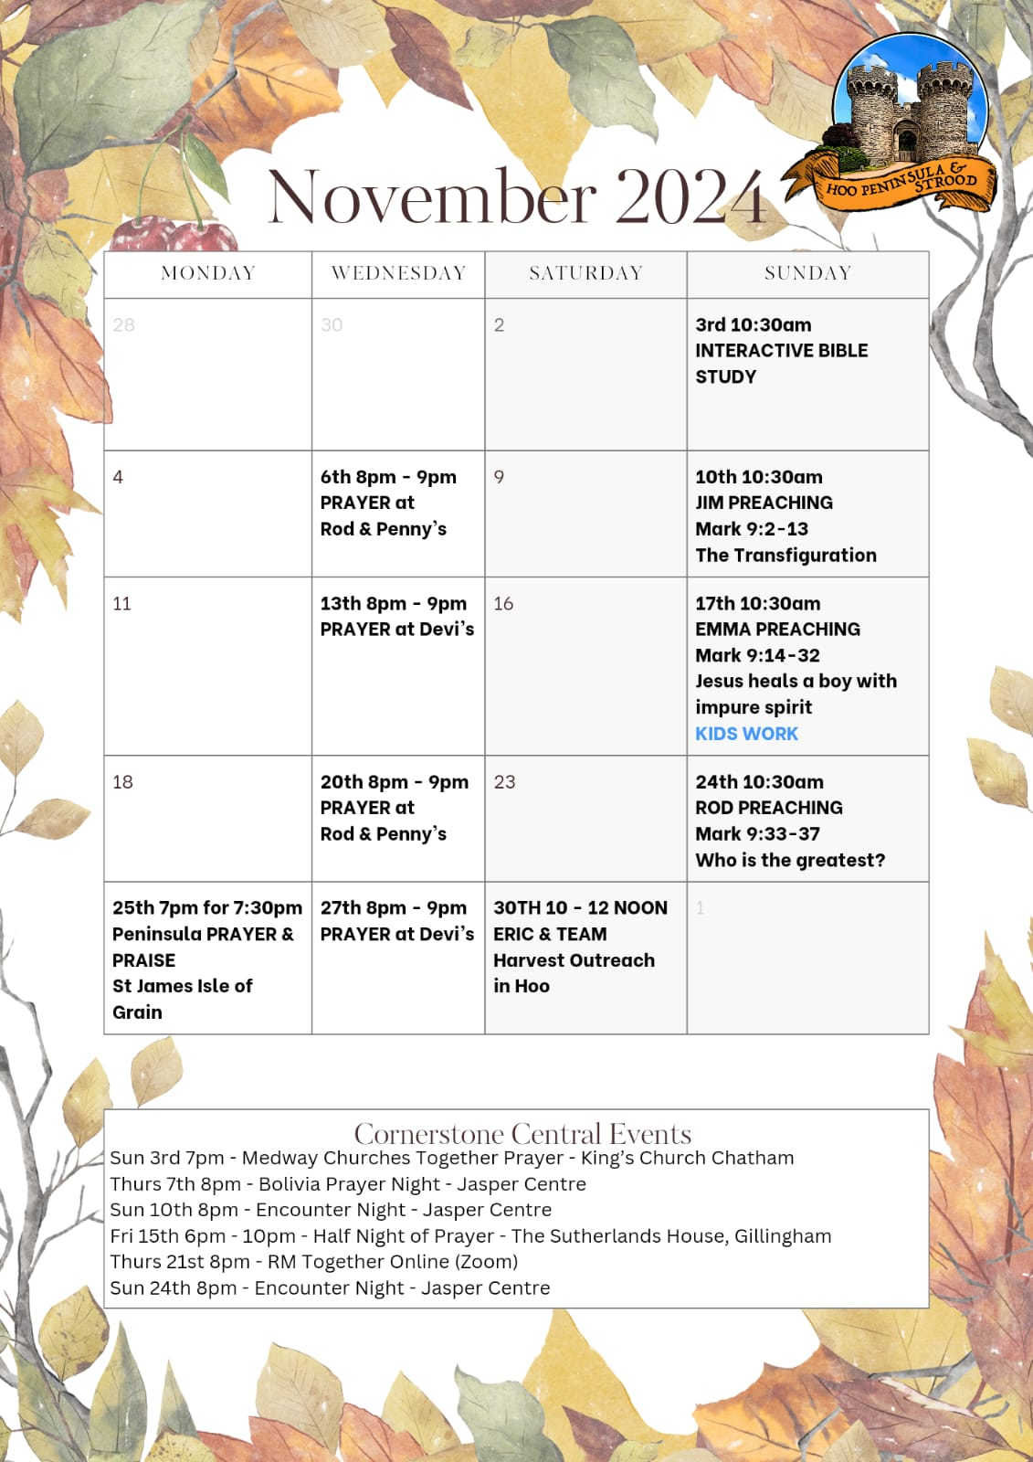

Slide 37


Slide 38
Still
CCLI Song # 3940963
Reuben Morgan
© 2002 Hillsong Music Publishing Australia (Admin. by Hillsong Music Publishing UK)
For use solely with the SongSelect® Terms of Use. All rights reserved. www.ccli.com
CCLI Licence No. 33265

Slide 39
1/3
Hide me now
Under Your wings
Cover me
Within Your mighty hand

Slide 40
2/3
When the oceans rise
And thunders roar
I will soar with You
Above the storm
Father You are King
Over the flood
I will be still and know
You are God

Slide 41
3/3
Find rest my soul
In Christ alone
Know His power
In quietness and trust

Slide 42
2 Corinthians 14 May the grace of the Lord Jesus Christ, and the love of God, and the fellowship of the Holy Spirit be with you all
Surely goodness and mercy shall follow me all the days of my life, and I shall dwell in the house of the Lord forever.

