Slide 1
Cornerstone City Church Peninsula Plus Community Hoo Are Ya
10th November 2024

Slide 2


Slide 3
My Redeemer Lives
CCLI Song # 2397964
Reuben Morgan
© 1998 Hillsong Music Publishing Australia (Admin. by Hillsong Music Publishing UK)
For use solely with the SongSelect® Terms of Use. All rights reserved. www.ccli.com
CCLI Licence No. 33265

Slide 4
1/4
I know He rescued my soul His blood has covered my sin I believe I believe My shame He's taken away My pain is healed in His name I believe I believe
I'll raise a banner 'Cause my Lord has conquered the grave

Slide 5
2/4
My Redeemer lives
My Redeemer lives
My Redeemer lives
My Redeemer lives

Slide 6
3/4
You lift my burdens
I'll rise with You
I'm dancing on this mountain top
To see Your kingdom come

Slide 7
4/4
My Redeemer lives
My Redeemer lives
My Redeemer lives
My Redeemer lives

Slide 8
Every Praise
CCLI Song # 6623483
Hezekiah Walker | John David Bratton
© 2013 Davo Pavo Music (Admin. by BMG Rights Management GmbH)
Li'l Eva Music (Admin. by Capitol CMG Publishing)
Luv Ki Publishing (Admin. by Capitol CMG Publishing)
For use solely with the SongSelect® Terms of Use. All rights reserved. www.ccli.com
CCLI Licence No. 33265

Slide 9
1/2
Every praise is to our God
Every word of worship with one accord
Every praise every praise is to our God
Sing hallelujah to our God
Glory hallelujah is due our God
Every praise every praise is to our God

Slide 10
2/2
God my Saviour
God my Healer
God my Deliverer
Yes He is yes He is
(Yes He is yes He is)

Slide 12
Open The Eyes of My Heart
CCLI Song # 2298355
Paul Baloche
© 1997 Integrity's Hosanna! Music (Admin. by Integrity Music Ltd)
For use solely with the SongSelect® Terms of Use. All rights reserved. www.ccli.com
CCLI Licence No. 33265

Slide 13
1/3
Open the eyes of my heart Lord
Open the eyes of my heart
I want to see You
I want to see You

Slide 14
2/3
To see You high and lifted up
Shining in the light of Your glory
Pour out Your power and love
As we sing holy holy holy

Slide 15
3/3
Holy holy holy
Holy holy holy
Holy holy holy
I want to see You

Slide 17
How Great Is Our God
CCLI Song # 4348399
Chris Tomlin | Ed Cash | Jesse Reeves
© 2004 sixsteps Music (Admin. by Integrity Music Ltd)
Vamos Publishing (Admin. by Integrity Music Ltd)
worshiptogether.com songs (Admin. by Integrity Music Ltd)
Wondrously Made Songs (Admin. by Song Solutions www.songsolutions.org)
For use solely with the SongSelect® Terms of Use. All rights reserved. www.ccli.com
CCLI Licence No. 33265

Slide 18
1/6
The splendour of the King
Clothed in majesty
Let all the earth rejoice
All the earth rejoice
He wraps Himself in light
And darkness tries to hide
And trembles at His voice
And trembles at His voice

Slide 19
2/6
How great is our God
Sing with me
How great is our God
And all will see how great
How great is our God

Slide 20
3/6
And age to age He stands
And time is in His hands
Beginning and the End
Beginning and the End
The Godhead three in one
Father Spirit Son
The Lion and the Lamb
The Lion and the Lamb

Slide 21
4/6
How great is our God
Sing with me
How great is our God
And all will see how great
How great is our God

Slide 22
5/6
Name above all names
Worthy of all praise
My heart will sing
How great is our God

Slide 23
6/6
How great is our God
Sing with me
How great is our God
And all will see how great
How great is our God

Slide 24
1/1
Chorus
Then sings my soul my Saviour God to Thee
How great Thou art how great Thou art
Then sings my soul my Saviour God to Thee
How great Thou art how great Thou art

Slide 25
1/1
Chorus
Turn your eyes upon Jesus
Look full in His wonderful face
And the things of earth
Will grow strangely dim
In the light of His glory and grace

Slide 26


Slide 27


Slide 28
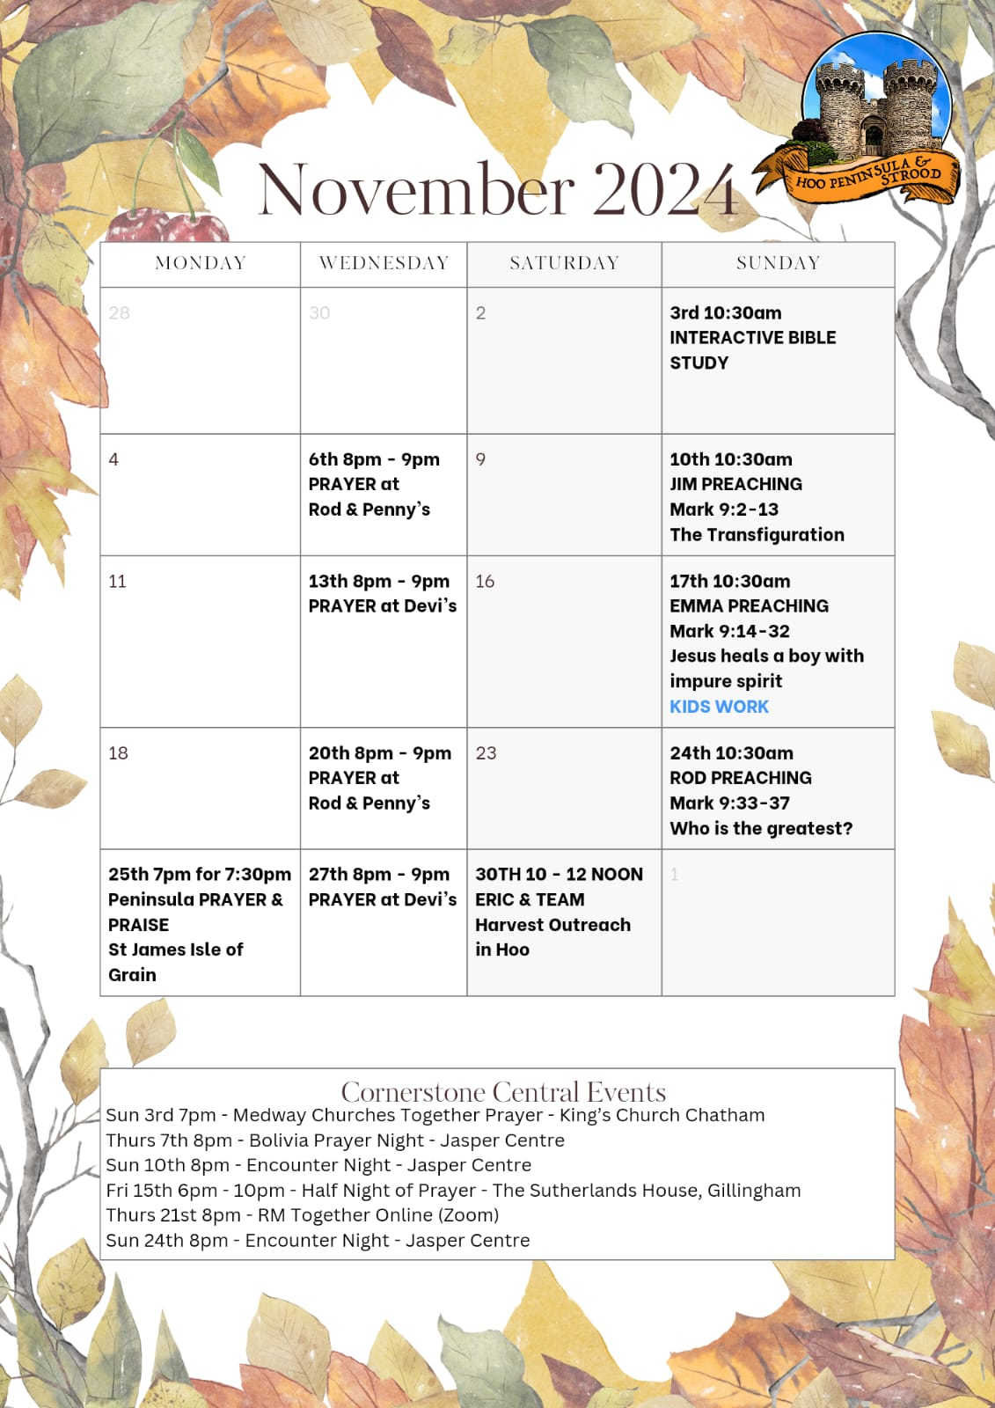

Slide 29


Slide 30
What A Beautiful Name
CCLI Song # 7068424
Ben Fielding | Brooke Ligertwood
© 2016 Hillsong Music Publishing Australia (Admin. by Hillsong Music Publishing UK)
For use solely with the SongSelect® Terms of Use. All rights reserved. www.ccli.com
CCLI Licence No. 33265

Slide 31
1/7
You were the Word at the beginning One with God the Lord Most High Your hidden glory in creation Now revealed in You our Christ

Slide 32
2/7
What a beautiful Name it is What a beautiful Name it is The Name of Jesus Christ my King What a beautiful Name it is Nothing compares to this What a beautiful Name it is The Name of Jesus

Slide 33
3/7
You didn't want heaven without us So Jesus You brought heaven down My sin was great Your love was greater What could separate us now

Slide 34
4/7
What a wonderful Name it is What a wonderful Name it is The Name of Jesus Christ my King What a wonderful Name it is Nothing compares to this What a wonderful Name it is The Name of Jesus What a wonderful Name it is The Name of Jesus

Slide 35
5/7
Death could not hold You The veil tore before You You silence the boast of sin and grave The heavens are roaring The praise of Your glory For You are raised to life again

Slide 36
6/7
You have no rival You have no equal Now and forever God You reign Yours is the kingdom Yours is the glory Yours is the Name above all names

Slide 37
7/7
What a powerful Name it is What a powerful Name it is The Name of Jesus Christ my King What a powerful Name it is Nothing can stand against What a powerful Name it is The Name of Jesus

Slide 38
2 Corinthians 14 May the grace of the Lord Jesus Christ, and the love of God, and the fellowship of the Holy Spirit be with you all

