Slide 1
Cornerstone City Church Peninsula Plus Community Hoo Are Ya
24th November 2024

Slide 2
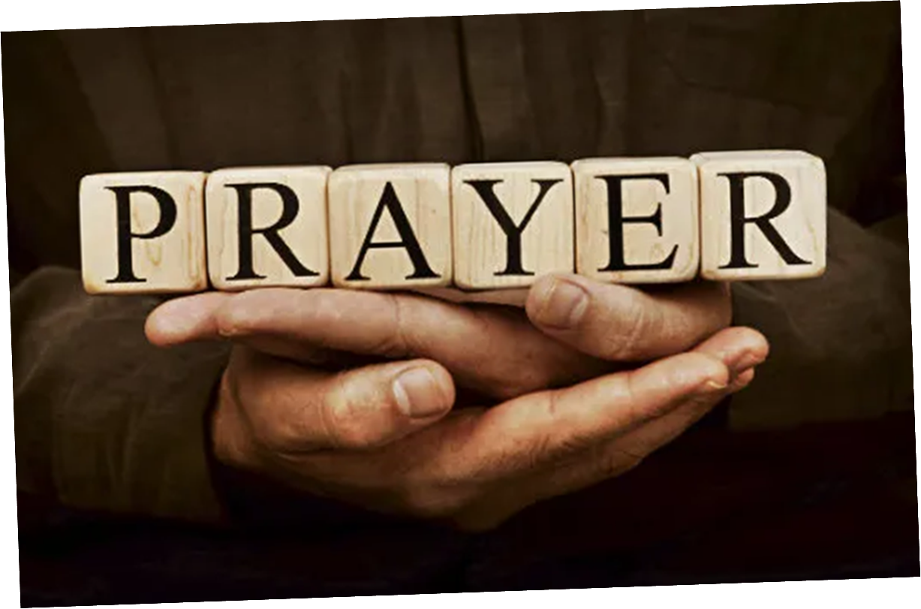

Slide 3
Servant King
CCLI Song # 78897
Graham Kendrick
© 1983 Thankyou Music
For use solely with the SongSelect® Terms of Use. All rights reserved. www.ccli.com
CCLI Licence No. 33265

Slide 4
1/8
Verse 1
From heav'n You came helpless babe
Enter'd our world Your glory veil'd
Not to be served but to serve
And give Your life that we might live

Slide 5
1/8
Chorus
This is our God the Servant King
He calls us now to follow Him
To bring our lives as a daily offering
Of worship to the Servant King

Slide 6
3/8
Verse 2
There in the garden of tears
My heavy load He chose to bear
His heart with sorrow was torn
Yet not my will but Yours He said

Slide 7
4/8
Chorus
This is our God the Servant King
He calls us now to follow Him
To bring our lives as a daily offering
Of worship to the Servant King

Slide 8
5/8
Verse 3
Come see His hands and His feet
The scars that speak of sacrifice
Hands that flung stars into space
To cruel nails
Surrendered

Slide 9
6/8
Chorus
This is our God the Servant King
He calls us now to follow Him
To bring our lives as a daily offering
Of worship to the Servant King

Slide 10
7/8
Verse 4
So let us learn how to serve
And in our lives enthrone Him
Each other's needs to prefer
For it is Christ we're serving

Slide 11
8/8
Chorus
This is our God the Servant King
He calls us now to follow Him
To bring our lives as a daily offering
Of worship to the Servant King

Slide 12
1/4
This is our God this is who He is
He loves us
This is our God this is what He does
He saves us
He bore the cross beat the grave
Let heaven and earth proclaim
This is our God King Jesus

Slide 13
2/4
Who pulled me out of that pit
He did He did
Who paid for all of our sin
Nobody but Jesus (REPEAT)

Slide 14
3/4
Who rescued me from that grave
Yahweh Yahweh
Who gets the glory and praise
Nobody but Jesus (Him) (REPEAT)

Slide 15
4/4
This is our God this is who He is
He loves us
This is our God this is what He does
He saves us
He bore the cross beat the grave
Let heaven and earth proclaim
This is our God King Jesus

Slide 16
1/1
Let’s bring our lives as a daily offering
Of worship to the Servant King

Slide 18
Here I am to Worship
CCLI Song # 3266032
Tim Hughes
© 2000 Thankyou Music (Admin. by Integrity Music Ltd)
For use solely with the SongSelect® Terms of Use. All rights reserved. www.ccli.com
CCLI Licence No. 33265

Slide 19
1/4
Light of the world
You stepped down into darkness
Opened my eyes let me see
Beauty that made
This heart adore You
Hope of a life spent with You

Slide 20
2/4
So here I am to worship
Here I am to bow down
Here I am to say that You're my God
And You're altogether lovely
Altogether worthy
Altogether wonderful to me

Slide 21
3/4
King of all days
Oh so highly exalted
Glorious in heaven above
Humbly You came
To the earth You created
All for love's sake became poor

Slide 22
4/4
And I'll never know how much it cost
To see my sin upon that cross
And I'll never know how much it cost
To see my sin upon that cross

Slide 23
There is None Like You G.CcliSongNumber 674545
Lenny LeBlanc
© 1991 Integrity's Hosanna! Music
For use solely with the SongSelect® G.LIT_TermsOfUse. All rights reserved. www.ccli.com
G.CcliLicenseNumber 33265

Slide 24
1/2
There is none like You
No one else can touch
My heart like You do
I could search
For all eternity long and find
There is none like You

Slide 25
2/2
Your mercy flows like a river wide
And healing comes from Your hands
Suffering children are safe in Your arms
There is none like You

Slide 27
Nothing Else
CCLI Song # 7123436
Cody Carnes | Hank Bentley | Jessie Early
© 2019 Capitol CMG Paragon (Admin. by Capitol CMG Publishing)
Songs By That Dog Will Hunt (Admin. by Capitol CMG Publishing)
Writer's Roof Publishing (Admin. by Capitol CMG Publishing)
For use solely with the SongSelect® Terms of Use. All rights reserved. www.ccli.com
CCLI Licence No. 33265

Slide 28
1/7
I'm caught up in Your presence
I just want to sit here at Your feet
I'm caught up in this holy moment
I never want to leave

Slide 29
2/7
Oh, I'm not here for blessings
Jesus, You don't owe me anything
More than anything that You can do
I just want You

Slide 30
3/7
I'm sorry when I've just gone through the motions
I'm sorry when I just sang another song
Take me back to where we started
I open up my heart to You

Slide 31
4/7
I'm sorry when I've come with my agenda
I'm sorry when I forgot that You're enough
Take me back to where we started
I open up my heart to You

Slide 32
5/7
I'm caught up in Your presence
I just want to sit here at Your feet
I'm caught up in this holy moment
I never want to leave

Slide 33
6/7
Oh, I'm not here for blessings
Jesus, You don't owe me anything
More than anything that You can do
I just want You

Slide 34
7/7
I just want You
Nothing else
Nothing else (Jesus)
Nothing else will do

Slide 35
Heart Of Worship CCLI Song # 2296522
Matt Redman
© 1997 Thankyou Music (Admin. by Integrity Music Ltd)
For use solely with the SongSelect® Terms of Use. All rights reserved. www.ccli.com
CCLI Licence No. 33265

Slide 36
1/6
When the music fades all is stripped away
And I simply come
Longing just to bring something that's of worth
That will bless Your heart

Slide 37
2/6
I'll bring You more than a song
For a song in itself is not what You have required
You search much deeper within
Through the way things appear
You're looking into my heart

Slide 38
3/6
I'm coming back to the heart of worship
And it's all about You all about You Jesus
I'm sorry Lord for the thing I've made it
When it's all about You all about You Jesus

Slide 39
4/6
King of endless worth no one could express
How much You deserve
Though I'm weak and poor all I have is Yours
Ev'ry single breath

Slide 40
5/6
I'll bring You more than a song
For a song in itself is not what You have required
You search much deeper within
Through the way things appear
You're looking into my heart

Slide 41
6/6
I'm coming back to the heart of worship
And it's all about You all about You Jesus
I'm sorry Lord for the thing I've made it
When it's all about You all about You Jesus

Slide 42


Slide 43


Slide 44
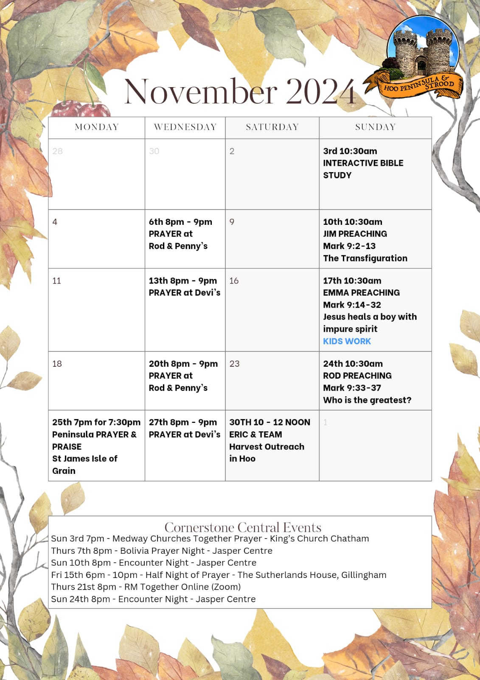

Slide 45


Slide 46


Slide 47
2 Corinthians 14 May the grace of the Lord Jesus Christ, and the love of God, and the fellowship of the Holy Spirit be with you all
Surely goodness and mercy shall follow me all the days of my life, and I shall dwell in the house of the Lord forever.

