Slide 1
Cornerstone City Church Peninsula Plus Community Hoo Are Ya
24th November 2024

Slide 2
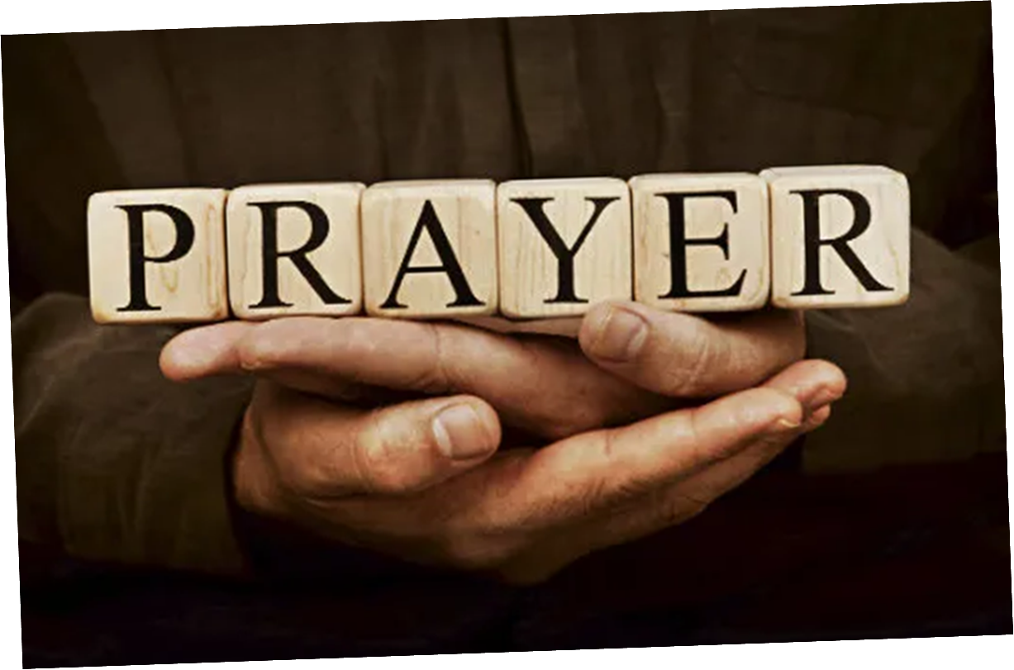

Slide 3
Joy To The World
CCLI Song # 7100235
George Frideric Handel | Isaac Watts | Joth Hunt
© 2017 Planetshakers Ministries Int. Inc.
For use solely with the SongSelect® Terms of Use. All rights reserved. www.ccli.com
CCLI License # 33265

Slide 4
1/3
Joy to the world the Lord has come
Let earth receive her King
Let ev'ry heart prepare Him room
And heaven and nature sing
And heaven and nature sing
And heaven heaven and nature sing

Slide 5
2/3
Joy to the world the Saviour reigns
Let men their songs employ
While fields and floods rocks hills and plains
Repeat the sounding joy
Repeat the sounding joy
Repeat repeat the sounding joy

Slide 6
3/3
He rules the world with truth and grace
And makes the nations prove
The glories of His righteousness
And wonders of His love
And wonders of His love
And wonders and wonders of His love

Slide 7
Hosanna (Praise Is Rising)
CCLI Song # 4662491
Brenton Brown | Paul Baloche
© 2005, 2006 Integrity's Hosanna! Music (Admin. by Integrity Music Ltd)
Thankyou Music (Admin. by Integrity Music Ltd)
For use solely with the SongSelect® Terms of Use. All rights reserved. www.ccli.com
CCLI Licence No. 33265

Slide 8
1/6
Praise is rising
Eyes are turning to You
We turn to You
Hope is stirring
Hearts are yearning for You
We long for You

Slide 9
2/6
‘Cause when we see You
We find strength to face the day
In Your presence
All our fears are washed away
(Washed away)

Slide 10
3/6
Hosanna Hosanna
You are the God who saves us
Worthy of all our praises
Hosanna Hosanna
Come have Your way among us
We welcome You here Lord Jesus

Slide 11
4/6
Hear the sound of
Hearts returning to You
We turn to You
In Your Kingdom
Broken lives are made new
You make us new

Slide 12
5/6
‘Cause when we see You
We find strength to face the day
In Your presence
All our fears are washed away
(Washed away)

Slide 13
6/6
Hosanna Hosanna
You are the God who saves us
Worthy of all our praises
Hosanna Hosanna
Come have Your way among us
We welcome You here Lord Jesus

Slide 14
Our God Saves
CCLI Song # 4972837
Brenton Brown | Paul Baloche
© 2007 Integrity's Hosanna! Music (Admin. by Integrity Music Ltd)
Leadworship Songs (Admin. by Integrity Music Ltd)
Thankyou Music (Admin. by Integrity Music Ltd)
For use solely with the SongSelect® Terms of Use. All rights reserved. www.ccli.com
CCLI Licence No. 33265

Slide 15
1/3
In the name of the Father
In the name of the Son
In the name of the Spirit,
Lord we come
We're gather'd together,
To lift up Your name
To call on our Savior to fall on Your grace

Slide 16
2/3
Hear the joyful sound of our offering
As Your saints bow down
As Your people sing
We will rise with You lifted on Your wings
And the world will see that

Slide 17
3/3
Our God saves our God saves
There is hope in Your name
Mourning turns to songs of praise
Our God saves our God saves

Slide 19
Cornerstone
CCLI Song # 6158927
Edward Mote | Eric Liljero | Jonas Myrin | Reuben Morgan | William Batchelder Bradbury
© 2011 Hillsong MP Songs (Admin. by Hillsong Music Publishing UK)
Hillsong Music Publishing Australia (Admin. by Hillsong Music Publishing UK)
Hillsong Music Publishing UK
For use solely with the SongSelect® Terms of Use. All rights reserved. www.ccli.com
CCLI Licence No. 33265

Slide 20
1/6
My hope is built on nothing less
Than Jesus' blood and righteousness
I dare not trust the sweetest frame
But wholly trust in Jesus' Name

Slide 21
2/6
Christ alone cornerstone
Weak made strong in the Saviour's love
Through the storm He is Lord
Lord of all

Slide 22
3/6
When darkness seems to hide His face
I rest on His unchanging grace
In every high and stormy gale
My anchor holds within the veil
My anchor holds within the veil

Slide 23
4/6
Christ alone cornerstone
Weak made strong in the Saviour's love
Through the storm He is Lord
Lord of all

Slide 24
5/6
When He shall come with trumpet sound
Oh may I then in Him be found
Dressed in His righteousness alone
Faultless stand before the throne

Slide 25
6/6
Christ alone cornerstone
Weak made strong in the Saviour's love
Through the storm He is Lord
Lord of all

Slide 26
1/1
Hope has a name
Emmanuel
The Light of the World
Who broke through the darkness
All hail the King
Emmanuel
The Light of the World
The Glory of Heaven

Slide 27


Slide 28


Slide 30


Slide 31
Living Hope CCLI Song # 7106807
Brian Johnson | Phil Wickham
© 2017 Phil Wickham Music; Simply Global Songs; Sing My Songs; Bethel Music Publishing
For use solely with the SongSelect® Terms of Use. All rights reserved. www.ccli.com
CCLI Licence No. 33265

Slide 32
1/6
How great the chasm that lay between us
How high the mountain I could not climb
In desperation I turned to heaven
And spoke Your name into the night
Then through the darkness Your loving-kindness
Tore through the shadows of my soul
The work is finished the end is written
Jesus Christ my living hope

Slide 33
2/6
Who could imagine so great a mercy
What heart could fathom such boundless grace
The God of ages stepped down from glory
To wear my sin and bear my shame
The cross has spoken I am forgiven
The King of kings calls me His own
Beautiful Savior I’m Yours forever
Jesus Christ my living hope

Slide 34
3/6
Hallelujah praise the One who set me free
Hallelujah death has lost its grip on me
You have broken every chain
There’s salvation in Your name
Jesus Christ my living hope

Slide 35
4/6
Then came the morning that sealed the promise
Your buried body began to breathe
Out of the silence the Roaring Lion
Declared the grave has no claim on me
(REPEAT)
Jesus Yours is the victory whoa

Slide 36
5/6
Hallelujah praise the One who set me free
Hallelujah death has lost its grip on me
You have broken every chain
There’s salvation in Your name
Jesus Christ my living hope

Slide 37
6/6
Jesus Christ my living hope
Oh God You are my living hope

Slide 38
2 Corinthians 14 May the grace of the Lord Jesus Christ, and the love of God, and the fellowship of the Holy Spirit be with you all
Surely goodness and mercy shall follow me all the days of my life, and I shall dwell in the house of the Lord forever.

