Slide 1
Cornerstone City Church Peninsula Plus Community Hoo Are Ya
16th June 2024

Slide 2
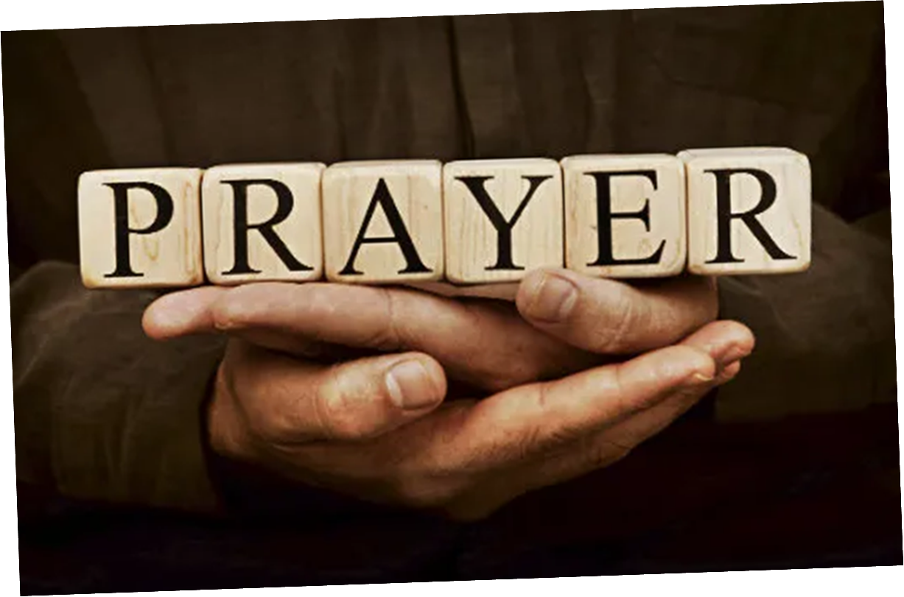

Slide 3


Slide 4
I’m So Blessed
CCLI Song # 7167000
Jonathan Smith | Logan Cain | Madison Cain | Matthew West | Taylor Cain
© All Essential Music; Be Essential Songs; Cashagamble Jet Music; Logan Cain Music; Madison Cain Music; Taylor Cain Music; Combustion Five; Third Story House Music
For use solely with the SongSelect® Terms of Use. All rights reserved. www.ccli.com
CCLI Licence No. 33265

Slide 5
1/10
Trouble knocking at my door today
I ain’t gonna let it in
Worry wanna steal my joy away
I ain’t gonna let it win

Slide 6
2/10
Cos on my best day I’m a child of God
On my worst day I’m a child of God
Oh everyday is a good day
You’re the reason why

Slide 7
3/10
I’m so blessed, I’m so blessed
Got this heartbeat in my chest
No it doesn’t matter about the rest
If I got You Lord I’m so blessed

Slide 8
4/10
I’m so blessed
Hallelujah I’m blessed
I’m so blessed
Hallelujah I’m blessed

Slide 9
5/10
When I count the problems that I see
Hope looks all but gone
But when I count the ways You’re good to me
You got me counting all day long

Slide 10
6/10
I’m so blessed, I’m so blessed
Got this heartbeat in my chest
No it doesn’t matter about the rest
If I got You Lord I’m so blessed
(2ce)

Slide 11
7/10
Cos on my best day I’m a child of God
On my worst day I’m a child of God
Oh everyday is a good day
You’re the reason why
(2ce)

Slide 12
8/10
I’m so blessed, I’m so blessed
Got this heartbeat in my chest
No it doesn’t matter about the rest
If I got You Lord I’m so blessed
(2ce)

Slide 13
9/10
On my best day I’m a child of God
On my worst day I’m a child of God
Oh everyday is a good day
You’re the reason why
(2ce)

Slide 14
10/10
I’m so blessed, hallelujah I’m blessed
I’m so blessed, hallelujah I’m blessed
No it doesn’t matter about the rest
If I got You Lord…..
Hallelujah I’m blessed

Slide 15
Turn It Up
CCLI Song # 6621485
Andy Harrison
© 2012 Planetshakers Ministries Int. Inc. (Admin. by Song Solutions www.songsolutions.org)
For use solely with the SongSelect® Terms of Use. All rights reserved. www.ccli.com
CCLI Licence No. 33265

Slide 16
1/9
You are here as we lift You up
You are riding on our praise
Be enthroned over everything
You are seated in our praise

Slide 17
2/9
This is prophetic I can feel it in the air
We lift our praise and You change the atmosphere
With hearts open now everybody singing out
Oh

Slide 18
3/9
Turn it up this sound of praise
Make it louder than any other
Lift Him up and shout His name over all

Slide 19
4/9
As we praise I can feel the change
As Your presence now invades
Hear the sound of the broken chains
Prison doors are giving way

Slide 20
5/9
This is prophetic I can feel it in the air
We lift our praise and You change the atmosphere
With hearts open now everybody singing out
I am free!

Slide 21
6/9
Turn it up this sound of praise
Make it louder than any other
Lift Him up and shout His name over all
(2ce)

Slide 22
7/9
Our praise goes up
Your rain comes down
(REPEAT)

Slide 23
8/9
With shouts of praise we celebrate
King of glory enter in
You are riding on our praise oh Lord

Slide 24
9/9
Turn it up this sound of praise
Make it louder than any other
Lift Him up and shout His name over all
2ce

Slide 26
Oceans (Where Feet May Fail)
G.CcliSongNumber 6428767
Joel Houston | Matt Crocker | Salomon Ligthelm
© 2012 Hillsong Music Publishing Australia
For use solely with the SongSelect® G.LIT_TermsOfUse. All rights reserved. www.ccli.com
G.CcliLicenseNumber 33265

Slide 27
1/6
You call me out upon the waters
The great unknown where feet may fail
And there I find You in the mystery
In oceans deep my faith will stand

Slide 28
2/6
Chorus:
And I will call upon Your name
And keep my eyes above the waves
When oceans rise
My soul will rest in Your embrace
For I am Yours and You are mine

Slide 29
3/6
Your grace abounds in deepest waters
Your sov'reign hand will be my guide
Where feet may fail and fear surrounds me
You've never failed and You won't start now

Slide 30
4/6
Chorus:
And I will call upon Your name
And keep my eyes above the waves
When oceans rise
My soul will rest in Your embrace
For I am Yours and You are mine

Slide 31
5/6
Spirit, lead me where my trust is without borders
Let me walk upon the waters
Wherever You would call me
Take me deeper than my feet could ever wander
And my faith will be made stronger
In the presence of my Saviour

Slide 32
6/6
Chorus:
And I will call upon Your name
And keep my eyes above the waves
When oceans rise
My soul will rest in Your embrace
For I am Yours and You are mine

Slide 33
Waiting Here For You
CCLI Song # 5925663
Chris Tomlin | Jesse Reeves | Martin Smith
© 2011 Rising Springs Music (Admin. by Capitol CMG Publishing)
Vamos Publishing (Admin. by Capitol CMG Publishing)
worshiptogether.com songs (Admin. by Capitol CMG Publishing)
Smith United (Admin. by Integrity Music Ltd)
Thankyou Music (Admin. by Integrity Music Ltd)
For use solely with the SongSelect® Terms of Use. All rights reserved. www.ccli.com
CCLI Licence No. 33265

Slide 34
1/7
If faith can move the mountains
Let the mountains move
We come with expectation
Waiting here for You
Waiting here for You

Slide 35
2/7
You're the Lord of all creation
And still You know my heart
The Author of salvation
You've loved us from the start

Slide 36
3/7
Waiting here for You with our hands
Lifted high in praise
And it's You we adore
Singing alleluia

Slide 37
4/7
You are ev'rything You've promised
Your faithfulness is true
We're desp'rate for Your presence
All we need is You

Slide 38
5/7
Waiting here for You with our hands
Lifted high in praise
And it's You we adore
Singing alleluia

Slide 39
6/7
Bridge:
Singing alleluia alleluia
Singing alleluia alleluia

Slide 40
7/7
Waiting here for You with our hands
Lifted high in praise
And it's You we adore singing alleluia
(We’re) singing alleluia

Slide 41
Draw Me Close
CCLI Song # 1459484
Kelly Carpenter
© 1994 Mercy / Vineyard Publishing
For use solely with the SongSelect® Terms of Use. All rights reserved. www.ccli.com
CCLI Licence No. 33265

Slide 42
1/2
Draw me close to You never let me go
I lay it all down again
To hear You say that I'm Your friend
You are my desire no one else will do
'Cause nothing else could take Your place
To feel the warmth of Your embrace
Help me find the way bring me back to You

Slide 43
2/2
You're all I want
You're all I've ever needed
You're all I want
Help me know You are near

Slide 44


Slide 45
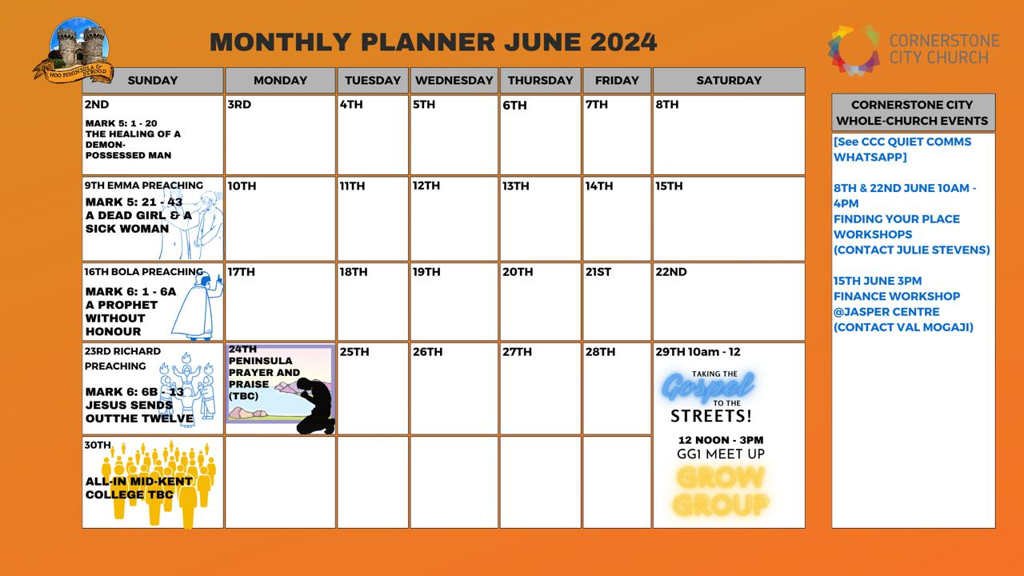

Slide 46


Slide 47


Slide 48


Slide 49
2 Corinthians 14 May the grace of the Lord Jesus Christ, and the love of God, and the fellowship of the Holy Spirit be with you all

