Slide 1
Cornerstone City Church Peninsula Plus Community Hoo Are Ya
26th January 2025

Slide 2


Slide 3
Great Big God
CCLI Song # 3373437
Jo Hemming | Nigel Hemming
© 2001 Vineyard Songs (UK/Eire) (Admin. by Integrity Music Ltd)
For use solely with the SongSelect® Terms of Use. All rights reserved. www.ccli.com
CCLI Licence No. 33265

Slide 4
1/2
Our God is a great big God
Our God is a great big God
Our God is a great big God
And He holds us in His hands

Slide 5
2/2
He's higher than a skyscraper
And He's deeper than a submarine
He's wider than the universe
And beyond my wildest dreams
And He's known me and He's loved me
Since before the world began
How wonderful to be a part of
God's amazing plan

Slide 6
The Lion And The Lamb
CCLI Song # 7038281
Brenton Brown | Brian Johnson | Leeland Mooring
© 2015 Meaux Mercy (Admin. by Capitol CMG Publishing)
The Devil Is A Liar! Publishing (Admin. by Capitol CMG Publishing)
Thankyou Music (Admin. by Integrity Music)
Bethel Music Publishing (Admin. by Song Solutions)
For use solely with the SongSelect® Terms of Use. All rights reserved. www.ccli.com
CCLI Licence No. 33265

Slide 7
1/5
He's coming on the clouds Kings and kingdoms will bow down And every chain will break As broken hearts declare His praise For who can stop the Lord Almighty

Slide 8
2/5
Our God is the Lion, the Lion of Judah He's roaring with power And fighting our battles And every knee will bow before Him

Slide 9
3/5
Our God is the Lamb, the Lamb that was slain For the sins of the world His blood breaks the chains And every knee will bow before the Lion and the Lamb Every knee will bow before Him

Slide 10
4/5
So open up the gates Make way before the King of kings The God who comes to save Is here to set the captives free For who can stop the Lord Almighty

Slide 11
5/5
Who can stop the Lord Almighty Who can stop the Lord (Almighty)

Slide 13
Holy Forever
CCLI Song # 7201044
Brian Johnson | Chris Tomlin | Jason Ingram | Jenn Johnson | Phil Wickham
© Phil Wickham Music (Admin. by / Small Stone Media BV, Holland (Admin. in the UK/Eire by Song Solutions www.songsolutions.org))
Simply Global Songs (Admin. by / Small Stone Media BV, Holland (Admin. in the UK/Eire by Song Solutions www.songsolutions.org))
Capitol CMG Paragon (Admin. by Capitol CMG Publishing)
S. D. G. Publishing (Admin. by Capitol CMG Publishing)
Be Essential Songs (Admin. by Essential Music Publishing LLC)
My Magnolia Music (Admin. by Essential Music Publishing LLC)
Bethel Music Publishing (Admin. by Song Solutions)
Brian and Jenn Publishing (Admin. by Song Solutions)
For use solely with the SongSelect® Terms of Use. All rights reserved. www.ccli.com
CCLI Licence No. 33265

Slide 14
1/10
A thousand generations falling down in worship
To sing the song of ages to the Lamb
And all who've gone before us
And all who will believe
Will sing the song of ages to the Lamb

Slide 15
2/10
(Jesus) Your name is the highest
Your name is the greatest
Your name stands above them all
All thrones and dominions
All powers and positions
Your name stands above them all

Slide 16
3/10
And the angels cry Holy
All creation cries Holy
You are lifted high Holy
Holy forever

Slide 17
4/10
If you've been forgiven and if you've been redeemed
Sing the song forever to the Lamb
If you walk in freedom and if you bear His name
Sing the song forever to the Lamb
We'll sing the song forever and amen

Slide 18
5/10
And the angels cry Holy
All creation cries Holy
You are lifted high Holy
Holy forever

Slide 19
6/10
Hear Your people sing Holy
To the King of Kings Holy
You will always be Holy
Holy forever

Slide 20
7/10
(Jesus) Your name is the highest
Your name is the greatest
Your name stands above them all
All thrones and dominions
All powers and positions
Your name stands above them all

Slide 21
8/10
And the angels cry Holy
All creation cries Holy
You are lifted high Holy
Holy forever

Slide 22
9/10
Hear Your people sing Holy
To the King of Kings Holy
You will always be Holy
Holy forever

Slide 23
10/10
You will always be Holy
Holy forever

Slide 25
Build My Life
CCLI Song # 7070345
Brett Younker | Karl Martin | Kirby Kaple | Matt Redman | Pat Barrett
© 2016 Capitol CMG Genesis (Admin. by Capitol CMG Publishing)
Housefires Sounds (Admin. by Capitol CMG Publishing)
sixsteps Music (Admin. by Capitol CMG Publishing)
Vamos Publishing (Admin. by Capitol CMG Publishing)
worshiptogether.com songs (Admin. by Capitol CMG Publishing)
Said And Done Music (Admin. by Integrity Music Ltd)
Thankyou Music (Admin. by Integrity Music Ltd)
Martin, Karl Andrew (Admin. by Sentric Music)
Bethel Music Publishing (Admin. by Song Solutions)
Kaple Music (Admin. by Song Solutions)
For use solely with the SongSelect® Terms of Use. All rights reserved. www.ccli.com
CCLI Licence No. 33265

Slide 26
1/4
Worthy of ev'ry song we could ever sing
Worthy of all the praise we could ever bring
Worthy of ev'ry breath we could ever breathe
We live for You

Slide 27
2/4
Jesus the name above ev'ry other name
Jesus the only one who could ever save
Worthy of ev'ry breath we could ever breathe
We live for You
We live for You

Slide 28
3/4
Holy there is no one like You
There is none beside You
Open up my eyes in wonder and show me who You are
And fill me with Your heart
And lead me in Your love to those around me

Slide 29
4/4
I will build my life upon Your love
It is a firm foundation
I will put my trust in You alone
And I will not be shaken

Slide 30


Slide 31


Slide 32
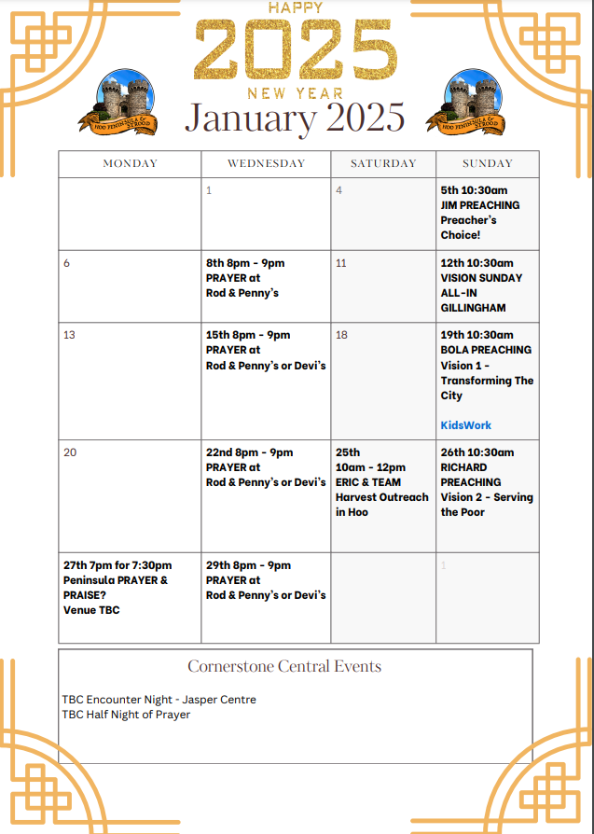

Slide 33


Slide 34
Servant King
CCLI Song # 78897
Graham Kendrick
© 1983 Thankyou Music
For use solely with the SongSelect® Terms of Use. All rights reserved. www.ccli.com
CCLI Licence No. 33265

Slide 35
1/8
Verse 1
From heav'n You came helpless babe
Enter'd our world Your glory veil'd
Not to be served but to serve
And give Your life that we might live

Slide 36
1/8
Chorus
This is our God the Servant King
He calls us now to follow Him
To bring our lives as a daily offering
Of worship to the Servant King

Slide 37
3/8
Verse 2
There in the garden of tears
My heavy load He chose to bear
His heart with sorrow was torn
Yet not my will but Yours He said

Slide 38
4/8
Chorus
This is our God the Servant King
He calls us now to follow Him
To bring our lives as a daily offering
Of worship to the Servant King

Slide 39
5/8
Verse 3
Come see His hands and His feet
The scars that speak of sacrifice
Hands that flung stars into space
To cruel nails
Surrendered

Slide 40
6/8
Chorus
This is our God the Servant King
He calls us now to follow Him
To bring our lives as a daily offering
Of worship to the Servant King

Slide 41
7/8
Verse 4
So let us learn how to serve
And in our lives enthrone Him
Each other's needs to prefer
For it is Christ we're serving

Slide 42
8/8
Chorus
This is our God the Servant King
He calls us now to follow Him
To bring our lives as a daily offering
Of worship to the Servant King

Slide 43
2 Corinthians 14 May the grace of the Lord Jesus Christ, and the love of God, and the fellowship of the Holy Spirit be with you all
Surely goodness and mercy shall follow me all the days of my life, and I shall dwell in the house of the Lord forever.

