Slide 1
Cornerstone City Church Peninsula Plus Community Hoo Are Ya 02-10-2022

Slide 2
Glorious Day
CCLI Song # 7081388
Jason Ingram | Jonathan Smith | Kristian Stanfill | Sean Curran
© 2017 KPS 1.0 (Admin. by Capitol CMG Publishing)
sixsteps Music (Admin. by Capitol CMG Publishing)
sixsteps Songs (Admin. by Capitol CMG Publishing)
Sounds Of Jericho (Admin. by Capitol CMG Publishing)
Worship Together Music (Admin. by Capitol CMG Publishing)
worshiptogether.com songs (Admin. by Capitol CMG Publishing)
Fellow Ships Music (Admin. by Essential Music Publishing LLC)
Hickory Bill Doc (Admin. by Essential Music Publishing LLC)
So Essential Tunes (Admin. by Essential Music Publishing LLC)
For use solely with the SongSelect® Terms of Use. All rights reserved. www.ccli.com
CCLI Licence No. 33265

Slide 3
1/6
I was buried beneath my shame
Who could carry that kind of weight
It was my tomb 'til I met You

Slide 4
2/6
I was breathing but not alive
All my failures I tried to hide
It was my tomb 'til I met You

Slide 5
3/6
('Cause when) You called my name (and)
I ran out of that grave
Out of the darkness into Your glorious day
You called my name (and) I ran out of that grave
Out of the darkness into Your glorious day

Slide 6
4/6
Now Your mercy has saved my soul
Now Your freedom is all that I know
The old made new Jesus when I met You

Slide 7
5/6
I needed rescue my sin was heavy
But chains break at the weight of Your glory
I needed shelter I was an orphan
Now You call me a citizen of Heaven
When I was broken You were my healing
Now Your love is the air that I'm breathing
I have a future my eyes are open

Slide 8
6/6
('Cause when) You called my name (and)
I ran out of that grave
Out of the darkness into Your glorious day
You called my name (and)
I ran out of that grave
Out of the darkness into Your glorious day

Slide 9
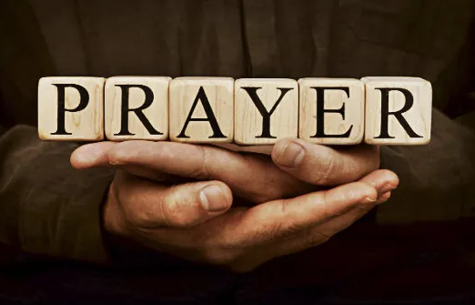

Slide 10
Firm Foundation (He Won't)
CCLI Song # 7188203
Austin Davis | Chandler Moore | Cody Carnes
© 2021 For Humans Publishing (Admin by Essential Music Publishing)
Maverick City Publishing (Admin by Essential Music Publishing)
Capitol CMG Paragon (Admin. by Capitol CMG Publishing)
TBCO Publishing (Admin. by Capitol CMG Publishing)
Writer's Roof Publishing (Admin. by Capitol CMG Publishing)
A.L.K.D. Music (Admin. by Watershed Music Group (Admin. by Capitol CMG Publishing))
For use solely with the SongSelect® Terms of Use. All rights reserved. www.ccli.com
CCLI Licence No. 33265

Slide 11
1/6
Christ is my firm foundation
The rock on which I stand
When everything around me is shaken
I've never been more glad
That I put my faith in Jesus
'Cause He's never let me down
He's faithful through generations
So why would He fail now

Slide 12
2/6
He won’t
He won't

Slide 13
3/6
I've still got joy in chaos
I've got peace that makes no sense
So I won't be going under
I'm not held by my own strength
'Cause I've built my life on Jesus
He's never let me down
He's faithful in every season
So why would He fail now

Slide 14
4/6
He won’t He won't
He won't fail
He won't fail

Slide 15
5/6
Rain came and wind blew
My house was built on You
I'm safe with You
I'm going to make it through

Slide 16
6/6
I'm going to make it through
‘Cause I’m standing strong on You
I’m going to make it through
‘Cause my house is built on You

Slide 18
In Christ Alone
CCLI Song # 3350395
Keith Getty | Stuart Townend
© 2001 Thankyou Music (Admin. by Integrity Music Ltd)
For use solely with the SongSelect® Terms of Use. All rights reserved. www.ccli.com
CCLI Licence No. 33265

Slide 19
1/4
In Christ alone my hope is found
He is my light my strength my song
This Cornerstone this solid Ground
Firm through the fiercest drought and storm
What heights of love what depths of peace
When fears are stilled when strivings cease
My Comforter my All in All
Here in the love of Christ I stand

Slide 20
2/4
In Christ alone who took on flesh
Fullness of God in helpless babe
This gift of love and righteousness
Scorned by the ones He came to save
Till on that cross as Jesus died
The wrath of God was satisfied
For every sin on Him was laid
Here in the death of Christ I live

Slide 21
3/4
There in the ground His body lay
Light of the world by darkness slain
Then bursting forth in glorious Day
Up from the grave He rose again
And as He stands in victory
Sin's curse has lost its grip on me
For I am His and He is mine
Bought with the precious blood of Christ

Slide 22
4/4
No guilt in life no fear in death
This is the power of Christ in me
From life's first cry to final breath
Jesus commands my destiny
No power of hell no scheme of man
Can ever pluck me from His hand
Till He returns or calls me home
Here in the power of Christ I'll stand

Slide 24


Slide 25

15th Oct

Slide 26
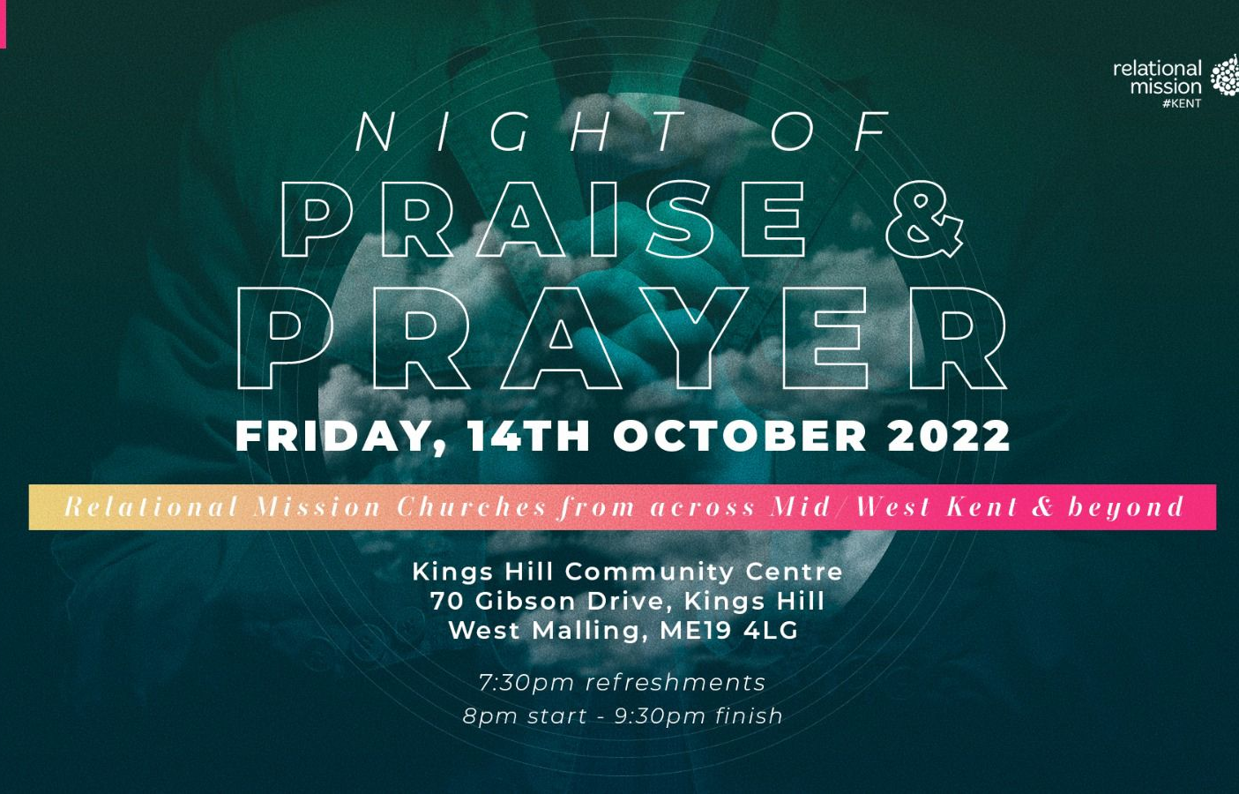

Slide 27


Slide 28
My Worship
CCLI Song # 7098688
Philip Nathan Thompson | Zenzo Matoga
© 2017 Integrity Worship Music (Admin. by Integrity Music Ltd)
Phil Thompson Worship (Admin. by Integrity Music Ltd)
Zenzo Matoga Music (Admin. by Integrity Music Ltd)
For use solely with the SongSelect® Terms of Use. All rights reserved. www.ccli.com
CCLI Licence No. 33265

Slide 29
1/3
You Lord
You are worthy
And no one can worship You for me
For all of the things You've done for me
And no one can worship You for me

Slide 30
2/3
Here's my worship
All of my worship
Receive my worship
All of my worship
(REPEAT)

Slide 31
3/3
And I will not be silent
I will always worship You
As long as I am breathing
I will always worship You

Slide 32
1/1
Thank You, Thank You
Thank You, Thank You
Thank You, Thank You
For all you have done
(REPEAT)

Slide 33
I Speak Jesus
CCLI Song # 7136201
Abby Benton | Carlene Prince | Dustin Smith | Jesse Reeves | Kristen Dutton | Raina Pratt
© 2019 Here Be Lions Publishing (Admin. by Integrity Music Ltd)
Integrity's Praise! Music (Admin. by Integrity Music Ltd)
BEC Worship (Admin. by Song Solutions)
Raina Pratt publishing designee (Admin. by Song Solutions www.songsolutions.org)
WriterWrong Music (Admin. by Song Solutions www.songsolutions.org)
Remaining portion is unaffiliated
For use solely with the SongSelect® Terms of Use. All rights reserved. www.ccli.com
CCLI Licence No. 33265

Slide 34
1/5
I just want to speak the Name of Jesus
Over ev'ry heart and ev'ry mind
'Cause I know there is peace within Your presence
I speak Jesus

Slide 35
2/5
I just want to speak the Name of Jesus
'Til ev'ry dark addiction starts to break
Declaring there is hope and there is freedom
I speak Jesus

Slide 36
3/5
('Cause) Your Name is power
Your Name is healing
Your Name is life
Break ev'ry stronghold
Shine through the shadows
Burn like a fire

Slide 37
4/5
I just want to speak the Name of Jesus
Over fear and all anxiety
To ev'ry soul held captive by depression
I speak Jesus

Slide 38
5/5
Shout Jesus from the mountains
Jesus in the streets
Jesus in the darkness over ev'ry enemy
Jesus for my fam'ly
I speak the holy Name Jesus

