Slide 1
Cornerstone City Church Peninsula Plus Community Hoo Are Ya
6th September 2026

Slide 2
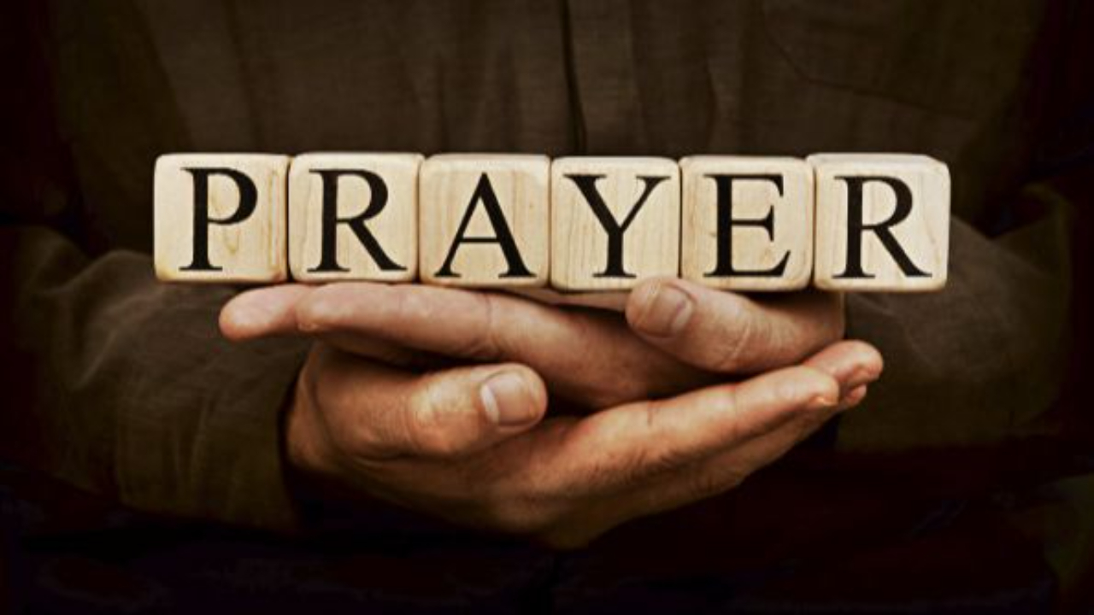

Slide 3
I reach Up High
CCLI Song # 1075387
Judy Bailey
© 1993 Song Solutions Daybreak (Admin. by Song Solutions www.songsolutions.org)
For use solely with the SongSelect® Terms of Use. All rights reserved. www.ccli.com
CCLI Licence No. 33265

Slide 4
1/5
I reach up high I touch the ground
I stomp my feet and turn around
I've got to (woo woo) Praise the Lord
I jump and dance with all my might
I might look funny but that's alright
I've got to (woo woo)
Praise my Lord

Slide 5
2/5
I'll do anything just for my God
'Cause He's done ev'rything for me
It doesn't matter who is looking on
Jesus is the person that I want to please

Slide 6
3/5
I reach up high I touch the ground
I stomp my feet and turn around
I've got to (woo woo) Praise the Lord
I jump and dance with all my might
I might look funny but that's alright
I've got to (woo woo)
Praise my Lord

Slide 7
4/5
May my whole life be a song of praise
To worship God in ev'ry way
In this song the actions praise His name
I want my actions ev'ry day to do the same

Slide 8
5/5
I reach up high I touch the ground
I stomp my feet and turn around
I've got to (woo woo) Praise the Lord
I jump and dance with all my might
I might look funny but that's alright
I've got to (woo woo)
Praise my Lord

Slide 9
Praise
CCLI Song # 7213077
© Brandon Lake MusicFor Humans PublishingMaverick City PublishingCapitol CMG GenesisCapitol CMG ParagonHousefires SoundsWriter's Roof PublishingMusic by Elevation Worship Publishing
For use solely with the SongSelect® Terms of Use. All rights reserved. www.ccli.com
Note: Reproduction of this sheet music requires a CCLI Music Reproduction Licence. Please report all copies.
CCLI Licence No. 33265

Slide 10
1/10
I’ll praise in the valley
Praise on the mountain
I’ll praise when I’m sure
Praise when I’m doubting

Slide 11
2/10
I’ll praise when outnumbered
Praise when surrounded
'Cause praise is the water
My enemies drown in

Slide 12
3/10
As long as I’m breathing
I’ve got a reason to Praise the Lord oh my soul
Praise the Lord oh my soul

Slide 13
4/10
I’ll praise when I feel it
And I’ll praise when I don’t
I’ll praise 'cause I know
You’re still in control

Slide 14
5/10
'Cause my praise is a weapon
It’s more than a sound
My praise is the shout
That brings Jericho down

Slide 15
6/10
As long as I’m breathing
I’ve got a reason to Praise the Lord oh my soul
Praise the Lord oh my soul

Slide 16
7/10
I won’t be quiet
My God is alive
How could I keep it inside
Praise the Lord oh my soul

Slide 17
8/10
I’ll praise 'cause You’re sovereign
Praise 'cause You reign
Praise 'cause You rose and defeated the grave
I’ll praise 'cause You’re faithful
Praise 'cause You’re true
Praise 'cause there’s nobody greater than You

Slide 18
9/10
Praise the Lord oh my soul
Praise the Lord oh my soul
Praise the Lord oh my soul
Praise the Lord oh my soul
I won’t be quiet
My God is alive
How could I keep it inside

Slide 19
1 0/10
I won’t be quiet
My God is alive
How could I keep it inside
I won’t be quiet
My God is alive
How could I keep it inside
Praise the Lord oh my soul

Slide 21
Christ is Enough
CCLI Song # 6514035
Jonas Myrin | Reuben Morgan
© 2012 Hillsong MP Songs; Hillsong Music Publishing Australia
For use solely with the SongSelect® Terms of Use. All rights reserved. www.ccli.com
CCLI License # 33265

Slide 22
1/6
Christ is my reward and all of my devotion
Now there's nothing in this world
That could ever satisfy
Through every trial my soul will sing
No turning back I've been set free

Slide 23
2/6
Christ is enough for me
Christ is enough for me
Everything I need is in You
Everything I need

Slide 24
3/6
Christ my all in all the joy of my salvation
And this hope will never fail
Heaven is our home
Through every storm my soul will sing
Jesus is here to God be the glory

Slide 25
4/6
Christ is enough for me
Christ is enough for me
Everything I need is in You
Everything I need

Slide 26
5/6
I have decided to follow Jesus
No turning back no turning back The cross before me the world behind me
No turning back no turning back

Slide 27
6/6
Christ is enough for me
Christ is enough for me
Everything I need is in You
Everything I need

Slide 29
Trust In God
CCLI Song # 7206001
Brandon Lake | Chris Brown | Mitch Wong | Steven Furtick
© Brandon Lake Music; Music by Elevation Worship Publishing; A Wong Made Write Publishing; Integrity's Praise! Music
For use solely with the SongSelect® Terms of Use. All rights reserved. www.ccli.com
CCLI Licence No. 33265

Slide 30
1/8
Blessed assurance
Jesus is mine
He's been my fourth man in the fire
Time after time

Slide 31
2/8
Born of His Spirit
Washed in His blood
And what He did for me on Calvary
Is more than enough

Slide 32
3/8
I trust in God
My Savior, the One
Who will never fail
He will never fail

Slide 33
4/8
Perfect submission
All is at rest
I know the author of tomorrow
Has ordered my steps

Slide 34
5/8
So this is my story
And this is my song
I’m praising my risen King and Savior
All the day long

Slide 35
6/8
I trust in God
My Savior, the One
Who will never fail
He will never fail

Slide 36
7/8
I sought the Lord and
He heard and He answered
(X3)
That’s why I trust Him
That’s why (I trust Him)

Slide 37
8/8
I trust in God
My Savior, the One
Who will never fail
He will never fail

Slide 39


Slide 40


Slide 41
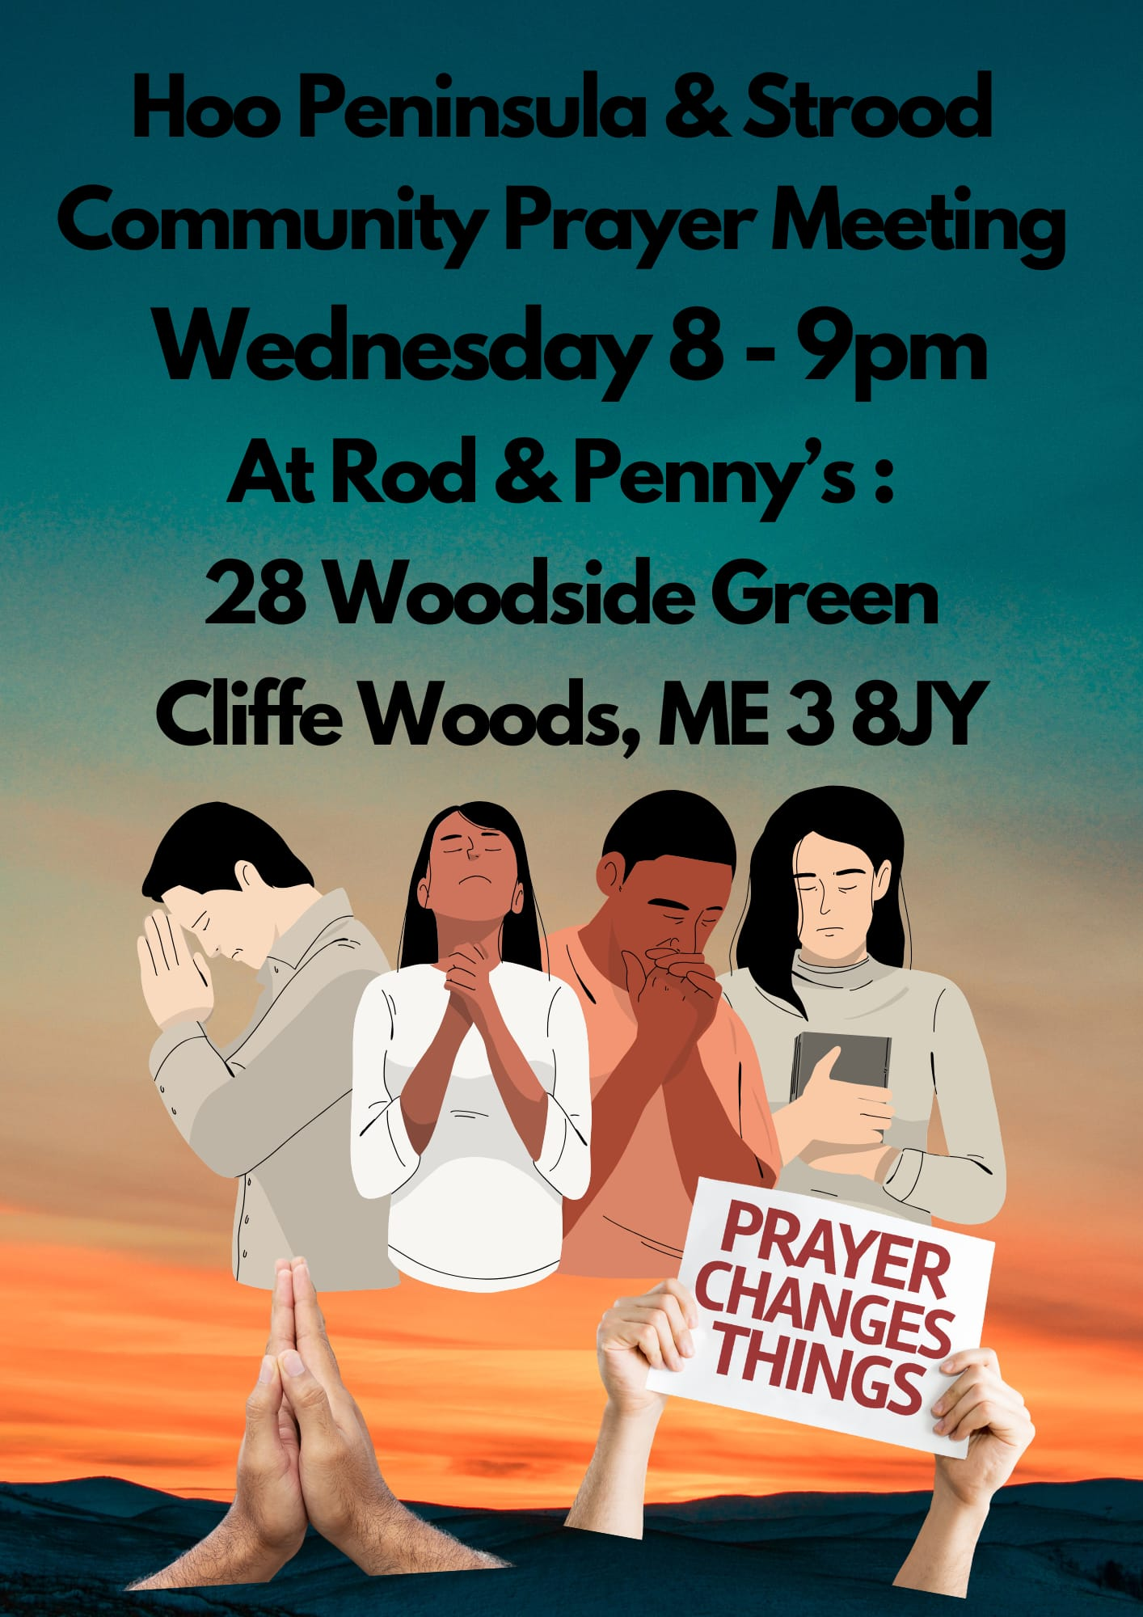

Slide 42
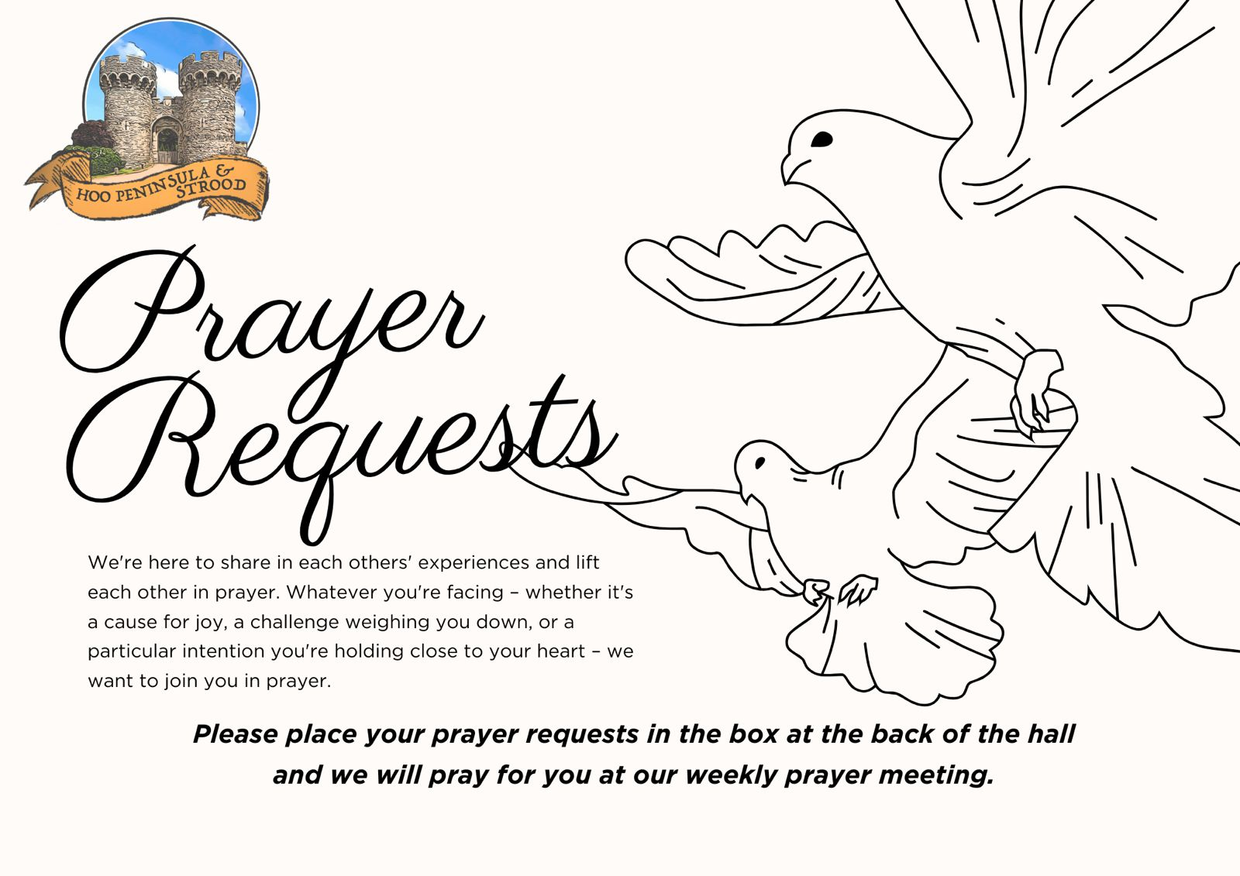

Slide 43
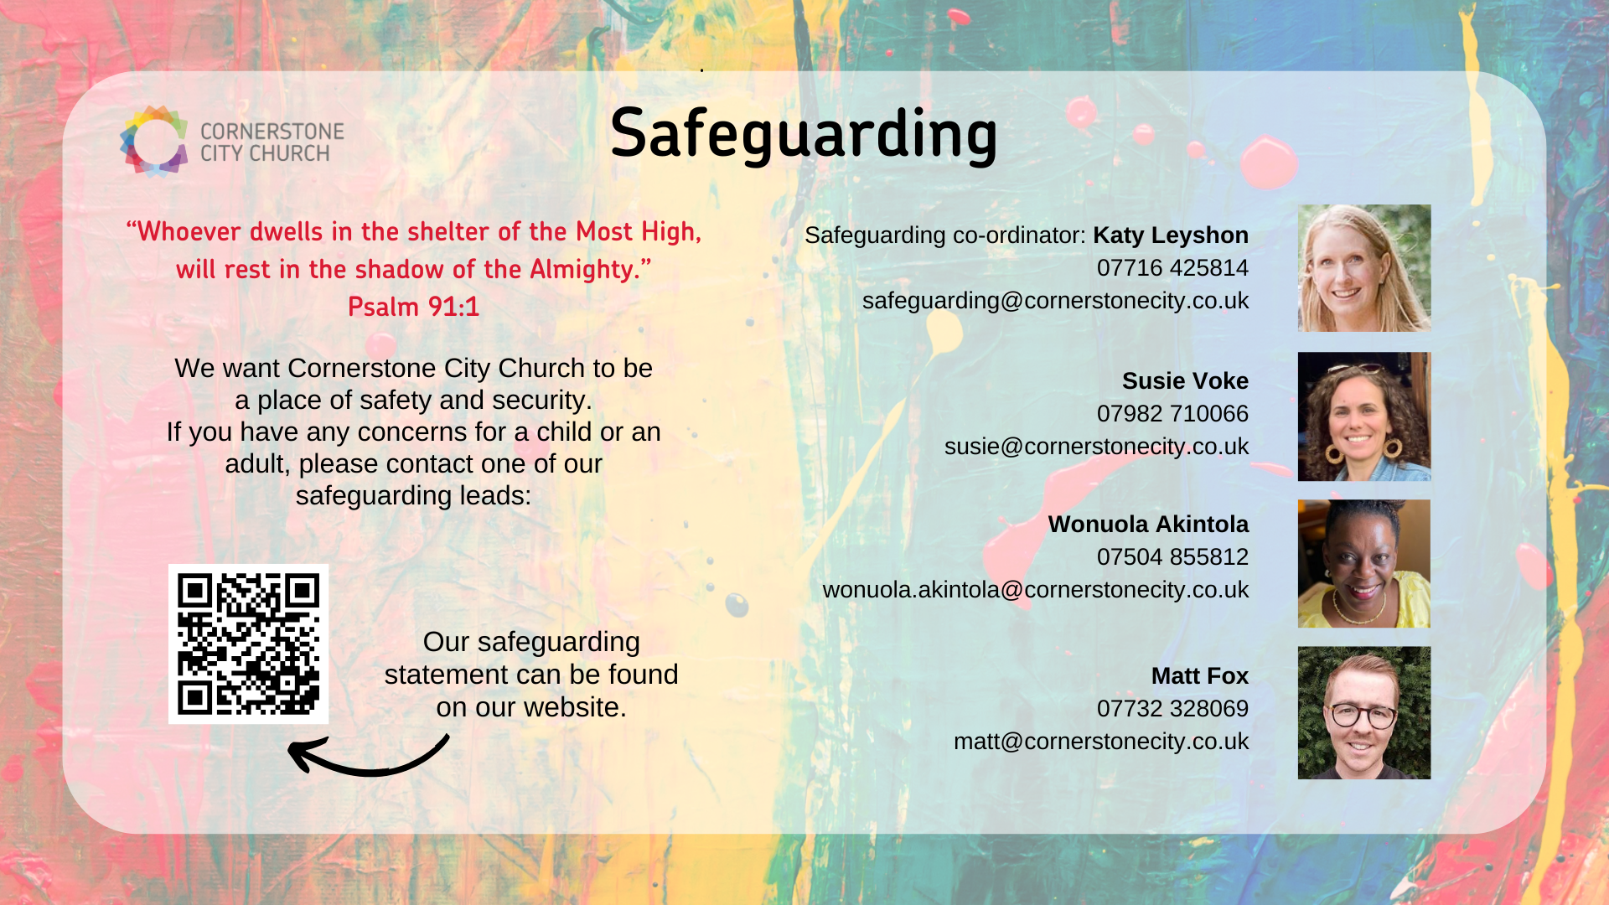

Slide 44


Slide 45


Slide 46
In Christ Alone
CCLI Song # 3350395
Keith Getty | Stuart Townend
© 2001 Thankyou Music (Admin. by Integrity Music Ltd)
For use solely with the SongSelect® Terms of Use. All rights reserved. www.ccli.com
CCLI Licence No. 33265

Slide 47
1/4
In Christ alone my hope is found
He is my light my strength my song
This Cornerstone this solid Ground
Firm through the fiercest drought and storm
What heights of love what depths of peace
When fears are stilled when strivings cease
My Comforter my All in All
Here in the love of Christ I stand

Slide 48
2/4
In Christ alone who took on flesh
Fullness of God in helpless babe
This gift of love and righteousness
Scorned by the ones He came to save
Till on that cross as Jesus died
The wrath of God was satisfied
For every sin on Him was laid
Here in the death of Christ I live

Slide 49
3/4
There in the ground His body lay
Light of the world by darkness slain
Then bursting forth in glorious Day
Up from the grave He rose again
And as He stands in victory
Sin's curse has lost its grip on me
For I am His and He is mine
Bought with the precious blood of Christ

Slide 50
4/4
No guilt in life no fear in death
This is the power of Christ in me
From life's first cry to final breath
Jesus commands my destiny
No power of hell no scheme of man
Can ever pluck me from His hand
Till He returns or calls me home
Here in the power of Christ I'll stand

Slide 51
Living Hope CCLI Song # 7106807
Brian Johnson | Phil Wickham
© 2017 Phil Wickham Music; Simply Global Songs; Sing My Songs; Bethel Music Publishing
For use solely with the SongSelect® Terms of Use. All rights reserved. www.ccli.com
CCLI Licence No. 33265

Slide 52
1/6
How great the chasm that lay between us
How high the mountain I could not climb
In desperation I turned to heaven
And spoke Your name into the night
Then through the darkness Your loving-kindness
Tore through the shadows of my soul
The work is finished the end is written
Jesus Christ my living hope

Slide 53
2/6
Who could imagine so great a mercy
What heart could fathom such boundless grace
The God of ages stepped down from glory
To wear my sin and bear my shame
The cross has spoken I am forgiven
The King of kings calls me His own
Beautiful Savior I’m Yours forever
Jesus Christ my living hope

Slide 54
3/6
Hallelujah praise the One who set me free
Hallelujah death has lost its grip on me
You have broken every chain
There’s salvation in Your name
Jesus Christ my living hope

Slide 55
4/6
Then came the morning that sealed the promise
Your buried body began to breathe
Out of the silence the Roaring Lion
Declared the grave has no claim on me
(REPEAT)
Jesus Yours is the victory whoa

Slide 56
5/6
Hallelujah praise the One who set me free
Hallelujah death has lost its grip on me
You have broken every chain
There’s salvation in Your name
Jesus Christ my living hope

Slide 57
6/6
Jesus Christ my living hope
Oh God You are my living hope

Slide 58
2 Corinthians 14 May the grace of the Lord Jesus Christ, and the love of God, and the fellowship of the Holy Spirit be with us all. And….
Surely goodness and mercy shall follow us all the days of our lives, and we shall dwell in the house of the Lord forever.

Slide 59
Amen!

