Slide 1
Cornerstone City Church Peninsula Plus Community Hoo Are Ya 10-05-2023

Slide 2
Your Love Never Fails
CCLI Song # 5337172
Anthony Skinner | Chris McClarney
© 2008 Integrity's Alleluia! Music (Admin. by Integrity Music Ltd)
Out Of The Cave Music (Admin. by Integrity Music Ltd)
Thankyou Music (Admin. by Integrity Music Ltd)
For use solely with the SongSelect® Terms of Use. All rights reserved. www.ccli.com
CCLI Licence No. 33265

Slide 3
1/4
Nothing can separate
Even if I ran away
Your love never fails
I know I still make mistakes but
You have new mercies for me ev'ryday
Your love never fails

Slide 4
2/4
(And) You stay the same through the ages
Your love never changes
There may be pain in the night
But joy comes in the morning
And when the oceans rage
I don't have to be afraid
Because I know that You love me
(Your love never fails)

Slide 5
3/4
The wind is strong and the water's deep
But I'm not alone here in these open seas
Your love never fails
The chasm is far too wide
I never thought I'd reach the other side
Your love never fails

Slide 6
4/4
You make all things
Work together for my good
You make all things
Work together for my good

Slide 7
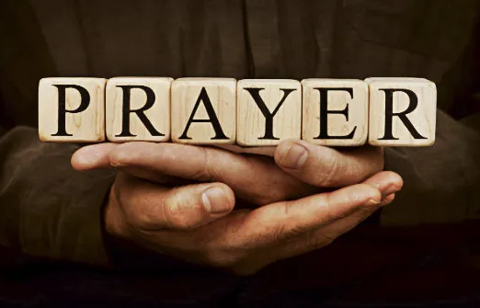

Slide 8
Firm Foundation (He Won't)
CCLI Song # 7188203
Austin Davis | Chandler Moore | Cody Carnes
© 2021 For Humans Publishing (Admin by Essential Music Publishing)
Maverick City Publishing (Admin by Essential Music Publishing)
Capitol CMG Paragon (Admin. by Capitol CMG Publishing)
TBCO Publishing (Admin. by Capitol CMG Publishing)
Writer's Roof Publishing (Admin. by Capitol CMG Publishing)
A.L.K.D. Music (Admin. by Watershed Music Group (Admin. by Capitol CMG Publishing))
For use solely with the SongSelect® Terms of Use. All rights reserved. www.ccli.com
CCLI Licence No. 33265

Slide 9
1/6
Christ is my firm foundation
The rock on which I stand
When everything around me is shaken
I've never been more glad
That I put my faith in Jesus
'Cause He's never let me down
He's faithful through generations
So why would He fail now

Slide 10
2/6
He won’t
He won't

Slide 11
3/6
I've still got joy in chaos
I've got peace that makes no sense
So I won't be going under
I'm not held by my own strength
'Cause I've built my life on Jesus
He's never let me down
He's faithful in every season
So why would He fail now

Slide 12
4/6
He won’t He won't
He won't fail
He won't fail

Slide 13
5/6
Rain came and wind blew
My house was built on You
I'm safe with You
I'm going to make it through

Slide 14
6/6
I'm going to make it through
‘Cause I’m standing strong on You
I’m going to make it through
‘Cause my house is built on You

