Slide 1
10,000 Reasons
CCLI Song # 6016351
Jonas Myrin | Matt Redman
© 2011 Thankyou Music (Admin. by Integrity Music Ltd)
Atlas Mountain Songs (Admin. by SHOUT! Music Publishing UK)
For use solely with the SongSelect® Terms of Use. All rights reserved. www.ccli.com
CCLI Licence No. 33265

Slide 2
1/7
Bless the Lord O my soul O my soul
Worship His holy name
Sing like never before O my soul
I'll worship Your holy name

Slide 3
2/7
The sun comes up it's a new day dawning
It's time to sing Your song again
Whatever may pass and whatever lies before me
Let me be singing when the evening comes

Slide 4
3/7
Bless the Lord O my soul O my soul
Worship His holy name
Sing like never before O my soul
I'll worship Your holy name

Slide 5
4/7
You're rich in love and You're slow to anger
Your name is great and Your heart is kind
For all Your goodness I will keep on singing
Ten thousand reasons for my heart to find

Slide 6
5/7
Bless the Lord O my soul O my soul
Worship His holy name
Sing like never before O my soul
I'll worship Your holy name

Slide 7
6/7
And on that day when my strength is failing
The end draws near and my time has come
Still my soul will sing Your praise unending
Ten thousand years and then forevermore

Slide 8
7/7
Bless the Lord O my soul O my soul
Worship His holy name
Sing like never before O my soul
I'll worship Your holy name

Slide 9
In Christ Alone
CCLI Song # 3350395
Keith Getty | Stuart Townend
© 2001 Thankyou Music (Admin. by Integrity Music Ltd)
For use solely with the SongSelect® Terms of Use. All rights reserved. www.ccli.com
CCLI Licence No. 33265

Slide 10
1/4
In Christ alone my hope is found
He is my light my strength my song
This Cornerstone this solid Ground
Firm through the fiercest drought and storm
What heights of love what depths of peace
When fears are stilled when strivings cease
My Comforter my All in All
Here in the love of Christ I stand

Slide 11
2/4
In Christ alone who took on flesh
Fullness of God in helpless babe
This gift of love and righteousness
Scorned by the ones He came to save
Till on that cross as Jesus died
The wrath of God was satisfied
For every sin on Him was laid
Here in the death of Christ I live

Slide 12
3/4
There in the ground His body lay
Light of the world by darkness slain
Then bursting forth in glorious Day
Up from the grave He rose again
And as He stands in victory
Sin's curse has lost its grip on me
For I am His and He is mine
Bought with the precious blood of Christ

Slide 13
4/4
No guilt in life no fear in death
This is the power of Christ in me
From life's first cry to final breath
Jesus commands my destiny
No power of hell no scheme of man
Can ever pluck me from His hand
Till He returns or calls me home
Here in the power of Christ I'll stand

Slide 14
What A Friend We Have In Jesus
CCLI Song # 7206913
Charles Crozat Converse | Joseph Medlicott Scriven | Paul Baloche
© Words: Public Domain; Music: Integrity Worship Music; Leadworship Songs
For use solely with the SongSelect® Terms of Use. All rights reserved. www.ccli.com
CCLI Licence No. 33265

Slide 15
1/3
What a friend we have in Jesus
All our sins and griefs to bear
What a privilege to carry
Everything to God in prayer
O what peace we often forfeit
O what needless pain we bear
All because we do not carry
Everything to God in prayer

Slide 16
2/3
Have we trials and temptations
Is there trouble anywhere
We should never be discouraged
Take it to the Lord in prayer
Can we find a friend so faithful
Who will all our sorrows share
Jesus knows our every weakness
Take it to the Lord in prayer

Slide 17
3/3
Are we weak and heavy laden
Cumbered with a load of care
Precious Saviour still our refuge
Take it to the Lord in prayer
Do thy friends despise forsake thee
Take it to the Lord in prayer
In His arms He'll take and shield thee
Thou wilt find a solace there

Slide 18
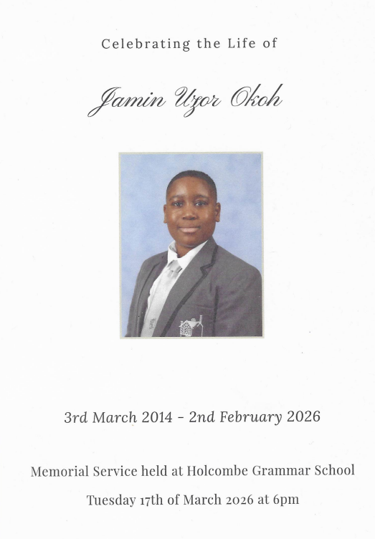

Slide 19
The Blessing
CCLI Song # 7147007
Chris Brown | Cody Carnes | Kari Jobe | Steven Furtick
© 2020 Capitol CMG Paragon; Kari Jobe Carnes Music; Worship Together Music; Writer's Roof Publishing; Music by Elevation Worship Publishing
For use solely with the SongSelect® Terms of Use. All rights reserved. www.ccli.com
CCLI Licence No. 33265

Slide 20
1/8
The Lord bless you
And keep you
Make His face shine upon you
And be gracious to you
The Lord turn His
Face toward you
And give you peace

Slide 21
2/8
Amen
Amen
Amen

Slide 22
3/8
The Lord bless you
And keep you
Make His face shine upon you
And be gracious to you
The Lord turn His
Face toward you
And give you peace

Slide 23
4/8
Amen
Amen
Amen

Slide 24
5/8
May His favour
Be upon you
And a thousand generations
And your family
And your children
And their children
And their children

Slide 25
6/8
May His presence
Go before you
And behind you
And beside you
All around you
And within you
He is with you
He is with you

Slide 26
7/8
In the morning
In the evening
In your coming
And your going
In your weeping
And rejoicing
He is for you
He is for you

Slide 27
8/8
Amen
Amen
Amen

Slide 28
Still
CCLI Song # 3940963
Reuben Morgan
© 2002 Hillsong Music Publishing Australia (Admin. by Hillsong Music Publishing UK)
For use solely with the SongSelect® Terms of Use. All rights reserved. www.ccli.com
CCLI Licence No. 33265

Slide 29
1/3
Hide me now
Under Your wings
Cover me
Within Your mighty hand

Slide 30
2/3
When the oceans rise
And thunders roar
I will soar with You
Above the storm
Father You are King
Over the flood
I will be still and know
You are God

Slide 31
3/3
Find rest my soul
In Christ alone
Know His power
In quietness and trust

