Slide 1
Cornerstone City Church Peninsula Plus Community Hoo Are Ya
2nd June 2024

Slide 2
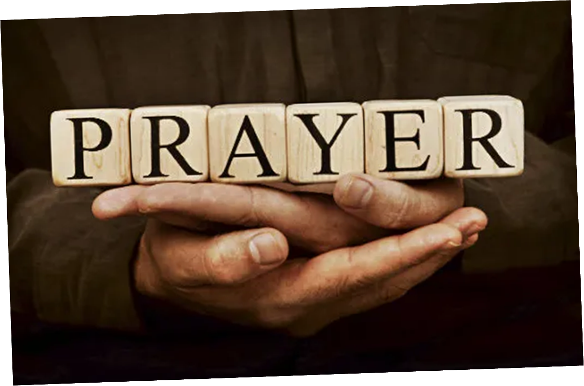

Slide 3


Slide 4
Our God Saves
CCLI Song # 4972837
Brenton Brown | Paul Baloche
© 2007 Integrity's Hosanna! Music (Admin. by Integrity Music Ltd)
Leadworship Songs (Admin. by Integrity Music Ltd)
Thankyou Music (Admin. by Integrity Music Ltd)
For use solely with the SongSelect® Terms of Use. All rights reserved. www.ccli.com
CCLI Licence No. 33265

Slide 5
1/3
In the name of the Father
In the name of the Son
In the name of the Spirit,
Lord we come
We're gather'd together,
To lift up Your name
To call on our Savior to fall on Your grace

Slide 6
2/3
Hear the joyful sound of our offering
As Your saints bow down
As Your people sing
We will rise with You lifted on Your wings
And the world will see that

Slide 7
3/3
Our God saves our God saves
There is hope in Your name
Mourning turns to songs of praise
Our God saves our God saves

Slide 8
The Lion And The Lamb
CCLI Song # 7038281
Brenton Brown | Brian Johnson | Leeland Mooring
© 2015 Meaux Mercy (Admin. by Capitol CMG Publishing)
The Devil Is A Liar! Publishing (Admin. by Capitol CMG Publishing)
Thankyou Music (Admin. by Integrity Music)
Bethel Music Publishing (Admin. by Song Solutions)
For use solely with the SongSelect® Terms of Use. All rights reserved. www.ccli.com
CCLI Licence No. 33265

Slide 9
1/5
He's coming on the clouds Kings and kingdoms will bow down And every chain will break As broken hearts declare His praise For who can stop the Lord Almighty

Slide 10
2/5
Our God is the Lion, the Lion of Judah He's roaring with power And fighting our battles And every knee will bow before Him

Slide 11
3/5
Our God is the Lamb, the Lamb that was slain For the sins of the world His blood breaks the chains And every knee will bow before the Lion and the Lamb Every knee will bow before Him

Slide 12
4/5
So open up the gates Make way before the King of kings The God who comes to save Is here to set the captives free For who can stop the Lord Almighty

Slide 13
5/5
Who can stop the Lord Almighty Who can stop the Lord (Almighty)

Slide 15
King of Kings
CCLI Song # 7127647
Brooke Ligertwood | Jason Ingram | Scott Ligertwood
© 2019 Fellow Ships Music (Admin. by Essential Music Publishing LLC)
So Essential Tunes (Admin. by Essential Music Publishing LLC)
Hillsong Music Publishing Australia (Admin. by Hillsong Music Publishing UK)
For use solely with the SongSelect® Terms of Use. All rights reserved. www.ccli.com
CCLI Licence No. 33265

Slide 16
1/9
In the darkness we were waiting
Without hope without light
Till from Heaven You came running
There was mercy in Your eyes

Slide 17
2/9
To fulfil the law and prophets
To a virgin came the Word
From a throne of endless glory
To a cradle in the dirt

Slide 18
3/9
Praise the Father
Praise the Son
Praise the Spirit three in one
God of Glory
Majesty
Praise forever to the King of kings

Slide 19
4/9
To reveal the kingdom coming
And to reconcile the lost
To redeem the whole creation
You did not despise the cros

Slide 20
5/9
For even in Your suffering
You saw to the other side
Knowing this was our salvation
Jesus for our sake You died

Slide 21
6/9
And the morning that You rose
All of heaven held its breath
Till that stone was moved for good
For the Lamb had conquered death

Slide 22
7/9
And the dead rose from their tombs
And the angels stood in awe
For the souls of all who'd come
To the Father are restored

Slide 23
8/9
And the Church of Christ was born
Then the Spirit lit the flame
Now this Gospel truth of old
Shall not kneel shall not faint

Slide 24
9/9
By His blood and in His Name
In His freedom I am free
For the love of Jesus Christ
Who has resurrected me

Slide 25
Majesty
CCLI Song # 4219071
Martin Smith | Stuart Garrard
© 2003, 2004 Curious? Music UK
For use solely with the SongSelect® Terms of Use. All rights reserved. www.ccli.com
CCLI Licence No. 33265

Slide 26
1/4
Here I am
Humbled by Your majesty
Covered by Your grace so free
Here I am
Knowing I'm a sinful man
Covered by the blood of the Lamb

Slide 27
2/4
Now I've found the greatest love of all is mine
Since You laid down Your life
The greatest sacrifice

Slide 28
3/4
Majesty majesty
Your grace has found me just as I am
Empty handed but alive in Your hands
Majesty majesty
Forever I am changed by Your love
In the presence of Your majesty

Slide 29
4/4
Here I am
Humbled by the love that You give
Forgiven so that I can forgive
Here I stand
Knowing that I'm Your desire
Sanctified by glory and fire

Slide 30
1/1
All hail King Jesus
All hail the Lord of Heaven and earth
All hail King Jesus
All hail the Savior of the world

Slide 32


Slide 33


Slide 34


Slide 35


Slide 38
2 Corinthians 14 May the grace of the Lord Jesus Christ, and the love of God, and the fellowship of the Holy Spirit be with you all

