Slide 1
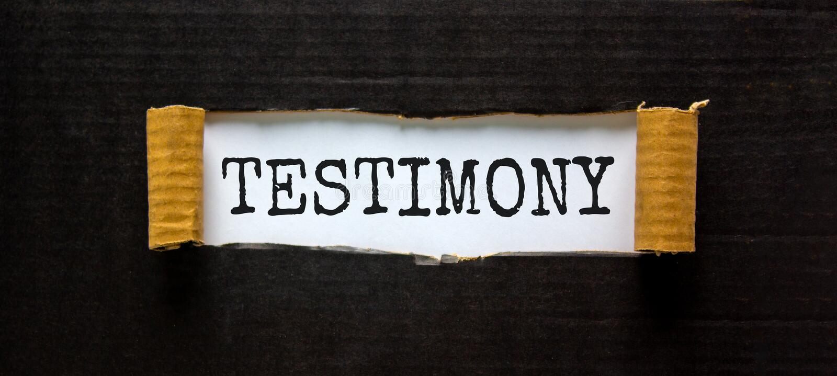

Hoo Are Ya 5-12-2021

Slide 2
I Am Fearfully And Wonderfully Made
CCLI Song # 1088972
Jim Bailey
© 1994 Thankyou Music (Admin. by Integrity Music Ltd)
For use solely with the SongSelect® Terms of Use. All rights reserved. www.ccli.com
CCLI Licence No. 33265

Slide 3
1/2
I am fearfully and wonderfully made
I am fearfully and wonderfully made
He who put the stars in place
And knows them all by name
Has made me fearfully and wonderfully made

Slide 4
2/2
I am made in the image of God
I am made in the image of God
From the top of my head to the tip of my toes
My Lord my name He knows
I am made in the image of God

Slide 5
I reach Up High
CCLI Song # 1075387
Judy Bailey
© 1993 Song Solutions Daybreak (Admin. by Song Solutions www.songsolutions.org)
For use solely with the SongSelect® Terms of Use. All rights reserved. www.ccli.com
CCLI Licence No. 33265

Slide 6
1/3
I reach up high I touch the ground
I stomp my feet and turn around
I've got to (woo woo) Praise the Lord
I jump and dance with all my might
I might look funny but that's alright
I've got to (woo woo)
Praise my Lord

Slide 7
2/3
I'll do anything just for my God
'Cause He's done ev'rything for me
It doesn't matter who is looking on
Jesus is the person that I want to please

Slide 8
3/3
May my whole life be a song of praise
To worship God in ev'ry way
In this song the actions praise His name
I want my actions ev'ry day to do the same

Slide 9


Slide 10
Every Praise
CCLI Song # 6623483
Hezekiah Walker | John David Bratton
© 2013 Davo Pavo Music (Admin. by BMG Rights Management GmbH)
Li'l Eva Music (Admin. by Capitol CMG Publishing)
Luv Ki Publishing (Admin. by Capitol CMG Publishing)
For use solely with the SongSelect® Terms of Use. All rights reserved. www.ccli.com
CCLI Licence No. 33265

Slide 11
1/2
Every praise is to our God
Every word of worship with one accord
Every praise every praise is to our God
Sing hallelujah to our God
Glory hallelujah is due our God
Every praise every praise is to our God

Slide 12
2/2
God my Saviour
God my Healer
God my Deliverer
Yes He is yes He is
(Yes He is yes He is)

Slide 13


Slide 14
Your Love Never Fails
CCLI Song # 5337172
Anthony Skinner | Chris McClarney
© 2008 Integrity's Alleluia! Music (Admin. by Integrity Music Ltd)
Out Of The Cave Music (Admin. by Integrity Music Ltd)
Thankyou Music (Admin. by Integrity Music Ltd)
For use solely with the SongSelect® Terms of Use. All rights reserved. www.ccli.com
CCLI Licence No. 33265

Slide 15
1/4
Nothing can separate
Even if I ran away
Your love never fails
I know I still make mistakes but
You have new mercies for me ev'ryday
Your love never fails

Slide 16
2/4
You stay the same through the ages
Your love never changes
There may be pain in the night
But joy comes in the morning
And when the oceans rage
I don't have to be afraid
Because I know that You love me
(Your love never fails)

Slide 17
3/4
The wind is strong and the water's deep
But I'm not alone here in these open seas
Your love never fails
The chasm is far too wide
I never thought I'd reach the other side
Your love never fails

Slide 18
4/4
You make all things
Work together for my good
You make all things
Work together for my good

Slide 19
Blessed Be Your Name
CCLI Song # 3798438
Beth Redman | Matt Redman
© 2002 Thankyou Music (Admin. by Integrity Music Ltd)
For use solely with the SongSelect® Terms of Use. All rights reserved. www.ccli.com
CCLI Licence No. 33265

Slide 20
1/7
Blessed be Your name
In the land that is plentiful
Where Your streams of abundance flow
Blessed be Your name

Slide 21
2/7
Blessed be Your name
When I'm found in the desert place
Though I walk through the wilderness
Blessed be Your name

Slide 22
3/7
Ev’ry blessing You pour out I’ll
Turn back to praise
When the darkness closes in Lord
Still I will say

Slide 23
4/7
Blessed be the name of the Lord
Blessed be Your name
Blessed be the name of the Lord
Blessed be Your glorious name

Slide 24
5/7
Blessed be Your name
When the sun's shining down on me
When the world's all as it should be
Blessed be Your name

Slide 25
6/7
Blessed be Your name
On the road marked with suffering
Though there's pain in the offering
Blessed be Your name

Slide 26
7/7
You give and take away
You give and take away
My heart will choose to say
Lord blessed be Your name

Slide 27


Slide 28


Slide 29
Shout To The Lord
CCLI Song # 1406918
Darlene Zschech
© 1993 Wondrous Worship (Admin. by Song Solutions www.songsolutions.org)
For use solely with the SongSelect® Terms of Use. All rights reserved. www.ccli.com
CCLI Licence No. 33265

Slide 30
1/3
My Jesus my Saviour
Lord there is none like You
All of my days I want to praise
The wonders of Your mighty love
My comfort my shelter
Tower of refuge and strength
Let every breath all that I am
Never cease to worship You

Slide 31
2/3
Shout to the Lord
All the earth let us sing
Power and majesty
Praise to the King
Mountains bow down
And the seas will roar
At the sound of Your name

Slide 32
3/3
I sing for joy
At the work of Your hands
Forever I'll love You
Forever I'll stand
Nothing compares to the promise
I have in You

Slide 33
Goodness Of God
CCLI Song # 7117726
Ben Fielding | Brian Johnson | Ed Cash | Jason Ingram | Jenn Johnson
© 2018 Capitol CMG Paragon (Admin. by Capitol CMG Publishing)
Fellow Ships Music (Admin. by Essential Music Publishing LLC)
So Essential Tunes (Admin. by Essential Music Publishing LLC)
SHOUT! Music Publishing Australia (Admin. by SHOUT! Music Publishing UK)
Bethel Music Publishing (Admin. by Song Solutions)
For use solely with the SongSelect® Terms of Use. All rights reserved. www.ccli.com
CCLI Licence No. 33265

Slide 34
1/5
I love You Lord
Oh Your mercy never fails me
All my days
I've been held in Your hands
From the moment that I wake up
Until I lay my head
I will sing of the goodness of God

Slide 35
2/5
All my life You have been faithful
All my life You have been so so good
With every breath that I am able
I will sing of the goodness of God

Slide 36
3/5
I love Your voice
You have led me through the fire
In darkest night
You are close like no other
I've known You as a father
I've known You as a friend
I have lived in the goodness of God

Slide 37
4/5
Your goodness is running after
It’s running after me
Your goodness is running after
It’s running after me
With my life laid down
I’m surrendered now
I give You everything
Your goodness is running after
It's running after me

Slide 38


Slide 39
Way Maker CCLI Song # 7115744
Osinachi Kalu Okoro Egbu
© 2016 Integrity Music Europe (Admin. by Integrity Music)
For use solely with the SongSelect® Terms of Use. All rights reserved. www.ccli.com
CCLI Licence No. 33265

Slide 40
1/4
You are here moving in our midst I worship You I worship You You are here working in this place I worship You I worship You
(You are) Way Maker Miracle Worker Promise Keeper Light in the darkness my God that is who You are

Slide 41
2/4
You are here touching ev'ry heart I worship You I worship You You are here healing ev'ry heart I worship You I worship You
(You are) Way Maker Miracle Worker Promise Keeper Light in the darkness my God that is who You are

Slide 42
You are here turning lives around I worship You I worship You You are here mending ev'ry heart I worship You yeah I worship You Lord
(You are) Way Maker Miracle Worker Promise Keeper Light in the darkness my God that is who You are
3/4

Slide 43
That is who You are x4
Even when I don't see it You're working Even when I don't feel it You're working You never stop You never stop working x2
4/4

Slide 44
You Are Good
CCLI Song # 3383788
Israel Houghton
© 2001 Integrity's Praise! Music (Admin. by Integrity Music)
Sound Of The New Breed (Admin. by Integrity Music)
For use solely with the SongSelect® Terms of Use. All rights reserved. www.ccli.com
CCLI Licence No. 33265

Slide 45
1/3
Lord You are good And Your mercy endureth forever Lord You are good And Your mercy endureth forever People from every nation and tongue From generation to generation

Slide 46
2/3
We worship You Hallelujah hallelujah We worship You for who You are We worship You Hallelujah hallelujah We worship You for who You are For You are good

Slide 47
3/3
You are good all the time All the time You are good You are good all the time All the time You are good

