Slide 1
Cornerstone City Church Peninsula Plus Community Hoo Are Ya
13th September 2026

Slide 2
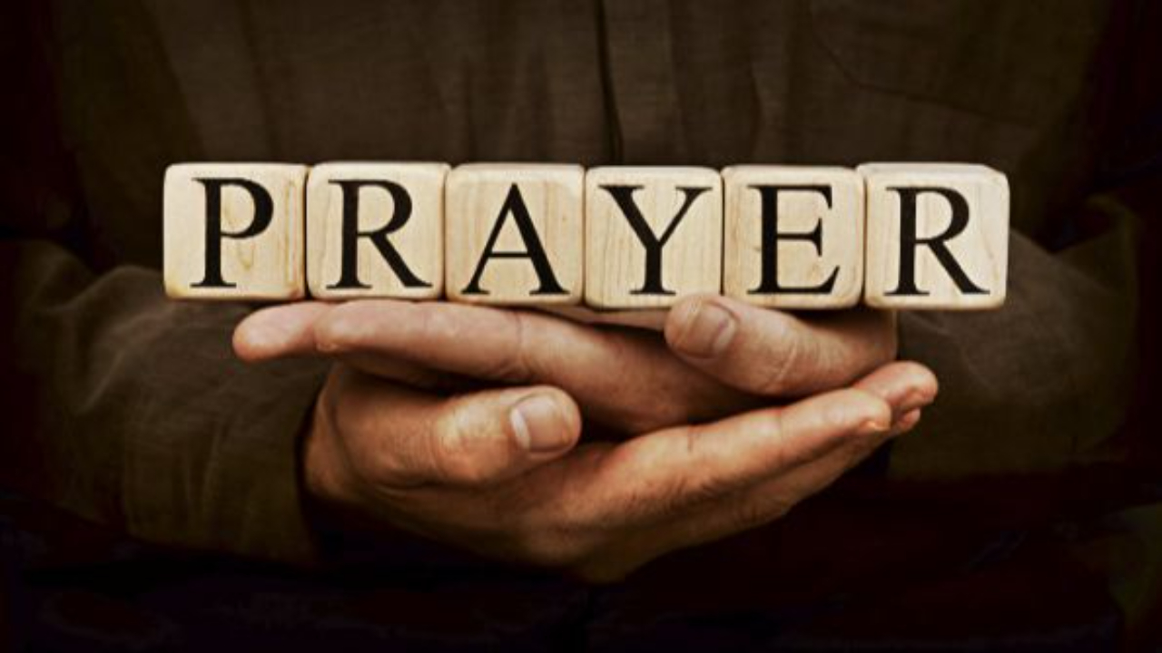

Slide 3
The Joy
CCLI Song # 7209419
Andrew Holt | Mitch Wong
© 2023 Andrew Holt Music Publishing; TBCO Publishing; A Wong Made Write Publishing; Integrity's Praise! Music
For use solely with the SongSelect® Terms of Use. All rights reserved. www.ccli.com
CCLI Licence No. 33265

Slide 4
1/10
This is the day You made
So I’ll rejoice and be glad
Rejoice and be glad in it
This is where I believe
That You are more than enough
More than enough for me

Slide 5
2/10
You are faithful to Your promise
You are strong when I am weak
When I’m standing in Your presence
I have everything I need

Slide 6
3/10
The joy of the Lord
The joy of the Lord is my strength
The joy of the Lord
The joy of the Lord is my strength
O my soul bless His Name
All that is within me say
The joy of the Lord
The joy of the Lord is my strength

Slide 7
4/10
Jesus come what may
You are worthy of all
Worthy of all my praise

Slide 8
5/10
You are faithful to Your promise
You are strong when I am weak
When I’m standing in Your presence
I have everything I need

Slide 9
6/10
The joy of the Lord
The joy of the Lord is my strength
The joy of the Lord
The joy of the Lord is my strength
O my soul bless His Name
All that is within me say
The joy of the Lord
The joy of the Lord is my strength

Slide 10
7/10
Let it rise up like a river
Overflowing Holy Spirit
Let it pour out with no limit
Overflowing Holy Spirit

Slide 11
8/10
The joy of the Lord
The joy of the Lord is my strength
The joy of the Lord
The joy of the Lord is my strength
O my soul bless His Name
All that is within me say
The joy of the Lord
The joy of the Lord is my strength

Slide 12
9/10
I've got the joy
I've got the joy
I've got the joy
It's the joy of the Lord
It's the joy of the Lord

Slide 13
10/10
O my soul bless His Name
All that is within me say
O my soul bless His Name
All that is within me say
O my soul bless His Name
All that is within me say
The joy of the Lord
The joy of the Lord is my strength

Slide 14
Yes And Amen
CCLI Song # 7048885
Chris McClarney | Nate Moore | Tony Brown
© 2016 Thankyou Music Ltd; Bethel Worship Publishing; Mouth Of The River Music; Songs Of Simply Hymns Music; Tony Brown Music Designee
For use solely with the SongSelect® Terms of Use. All rights reserved. www.ccli.com

Slide 15
1/8
Father of kindness You have poured out grace
You brought me out of darkness
You have filled me with peace
Giver of mercy You're my help in time of need
Lord I can't help but sing

Slide 16
2/8
Faithful You are
Faithful forever You will be
Faithful You are
All Your promises are Yes and Amen
All Your promises are Yes and Amen

Slide 17
3/8
Beautiful Saviour, You have brought me near
You pulled me from the ashes
You have broken ev'ry curse
Blessed Redeemer You have set this captive free
Lord I can't help but sing

Slide 18
4/8
Faithful You are
Faithful forever You will be
Faithful You are
All Your promises are Yes and Amen
All Your promises are Yes and Amen

Slide 19
5/8
I will rest in Your promises
My confidence is Your faithfulness
(REPEAT)

Slide 20
6/8
Faithful You are
Faithful forever You will be
Faithful You are
All Your promises are Yes and Amen
All Your promises are Yes and Amen

Slide 21
7/8
O Holy Spirit You have changed my life
You comfort and direct me
You have filled me with love
Teacher and defender, you're my guide in time of need
Lord I can't help but sing

Slide 22
8/8
Faithful You are
Faithful forever You will be
Faithful You are
All Your promises are Yes and Amen
All Your promises are Yes and Amen

Slide 24
Heart Of Worship CCLI Song # 2296522
Matt Redman
© 1997 Thankyou Music (Admin. by Integrity Music Ltd)
For use solely with the SongSelect® Terms of Use. All rights reserved. www.ccli.com
CCLI Licence No. 33265

Slide 25
1/6
When the music fades all is stripped away
And I simply come
Longing just to bring something that's of worth
That will bless Your heart

Slide 26
2/6
I'll bring You more than a song
For a song in itself is not what You have required
You search much deeper within
Through the way things appear
You're looking into my heart

Slide 27
3/6
I'm coming back to the heart of worship
And it's all about You all about You Jesus
I'm sorry Lord for the thing I've made it
When it's all about You all about You Jesus

Slide 28
4/6
King of endless worth no one could express
How much You deserve
Though I'm weak and poor all I have is Yours
Ev'ry single breath

Slide 29
5/6
I'll bring You more than a song
For a song in itself is not what You have required
You search much deeper within
Through the way things appear
You're looking into my heart

Slide 30
6/6
I'm coming back to the heart of worship
And it's all about You all about You Jesus
I'm sorry Lord for the thing I've made it
When it's all about You all about You Jesus

Slide 31
1/1
We give You the highest praise
We give You the highest praise
We give You the highest praise
Jesus our Savior
You’re worthy of it all

Slide 32
Worthy Of it All
CCLI Song # 6280644
David Brymer | Ryan Hall
© 2012 Common Hymnal Publishing (Admin. by Integrity Music Ltd)
Innerland (Admin. by Integrity Music Ltd)
Underground Treasure (Admin. by Integrity Music Ltd)
Wayfinder Music (Admin. by Integrity Music Ltd)
For use solely with the SongSelect® Terms of Use. All rights reserved. www.ccli.com
CCLI Licence No. 33265

Slide 33
1/4
All the saints and angels
Bow before Your throne
All the elders cast their crowns
Before the Lamb of God and sing

Slide 34
2/4
You are worthy of it all
You are worthy of it all
For from You are all things
And to You are all things
You deserve the glory

Slide 35
3/4
Day and night,
Night and day,
Let incense arise
(X4)
Day and night
Night and day

Slide 36
4/4
You are worthy of it all
You are worthy of it all
For from You are all things
And to You are all things
You deserve the glory

Slide 37
1/2
Name above all names
Worthy of all praise
My heart will sing
How great is our God

Slide 38
2/2
How great is our God
Sing with me
How great is our God
And all will see how great
How great is our God

Slide 40


Slide 41


Slide 42
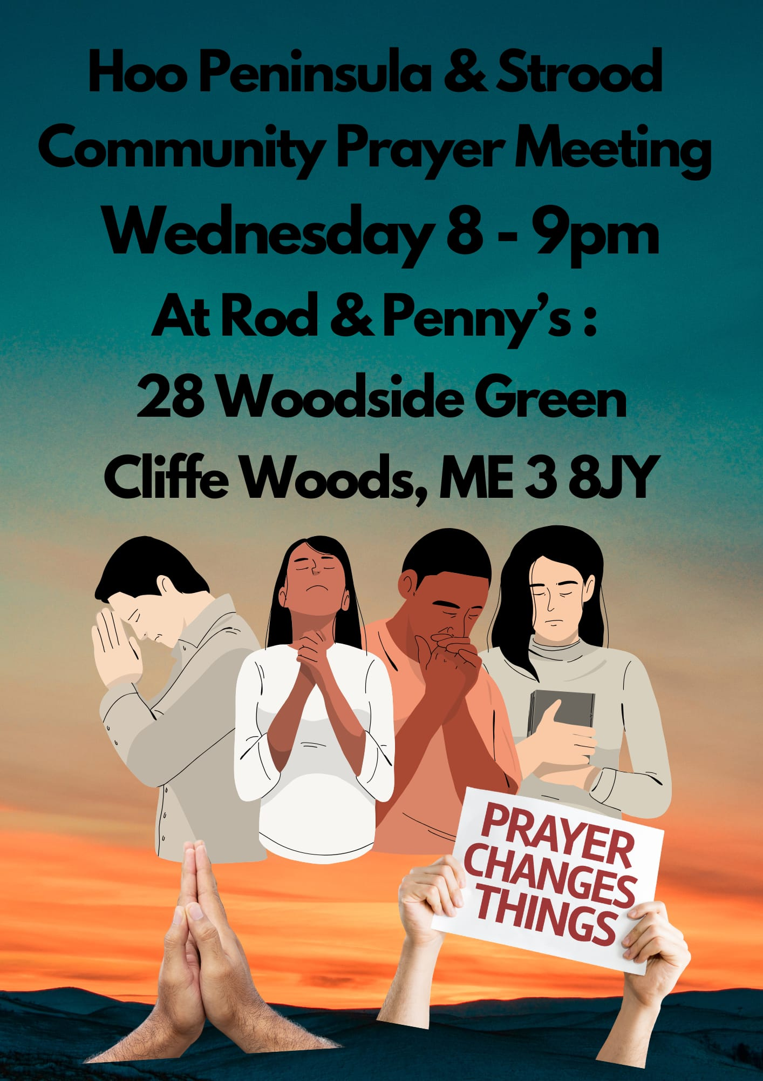

Slide 43
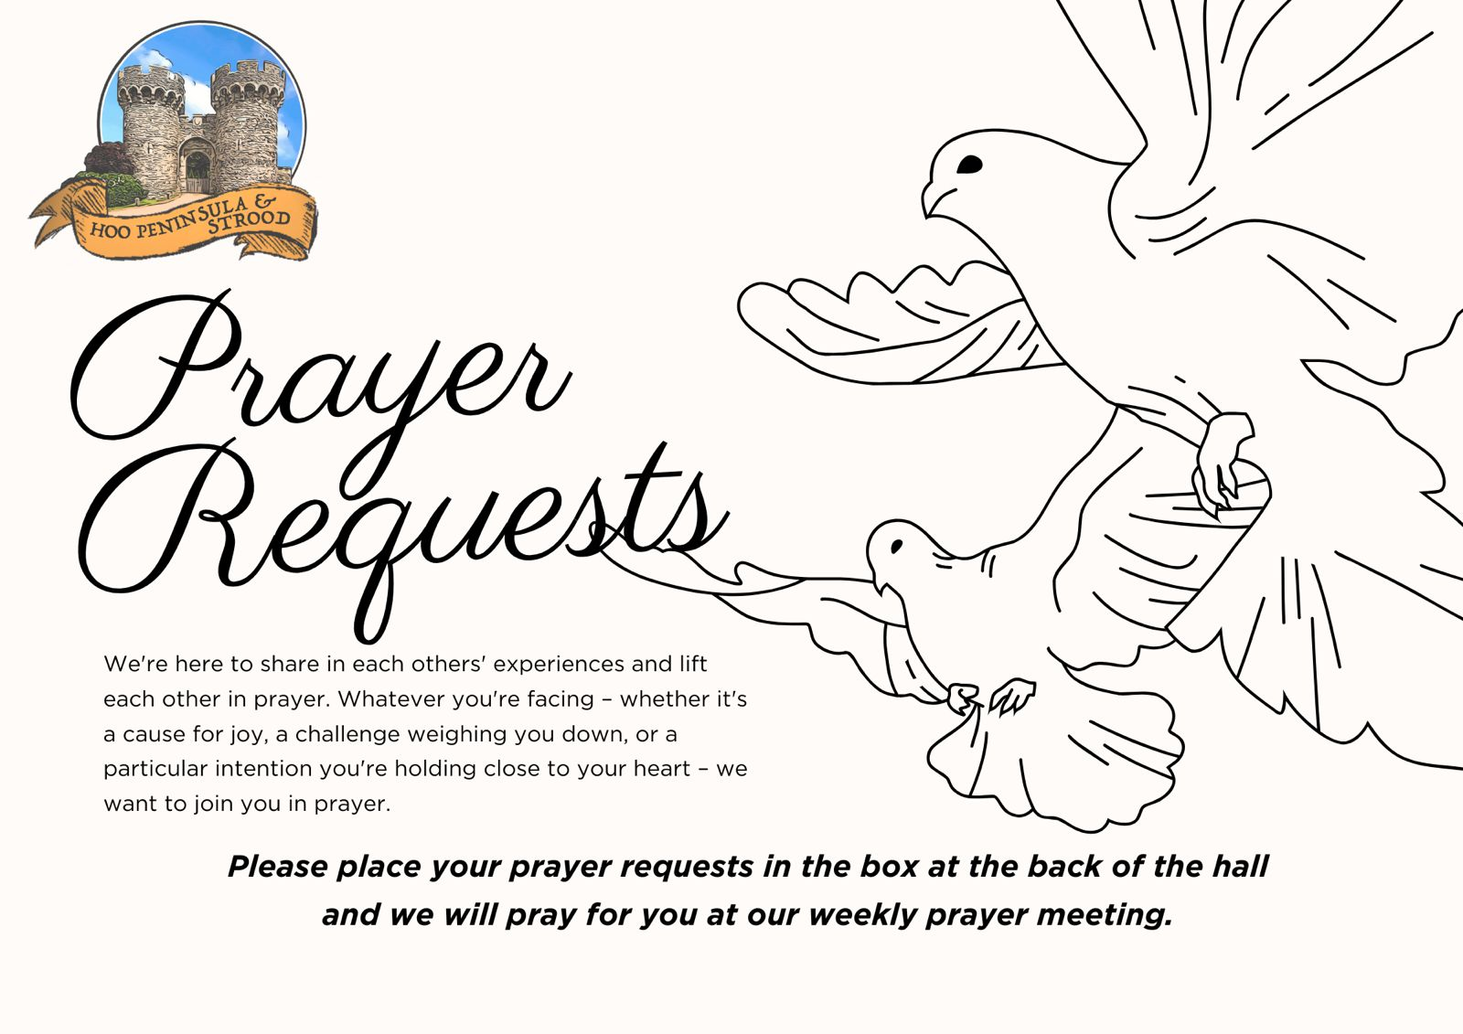

Slide 44


Slide 45


Slide 46


Slide 47
2 Corinthians 14 May the grace of the Lord Jesus Christ, and the love of God, and the fellowship of the Holy Spirit be with us all. And….
Surely goodness and mercy shall follow us all the days of our lives, and we shall dwell in the house of the Lord forever.

Slide 48
Amen!

