Slide 1
Cornerstone City Church Peninsula Plus Community Hoo Are Ya
23rd June 2024

Slide 2
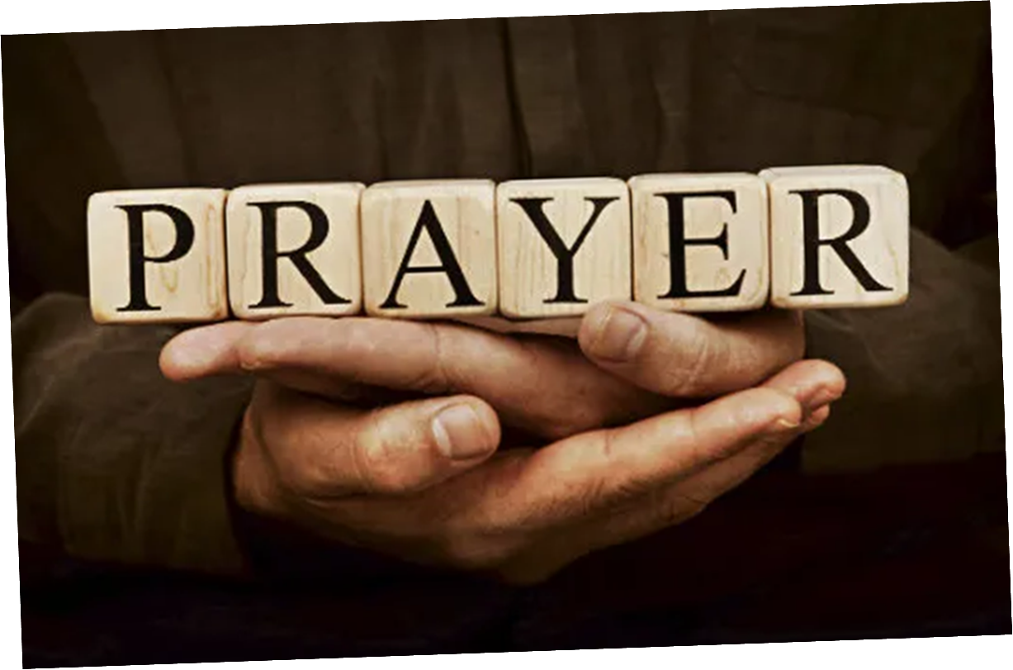

Slide 3
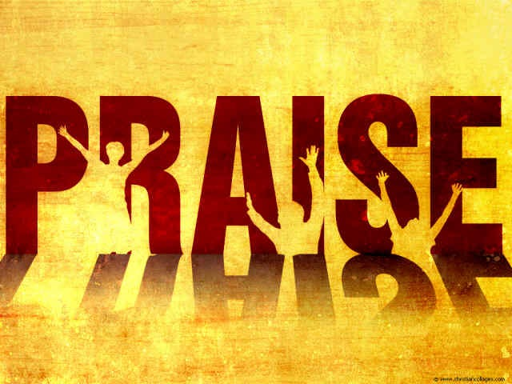

Slide 4
Turn It Up
CCLI Song # 6621485
Andy Harrison
© 2012 Planetshakers Ministries Int. Inc. (Admin. by Song Solutions www.songsolutions.org)
For use solely with the SongSelect® Terms of Use. All rights reserved. www.ccli.com
CCLI Licence No. 33265

Slide 5
1/9
You are here as we lift You up
You are riding on our praise
Be enthroned over everything
You are seated in our praise

Slide 6
2/9
This is prophetic I can feel it in the air
We lift our praise and You change the atmosphere
With hearts open now everybody singing out
Oh

Slide 7
3/9
Turn it up this sound of praise
Make it louder than any other
Lift Him up and shout His name over all

Slide 8
4/9
As we praise I can feel the change
As Your presence now invades
Hear the sound of the broken chains
Prison doors are giving way

Slide 9
5/9
This is prophetic I can feel it in the air
We lift our praise and You change the atmosphere
With hearts open now everybody singing out
I am free!

Slide 10
6/9
Turn it up this sound of praise
Make it louder than any other
Lift Him up and shout His name over all
(2ce)

Slide 11
7/9
Our praise goes up
Your rain comes down
(REPEAT)

Slide 12
8/9
With shouts of praise we celebrate
King of glory enter in
You are riding on our praise oh Lord

Slide 13
9/9
Turn it up this sound of praise
Make it louder than any other
Lift Him up and shout His name over all
2ce

Slide 14
Glorious Day
CCLI Song # 7081388
Jason Ingram | Jonathan Smith | Kristian Stanfill | Sean Curran
© 2017 KPS 1.0 (Admin. by Capitol CMG Publishing)
sixsteps Music (Admin. by Capitol CMG Publishing)
sixsteps Songs (Admin. by Capitol CMG Publishing)
Sounds Of Jericho (Admin. by Capitol CMG Publishing)
Worship Together Music (Admin. by Capitol CMG Publishing)
worshiptogether.com songs (Admin. by Capitol CMG Publishing)
Fellow Ships Music (Admin. by Essential Music Publishing LLC)
Hickory Bill Doc (Admin. by Essential Music Publishing LLC)
So Essential Tunes (Admin. by Essential Music Publishing LLC)
For use solely with the SongSelect® Terms of Use. All rights reserved. www.ccli.com
CCLI Licence No. 33265

Slide 15
1/6
I was buried beneath my shame
Who could carry that kind of weight
It was my tomb 'til I met You

Slide 16
2/6
I was breathing but not alive
All my failures I tried to hide
It was my tomb 'til I met You

Slide 17
3/6
('Cause when) You called my name (and)
I ran out of that grave
Out of the darkness into Your glorious day
You called my name (and) I ran out of that grave
Out of the darkness into Your glorious day

Slide 18
4/6
Now Your mercy has saved my soul
Now Your freedom is all that I know
The old made new Jesus when I met You

Slide 19
5/6
I needed rescue my sin was heavy
But chains break at the weight of Your glory
I needed shelter I was an orphan
Now You call me a citizen of Heaven
When I was broken You were my healing
Now Your love is the air that I'm breathing
I have a future my eyes are open

Slide 20
6/6
('Cause when) You called my name (and)
I ran out of that grave
Out of the darkness into Your glorious day
You called my name (and)
I ran out of that grave
Out of the darkness into Your glorious day

Slide 21
Show Your Power
CCLI Song # 861891
Kevin Prosch
© 1991 Mercy / Vineyard Publishing (Admin. by Integrity Music Ltd)
For use solely with the SongSelect® Terms of Use. All rights reserved. www.ccli.com
CCLI Licence No. 33265

Slide 22
1/4
Well He is the Lord He reigns on high
He is the Lord
Spoke into the darkness created the light
He is the Lord
Who is like unto Him never ending in days
He is the Lord
And He comes in power when we call on His name
He is the Lord

Slide 23
2/4
Show Your power oh Lord our God
Show Your power oh Lord our God
Oh Lord our God

Slide 24
3/4
Your gospel oh Lord is the hope for our nation
You are the Lord
It's the power of God for our salvation
You are the Lord
We ask not for riches but look to the cross
You are the Lord
And for our inheritance give us the lost
You are the Lord

Slide 25
4/4
Show Your power oh Lord our God
Show Your power oh Lord our God
Oh Lord our God

Slide 27
Build My Life
CCLI Song # 7070345
Brett Younker | Karl Martin | Kirby Kaple | Matt Redman | Pat Barrett
© 2016 Capitol CMG Genesis (Admin. by Capitol CMG Publishing)
Housefires Sounds (Admin. by Capitol CMG Publishing)
sixsteps Music (Admin. by Capitol CMG Publishing)
Vamos Publishing (Admin. by Capitol CMG Publishing)
worshiptogether.com songs (Admin. by Capitol CMG Publishing)
Said And Done Music (Admin. by Integrity Music Ltd)
Thankyou Music (Admin. by Integrity Music Ltd)
Martin, Karl Andrew (Admin. by Sentric Music)
Bethel Music Publishing (Admin. by Song Solutions)
Kaple Music (Admin. by Song Solutions)
For use solely with the SongSelect® Terms of Use. All rights reserved. www.ccli.com
CCLI Licence No. 33265

Slide 28
1/4
Worthy of ev'ry song we could ever sing
Worthy of all the praise we could ever bring
Worthy of ev'ry breath we could ever breathe
We live for You

Slide 29
2/4
Jesus the name above ev'ry other name
Jesus the only one who could ever save
Worthy of ev'ry breath we could ever breathe
We live for You
We live for You

Slide 30
3/4
Holy there is no one like You
There is none beside You
Open up my eyes in wonder and show me who You are
And fill me with Your heart
And lead me in Your love to those around me

Slide 31
4/4
I will build my life upon Your love
It is a firm foundation
I will put my trust in You alone
And I will not be shaken

Slide 32
1/1
When the oceans rise
And thunders roar
I will soar with You
Above the storm
Father You are King
Over the flood
I will be still and know
You are God

Slide 33


Slide 34
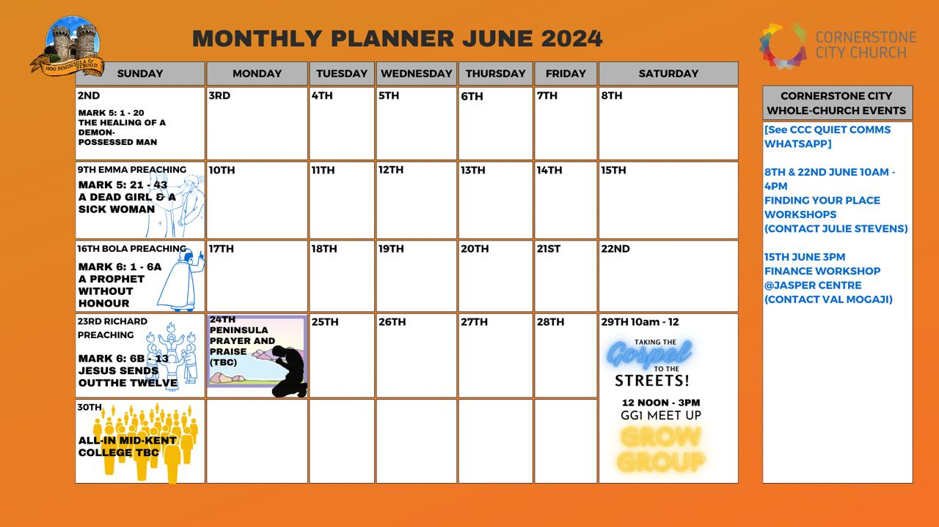

Slide 35


Slide 36


Slide 37
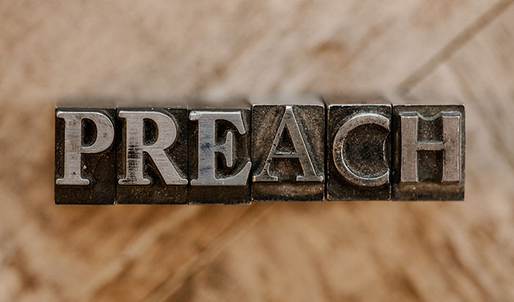

Slide 38
God of This City
CCLI Song # 5037070
Aaron Boyd | Andrew McCann | Ian Jordan | Peter Comfort | Peter Kernoghan | Richard Bleakley
© 2006 Thankyou Music (Admin. by Integrity Music Ltd)
For use solely with the SongSelect® Terms of Use. All rights reserved. www.ccli.com
CCLI Licence No. 33265

Slide 39
1/2
You're the God of this city
You're the King of these people
You're the Lord of this nation
You are
You're the light in this darkness
You're the hope to the hopeless
You're the peace to the restless
You are

Slide 40
2/2
There is no one like our God
There is no one like You God
Greater things have yet to come
And greater things have still to be done
In this city
Greater things have yet to come
And greater things have still to be done here

Slide 41
2 Corinthians 14 May the grace of the Lord Jesus Christ, and the love of God, and the fellowship of the Holy Spirit be with you all

