Slide 1
Cornerstone City Church Peninsula Plus Community Hoo Are Ya 23-01-2022

Slide 2
Lord I Lift Your Name On High CCLI Song # 117947
Rick Founds
© 1989 Universal Music - Brentwood Benson Publishing (Admin. by Brentwood-Benson Music Publishing, Inc.)
For use solely with the SongSelect® Terms of Use. All rights reserved. www.ccli.com
CCLI Licence No. 33265

Slide 3
1/2
Lord I lift Your name on high
Lord I love to sing Your praises
I'm so glad You're in my life
I'm so glad You came to save us

Slide 4
2/2
You came from heaven to earth
To show the way
From the earth to the cross
My debt to pay
From the cross to the grave
From the grave to the sky
Lord I lift Your name on high

Slide 5
Sing Unto the Lord
CCLI Song # 4109954
Howard Francis | Mark Beswick | Nicky Brown
© 2003 Thankyou Music (Admin. by Integrity Music Ltd)
Remaining portion is unaffiliated
For use solely with the SongSelect® Terms of Use. All rights reserved. www.ccli.com
CCLI Licence No. 33265

Slide 6
1/3
Sing unto the Lord a new song
Bless Him praise Him
Lift Him higher
All you chosen generation
Dance and celebrate
(REPEAT)

Slide 7
2/3
If you lift Him high
He will draw us
Nearer ever closer to Him
Day by day

Slide 8
3/3
If you lift Him high
He will draw us
Nearer ever closer to Him
Every day

Slide 9
1/1
And we will say
(Our God is Good)
His mercies shall
(Endure for life)

Slide 10
O Come To The Altar
CCLI Song # 7051511
Chris Brown | Mack Brock | Steven Furtick | Wade Joye
© 2015 Music by Elevation Worship Publishing (Admin. by Essential Music Publishing LLC)
For use solely with the SongSelect® Terms of Use. All rights reserved. www.ccli.com
CCLI Licence No. 33265

Slide 11
1/5
Are you hurting and broken within
Overwhelmed by the weight of your sin
Jesus is calling
Have you come to the end of yourself
Do you thirst for a drink from the well
Jesus is calling

Slide 12
2/5
O come to the altar
The Father's arms are open wide
Forgiveness was bought with
The precious blood of Jesus Christ

Slide 13
3/5
Leave behind your regrets and mistakes
Come today there's no reason to wait
Jesus is calling
Bring your sorrows and trade them for joy
From the ashes a new life is born
Jesus is calling

Slide 14
4/5
Oh what a Savior
Isn't he wonderful
Sing alleluia Christ is risen
Bow down before him
For he is Lord of all
Sing alleluia Christ is risen

Slide 15
5/5
Bear your cross as you wait for the crown
Tell the world of the treasure you've found

Slide 16
Rain
CCLI Song # 5842643
Donna Akodu | Noel Robinson
© 2009 Thankyou Music (Admin. by Integrity Music Ltd)
For use solely with the SongSelect® Terms of Use. All rights reserved. www.ccli.com
CCLI Licence No. 33265

Slide 17
1/2
Rain, rain on me
Open the windows of heaven

Slide 18
2/2
Open up the heavens
Pouring out a blessing
Lord we need refreshing
Till it overflows

Slide 19
Draw me close
CCLI Song # 1459484
Kelly Carpenter
© 1994 Mercy / Vineyard Publishing (Admin. by Integrity Music Ltd)
For use solely with the SongSelect® Terms of Use. All rights reserved. www.ccli.com
CCLI Licence No. 33265

Slide 20
1/2
Draw me close to You never let me go
I lay it all down again
To hear You say that I'm Your friend
You are my desire no one else will do
'Cause nothing else could take Your place
To feel the warmth of Your embrace
Help me find the way bring me back to You

Slide 21
2/2
You're all I want
You're all I've ever needed
You're all I want
Help me know You are near

Slide 22
1/1
So I'll stand
With arms high and heart abandoned
In awe of the One who gave it all
I'll stand
My soul Lord to You surrendered
All I am is Yours

Slide 23


Slide 24
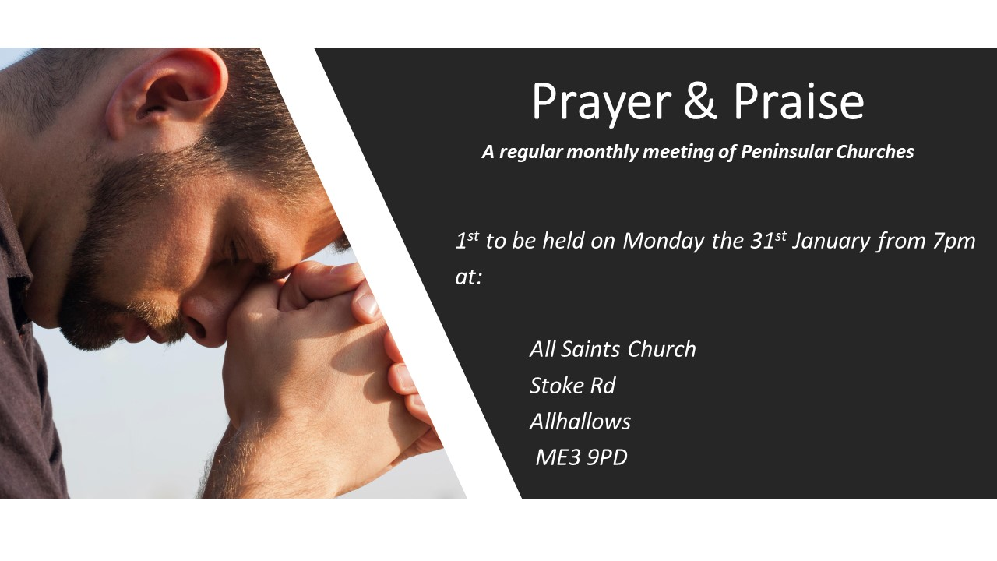

Slide 27
Jesus at the Center
CCLI Song # 6115180
Adam Ranney | Israel Houghton | Micah Massey
© 2011 Integrity Worship Music (Admin. by Integrity Music Ltd)
Integrity's Praise! Music (Admin. by Integrity Music Ltd)
Sound Of The New Breed (Admin. by Integrity Music Ltd)
Heart Anthem Music (Admin. by Song Solutions www.songsolutions.org)
For use solely with the SongSelect® Terms of Use. All rights reserved. www.ccli.com
CCLI Licence No. 33265

Slide 28
Jesus at the center of it all
Jesus at the center of it all
From beginning to the end
It will always be it's always been You Jesus Jesus
1/5

Slide 29
And nothing else matters
Nothing in this world will do
Jesus You're the center
Ev'rything revolves around You Jesus You
2/5

Slide 30
Jesus be the center of my life
Jesus be the center of my life
From beginning to the end
It will always be it's always been You Jesus Jesus
3/5

Slide 31
From my heart to the heavens Jesus be the center
It's all about You yes it's all about You
From my heart to the heavens Jesus be the center
It's all about You yes it's all about You
4/5

Slide 32
5/5
Jesus be the center of Your church
Jesus be the center of Your church
And ev'ry knee will bow
And ev'ry tongue shall confess You

Slide 33
The Stand
CCLI Song # 4705248
Joel Houston
© 2005 Hillsong Music Publishing Australia (Admin. by Hillsong Music Publishing UK)
For use solely with the SongSelect® Terms of Use. All rights reserved. www.ccli.com
CCLI Licence No. 33265

Slide 34
1/6
You stood before creation
Eternity in Your hand
You spoke the earth into motion
My soul now to stan

Slide 35
2/6
I know who God says I am What He says I am
Where He says I’am at
I know who I am (REPEAT)

Slide 36
3/6
You stood before my failure
And carried the cross for my shame
My sin weighed upon Your shoulders
My soul now to stand

Slide 37
4/6
So what can I say
And what can I do
But offer this heart O God
Completely to You

Slide 38
5/6
So I'll walk upon salvation
Your Spirit alive in me
My life to declare Your promise
My soul now to stand

Slide 39
6/6
So I'll stand
With arms high and heart abandoned
In awe of the One who gave it all
I'll stand
My soul Lord to You surrendered
All I am is Yours

