Slide 1
Cornerstone City Church
Peninsula Plus Community
Hoo Are Ya
8th November 2026

Slide 2
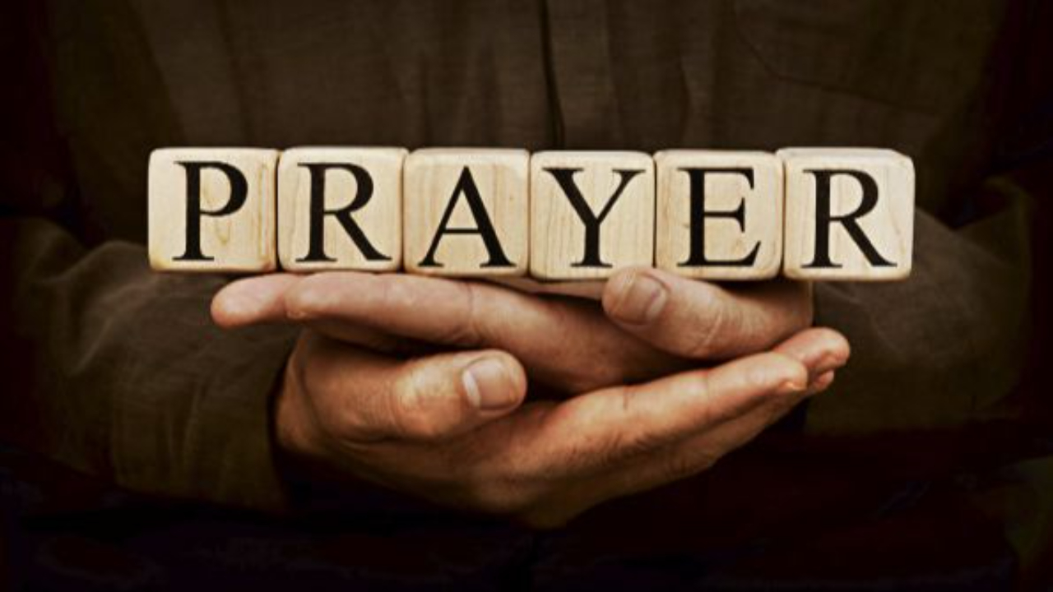

Slide 3
This Is Amazing Grace
CCLI Song # 6333821
Jeremy Riddle | Josh Farro | Phil Wickham
© 2012 WC Music Corp. (Admin. by / Small Stone Media BV, Holland (Admin. in the UK/Eire by Song Solutions www.songsolutions.org))
Bethel Music Publishing (Admin. by Song Solutions)
Phil Wickham Music (Admin. by Song Solutions www.songsolutions.org)
Seems Like Music (Admin. by Song Solutions www.songsolutions.org)
Sing My Songs (Admin. by Song Solutions www.songsolutions.org)
For use solely with the SongSelect® Terms of Use. All rights reserved. www.ccli.com
CCLI Licence No. 33265

Slide 4
1/8
Who breaks the power of sin and darkness
Whose love is mighty and so much stronger
The King of Glory the King above all kings

Slide 5
2/8
Who shakes the whole earth with holy thunder
And leaves us breathless in awe and wonder
The King of Glory the King above all kings

Slide 6
3/8
This is amazing grace
This is unfailing love
That You would take my place
That You would bear my cross
You laid down Your life
That I would be set free
Oh Jesus I sing for all that You've done for me

Slide 7
4/8
Who brings our chaos back into order
Who makes the orphan a son and daughter
The King of Glory the King of Glory

Slide 8
5/8
Who rules the nations with truth and justice
Shines like the sun in all of its brilliance
The King of Glory the King above all kings

Slide 9
6/8
This is amazing grace
This is unfailing love
That You would take my place
That You would bear my cross
You laid down Your life
That I would be set free
Oh Jesus I sing for all that You've done for me

Slide 10
7/8
Worthy is the Lamb who was slain
Worthy is the King who conquered the grave
Worthy is the Lamb who was slain
Worthy is the King who conquered the grave
Worthy is the Lamb who was slain
Worthy is the King who conquered the grave
Worthy is the Lamb who was slain
Worthy worthy worthy

Slide 11
8/8
This is amazing grace
This is unfailing love
That You would take my place
That You would bear my cross
You laid down Your life
That I would be set free
Oh Jesus I sing for all that You've done for me

Slide 12
Firm Foundation
(He Won't)
CCLI Song # 7188203
Austin Davis | Chandler Moore | Cody Carnes
© 2021 For Humans Publishing (Admin by Essential Music Publishing)
Maverick City Publishing (Admin by Essential Music Publishing)
Capitol CMG Paragon (Admin. by Capitol CMG Publishing)
TBCO Publishing (Admin. by Capitol CMG Publishing)
Writer's Roof Publishing (Admin. by Capitol CMG Publishing)
A.L.K.D. Music (Admin. by Watershed Music Group (Admin. by Capitol CMG Publishing))
For use solely with the SongSelect® Terms of Use. All rights reserved. www.ccli.com
CCLI Licence No. 33265

Slide 13
1/11
Christ is my firm foundation
The rock on which I stand
When everything around me is shaken
I've never been more glad

Slide 14
2/11
That I put my faith in Jesus
'Cause He's never let me down
He's faithful through generations
So why would He fail now

Slide 15
3/11
He won’t
He won't

Slide 16
4/11
I've still got joy in chaos
I've got peace that makes no sense
So I won't be going under
I'm not held by my own strength

Slide 17
5/11
'Cause I've built my life on Jesus
He's never let me down
He's faithful in every season
So why would He fail now

Slide 18
6/11
He won’t
He won't
He won't fail
He won't fail

Slide 19
7/11
Rain came and wind blew
My house was built on You
I'm safe with You
I'm going to make it through

Slide 20
8/11
I'm going to make it through
‘Cause I’m standing strong on You
I’m going to make it through
‘Cause my house is built on You

Slide 21
9/11
Christ is my firm foundation
The rock on which I stand
When everything around me is shaken
I've never been more glad

Slide 22
10/11
That I put my faith in Jesus
'Cause He's never let me down
He's faithful through generations
So why would He fail now

Slide 23
11/11
He won’t
He won't
He won't fail
He won't fail

Slide 25
Trust In God
CCLI Song # 7206001
Brandon Lake | Chris Brown | Mitch Wong | Steven Furtick
© Brandon Lake Music; Music by Elevation Worship Publishing; A Wong Made Write Publishing; Integrity's Praise! Music
For use solely with the SongSelect® Terms of Use. All rights reserved. www.ccli.com
CCLI Licence No. 33265

Slide 26
1/8
Blessed assurance
Jesus is mine
He's been my fourth man in the fire
Time after time

Slide 27
2/8
Born of His Spirit
Washed in His blood
And what He did for me on Calvary
Is more than enough

Slide 28
3/8
I trust in God
My Savior, the One
Who will never fail
He will never fail

Slide 29
4/8
Perfect submission
All is at rest
I know the author of tomorrow
Has ordered my steps

Slide 30
5/8
So this is my story
And this is my song
I’m praising my risen King and Savior
All the day long

Slide 31
6/8
I trust in God
My Savior, the One
Who will never fail
He will never fail

Slide 32
7/8
I sought the Lord and
He heard and He answered
(X3)
That’s why I trust Him
That’s why (I trust Him)

Slide 33
8/8
I trust in God
My Savior, the One
Who will never fail
He will never fail

Slide 35
Still The King
CCLI Song # 7244159
Colton Price | Jess Cates | Kaelob Mecum
© 2025 Twenty One Strong Music; We Are TIM Music; Be Essential Songs; Paid The Price Publishing; Wisteria Drive
For use solely with the SongSelect® Terms of Use. All rights reserved. www.ccli.com
CCLI Licence No. 33265

Slide 36
1/12
When I think of the cross
The cross of Christ
Praise begins to rise
Praise begins to rise

Slide 37
2/12
When I look on the Lamb
The wounded Lamb
My hands will lift to Him
My hands will lift to Him

Slide 38
3/12
Isn't He worthy of all our worship
Isn't He worthy of the praises we bring
How could my heart not sing hallelujah
For the blood is still the blood
And the King is still the King

Slide 39
4/12
When I recount the cost
The cost of grace
You bought my sin and shame
I'll never be the same

Slide 40
5/12
When I look at my life
How good You've been
Oh I can't hold it in
I'll never hold it in

Slide 41
6/12
Isn't He worthy of all our worship
Isn't He worthy of the praises we bring
How could my heart not sing hallelujah
For the blood is still the blood
And the King is still the King

Slide 42
7/12
When I think of the tomb
The empty tomb
I'm filled with gratitude
Endless gratitude

Slide 43
8/12
For He defeated death
And He reigns above
No grave could hold His love
No grave could hold His love

Slide 44
9/12
When I think of the tomb
The empty tomb
I'm filled with gratitude
Endless gratitude

Slide 45
10/12
For He defeated death
And He reigns above
No grave could hold His love
No grave could hold His love

Slide 46
11/12
Isn't He worthy of all our worship
Isn't He worthy of the praises we bring
How could my heart not sing hallelujah
For the blood is still the blood
And the King is still the King

Slide 47
12/12
Isn't he worthy of all our worship
Isn't he worthy of the praises we bring
How could my heart not sing
Of all You've done for me
For the blood is still the blood
And the King is still the King

Slide 49
Heart Of Worship
CCLI Song # 2296522
Matt Redman
© 1997 Thankyou Music (Admin. by Integrity Music Ltd)
For use solely with the SongSelect® Terms of Use. All rights reserved. www.ccli.com
CCLI Licence No. 33265

Slide 50
1/6
When the music fades all is stripped away
And I simply come
Longing just to bring something that's of worth
That will bless Your heart

Slide 51
2/6
I'll bring You more than a song
For a song in itself is not what You have required
You search much deeper within
Through the way things appear
You're looking into my heart

Slide 52
3/6
I'm coming back to the heart of worship
And it's all about You all about You Jesus
I'm sorry Lord for the thing I've made it
When it's all about You all about You Jesus

Slide 53
4/6
King of endless worth no one could express
How much You deserve
Though I'm weak and poor all I have is Yours
Ev'ry single breath

Slide 54
5/6
I'll bring You more than a song
For a song in itself is not what You have required
You search much deeper within
Through the way things appear
You're looking into my heart

Slide 55
6/6
I'm coming back to the heart of worship
And it's all about You all about You Jesus
I'm sorry Lord for the thing I've made it
When it's all about You all about You Jesus

Slide 56


Slide 57
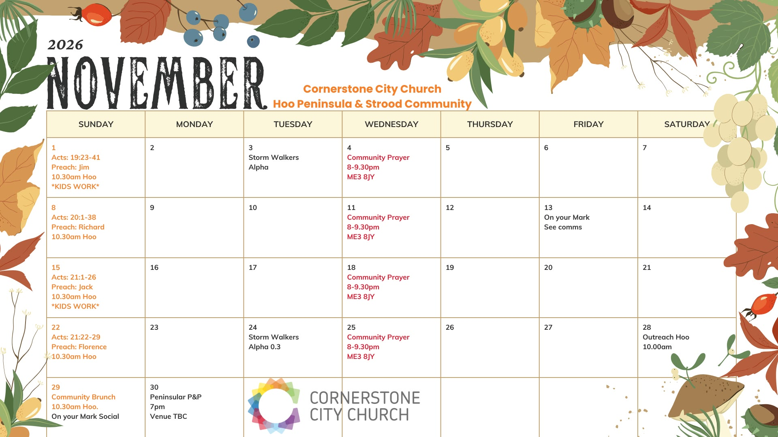

Slide 58
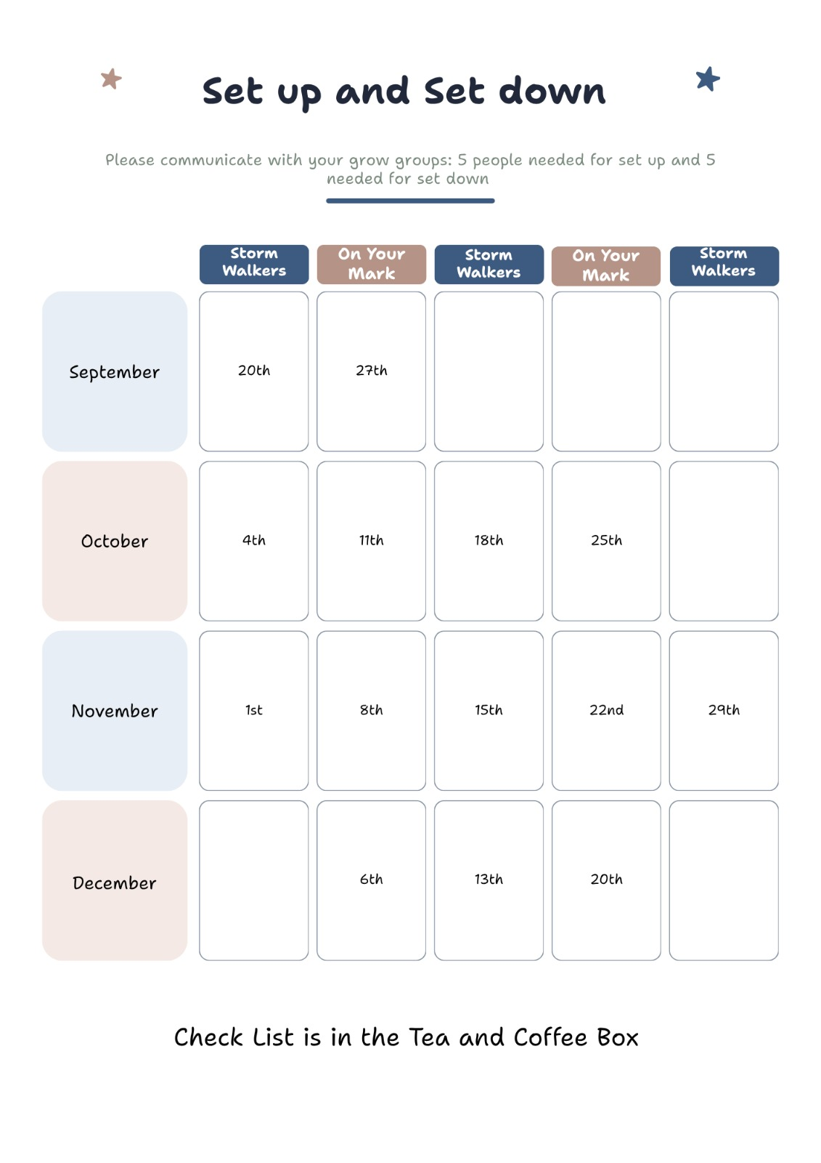

Slide 59
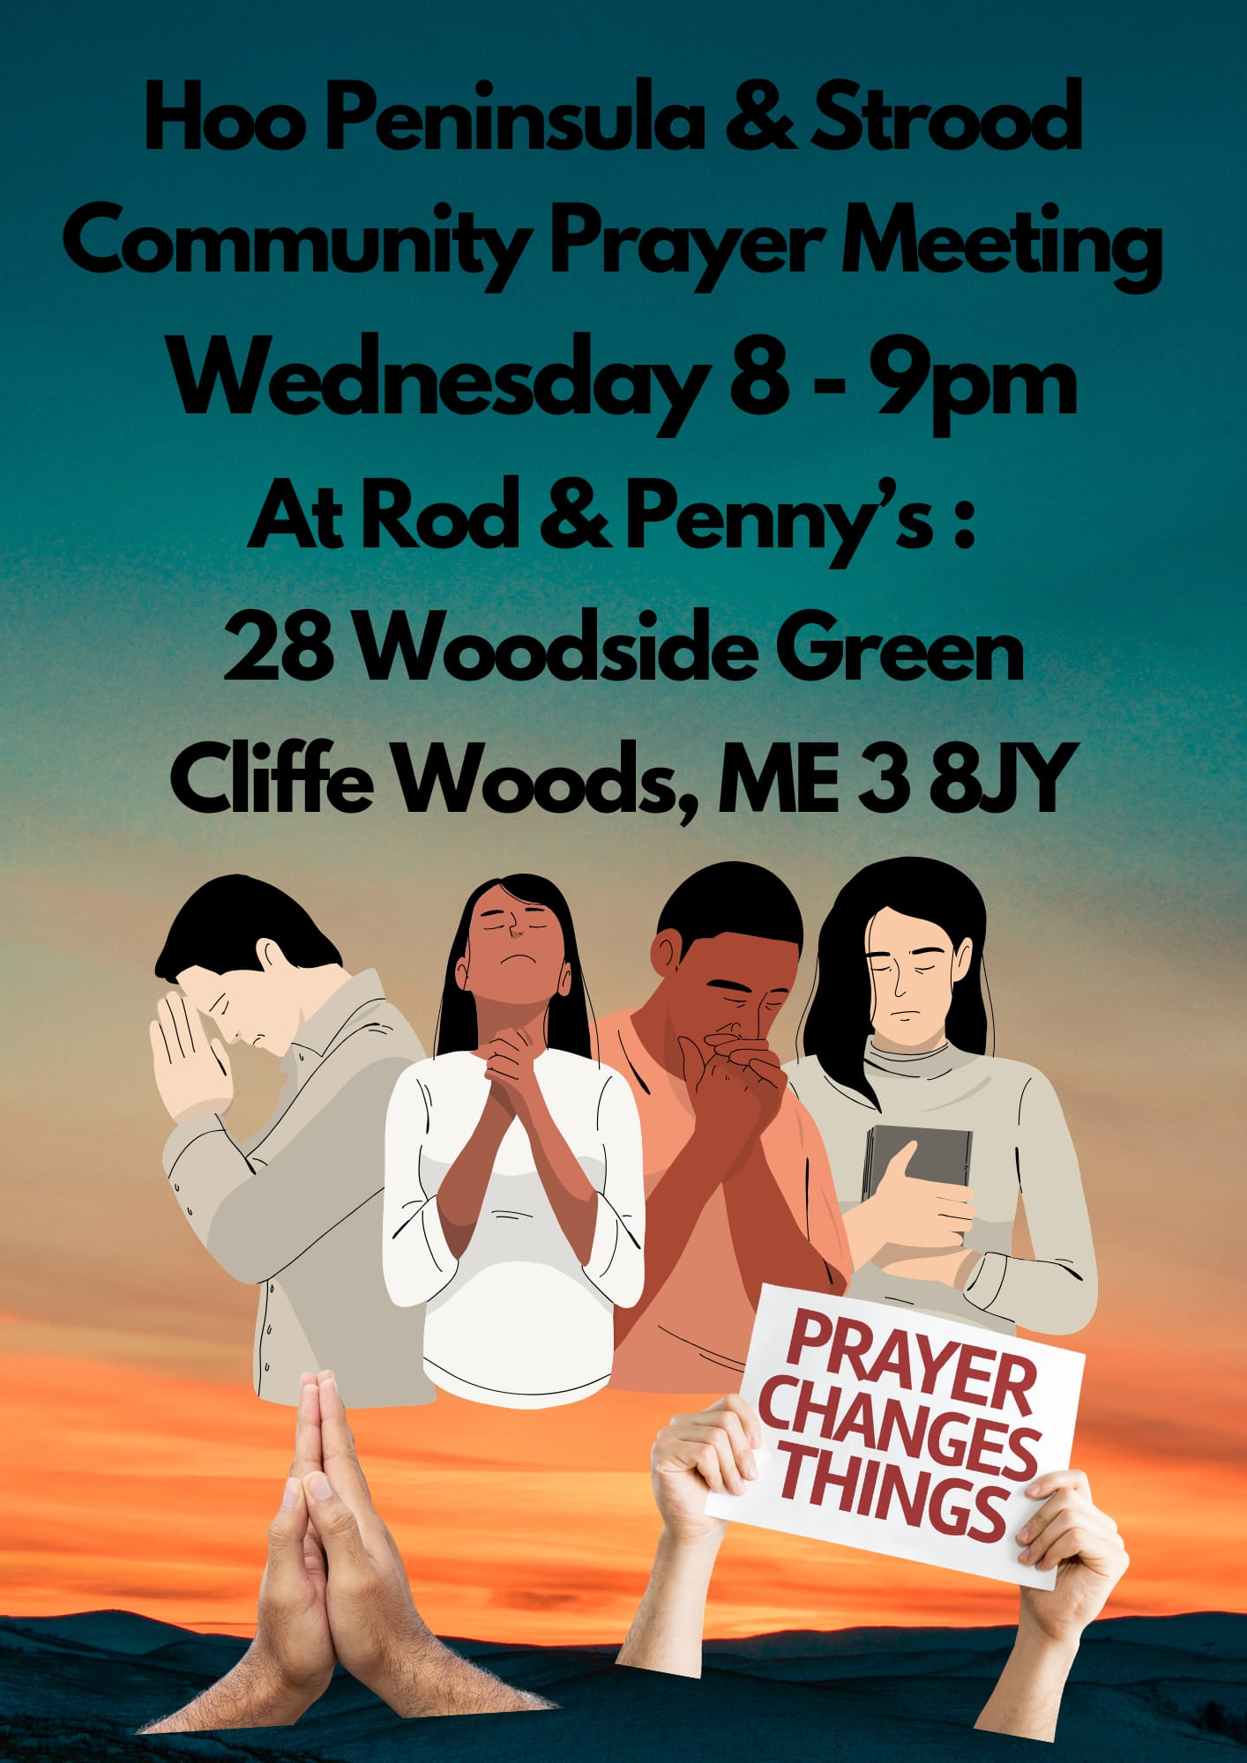

Slide 60
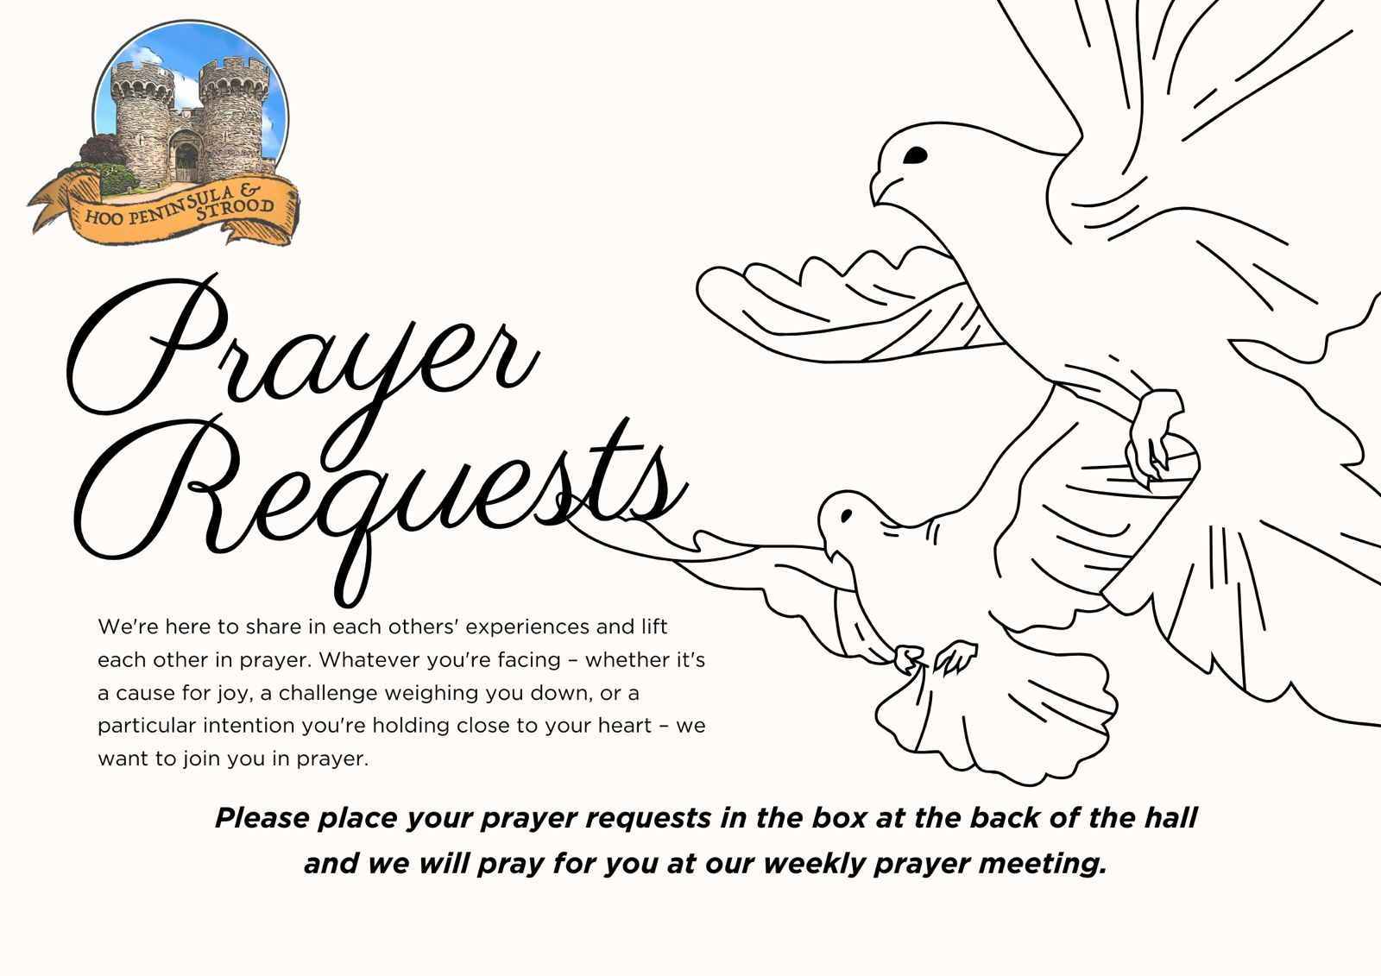

Slide 61


Slide 62


Slide 63
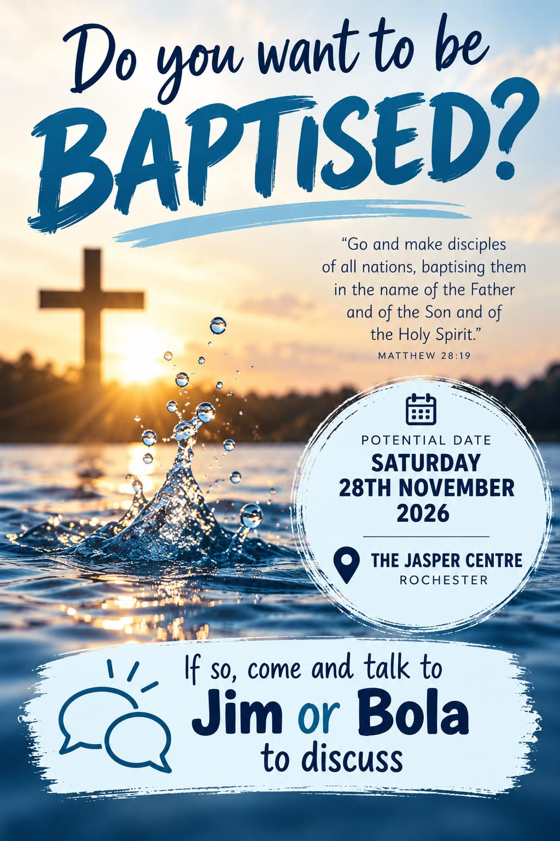

Slide 64
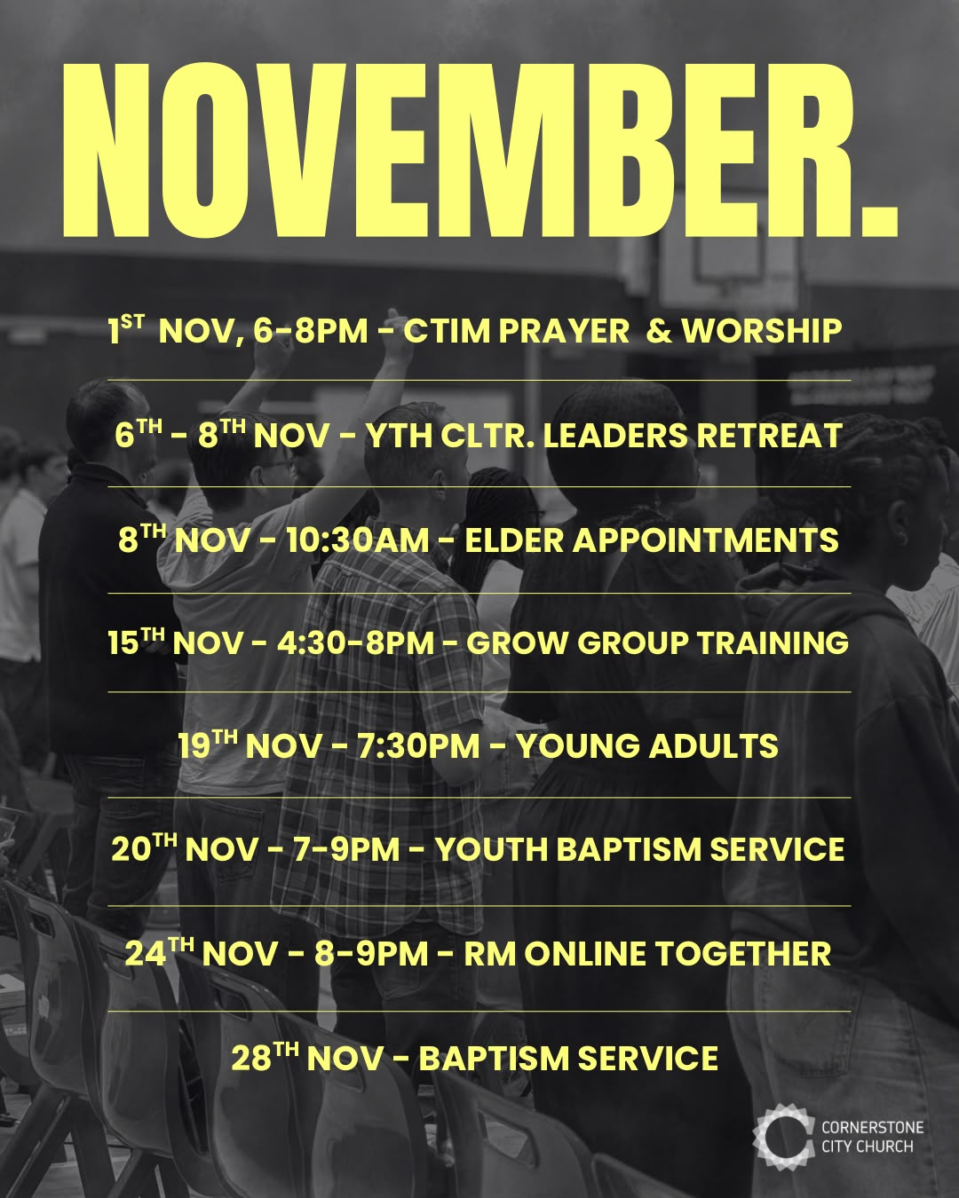

Slide 65
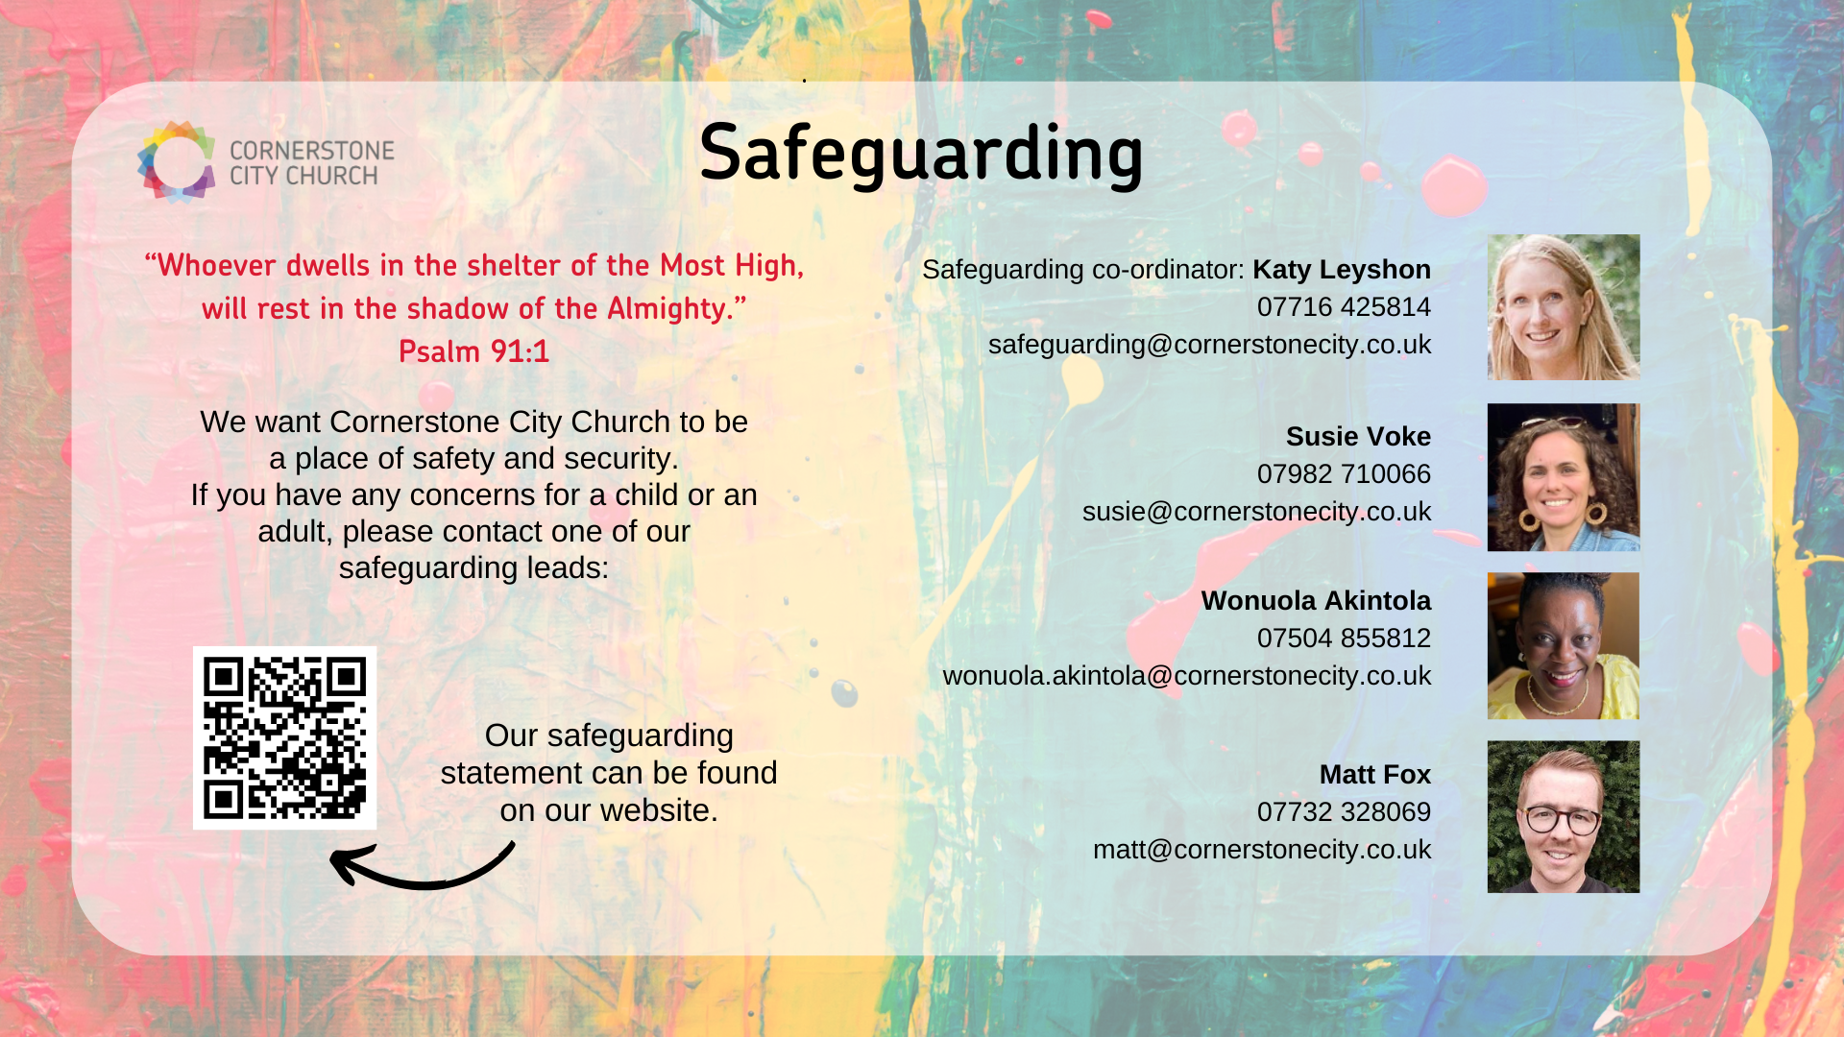

Slide 66
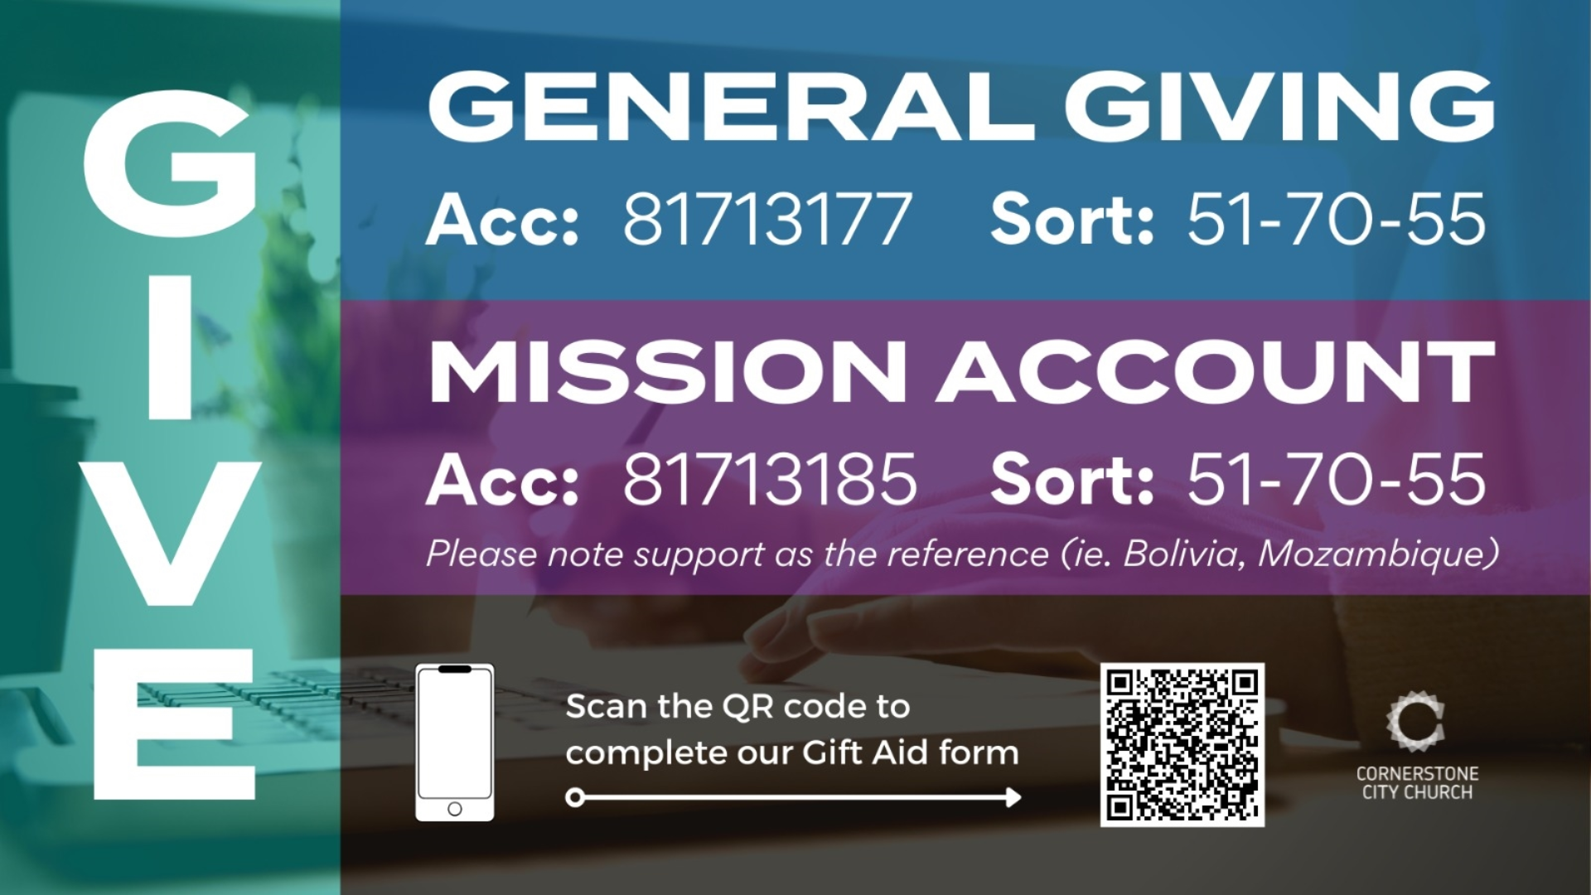

Slide 67
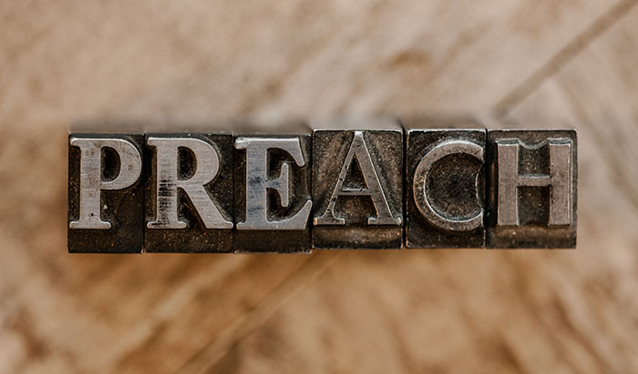

Slide 68
2 Corinthians 14
May the grace of the Lord Jesus Christ, and the love of God, and the fellowship of the Holy Spirit be with us all.
And….
Surely goodness and mercy shall follow us all the days of our lives, and we shall dwell in the house of the Lord forever.

Slide 69
Amen!

