Slide 1
Cornerstone City Church Peninsula Plus Community Hoo Are Ya
1st September 2024

Slide 2
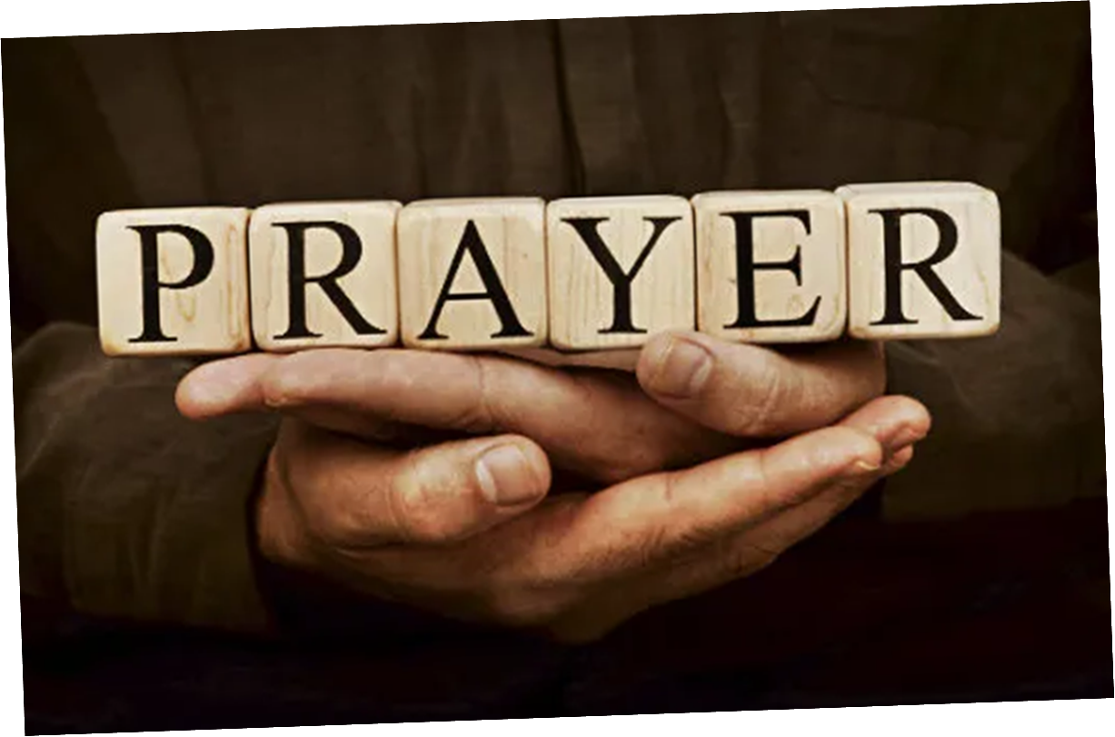

Slide 3


Slide 4
Hosanna (Praise Is Rising)
CCLI Song # 4662491
Brenton Brown | Paul Baloche
© 2005, 2006 Integrity's Hosanna! Music (Admin. by Integrity Music Ltd)
Thankyou Music (Admin. by Integrity Music Ltd)
For use solely with the SongSelect® Terms of Use. All rights reserved. www.ccli.com
CCLI Licence No. 33265

Slide 5
1/6
Praise is rising
Eyes are turning to You
We turn to You
Hope is stirring
Hearts are yearning for You
We long for You

Slide 6
2/6
‘Cause when we see You
We find strength to face the day
In Your presence
All our fears are washed away
(Washed away)

Slide 7
3/6
Hosanna Hosanna
You are the God who saves us
Worthy of all our praises
Hosanna Hosanna
Come have Your way among us
We welcome You here Lord Jesus

Slide 8
4/6
Hear the sound of
Hearts returning to You
We turn to You
In Your Kingdom
Broken lives are made new
You make us new

Slide 9
5/6
‘Cause when we see You
We find strength to face the day
In Your presence
All our fears are washed away
(Washed away)

Slide 10
6/6
Hosanna Hosanna
You are the God who saves us
Worthy of all our praises
Hosanna Hosanna
Come have Your way among us
We welcome You here Lord Jesus

Slide 11
Great Are You Lord
CCLI Song # 6460220
David Leonard | Jason Ingram | Leslie Jordan
© 2012 Open Hands Music (Admin. by Essential Music Publishing LLC)
So Essential Tunes (Admin. by Essential Music Publishing LLC)
Integrity's Praise! Music (Admin. by Integrity Music Ltd)
Little Way Creative (Admin. by Integrity Music Ltd)
For use solely with the SongSelect® Terms of Use. All rights reserved. www.ccli.com
CCLI Licence No. 33265

Slide 12
1/3
You give life You are love
You bring light to the darkness
You give hope You restore ev'ry heart that is broken
And great are You Lord

Slide 13
2/3
It's Your breath in our lungs
So we pour out our praise
We pour out our praise
It's Your breath in our lungs
So we pour out our praise to You only

Slide 14
3/3
And all the earth will shout Your praise
Our hearts will cry these bones will sing
Great are You Lord
(REPEAT)

Slide 15
My Worship
CCLI Song # 7098688
Philip Nathan Thompson | Zenzo Matoga
© 2017 Integrity Worship Music (Admin. by Integrity Music Ltd)
Phil Thompson Worship (Admin. by Integrity Music Ltd)
Zenzo Matoga Music (Admin. by Integrity Music Ltd)
For use solely with the SongSelect® Terms of Use. All rights reserved. www.ccli.com
CCLI Licence No. 33265

Slide 16
1/3
You Lord
You are worthy
And no one can worship You for me
For all of the things You've done for me
And no one can worship You for me

Slide 17
2/3
Here's my worship
All of my worship
Receive my worship
All of my worship
(REPEAT)

Slide 18
3/3
And I will not be silent
I will always worship You
As long as I am breathing
I will always worship You

Slide 20
Open The Eyes of My Heart
CCLI Song # 2298355
Paul Baloche
© 1997 Integrity's Hosanna! Music (Admin. by Integrity Music Ltd)
For use solely with the SongSelect® Terms of Use. All rights reserved. www.ccli.com
CCLI Licence No. 33265

Slide 21
1/3
Open the eyes of my heart Lord
Open the eyes of my heart
I want to see You
I want to see You

Slide 22
2/3
To see You high and lifted up
Shining in the light of Your glory
Pour out Your power and love
As we sing holy holy holy

Slide 23
3/3
Holy holy holy
Holy holy holy
Holy holy holy
I want to see You

Slide 24
Holy Forever
CCLI Song # 7201044
Brian Johnson | Chris Tomlin | Jason Ingram | Jenn Johnson | Phil Wickham
© Phil Wickham Music (Admin. by / Small Stone Media BV, Holland (Admin. in the UK/Eire by Song Solutions www.songsolutions.org))
Simply Global Songs (Admin. by / Small Stone Media BV, Holland (Admin. in the UK/Eire by Song Solutions www.songsolutions.org))
Capitol CMG Paragon (Admin. by Capitol CMG Publishing)
S. D. G. Publishing (Admin. by Capitol CMG Publishing)
Be Essential Songs (Admin. by Essential Music Publishing LLC)
My Magnolia Music (Admin. by Essential Music Publishing LLC)
Bethel Music Publishing (Admin. by Song Solutions)
Brian and Jenn Publishing (Admin. by Song Solutions)
For use solely with the SongSelect® Terms of Use. All rights reserved. www.ccli.com
CCLI Licence No. 33265

Slide 25
1/10
A thousand generations falling down in worship
To sing the song of ages to the Lamb
And all who've gone before us
And all who will believe
Will sing the song of ages to the Lamb

Slide 26
2/10
(Jesus) Your name is the highest
Your name is the greatest
Your name stands above them all
All thrones and dominions
All powers and positions
Your name stands above them all

Slide 27
3/10
And the angels cry Holy
All creation cries Holy
You are lifted high Holy
Holy forever

Slide 28
4/10
If you've been forgiven and if you've been redeemed
Sing the song forever to the Lamb
If you walk in freedom and if you bear His name
Sing the song forever to the Lamb
We'll sing the song forever and amen

Slide 29
5/10
And the angels cry Holy
All creation cries Holy
You are lifted high Holy
Holy forever

Slide 30
6/10
Hear Your people sing Holy
To the King of Kings Holy
You will always be Holy
Holy forever

Slide 31
7/10
(Jesus) Your name is the highest
Your name is the greatest
Your name stands above them all
All thrones and dominions
All powers and positions
Your name stands above them all

Slide 32
8/10
And the angels cry Holy
All creation cries Holy
You are lifted high Holy
Holy forever

Slide 33
9/10
Hear Your people sing Holy
To the King of Kings Holy
You will always be Holy
Holy forever

Slide 34
10/10
You will always be Holy
Holy forever

Slide 35


Slide 37


Slide 39
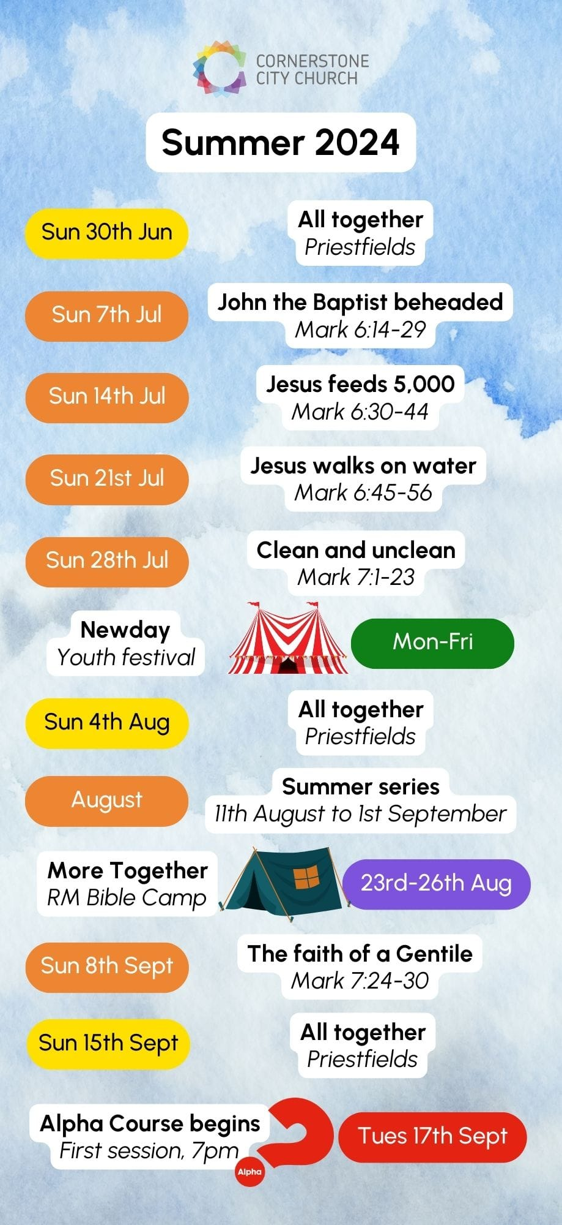

Slide 40


Slide 41
2 Corinthians 14 May the grace of the Lord Jesus Christ, and the love of God, and the fellowship of the Holy Spirit be with you all

