Slide 1
Cornerstone City Church Peninsula Plus Community Hoo Are Ya 09-10-2022

Slide 2
Every Praise
CCLI Song # 6623483
Hezekiah Walker | John David Bratton
© 2013 Davo Pavo Music (Admin. by BMG Rights Management GmbH)
Li'l Eva Music (Admin. by Capitol CMG Publishing)
Luv Ki Publishing (Admin. by Capitol CMG Publishing)
For use solely with the SongSelect® Terms of Use. All rights reserved. www.ccli.com
CCLI Licence No. 33265

Slide 3
1/3
Open the eyes of my heart Lord
Open the eyes of my heart
I want to see You
I want to see You

Slide 4
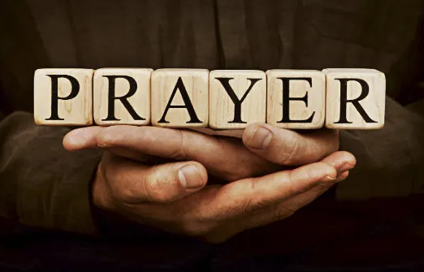

Slide 6


