Slide 1
Cornerstone City Church Peninsula Plus Community Hoo Are Ya
19th January 2025

Slide 2
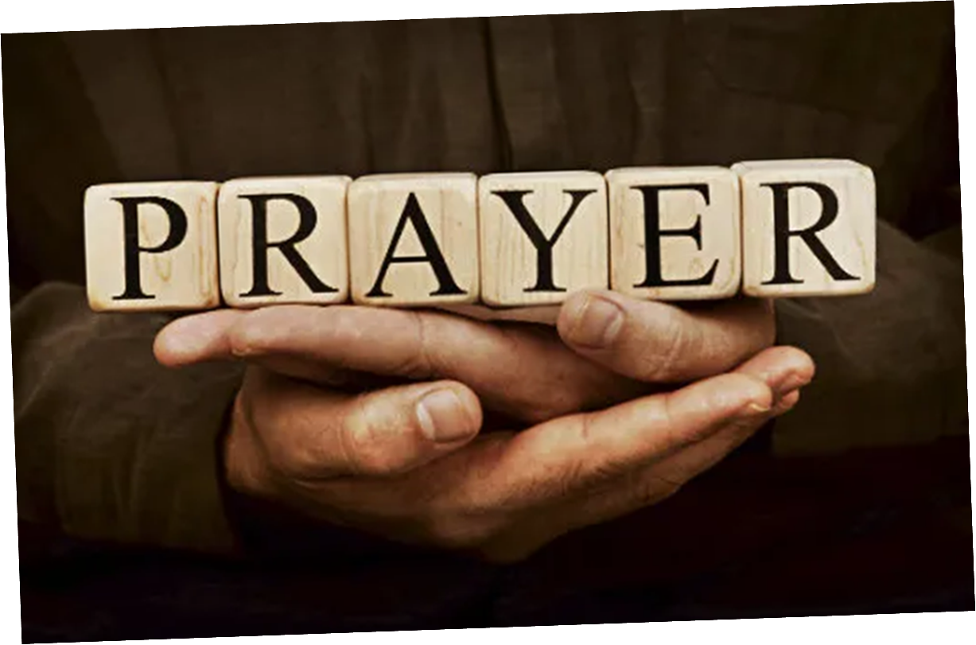

Slide 3
Thanksgiving
CCLI Song # 7199589
Nick Herbert | Taku Mudere | Zo Chilengwe
© Capitol CMG Genesis; Safe and Sound Music; Remaining portion is unaffiliated
For use solely with the SongSelect® Terms of Use. All rights reserved. www.ccli.com
CCLI Licence No. 33265

Slide 4
1/8
Enter in (Enter in)
His courts with praise (His courts with praise)
For He is greatly (He is greatly)
To be praised (To be praised)

Slide 5
2/8
What shall we do
We shall lift up a shout
What shall we do
We shall praise Him
What shall we do
For our God made a way
We'll give Him our thanksgiving

Slide 6
3/8
Magnify (Magnify)
His Holy Name (His Holy Name)
For He is greatly (For He is greatly)
To be praised (To be praised)

Slide 7
4/8
What shall we do
We shall lift up a shout
What shall we do
We shall praise Him
What shall we do
For our God made a way
We'll give Him our thanksgiving

Slide 8
5/8
Even if the rocks cry out
We're gonna drown them out
With a louder shout of praise
Even when the battles roar
We're gonna praise You Lord
'Cause You are always worthy

Slide 9
6/8
You are worthy
Worthy of honour and praise
You are worthy
We'll sing it again and again

Slide 10
7/8
What shall we do
We shall lift up a shout
What shall we do
We shall praise Him
What shall we do
For our God made a way
We'll give Him our thanksgiving

Slide 11
8/8
We'll give Him our thanksgiving
We'll give Him our thanksgiving

Slide 12
Praise
CCLI Song # 7213077
© Brandon Lake MusicFor Humans PublishingMaverick City PublishingCapitol CMG GenesisCapitol CMG ParagonHousefires SoundsWriter's Roof PublishingMusic by Elevation Worship Publishing
For use solely with the SongSelect® Terms of Use. All rights reserved. www.ccli.com
Note: Reproduction of this sheet music requires a CCLI Music Reproduction Licence. Please report all copies.
CCLI Licence No. 33265

Slide 13
1/12
Let everything that has breath
Praise the Lord
Praise the Lord

Slide 14
2/12
I’ll praise in the valley
Praise on the mountain
I’ll praise when I’m sure
Praise when I’m doubting

Slide 15
3/12
I’ll praise when outnumbered
Praise when surrounded
'Cause praise is the water
My enemies drown in

Slide 16
4/12
As long as I’m breathing
I’ve got a reason to Praise the Lord oh my soul
Praise the Lord oh my soul

Slide 17
5/12
I’ll praise when I feel it
And I’ll praise when I don’t
I’ll praise 'cause I know
You’re still in control

Slide 18
6/12
'Cause my praise is a weapon
It’s more than a sound
My praise is the shout
That brings Jericho down

Slide 19
7/12
As long as I’m breathing
I’ve got a reason to Praise the Lord oh my soul
Praise the Lord oh my soul

Slide 20
8/12
I won’t be quiet
My God is alive
How could I keep it inside
Praise the Lord oh my soul

Slide 21
9/12
I’ll praise 'cause You’re sovereign
Praise 'cause You reign
Praise 'cause You rose and defeated the grave
I’ll praise 'cause You’re faithful
Praise 'cause You’re true
Praise 'cause there’s nobody greater than You

Slide 22
10/12
Praise the Lord oh my soul
Praise the Lord oh my soul
Praise the Lord oh my soul
Praise the Lord oh my soul
I won’t be quiet
My God is alive
How could I keep it inside

Slide 23
1 1/12
I won’t be quiet
My God is alive
How could I keep it inside
I won’t be quiet
My God is alive
How could I keep it inside
Praise the Lord oh my soul

Slide 24
12/12
Let everything that has breath
Praise the Lord
Praise the Lord

Slide 25
Trust In God
CCLI Song # 7206001
Brandon Lake | Chris Brown | Mitch Wong | Steven Furtick
© Brandon Lake Music; Music by Elevation Worship Publishing; A Wong Made Write Publishing; Integrity's Praise! Music
For use solely with the SongSelect® Terms of Use. All rights reserved. www.ccli.com
CCLI Licence No. 33265

Slide 26
1/6
Blessed assurance
Jesus is mine
He's been my fourth man in the fire
Time after time
Born of His Spirit
Washed in His blood
And what He did for me on Calvary
Is more than enough

Slide 27
2/6
I trust in God
My Savior
The One who will never fail
He will never fail

Slide 28
3/6
Perfect submission
All is at rest
I know the author of tomorrow
Has ordered my steps
So this is my story
And this is my song
I’m praising my risen King and Savior
All the day long

Slide 29
4/6
I trust in God
My Savior
The One who will never fail
He will never fail

Slide 30
5/6
I sought the Lord and He heard and He answered
I sought the Lord and He heard and He answered
I sought the Lord and He heard and He answered
That’s why I trust Him
That’s why (I trust Him)

Slide 31
6/6
I trust in God
My Savior
The One who will never fail
He will never fail

Slide 33
Still
CCLI Song # 3940963
Reuben Morgan
© 2002 Hillsong Music Publishing Australia (Admin. by Hillsong Music Publishing UK)
For use solely with the SongSelect® Terms of Use. All rights reserved. www.ccli.com
CCLI Licence No. 33265

Slide 34
1/3
Hide me now
Under Your wings
Cover me
Within Your mighty hand

Slide 35
2/3
When the oceans rise
And thunders roar
I will soar with You
Above the storm
Father You are King
Over the flood
I will be still and know
You are God

Slide 36
3/3
Find rest my soul
In Christ alone
Know His power
In quietness and trust

Slide 38
Worthy Of it All
CCLI Song # 6280644
David Brymer | Ryan Hall
© 2012 Common Hymnal Publishing (Admin. by Integrity Music Ltd)
Innerland (Admin. by Integrity Music Ltd)
Underground Treasure (Admin. by Integrity Music Ltd)
Wayfinder Music (Admin. by Integrity Music Ltd)
For use solely with the SongSelect® Terms of Use. All rights reserved. www.ccli.com
CCLI Licence No. 33265

Slide 39
1/3
All the saints and angels
Bow before Your throne
All the elders cast their crowns
Before the Lamb of God and sing

Slide 40
2/3
You are worthy of it all
You are worthy of it all
For from You are all things
And to You are all things
You deserve the glory

Slide 41
3/3
Day and night,
Night and day,
Let incense arise
(X4)
Day and night
Night and day

Slide 42


Slide 43


Slide 44
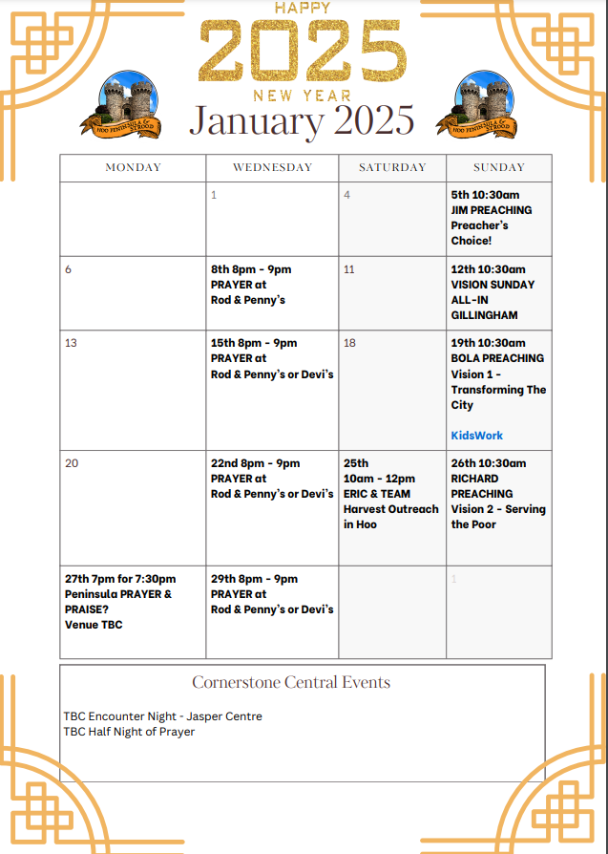

Slide 45


Slide 46
God of This City
CCLI Song # 5037070
Aaron Boyd | Andrew McCann | Ian Jordan | Peter Comfort | Peter Kernoghan | Richard Bleakley
© 2006 Thankyou Music (Admin. by Integrity Music Ltd)
For use solely with the SongSelect® Terms of Use. All rights reserved. www.ccli.com
CCLI Licence No. 33265

Slide 47
1/2
You're the God of this city
You're the King of these people
You're the Lord of this nation
You are
You're the light in this darkness
You're the hope to the hopeless
You're the peace to the restless
You are

Slide 48
2/2
There is no one like our God
There is no one like You God
Greater things have yet to come
And greater things have still to be done
In this city
Greater things have yet to come
And greater things have still to be done here

Slide 49
2 Corinthians 14 May the grace of the Lord Jesus Christ, and the love of God, and the fellowship of the Holy Spirit be with you all
Surely goodness and mercy shall follow me all the days of my life, and I shall dwell in the house of the Lord forever.

