Slide 1
Cornerstone City Church
Peninsula Plus Community
Hoo Are Ya
11th October 2026

Slide 2
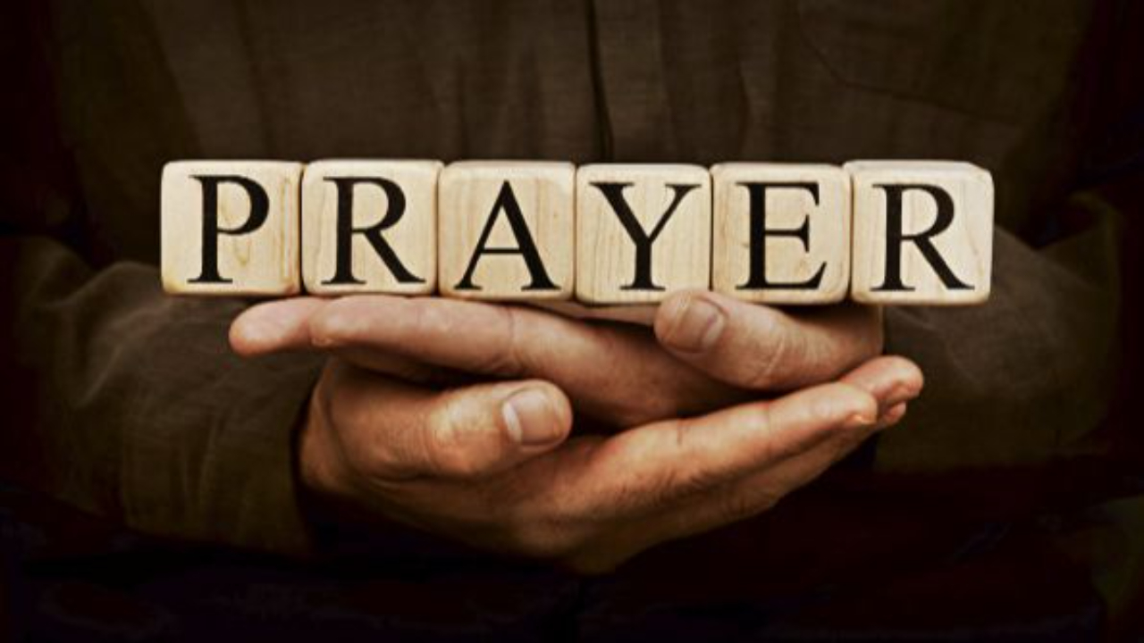

Slide 3
My Redeemer Lives
CCLI Song # 2397964
Reuben Morgan
© 1998 Hillsong Music Publishing Australia (Admin. by Hillsong Music Publishing UK)
For use solely with the SongSelect® Terms of Use. All rights reserved. www.ccli.com
CCLI Licence No. 33265

Slide 4
1/4
I know He rescued my soul
His blood has covered my sin
I believe I believe
My shame He's taken away
My pain is healed in His name
I believe I believe
I'll raise a banner
'Cause my Lord has conquered the grave

Slide 5
2/4
My Redeemer lives
My Redeemer lives
My Redeemer lives
My Redeemer lives

Slide 6
3/4
You lift my burdens
I'll rise with You
I'm dancing on this mountain top
To see Your kingdom come

Slide 7
4/4
My Redeemer lives
My Redeemer lives
My Redeemer lives
My Redeemer lives

Slide 8
Open The Eyes of My Heart
CCLI Song # 2298355
Paul Baloche
© 1997 Integrity's Hosanna! Music (Admin. by Integrity Music Ltd)
For use solely with the SongSelect® Terms of Use. All rights reserved. www.ccli.com
CCLI Licence No. 33265

Slide 9
1/3
Open the eyes of my heart Lord
Open the eyes of my heart
I want to see You
I want to see You

Slide 10
2/3
To see You high and lifted up
Shining in the light of Your glory
Pour out Your power and love
As we sing holy holy holy

Slide 11
3/3
Holy holy holy
Holy holy holy
Holy holy holy
I want to see You

Slide 13
Great Are You Lord
CCLI Song # 6460220
David Leonard | Jason Ingram | Leslie Jordan
© 2012 Open Hands Music (Admin. by Essential Music Publishing LLC)
So Essential Tunes (Admin. by Essential Music Publishing LLC)
Integrity's Praise! Music (Admin. by Integrity Music Ltd)
Little Way Creative (Admin. by Integrity Music Ltd)
For use solely with the SongSelect® Terms of Use. All rights reserved. www.ccli.com
CCLI Licence No. 33265

Slide 14
1/3
You give life You are love
You bring light to the darkness
You give hope You restore ev'ry heart that is broken
And great are You Lord

Slide 15
2/3
It's Your breath in our lungs
So we pour out our praise
We pour out our praise
It's Your breath in our lungs
So we pour out our praise to You only

Slide 16
3/3
And all the earth will shout Your praise
Our hearts will cry these bones will sing
Great are You Lord
(REPEAT)

Slide 18
I Speak Jesus
CCLI Song # 7136201
Abby Benton | Carlene Prince | Dustin Smith | Jesse Reeves | Kristen Dutton | Raina Pratt
© 2019 Here Be Lions Publishing (Admin. by Integrity Music Ltd)
Integrity's Praise! Music (Admin. by Integrity Music Ltd)
BEC Worship (Admin. by Song Solutions)
Raina Pratt publishing designee (Admin. by Song Solutions www.songsolutions.org)
WriterWrong Music (Admin. by Song Solutions www.songsolutions.org)
Remaining portion is unaffiliated
For use solely with the SongSelect® Terms of Use. All rights reserved. www.ccli.com
CCLI Licence No. 33265

Slide 19
1/5
I just want to speak the Name of Jesus
Over ev'ry heart and ev'ry mind
'Cause I know there is peace within Your presence
I speak Jesus

Slide 20
2/5
I just want to speak the Name of Jesus
'Til ev'ry dark addiction starts to break
Declaring there is hope and there is freedom
I speak Jesus

Slide 21
3/5
('Cause) Your Name is power
Your Name is healing
Your Name is life
Break ev'ry stronghold
Shine through the shadows
Burn like a fire

Slide 22
4/5
I just want to speak the Name of Jesus
Over fear and all anxiety
To ev'ry soul held captive by depression
I speak Jesus

Slide 23
5/5
Shout Jesus from the mountains
Jesus in the streets
Jesus in the darkness over ev'ry enemy
Jesus for my fam'ly
I speak the holy Name Jesus

Slide 24


Slide 25
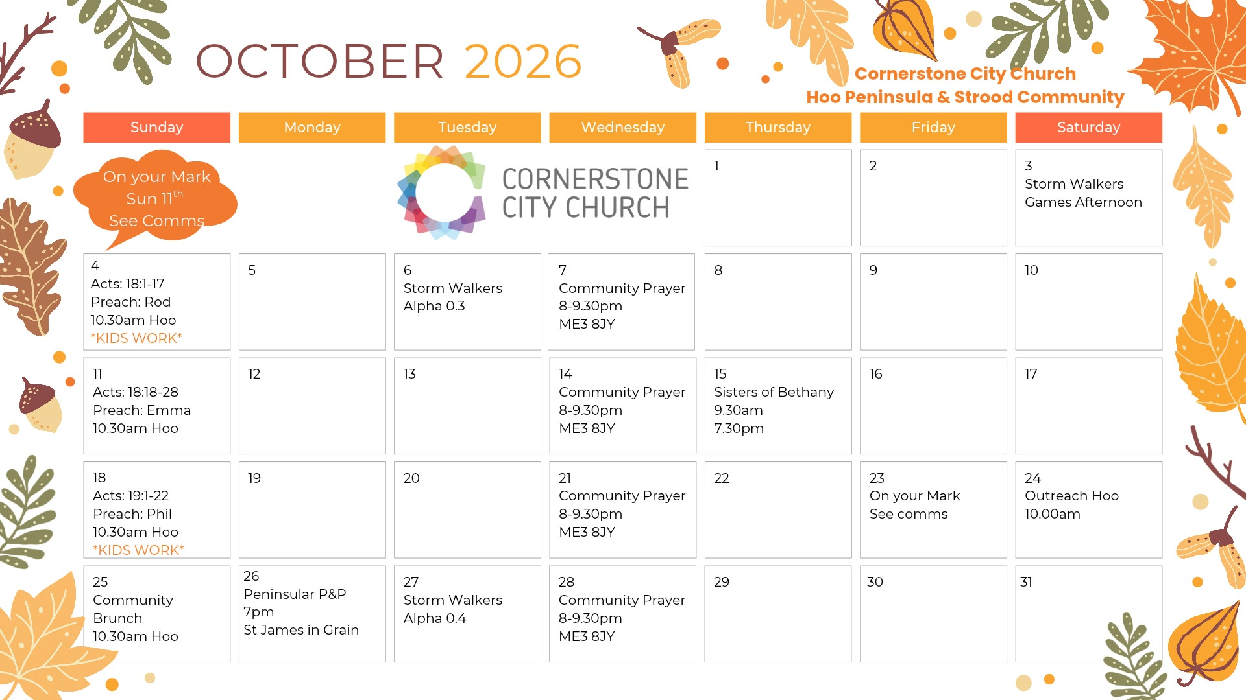

Slide 26
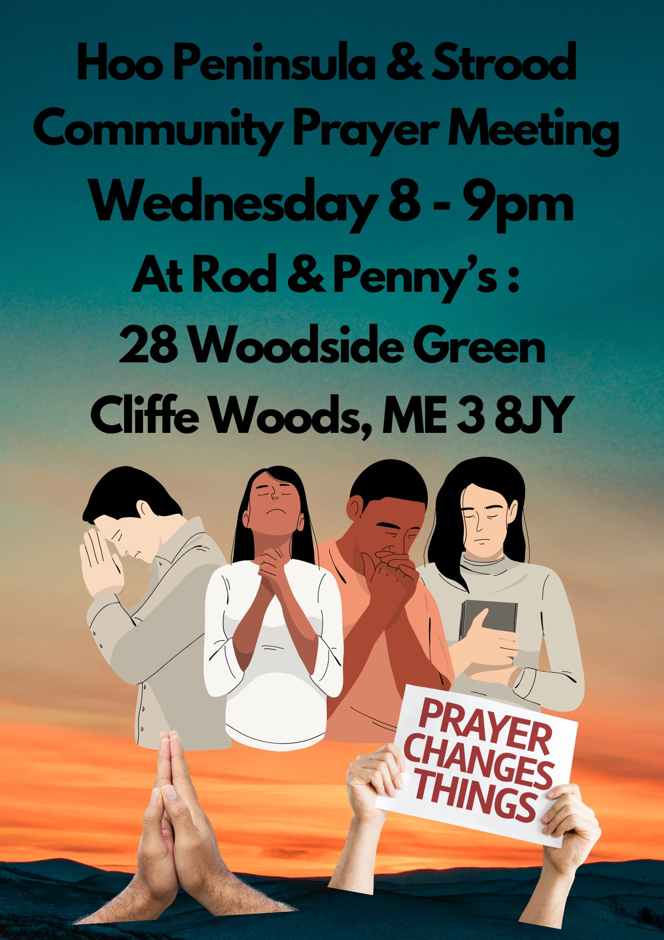

Slide 27
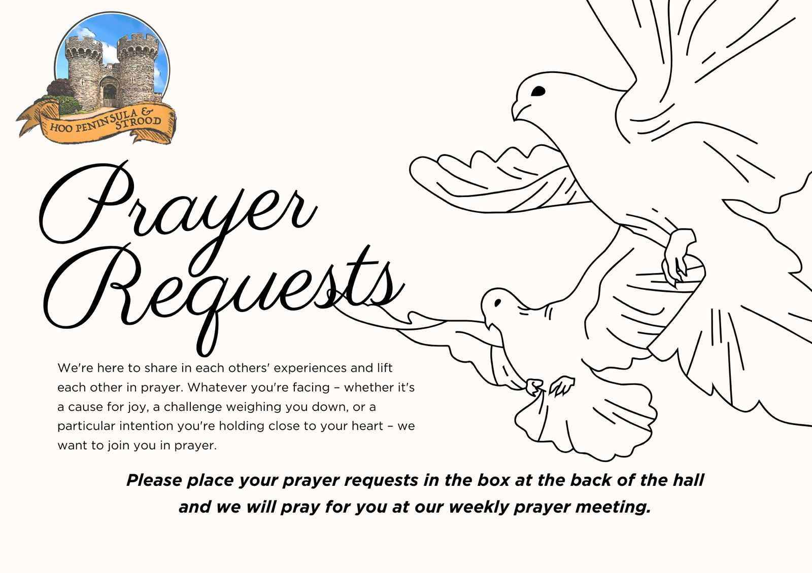

Slide 28


Slide 29
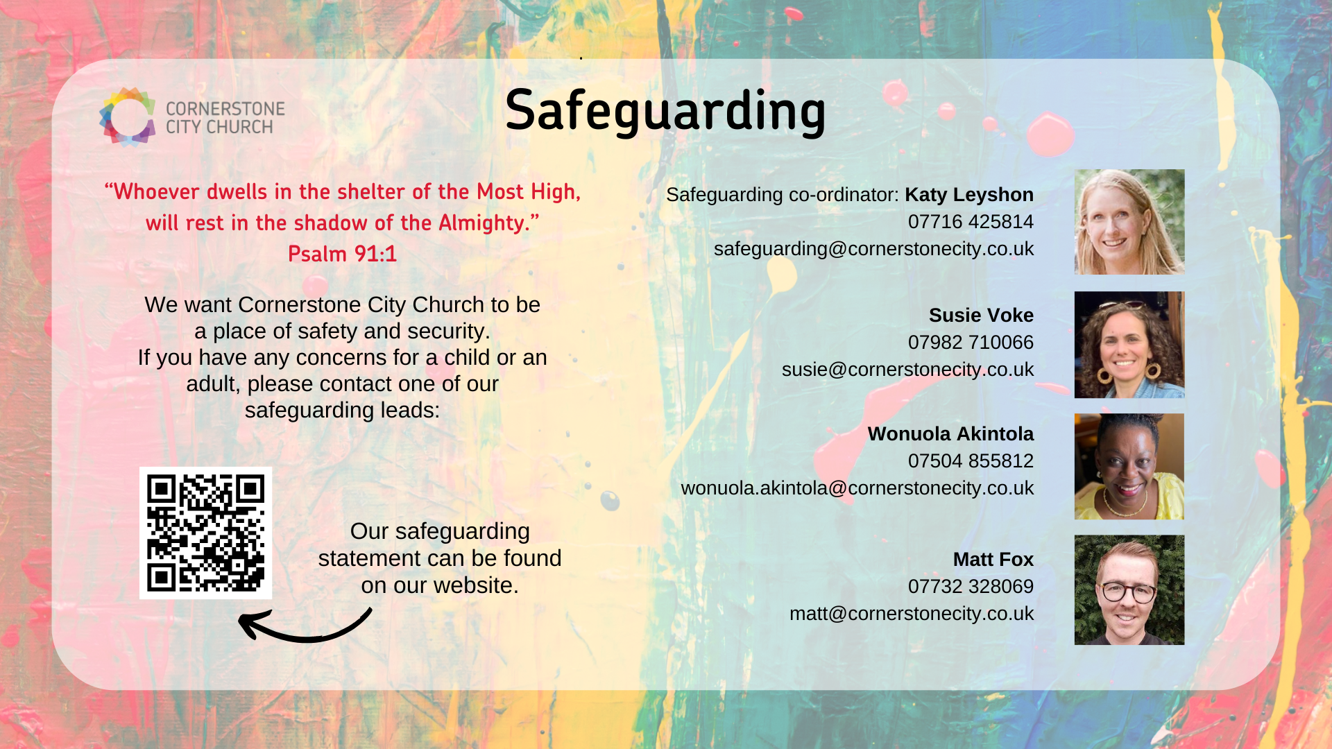

Slide 30


Slide 31


Slide 32
Reign Above It All
CCLI Song # 7134098
Ethan Hulse | Hannah McClure | Jess Cates | Paul McClure
© 2019 We Are TIM Music; Zoom Out Songs; Be Essential Songs; EGH Music Publishing; Bethel Music Publishing
For use solely with the SongSelect® Terms of Use. All rights reserved. www.ccli.com
CCLI Licence No. 33265

Slide 33
1/8
The reign of darkness now has ended
In the kingdom of light
In the kingdom of light
Forever under Your dominion
You’re the King of my life
You’re the King of my life

Slide 34
2/8
You reign above it all
You reign above it all
Over the universe
And over every heart
There is no higher name
Jesus You reign above it all

Slide 35
3/8
On the cross the work was finished
God You poured out Your life
Just to give us new life
Now from the lips of the forgiven
Hear an anthem arise
'Cause Jesus You’re alive

Slide 36
4/8
You reign above it all
You reign above it all
Over the universe
And over every heart
There is no higher name
Jesus You reign above it all

Slide 37
5/8
Let all of heaven
And the earth erupt in song
Sing hallelujah to the Everlasting One
There is no higher name
Jesus You reign above it all

Slide 38
6/8
You sent the darkness running
Out of an empty grave
Now seated alone in glory
Enthroned on the highest praise
(REPEAT)

Slide 39
7/8
You reign above it all
You reign above it all
Over the universe
And over every heart
There is no higher name
Jesus You reign above it all

Slide 40
8/8
Let all of heaven
And the earth erupt in song
Sing hallelujah to the Everlasting One
There is no higher name
Jesus You reign above it all

Slide 41
2 Corinthians 14
May the grace of the Lord Jesus Christ, and the love of God, and the fellowship of the Holy Spirit be with us all.
And….
Surely goodness and mercy shall follow us all the days of our lives, and we shall dwell in the house of the Lord forever.

Slide 42
Amen!

