Slide 1
Cornerstone City Church
Peninsula Plus Community
Hoo Are Ya
11th October 2026

Slide 2


Slide 3
Come Now Is the Time To Worship
CCLI Song # 2430948
Brian Doerksen
© 1998 Vineyard Songs (UK/Eire) (Admin. by Integrity Music Ltd)
For use solely with the SongSelect® Terms of Use. All rights reserved. www.ccli.com
CCLI Licence No. 33265

Slide 4
1/5
Come now is the time to worship
Come now is the time to give your heart
Come just as you are to worship
Come just as you are before your God
Come

Slide 5
2/5
One day every tongue
Will confess You are God
One day every knee will bow
Still the greatest treasure remains
For those who gladly choose You now

Slide 6
3/5
Come now is the time to worship
Come now is the time to give your heart
Come just as you are to worship
Come just as you are before your God
Come

Slide 7
4/5
Willingly we choose to surrender our lives
Willingly our knees will bow
With all our heart soul mind and strength
We gladly choose You now

Slide 8
5/5
Come now is the time to worship
Come now is the time to give your heart
Come just as you are to worship
Come just as you are before your God
Come

Slide 9
King of Kings
CCLI Song # 7127647
Brooke Ligertwood | Jason Ingram | Scott Ligertwood
© 2019 Fellow Ships Music (Admin. by Essential Music Publishing LLC)
So Essential Tunes (Admin. by Essential Music Publishing LLC)
Hillsong Music Publishing Australia (Admin. by Hillsong Music Publishing UK)
For use solely with the SongSelect® Terms of Use. All rights reserved. www.ccli.com
CCLI Licence No. 33265

Slide 10
1/11
In the darkness we were waiting
Without hope without light
Till from Heaven You came running
There was mercy in Your eyes

Slide 11
2/11
To fulfil the law and prophets
To a virgin came the Word
From a throne of endless glory
To a cradle in the dirt

Slide 12
3/11
Praise the Father
Praise the Son
Praise the Spirit three in one
God of Glory
Majesty
Praise forever to the King of kings

Slide 13
4/11
To reveal the kingdom coming
And to reconcile the lost
To redeem the whole creation
You did not despise the cross

Slide 14
5/11
For even in Your suffering
You saw to the other side
Knowing this was our salvation
Jesus for our sake You died

Slide 15
6/11
Praise the Father
Praise the Son
Praise the Spirit three in one
God of Glory
Majesty
Praise forever to the King of kings

Slide 16
7/11
And the morning that You rose
All of heaven held its breath
Till that stone was moved for good
For the Lamb had conquered death

Slide 17
8/11
And the dead rose from their tombs
And the angels stood in awe
For the souls of all who'd come
To the Father are restored

Slide 18
9/11
And the Church of Christ was born
Then the Spirit lit the flame
Now this Gospel truth of old
Shall not kneel shall not faint

Slide 19
10/11
By His blood and in His Name
In His freedom I am free
For the love of Jesus Christ
Who has resurrected me

Slide 20
11/11
Praise the Father
Praise the Son
Praise the Spirit three in one
God of Glory
Majesty
Praise forever to the King of kings

Slide 21
1/6
Bless God in the sanctuary
Bless God in the fields of plenty
Bless God in the darkest valley
Every chance I get I bless Your name

Slide 22
2/6
Bless God when my hands are empty
Bless God with a praise that costs me
Bless God when nobody’s watching
Every chance I get I bless Your name

Slide 23
3/6
Bless God when the weapon’s forming
Bless God when the walls are falling
Bless God ‘cause He goes before me
Every chance I get I bless Your name

Slide 24
4/6
Bless God for He holds the vict’ry
Bless God for He’s always with me
Bless God for He’s always worthy
Every chance I get I bless Your name
Every chance I get I bless Your name

Slide 25
5/6
Come on and praise the Lord with me
Sing if you love His name
Come on and lift your voice with me
He’s worthy of all our praise

Slide 26
6/6
Come on and bring your offering
Sing if you’ve known His grace
Come on and lift up your holy hands
He’s worthy of all our praise

Slide 27
Bless God
CCLI Song # 7206380
Brandon Lake | Brooke Ligertwood | Cody Carnes
© 2023 Brandon Lake Music; Brooke Ligertwood Designee; Capitol CMG Paragon; Writer's Roof Publishing
For use solely with the SongSelect® Terms of Use. All rights reserved. www.ccli.com

Slide 28
1/11
Blessed are those who run to Him
Who place their hope and confidence in Jesus
He won’t forsake them
Blessed are those who seek His face
Who bend their knee and fix their gaze on Jesus
They won’t be shaken

Slide 29
2/11
Come on and praise the Lord with me
Sing if you love His name
Come on and lift your voice with me
He’s worthy of all our praise

Slide 30
3/11
Blessed are those who walk with Him
Whose hearts are set on pilgrimage with Jesus
They’ll see His glory
Blessed are those who die to live
Whose joy it is to give it all for Jesus
And for Him only
Oh Jesus all for Your glory

Slide 31
4/11
Come on and praise the Lord with me
Sing if you love His name
Come on and lift your voice with me
He’s worthy of all our praise

Slide 32
5/11
Come on and bring your offering
Sing if you’ve known His grace
Come on and lift up your holy hands
He’s worthy of all our praise

Slide 33
6/11
Bless God in the sanctuary
Bless God in the fields of plenty
Bless God in the darkest valley
Every chance I get I bless Your name

Slide 34
7/11
Bless God when my hands are empty
Bless God with a praise that costs me
Bless God when nobody’s watching
Every chance I get I bless Your name

Slide 35
8/11
Bless God when the weapon’s forming
Bless God when the walls are falling
Bless God ‘cause He goes before me
Every chance I get I bless Your name

Slide 36
9/11
Bless God for He holds the vict’ry
Bless God for He’s always with me
Bless God for He’s always worthy
Every chance I get I bless Your name
Every chance I get I bless Your name

Slide 37
10/11
Come on and praise the Lord with me
Sing if you love His name
Come on and lift your voice with me
He’s worthy of all our praise

Slide 38
11/11
Come on and bring your offering
Sing if you’ve known His grace
Come on and lift up your holy hands
He’s worthy of all our praise
He’s worthy of all our praise

Slide 40
Who Else
CCLI Song # 7223119
Abbie Gamboa | Josiah Funderburk | Zac Rowe
© 2023 Gateway Music Global Publishing; Gamboa World, LLC
For use solely with the SongSelect® Terms of Use. All rights reserved. www.ccli.com
CCLI Licence No. 33265

Slide 41
1/8
I am an instrument of exaltation
And I was born to lift Your name above all names
You hear the melody of all creation
But there's a song of praise that only I can bring

Slide 42
2/8
Who else is worthy who else is worthy
There is no one only You Jesus
Who else is worthy who else is worthy
There is no one only You Jesus

Slide 43
3/8
You are the infinite God of the ages
Yet You chose to make my heart Your dwelling place
You healed my brokenness showed me Your glory
So I have songs of thanks not even angels sing

Slide 44
4/8
Who else is worthy who else is worthy
There is no one only You Jesus
Who else is worthy who else is worthy
There is no one only You Jesus

Slide 45
5/8
Lamb of God anointed one
Who was and is and is to come
Seated on the throne above
Holy holy

Slide 46
6/8
Righteous One who shed His blood
You proved to us the Father's love
Jesus Christ be lifted up
(Holy holy)

Slide 47
7/8
Who else is worthy who else is worthy
There is no one only You Jesus
Who else is worthy who else is worthy
There is no one only You Jesus

Slide 48
8/8
There is no one only You Jesus
(REPEAT)
Who else is worthy who else is worthy
There is no one only You Jesus
(REPEAT)

Slide 49
1/3
Jesus Jesus You make the darkness tremble
Jesus Jesus You silence fear
Jesus Jesus You make the darkness tremble
Jesus Jesus

Slide 50
2/3
Your name is a light that the shadows can't deny
Your name cannot be overcome
Your name is alive forever lifted high
Your name cannot be overcome

Slide 51
3/3
Jesus Jesus You make the darkness tremble
Jesus Jesus You silence fear
Jesus Jesus You make the darkness tremble
Jesus Jesus

Slide 53


Slide 54


Slide 55


Slide 56


Slide 57
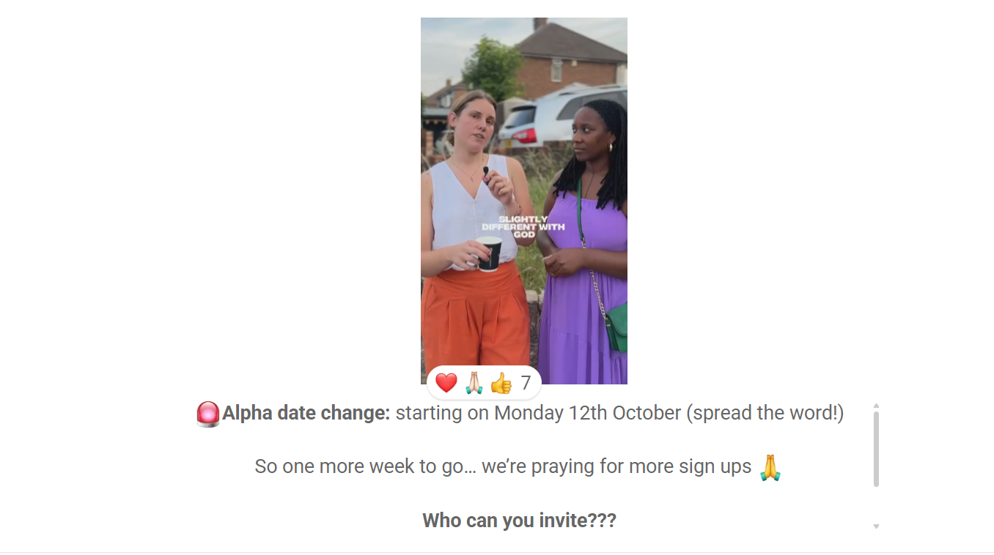

Slide 58


Slide 59
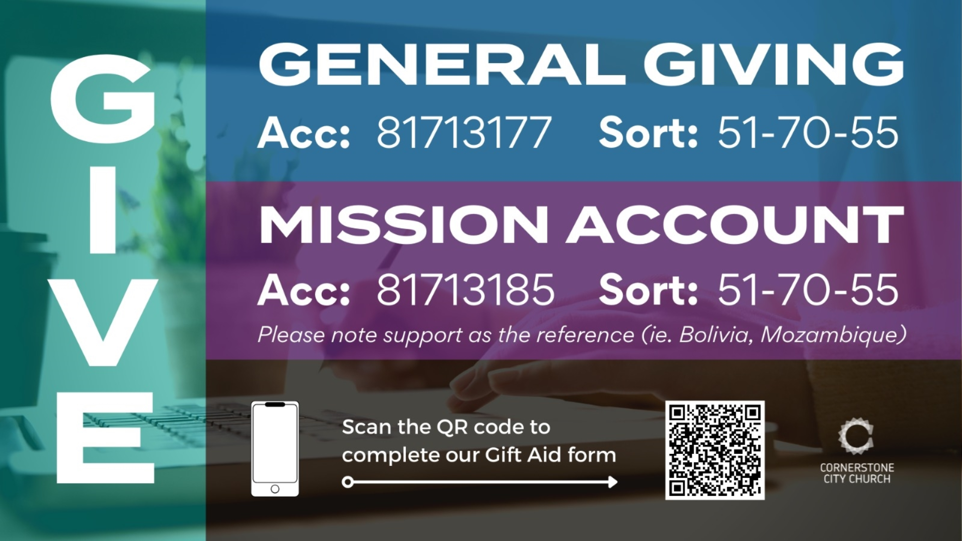

Slide 60
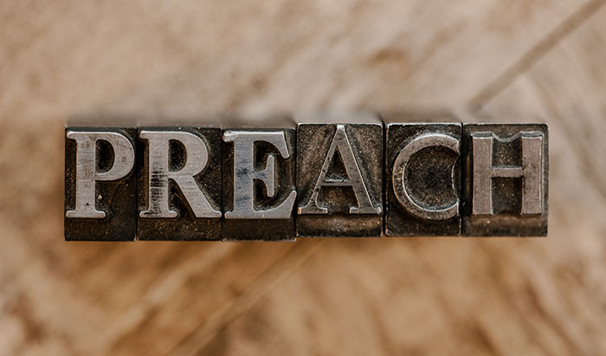

Slide 61
What A Friend We Have In Jesus
CCLI Song # 7206913
Charles Crozat Converse | Joseph Medlicott Scriven | Paul Baloche
© Words: Public Domain; Music: Integrity Worship Music; Leadworship Songs
For use solely with the SongSelect® Terms of Use. All rights reserved. www.ccli.com
CCLI Licence No. 33265

Slide 62
1/3
What a friend we have in Jesus
All our sins and griefs to bear
What a privilege to carry
Everything to God in prayer
O what peace we often forfeit
O what needless pain we bear
All because we do not carry
Everything to God in prayer

Slide 63
2/3
Have we trials and temptations
Is there trouble anywhere
We should never be discouraged
Take it to the Lord in prayer
Can we find a friend so faithful
Who will all our sorrows share
Jesus knows our every weakness
Take it to the Lord in prayer

Slide 64
3/3
Are we weak and heavy laden
Cumbered with a load of care
Precious Savior still our refuge
Take it to the Lord in prayer
Do thy friends despise forsake thee
Take it to the Lord in prayer
In His arms He'll take and shield thee
Thou wilt find a solace there

Slide 65
2 Corinthians 14
May the grace of the Lord Jesus Christ, and the love of God, and the fellowship of the Holy Spirit be with us all.
And….
Surely goodness and mercy shall follow us all the days of our lives, and we shall dwell in the house of the Lord forever.

Slide 66
Amen!

