Slide 1
Cornerstone City Church Peninsula Plus Community Hoo Are Ya 30-01-2022

Slide 2
Blessed Be Your Name
CCLI Song # 3798438
Beth Redman | Matt Redman
© 2002 Thankyou Music (Admin. by Integrity Music Ltd)
For use solely with the SongSelect® Terms of Use. All rights reserved. www.ccli.com
CCLI Licence No. 33265

Slide 3
1/7
Blessed be Your name
In the land that is plentiful
Where Your streams of abundance flow
Blessed be Your name

Slide 4
2/7
Blessed be Your name
When I'm found in the desert place
Though I walk through the wilderness
Blessed be Your name

Slide 5
3/7
Ev’ry blessing You pour out I’ll
Turn back to praise
When the darkness closes in Lord
Still I will say

Slide 6
4/7
Blessed be the name of the Lord
Blessed be Your name
Blessed be the name of the Lord
Blessed be Your glorious name

Slide 7
5/7
Blessed be Your name
When the sun's shining down on me
When the world's all as it should be
Blessed be Your name

Slide 8
6/7
Blessed be Your name
On the road marked with suffering
Though there's pain in the offering
Blessed be Your name

Slide 9
7/7
You give and take away
You give and take away
My heart will choose to say
Lord blessed be Your name

Slide 10
Our God
CCLI Song # 5677416
Chris Tomlin | Jesse Reeves | Jonas Myrin | Matt Redman
© 2010 sixsteps Music (Admin. by Integrity Music)
Thankyou Music (Admin. by Integrity Music)
Vamos Publishing (Admin. by Integrity Music)
worshiptogether.com songs (Admin. by Integrity Music)
Atlas Mountain Songs (Admin. by SHOUT! Music Publishing UK)
For use solely with the SongSelect® Terms of Use. All rights reserved. www.ccli.com
CCLI Licence No. 33265

Slide 11
1/3
Water You turned into wine Opened the eyes of the blind There's no one like you None like you Into the darkness You shine Out of the ashes we rise There's No one like you None like you

Slide 12
2/3
Our God is greater,
Our God is stronger God You are higher than any other Our God is Healer,
Awesome in power Our God, Our God

Slide 13
3/3
And if Our God is for us,
Then who could ever stop us? And if our God is with us,
Then what can stand against?

Slide 14
Lead Me To The Cross
CCLI Song # 4785828
Brooke Ligertwood
© 2006 Hillsong Music Publishing Australia (Admin. by Hillsong Music Publishing UK)
For use solely with the SongSelect® Terms of Use. All rights reserved. www.ccli.com
CCLI Licence No. 33265

Slide 15
1/3
Saviour I come quiet my soul
Remember
Redemption's hill
Where Your blood was spilled
For my ransom
Ev’rything I once held dear
I count it all as loss

Slide 16
2/3
Lead me to the cross
Where Your love poured out
Bring me to my knees
Lord I lay me down
Rid me of myself
I belong to You
Oh lead me lead me to the cross

Slide 17
3/4
You were as I tempted and tried Human
The word became flesh
Bore my sin in death
Now You're risen Ev’rything I once held dear
I count it all as loss

Slide 18
4/4
To Your heart
To Your heart
Lead me to Your heart
Lead me to Your heart

Slide 19
Cornerstone
CCLI Song # 6158927
Edward Mote | Eric Liljero | Jonas Myrin | Reuben Morgan | William Batchelder Bradbury
© 2011 Hillsong MP Songs (Admin. by Hillsong Music Publishing UK)
Hillsong Music Publishing Australia (Admin. by Hillsong Music Publishing UK)
Hillsong Music Publishing UK
For use solely with the SongSelect® Terms of Use. All rights reserved. www.ccli.com
CCLI Licence No. 33265

Slide 20
1/4
My hope is built on nothing less
Than Jesus' blood and righteousness
I dare not trust the sweetest frame
But wholly trust in Jesus' Name

Slide 21
2/4
Christ alone cornerstone
Weak made strong in the Saviour's love
Through the storm He is Lord
Lord of all

Slide 22
3/4
When darkness seems to hide His face
I rest on His unchanging grace
In every high and stormy gale
My anchor holds within the veil
My anchor holds within the veil

Slide 23
4/4
When He shall come with trumpet sound
Oh may I then in Him be found
Dressed in His righteousness alone
Faultless stand before the throne

Slide 24
1/1
Turn your eyes upon Jesus
Look full in His wonderful face
And the things of earth
Will grow strangely dim
In the light of His glory and grace

Slide 26


Slide 27
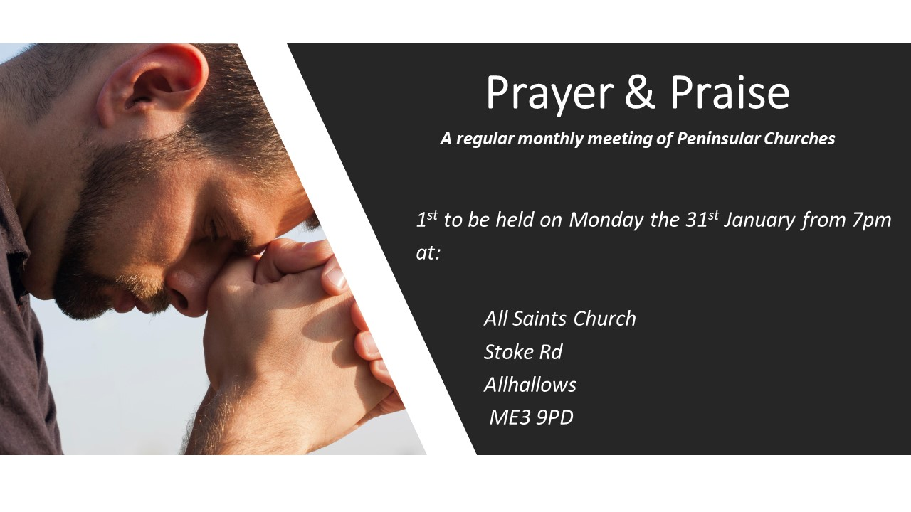

Slide 29
Turn Your Eyes Upon Jesus
CCLI Song # 15960
Helen H. Lemmel
© Words: 1922. Renewed 1950 New Spring (Admin. by / Small Stone Media BV, Holland (Admin. in the UK/Eire by Song Solutions www.songsolutions.org))
Music: 1922. Renewed 1950 New Spring (Admin. by / Small Stone Media BV, Holland (Admin. in the UK/Eire by Song Solutions www.songsolutions.org))
For use solely with the SongSelect® Terms of Use. All rights reserved. www.ccli.com
CCLI Licence No. 33265

Slide 30
1/4
O soul are you weary and troubled
No light in the darkness you see
There's light for a look at the Savior
And life more abundant and free

Slide 31
2/4
Turn your eyes upon Jesus
Look full in His wonderful face
And the things of earth
Will grow strangely dim
In the light of His glory and grace

Slide 32
3/4
Through death into life everlasting
He passed and we follow Him there
Over us sin no more hath dominion
For more than conquerors we are

Slide 33
4/4
His Word shall not fail you He promised
Believe Him and all will be well
Then go to a world that is dying
His perfect salvation to tell

Slide 34
In Jesus Name
CCLI Song # 6454638
Darlene Zschech | Israel Houghton
© 2013 EWI (Admin. by Integrity Music Ltd)
Integrity Worship Music (Admin. by Integrity Music Ltd)
Integrity's Praise! Music (Admin. by Integrity Music Ltd)
Sound Of The New Breed (Admin. by Integrity Music Ltd)
For use solely with the SongSelect® Terms of Use. All rights reserved. www.ccli.com
CCLI Licence No. 33265

Slide 35
1/9
God is fighting for us God is on our side
He has overcome yes
He has overcome
We will not be shaken we will not be moved
Jesus You are here

Slide 36
2/9
Carrying our burdens covering our shame
He has overcome yes
He has overcome
We will not be shaken we will not be moved
Jesus You are here

Slide 37
3/9
I will live I will not die
The resurrection pow'r of Christ alive in me
And I am free in Jesus' Name

Slide 38
4/9
Carrying our burdens covering our shame
He has overcome yes
He has overcome
We will not be shaken we will not be moved
Jesus You are here

Slide 39
5/9
I will live I will not die
The resurrection pow'r of Christ alive in me
And I am free in Jesus' Name

Slide 40
6/9
I will live I will not die
I will declare and lift You high
Christ revealed and I am healed in Jesus' Name

Slide 41
7/9
God is fighting for us pushing back the darkness
Lighting up the Kingdom that cannot be shaken
In the Name of Jesus enemy's defeated
And we will shout it out shout it out

Slide 42
8/9
I will live I will not die
The resurrection pow'r of Christ alive in me
And I am free in Jesus' Name

Slide 43
9/9
I will live I will not die
I will declare and lift You high
Christ revealed and I am healed in Jesus' Name In Jesus' Name
In Jesus' Name
In Jesus' Name

