Slide 1
Cornerstone City Church Peninsula Plus Community Hoo Are Ya 19-04-2023

Slide 2
My Worship
CCLI Song # 7098688
Philip Nathan Thompson | Zenzo Matoga
© 2017 Integrity Worship Music (Admin. by Integrity Music Ltd)
Phil Thompson Worship (Admin. by Integrity Music Ltd)
Zenzo Matoga Music (Admin. by Integrity Music Ltd)
For use solely with the SongSelect® Terms of Use. All rights reserved. www.ccli.com
CCLI Licence No. 33265

Slide 3
1/3
You Lord
You are worthy
And no one can worship You for me
For all of the things You've done for me
And no one can worship You for me

Slide 4
2/3
Here's my worship
All of my worship
Receive my worship
All of my worship
(REPEAT)

Slide 5
3/3
And I will not be silent
I will always worship You
As long as I am breathing
I will always worship You

Slide 6
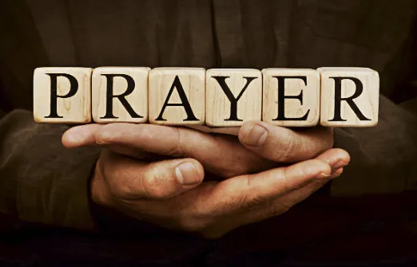

Slide 7
Great Are You Lord
CCLI Song # 6460220
David Leonard | Jason Ingram | Leslie Jordan
© 2012 Open Hands Music (Admin. by Essential Music Publishing LLC)
So Essential Tunes (Admin. by Essential Music Publishing LLC)
Integrity's Praise! Music (Admin. by Integrity Music Ltd)
Little Way Creative (Admin. by Integrity Music Ltd)
For use solely with the SongSelect® Terms of Use. All rights reserved. www.ccli.com
CCLI Licence No. 33265

Slide 8
1/3
You give life You are love
You bring light to the darkness
You give hope You restore ev'ry heart that is broken
And great are You Lord

Slide 9
2/3
It's Your breath in our lungs
So we pour out our praise
We pour out our praise
It's Your breath in our lungs
So we pour out our praise to You only

Slide 10
3/3
And all the earth will shout Your praise
Our hearts will cry these bones will sing
Great are You Lord
(REPEAT)

