Slide 1
Cornerstone City Church
Peninsula Plus Community
Hoo Are Ya
4th October 2026

Slide 2


Slide 3
Great Big God
CCLI Song # 3373437
Jo Hemming | Nigel Hemming
© 2001 Vineyard Songs (UK/Eire) (Admin. by Integrity Music Ltd)
For use solely with the SongSelect® Terms of Use. All rights reserved. www.ccli.com
CCLI Licence No. 33265

Slide 4
1/2
Our God is a great big God
Our God is a great big God
Our God is a great big God
And He holds us in His hands

Slide 5
2/2
He's higher than a skyscraper
And He's deeper than a submarine
He's wider than the universe
And beyond my wildest dreams
And He's known me and He's loved me
Since before the world began
How wonderful to be a part of
God's amazing plan

Slide 6
Thanksgiving
CCLI Song # 7199589
Nick Herbert | Taku Mudere | Zo Chilengwe
© Capitol CMG Genesis; Safe and Sound Music; Remaining portion is unaffiliated
For use solely with the SongSelect® Terms of Use. All rights reserved. www.ccli.com
CCLI Licence No. 33265

Slide 7
1/10
Enter in (Enter in)
His courts with praise (His courts with praise)
For He is greatly (He is greatly)
To be praised (To be praised)

Slide 8
2/10
Enter in (Enter in)
His courts with praise (His courts with praise)
For He is greatly (He is greatly)
To be praised

Slide 9
3/10
What shall we do
We shall lift up a shout
What shall we do
We shall praise Him
What shall we do
For our God made a way
We'll give Him our thanksgiving

Slide 10
4/10
Magnify (Magnify)
His Holy Name (His Holy Name)
For He is greatly (For He is greatly)
To be praised (To be praised)

Slide 11
5/10
Magnify (Magnify)
His Holy Name (His Holy Name)
For He is greatly (For He is greatly)
To be praised

Slide 12
6/10
What shall we do
We shall lift up a shout
What shall we do
We shall praise Him
What shall we do
For our God made a way
We'll give Him our thanksgiving

Slide 13
7/10
Even if the rocks cry out
We're gonna drown them out
With a louder shout of praise
Even when the battles roar
We're gonna praise You Lord
'Cause You are always worthy

Slide 14
8/10
You are worthy
Worthy of honour and praise
You are worthy
We'll sing it again and again

Slide 15
9/10
What shall we do
We shall lift up a shout
What shall we do
We shall praise Him
What shall we do
For our God made a way
We'll give Him our thanksgiving

Slide 16
10/10
We'll give Him our thanksgiving
We'll give Him our thanksgiving

Slide 18
Your Love Never Fails
CCLI Song # 5337172
Anthony Skinner | Chris McClarney
© 2008 Integrity's Alleluia! Music (Admin. by Integrity Music Ltd)
Out Of The Cave Music (Admin. by Integrity Music Ltd)
Thankyou Music (Admin. by Integrity Music Ltd)
For use solely with the SongSelect® Terms of Use. All rights reserved. www.ccli.com
CCLI Licence No. 33265

Slide 19
1/6
Nothing can separate
Even if I ran away
Your love never fails
I know I still make mistakes but
You have new mercies for me ev'ryday
Your love never fails

Slide 20
2/6
(And) You stay the same through the ages
Your love never changes
There may be pain in the night
But joy comes in the morning
And when the oceans rage
I don't have to be afraid
Because I know that You love me
(Your love never fails)

Slide 21
3/6
The wind is strong and the water's deep
But I'm not alone here in these open seas
Your love never fails
The chasm is far too wide
I never thought I'd reach the other side
Your love never fails

Slide 22
4/6
(And) You stay the same through the ages
Your love never changes
There may be pain in the night
But joy comes in the morning
And when the oceans rage
I don't have to be afraid
Because I know that You love me
(Your love never fails)

Slide 23
5/6
You make all things
Work together for my good
You make all things
Work together for my good

Slide 24
6/6
(And) You stay the same through the ages
Your love never changes
There may be pain in the night
But joy comes in the morning
And when the oceans rage
I don't have to be afraid
Because I know that You love me
(Your love never fails)

Slide 26
My Worship
CCLI Song # 7098688
Philip Nathan Thompson | Zenzo Matoga
© 2017 Integrity Worship Music (Admin. by Integrity Music Ltd)
Phil Thompson Worship (Admin. by Integrity Music Ltd)
Zenzo Matoga Music (Admin. by Integrity Music Ltd)
For use solely with the SongSelect® Terms of Use. All rights reserved. www.ccli.com
CCLI Licence No. 33265

Slide 27
1/3
You Lord
You are worthy
And no one can worship You for me
For all of the things You've done for me
And no one can worship You for me

Slide 28
2/3
Here's my worship
All of my worship
Receive my worship
All of my worship
(REPEAT)

Slide 29
3/3
And I will not be silent
I will always worship You
As long as I am breathing
I will always worship You

Slide 30
Great Are You Lord
CCLI Song # 6460220
David Leonard | Jason Ingram | Leslie Jordan
© 2012 Open Hands Music (Admin. by Essential Music Publishing LLC)
So Essential Tunes (Admin. by Essential Music Publishing LLC)
Integrity's Praise! Music (Admin. by Integrity Music Ltd)
Little Way Creative (Admin. by Integrity Music Ltd)
For use solely with the SongSelect® Terms of Use. All rights reserved. www.ccli.com
CCLI Licence No. 33265

Slide 31
1/3
You give life You are love
You bring light to the darkness
You give hope You restore ev'ry heart that is broken
And great are You Lord

Slide 32
2/3
It's Your breath in our lungs
So we pour out our praise
We pour out our praise
It's Your breath in our lungs
So we pour out our praise to You only

Slide 33
3/3
And all the earth will shout Your praise
Our hearts will cry these bones will sing
Great are You Lord
(REPEAT)

Slide 34


Slide 35
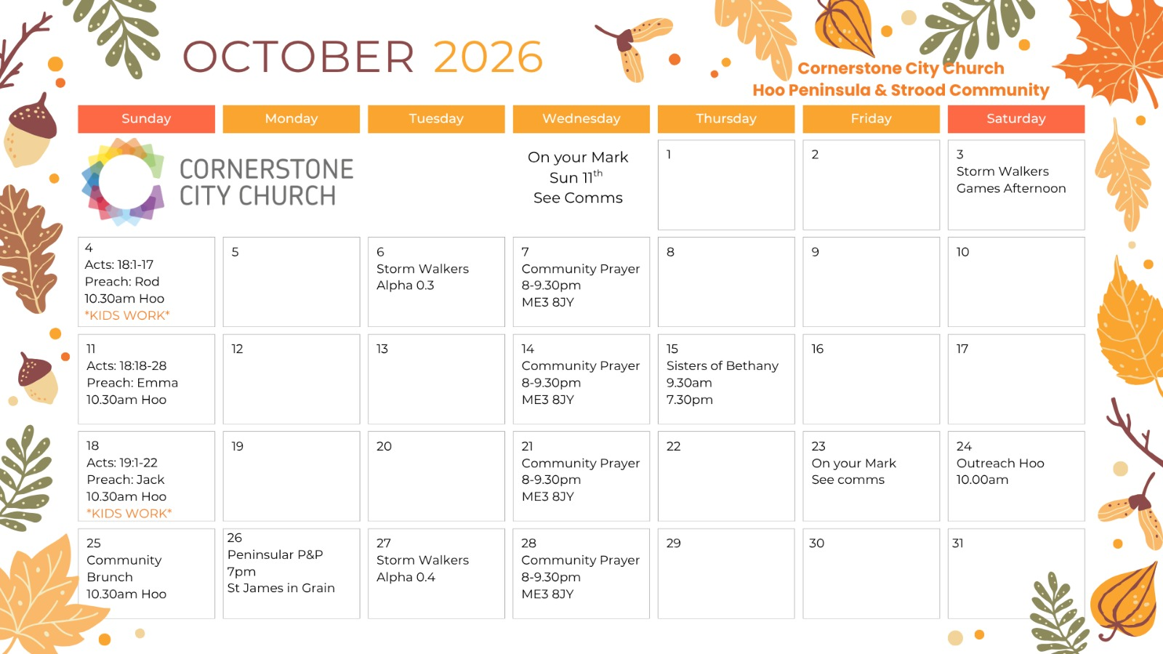

Slide 36


Slide 37


Slide 38


Slide 39
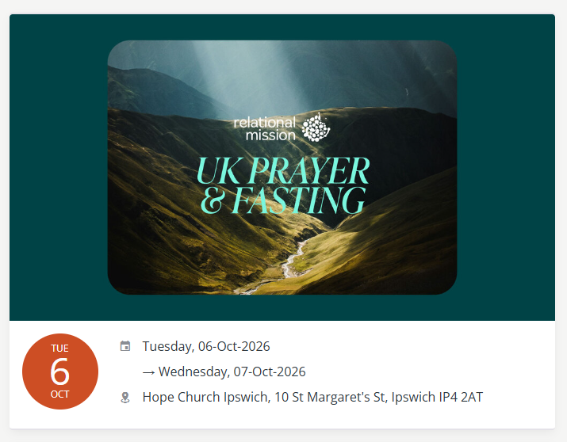

Slide 40
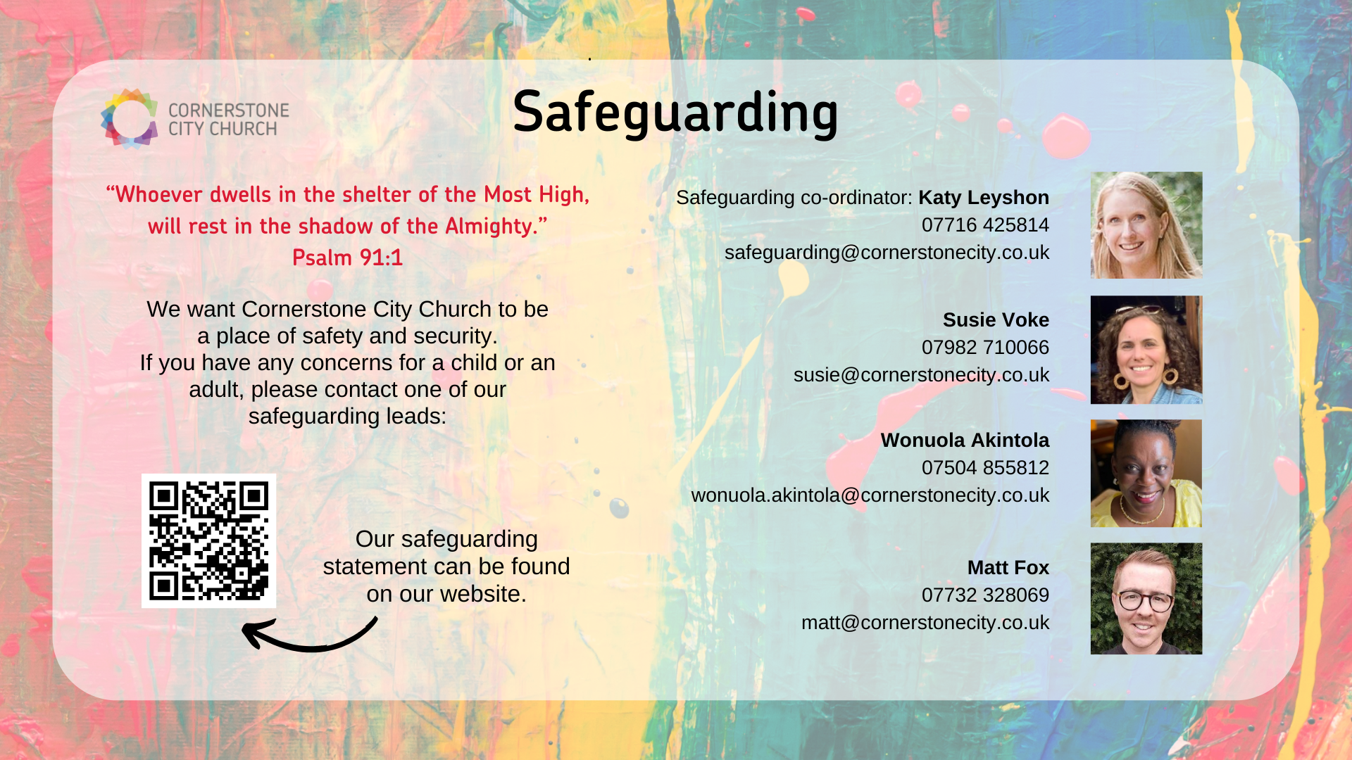

Slide 41
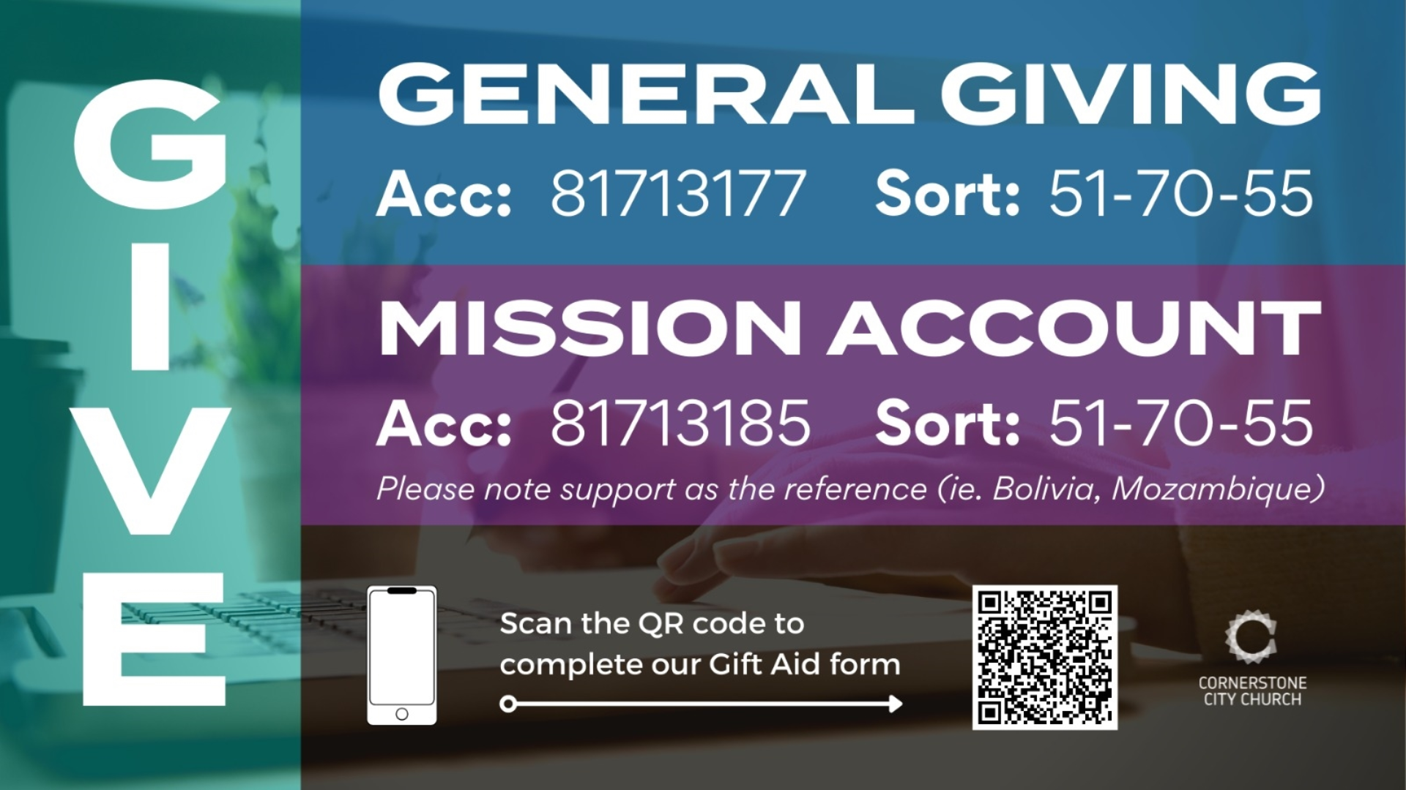

Slide 42
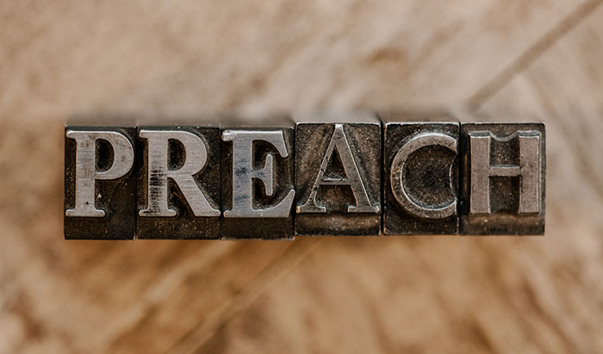

Slide 43
2 Corinthians 14
May the grace of the Lord Jesus Christ, and the love of God, and the fellowship of the Holy Spirit be with us all.
And….
Surely goodness and mercy shall follow us all the days of our lives, and we shall dwell in the house of the Lord forever.

Slide 44
Amen!

