Slide 1
Cornerstone City Church Peninsula Plus Community Hoo Are Ya
5th January 2025

Slide 2
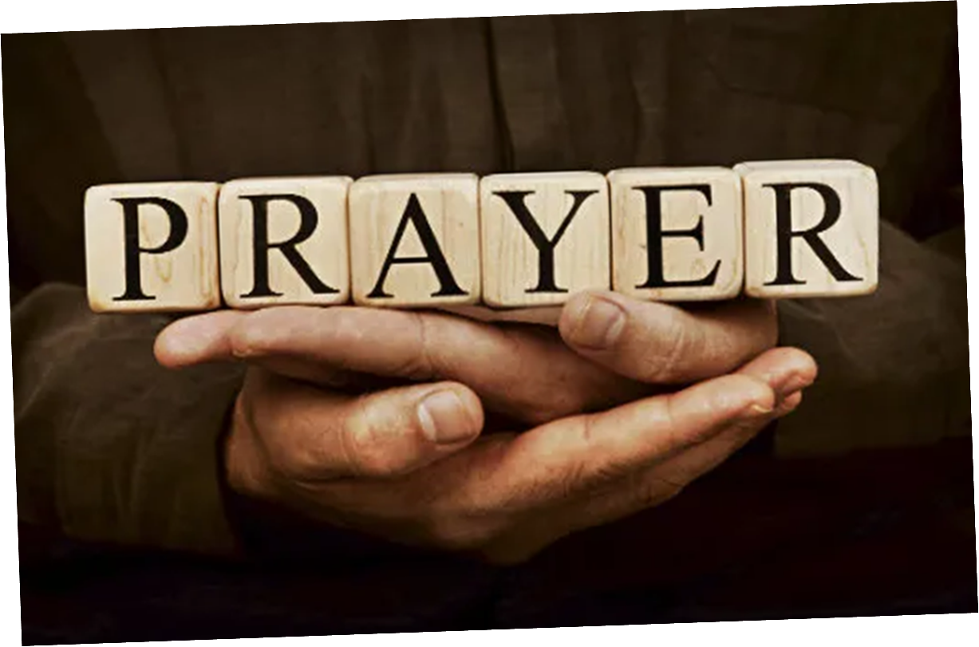

Slide 3
Everlasting God
CCLI Song # 4556538
Brenton Brown | Ken Riley
© 2005 Thankyou Music (Admin. by Integrity Music Ltd)
For use solely with the SongSelect® Terms of Use. All rights reserved. www.ccli.com
CCLI Licence No. 33265

Slide 4
1/3
Strength will rise as we wait upon the Lord
We will wait upon the Lord
We will wait upon the Lord
Strength will rise as we wait upon the Lord
We will wait upon the Lord
We will wait upon the Lord

Slide 5
2/3
Our God You reign forever
Our Hope our strong Deliv'rer

Slide 6
3/3
You are the everlasting God
The everlasting God
You do not faint
You won't grow weary
You're the defender of the weak
You comfort those in need
You lift us up on wings like eagles

Slide 7
This Is Amazing Grace
CCLI Song # 6333821
Jeremy Riddle | Josh Farro | Phil Wickham
© 2012 WC Music Corp. (Admin. by / Small Stone Media BV, Holland (Admin. in the UK/Eire by Song Solutions www.songsolutions.org))
Bethel Music Publishing (Admin. by Song Solutions)
Phil Wickham Music (Admin. by Song Solutions www.songsolutions.org)
Seems Like Music (Admin. by Song Solutions www.songsolutions.org)
Sing My Songs (Admin. by Song Solutions www.songsolutions.org)
For use solely with the SongSelect® Terms of Use. All rights reserved. www.ccli.com
CCLI Licence No. 33265

Slide 8
1/7
Who breaks the power of sin and darkness
Whose love is mighty and so much stronger
The King of Glory the King above all kings

Slide 9
2/7
Who shakes the whole earth with holy thunder
And leaves us breathless in awe and wonder
The King of Glory the King above all kings

Slide 10
3/7
This is amazing grace
This is unfailing love
That You would take my place
That You would bear my cross
You laid down Your life
That I would be set free
Oh Jesus I sing for all that You've done for me

Slide 11
4/7
Who brings our chaos back into order
Who makes the orphan a son and daughter
The King of Glory the King above all kings

Slide 12
5/7
Who rules the nations with truth and justice
Shines like the sun in all of its brilliance
The King of Glory the King above all kings

Slide 13
6/7
This is amazing grace
This is unfailing love
That You would take my place
That You would bear my cross
You laid down Your life
That I would be set free
Oh Jesus I sing for all that You've done for me

Slide 14
7/7
Worthy is the Lamb who was slain
Worthy is the King who conquered the grave
Worthy is the Lamb who was slain
Worthy is the King who conquered the grave
Worthy is the Lamb who was slain
Worthy is the King who conquered the grave
Worthy is the Lamb who was slain
Worthy worthy worthy

Slide 15
Great Are You Lord
CCLI Song # 6460220
David Leonard | Jason Ingram | Leslie Jordan
© 2012 Open Hands Music (Admin. by Essential Music Publishing LLC)
So Essential Tunes (Admin. by Essential Music Publishing LLC)
Integrity's Praise! Music (Admin. by Integrity Music Ltd)
Little Way Creative (Admin. by Integrity Music Ltd)
For use solely with the SongSelect® Terms of Use. All rights reserved. www.ccli.com
CCLI Licence No. 33265

Slide 16
1/6
You give life You are love
You bring light to the darkness
You give hope You restore ev'ry heart that is broken
And great are You Lord

Slide 17
2/6
It's Your breath in our lungs
So we pour out our praise
We pour out our praise
It's Your breath in our lungs
So we pour out our praise to You only

Slide 18
3/6
And all the earth will shout Your praise
Our hearts will cry these bones will sing
Great are You Lord
(REPEAT)

Slide 19
4/6
Here's my worship
All of my worship
Receive my worship
All of my worship
(REPEAT)

Slide 20
5/6
And I will not be silent
I will always worship You
As long as I am breathing
I will always worship You

Slide 21
6/6
It's Your breath in our lungs
So we pour out our praise
We pour out our praise
It's Your breath in our lungs
So we pour out our praise to You only

Slide 23
This is Our God
CCLI Song # 7211413
Brandon Lake | Pat Barrett | Phil Wickham | Steven Furtick
© Brandon Lake Music; Phil Wickham Music; Simply Global Songs; Capitol CMG Genesis; Housefires Sounds; Music by Elevation Worship Publishing
For use solely with the SongSelect® Terms of Use. All rights reserved. www.ccli.com
CCLI Licence No. 33265

Slide 24
1/9
Remember those walls that we called sin and shame
They were like prisons that we couldn’t escape
But He came and He died and He rose
Those walls are rubble now

Slide 25
2/9
Remember those giants we called death and grave
They were like mountains that stood in our way
But He came and He died and He rose
Those giants are dead now

Slide 26
3/9
This is our God this is who He is
He loves us
This is our God this is what He does
He saves us
He bore the cross beat the grave
Let heaven and earth proclaim
This is our God King Jesus

Slide 27
4/9
Remember that fear that took our breath away
Faith so weak that we could barely pray
But He heard every word every whisper
Now those altars in the wilderness
Tell the story of His faithfulness
Never once did He fail and He never will

Slide 28
5/9
This is our God this is who He is
He loves us
This is our God this is what He does
He saves us
He bore the cross beat the grave
Let heaven and earth proclaim
This is our God King Jesus

Slide 29
6/9
Who pulled me out of that pit
He did He did
Who paid for all of our sin
Nobody but Jesus

Slide 30
7/9
Who rescued me from that grave
Yahweh Yahweh
Who gets the glory and praise
Nobody but Jesus (Him)

Slide 31
8/9
This is our God this is who He is
He loves us
This is our God this is what He does
He saves us
He bore the cross beat the grave
Let heaven and earth proclaim
This is our God King Jesus

Slide 32
9/9
He bore the cross beat the grave
Let heaven and earth proclaim
This is our God King Jesus

Slide 33


Slide 34


Slide 35
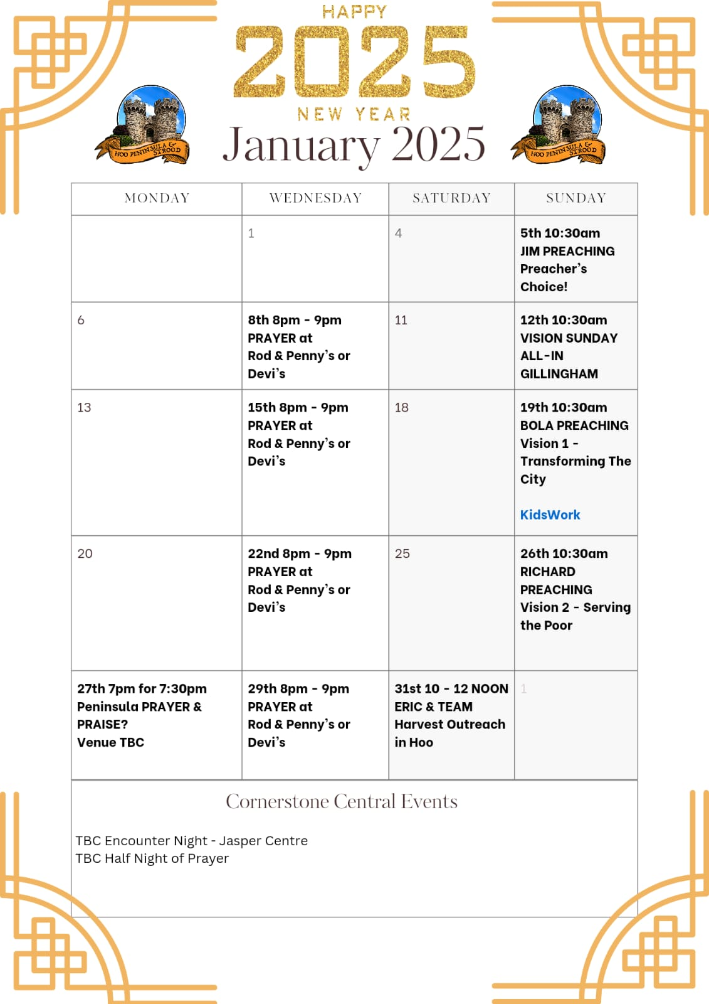

Slide 37


Slide 38
2 Corinthians 14 May the grace of the Lord Jesus Christ, and the love of God, and the fellowship of the Holy Spirit be with you all
Surely goodness and mercy shall follow me all the days of my life, and I shall dwell in the house of the Lord forever.

