Slide 1
Cornerstone City Church
Cross Over New Years Eve
31st December 2025

Slide 2
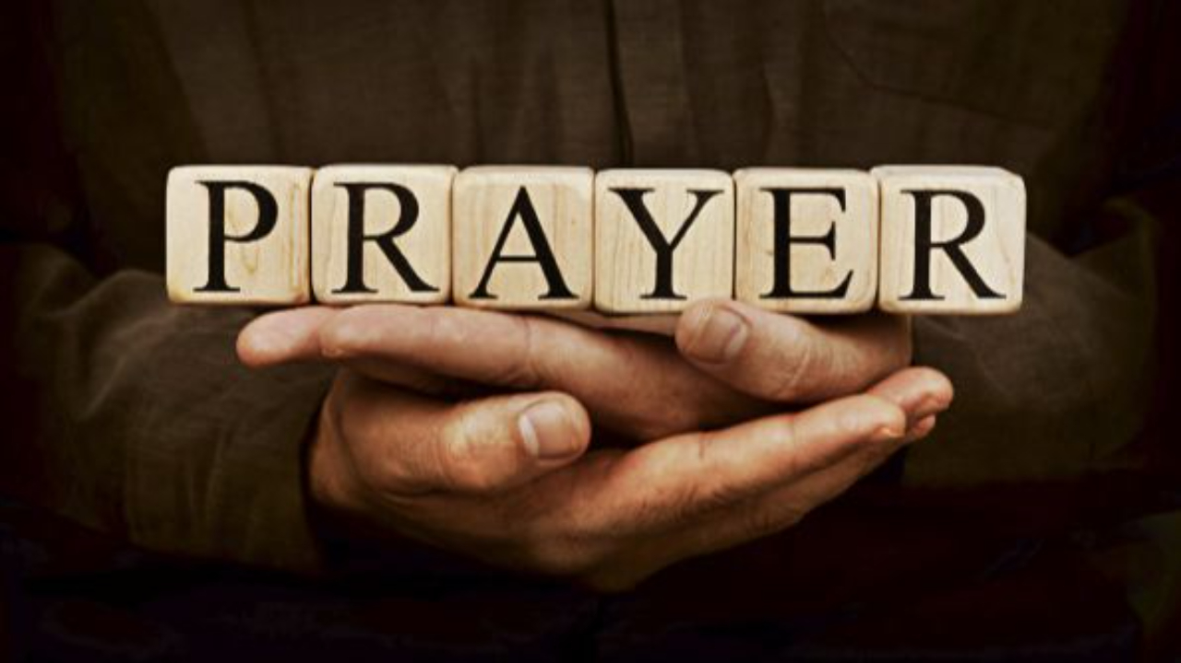

Slide 3
Thanksgiving
CCLI Song # 7199589
Nick Herbert | Taku Mudere | Zo Chilengwe
© Capitol CMG Genesis; Safe and Sound Music; Remaining portion is unaffiliated
For use solely with the SongSelect® Terms of Use. All rights reserved. www.ccli.com
CCLI Licence No. 33265

Slide 4
1/10
Enter in (Enter in)
His courts with praise (His courts with praise)
For He is greatly (He is greatly)
To be praised (To be praised)

Slide 5
2/10
Enter in (Enter in)
His courts with praise (His courts with praise)
For He is greatly (He is greatly)
To be praised

Slide 6
3/10
What shall we do
We shall lift up a shout
What shall we do
We shall praise Him
What shall we do
For our God made a way
We'll give Him our thanksgiving

Slide 7
4/10
Magnify (Magnify)
His Holy Name (His Holy Name)
For He is greatly (For He is greatly)
To be praised (To be praised)

Slide 8
5/10
Magnify (Magnify)
His Holy Name (His Holy Name)
For He is greatly (For He is greatly)
To be praised

Slide 9
6/10
What shall we do
We shall lift up a shout
What shall we do
We shall praise Him
What shall we do
For our God made a way
We'll give Him our thanksgiving

Slide 10
7/10
Even if the rocks cry out
We're gonna drown them out
With a louder shout of praise
Even when the battles roar
We're gonna praise You Lord
'Cause You are always worthy

Slide 11
8/10
You are worthy
Worthy of honour and praise
You are worthy
We'll sing it again and again

Slide 12
9/10
What shall we do
We shall lift up a shout
What shall we do
We shall praise Him
What shall we do
For our God made a way
We'll give Him our thanksgiving

Slide 13
10/10
We'll give Him our thanksgiving
We'll give Him our thanksgiving

Slide 14
House Of The Lord
CCLI Song # 7168995
© 2020 Phil Wickham MusicSimply Global SongsBe Essential SongsCashagamble Jet Music
For use solely with the SongSelect® Terms of Use. All rights reserved. www.ccli.com
Note: Reproduction of this sheet music requires a CCLI Music Reproduction Licence. Please report all copies.
CCLI Licence No. 33265

Slide 15
1/9
We worship the God who was
We worship the God who is
We worship the God who evermore will be
He opened the prison doors
He parted the raging sea
My God He holds the victory yeah

Slide 16
2/9
There’s joy in the house of the Lord
There’s joy in the house of the Lord today
And we won’t be quiet
We shout out Your praise

Slide 17
3/9
There’s joy in the house of the Lord
Our God is surely in this place
And we won’t be quiet
We shout out Your praise

Slide 18
4/9
We sing to the God who heals
We sing to the God who saves
We sing to the God who always makes a way
'Cause He hung up on that cross
Then He rose up from that grave
My God’s still rolling stones away

Slide 19
5/9
There’s joy in the house of the Lord
There’s joy in the house of the Lord today
And we won’t be quiet
We shout out Your praise

Slide 20
6/9
There’s joy in the house of the Lord
Our God is surely in this place
And we won’t be quiet
We shout out Your praise

Slide 21
7/9
We were the beggars
Now we’re royalty
We were the prisoners
Now we’re running free
We are forgiven accepted
Redeemed by His grace
Let the house of the Lord sing praise
(REPEAT)

Slide 22
8/9
There’s joy in the house of the Lord
There’s joy in the house of the Lord today
And we won’t be quiet
We shout out Your praise

Slide 23
9/9
There’s joy in the house of the Lord
Our God is surely in this place
And we won’t be quiet
We shout out Your praise

Slide 24
1/2
You came from heaven to earth
To show the way
From the earth to the cross
My debt to pay
From the cross to the grave
From the grave to the sky
Lord I lift Your name on high

Slide 25
2/2
Lord I lift Your name on high
Lord I love to sing Your praises
I'm so glad You're in my life
I'm so glad You came to save us

Slide 27
Yes And Amen
CCLI Song # 7048885
Chris McClarney | Nate Moore | Tony Brown
© 2016 Thankyou Music Ltd; Bethel Worship Publishing; Mouth Of The River Music; Songs Of Simply Hymns Music; Tony Brown Music Designee
For use solely with the SongSelect® Terms of Use. All rights reserved. www.ccli.com

Slide 28
1/8
Father of kindness You have poured out grace
You brought me out of darkness
You have filled me with peace
Giver of mercy You're my help in time of need
Lord I can't help but sing

Slide 29
2/8
Faithful You are
Faithful forever You will be
Faithful You are
All Your promises are Yes and Amen
All Your promises are Yes and Amen

Slide 30
3/8
Beautiful Saviour, You have brought me near
You pulled me from the ashes
You have broken ev'ry curse
Blessed Redeemer You have set this captive free
Lord I can't help but sing

Slide 31
4/8
Faithful You are
Faithful forever You will be
Faithful You are
All Your promises are Yes and Amen
All Your promises are Yes and Amen

Slide 32
5/8
I will rest in Your promises
My confidence is Your faithfulness
(REPEAT)

Slide 33
6/8
Faithful You are
Faithful forever You will be
Faithful You are
All Your promises are Yes and Amen
All Your promises are Yes and Amen

Slide 34
7/8
O Holy Spirit You have changed my life
You comfort and direct me
You have filled me with love
Teacher and defender, you're my guide in time of need
Lord I can't help but sing

Slide 35
8/8
Faithful You are
Faithful forever You will be
Faithful You are
All Your promises are Yes and Amen
All Your promises are Yes and Amen

Slide 36
1/6
Bless God in the sanctuary
Bless God in the fields of plenty
Bless God in the darkest valley
Every chance I get I bless Your name

Slide 37
2/6
Bless God when my hands are empty
Bless God with a praise that costs me
Bless God when nobody’s watching
Every chance I get I bless Your name

Slide 38
3/6
Bless God when the weapon’s forming
Bless God when the walls are falling
Bless God ‘cause He goes before me
Every chance I get I bless Your name

Slide 39
4/6
Bless God for He holds the vict’ry
Bless God for He’s always with me
Bless God for He’s always worthy
Every chance I get I bless Your name
Every chance I get I bless Your name

Slide 40
5/6
Come on and praise the Lord with me
Sing if you love His name
Come on and lift your voice with me
He’s worthy of all our praise

Slide 41
6/6
Come on and bring your offering
Sing if you’ve known His grace
Come on and lift up your holy hands
He’s worthy of all our praise
He’s worthy of all our praise

Slide 43
Praise
CCLI Song # 7213077
© Brandon Lake MusicFor Humans PublishingMaverick City PublishingCapitol CMG GenesisCapitol CMG ParagonHousefires SoundsWriter's Roof PublishingMusic by Elevation Worship Publishing
For use solely with the SongSelect® Terms of Use. All rights reserved. www.ccli.com
Note: Reproduction of this sheet music requires a CCLI Music Reproduction Licence. Please report all copies.
CCLI Licence No. 33265

Slide 44
1/12
Let everything that has breath
Praise the Lord
Praise the Lord

Slide 45
2/12
I’ll praise in the valley
Praise on the mountain
I’ll praise when I’m sure
Praise when I’m doubting

Slide 46
3/12
I’ll praise when outnumbered
Praise when surrounded
'Cause praise is the water
My enemies drown in

Slide 47
4/12
As long as I’m breathing
I’ve got a reason to
Praise the Lord oh my soul
Praise the Lord oh my soul

Slide 48
5/12
I’ll praise when I feel it
And I’ll praise when I don’t
I’ll praise 'cause I know
You’re still in control

Slide 49
6/12
'Cause my praise is a weapon
It’s more than a sound
My praise is the shout
That brings Jericho down

Slide 50
7/12
As long as I’m breathing
I’ve got a reason to
Praise the Lord oh my soul
Praise the Lord oh my soul

Slide 51
8/12
I won’t be quiet
My God is alive
How could I keep it inside
Praise the Lord oh my soul

Slide 52
9/12
I’ll praise 'cause You’re sovereign
Praise 'cause You reign
Praise 'cause You rose and defeated the grave
I’ll praise 'cause You’re faithful
Praise 'cause You’re true
Praise 'cause there’s nobody greater than You

Slide 53
10/12
Praise the Lord oh my soul
Praise the Lord oh my soul
Praise the Lord oh my soul
Praise the Lord oh my soul
I won’t be quiet
My God is alive
How could I keep it inside

Slide 54
1 1/12
I won’t be quiet
My God is alive
How could I keep it inside
I won’t be quiet
My God is alive
How could I keep it inside
Praise the Lord oh my soul

Slide 55
1/2
You picked me up You turned me around
And placed my feet on solid ground
I thank the Master I thank the Savior
Because You healed my heart
You changed my name
Forever free I'm not the same
I thank the Master I thank the Savior

Slide 56
2/2
You picked me up You turned me around
And placed my feet on solid ground
I thank the Master I thank the Savior
Because You healed my heart
You changed my name
Forever free I'm not the same
I thank the Master I thank the Savior
I thank God

Slide 57
12/12
Let everything that has breath
Praise the Lord
Praise the Lord

