Slide 1
Cornerstone City Church
Peninsula Plus Community
Hoo Are Ya
15th November 2026

Slide 2
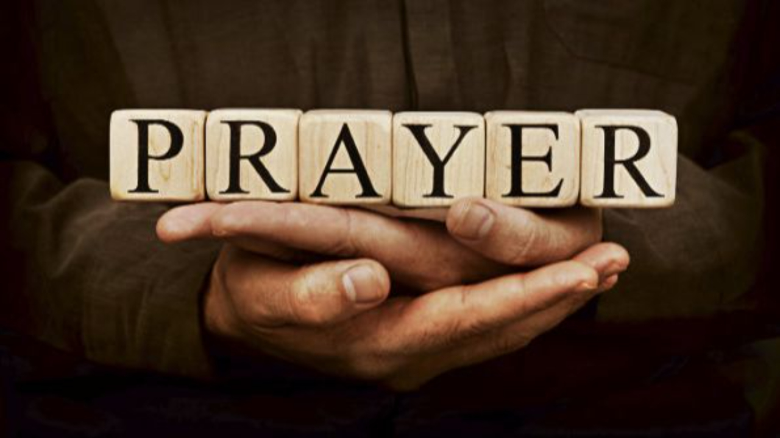

Slide 3
The Joy
CCLI Song # 7209419
Andrew Holt | Mitch Wong
© 2023 Andrew Holt Music Publishing; TBCO Publishing; A Wong Made Write Publishing; Integrity's Praise! Music
For use solely with the SongSelect® Terms of Use. All rights reserved. www.ccli.com
CCLI Licence No. 33265

Slide 4
1/10
This is the day You made
So I’ll rejoice and be glad
Rejoice and be glad in it
This is where I believe
That You are more than enough
More than enough for me

Slide 5
2/10
You are faithful to Your promise
You are strong when I am weak
When I’m standing in Your presence
I have everything I need

Slide 6
3/10
The joy of the Lord
The joy of the Lord is my strength
The joy of the Lord
The joy of the Lord is my strength
O my soul bless His Name
All that is within me say
The joy of the Lord
The joy of the Lord is my strength

Slide 7
4/10
Jesus come what may
You are worthy of all
Worthy of all my praise

Slide 8
5/10
You are faithful to Your promise
You are strong when I am weak
When I’m standing in Your presence
I have everything I need

Slide 9
6/10
The joy of the Lord
The joy of the Lord is my strength
The joy of the Lord
The joy of the Lord is my strength
O my soul bless His Name
All that is within me say
The joy of the Lord
The joy of the Lord is my strength

Slide 10
7/10
Let it rise up like a river
Overflowing Holy Spirit
Let it pour out with no limit
Overflowing Holy Spirit

Slide 11
8/10
The joy of the Lord
The joy of the Lord is my strength
The joy of the Lord
The joy of the Lord is my strength
O my soul bless His Name
All that is within me say
The joy of the Lord
The joy of the Lord is my strength

Slide 12
9/10
I've got the joy
I've got the joy
I've got the joy
It's the joy of the Lord
It's the joy of the Lord

Slide 13
10/10
O my soul bless His Name
All that is within me say
O my soul bless His Name
All that is within me say
O my soul bless His Name
All that is within me say
The joy of the Lord
The joy of the Lord is my strength

Slide 14
Mighty Name Of Jesus
CCLI Song # 7244496
Hope Darst | Jacob Sooter | Lauren Sloat
© 2024 Fair Trade Global Songs; Hope For The Best Songs; TBCO Publishing; Just When Publishing; So Essential Tunes; Remaining portion is unaffiliated
For use solely with the SongSelect® Terms of Use. All rights reserved. www.ccli.com
CCLI Licence No. 33265

Slide 15
1/9
I pray into the atmosphere
Spirit of God You're here
You have all authority
I pray over my heart and mind
I am healed by Your stripes
Your blood declares that I am free

Slide 16
2/9
In the mighty name of Jesus I pray
Calling on the power of heaven I proclaim
Every weapon formed against me must break
In the mighty name of Jesus

Slide 17
3/9
I draw a permanent boundary line
The enemy has no rights
To come near my family
No scheme could ever undo God's plans
No matter the circumstance
The cross has sealed my destiny

Slide 18
4/9
In the mighty name of Jesus, I pray
Calling on the power of heaven I proclaim
Every weapon formed against me must break
In the mighty name of Jesus

Slide 19
5/9
In the mighty name of Jesus, I know
All the power of fear and darkness must go
'Cause every key to every victory I hold
In the mighty name of Jesus

Slide 20
6/9
I will not fear I will not fear
When the enemy comes near
On the doorframe of my life
Is the blood of Jesus Christ

Slide 21
7/9
I will not fear I will not fear
There's an army of angels here
I'm protected on all sides
By the blood of Jesus Christ

Slide 22
8/9
In the mighty name of Jesus, I pray
Calling on the power of heaven I proclaim
Every weapon formed against me must break
In the mighty name of Jesus

Slide 23
9/9
In the mighty name of Jesus, I know
All the power of fear and darkness must go
'Cause every key to every victory I hold
In the mighty name of Jesus
In the mighty name of Jesus

Slide 25
Reign Above It All
CCLI Song # 7134098
Ethan Hulse | Hannah McClure | Jess Cates | Paul McClure
© 2019 We Are TIM Music; Zoom Out Songs; Be Essential Songs; EGH Music Publishing; Bethel Music Publishing
For use solely with the SongSelect® Terms of Use. All rights reserved. www.ccli.com
CCLI Licence No. 33265

Slide 26
1/8
The reign of darkness now has ended
In the kingdom of light
In the kingdom of light
Forever under Your dominion
You’re the King of my life
You’re the King of my life

Slide 27
2/8
You reign above it all
You reign above it all
Over the universe
And over every heart
There is no higher name
Jesus You reign above it all

Slide 28
3/8
On the cross the work was finished
God You poured out Your life
Just to give us new life
Now from the lips of the forgiven
Hear an anthem arise
'Cause Jesus You’re alive

Slide 29
4/8
You reign above it all
You reign above it all
Over the universe
And over every heart
There is no higher name
Jesus You reign above it all

Slide 30
5/8
Let all of heaven
And the earth erupt in song
Sing hallelujah to the Everlasting One
There is no higher name
Jesus You reign above it all

Slide 31
6/8
You sent the darkness running
Out of an empty grave
Now seated alone in glory
Enthroned on the highest praise
(REPEAT)

Slide 32
7/8
You reign above it all
You reign above it all
Over the universe
And over every heart
There is no higher name
Jesus You reign above it all

Slide 33
8/8
Let all of heaven
And the earth erupt in song
Sing hallelujah to the Everlasting One
There is no higher name
Jesus You reign above it all

Slide 35
Still The King
CCLI Song # 7244159
Colton Price | Jess Cates | Kaelob Mecum
© 2025 Twenty One Strong Music; We Are TIM Music; Be Essential Songs; Paid The Price Publishing; Wisteria Drive
For use solely with the SongSelect® Terms of Use. All rights reserved. www.ccli.com
CCLI Licence No. 33265

Slide 36
1/12
When I think of the cross
The cross of Christ
Praise begins to rise
Praise begins to rise

Slide 37
2/12
When I look on the Lamb
The wounded Lamb
My hands will lift to Him
My hands will lift to Him

Slide 38
3/12
Isn't He worthy of all our worship
Isn't He worthy of the praises we bring
How could my heart not sing hallelujah
For the blood is still the blood
And the King is still the King

Slide 39
4/12
When I recount the cost
The cost of grace
You bought my sin and shame
I'll never be the same

Slide 40
5/12
When I look at my life
How good You've been
Oh I can't hold it in
I'll never hold it in

Slide 41
6/12
Isn't He worthy of all our worship
Isn't He worthy of the praises we bring
How could my heart not sing hallelujah
For the blood is still the blood
And the King is still the King

Slide 42
7/12
When I think of the tomb
The empty tomb
I'm filled with gratitude
Endless gratitude

Slide 43
8/12
For He defeated death
And He reigns above
No grave could hold His love
No grave could hold His love

Slide 44
9/12
When I think of the tomb
The empty tomb
I'm filled with gratitude
Endless gratitude

Slide 45
10/12
For He defeated death
And He reigns above
No grave could hold His love
No grave could hold His love

Slide 46
11/12
Isn't He worthy of all our worship
Isn't He worthy of the praises we bring
How could my heart not sing hallelujah
For the blood is still the blood
And the King is still the King

Slide 47
12/12
Isn't he worthy of all our worship
Isn't he worthy of the praises we bring
How could my heart not sing
Of all You've done for me
For the blood is still the blood
And the King is still the King

Slide 49


Slide 50
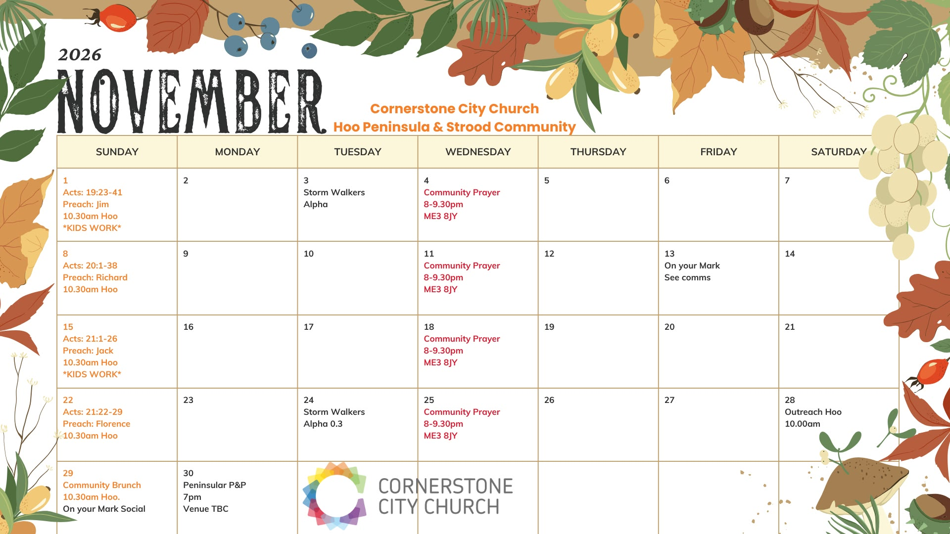

Slide 51
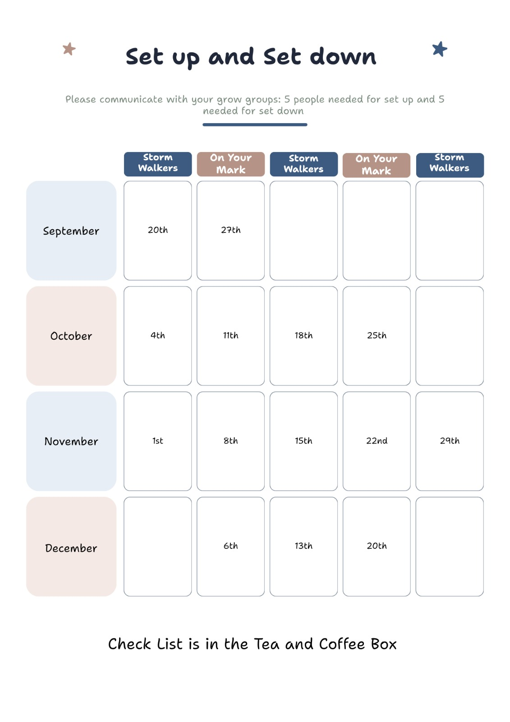

Slide 52
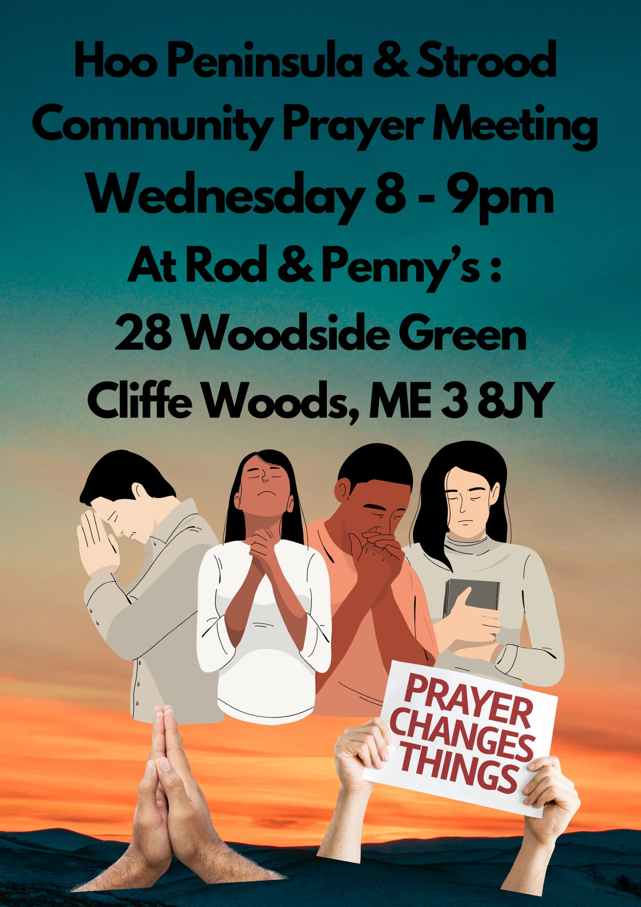

Slide 53
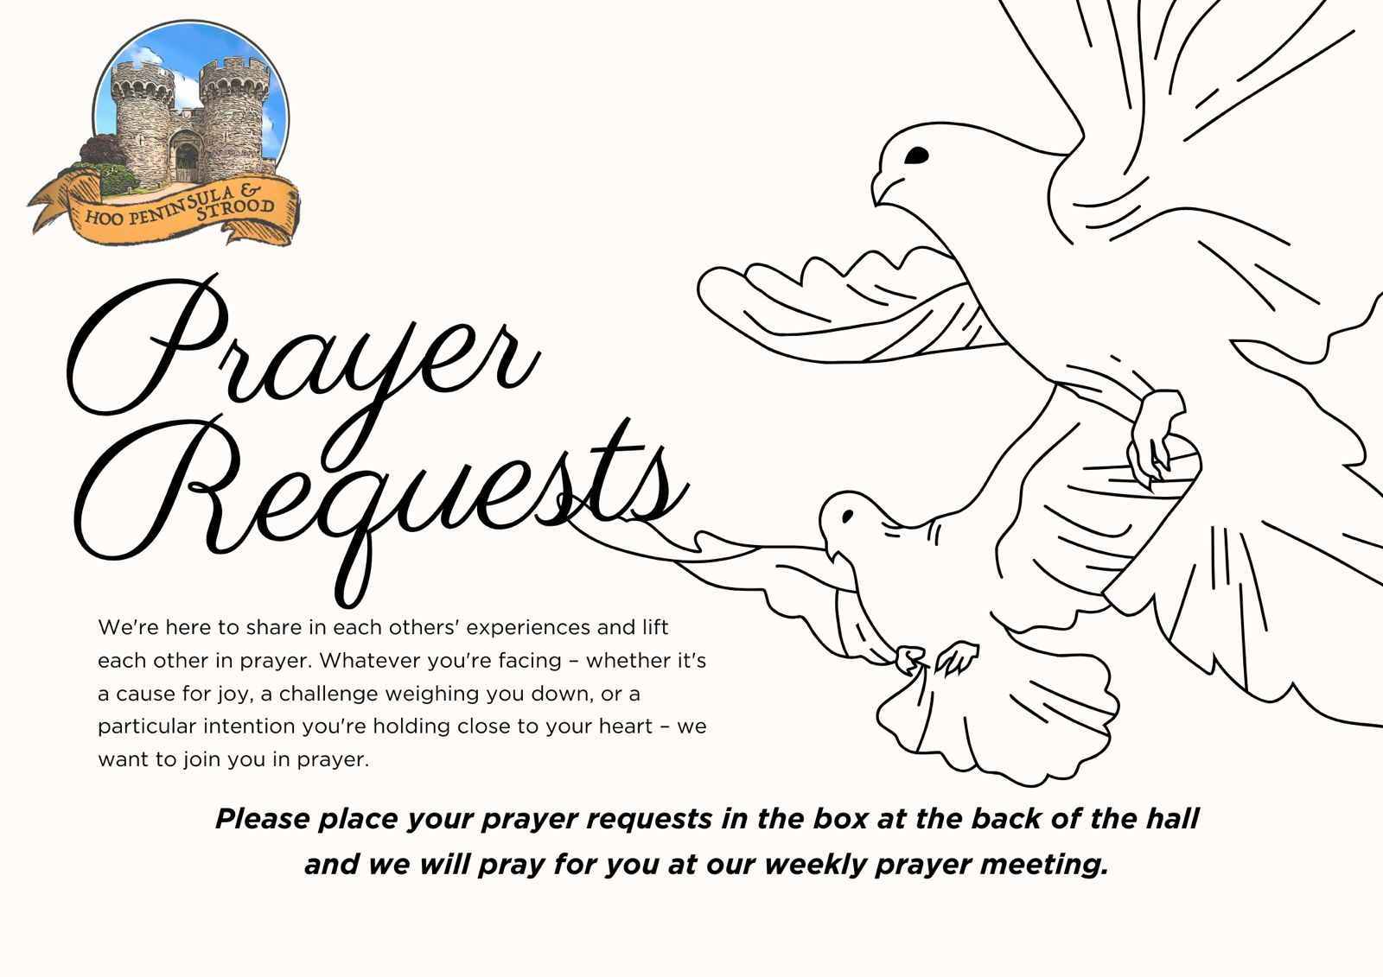

Slide 54


Slide 55


Slide 56
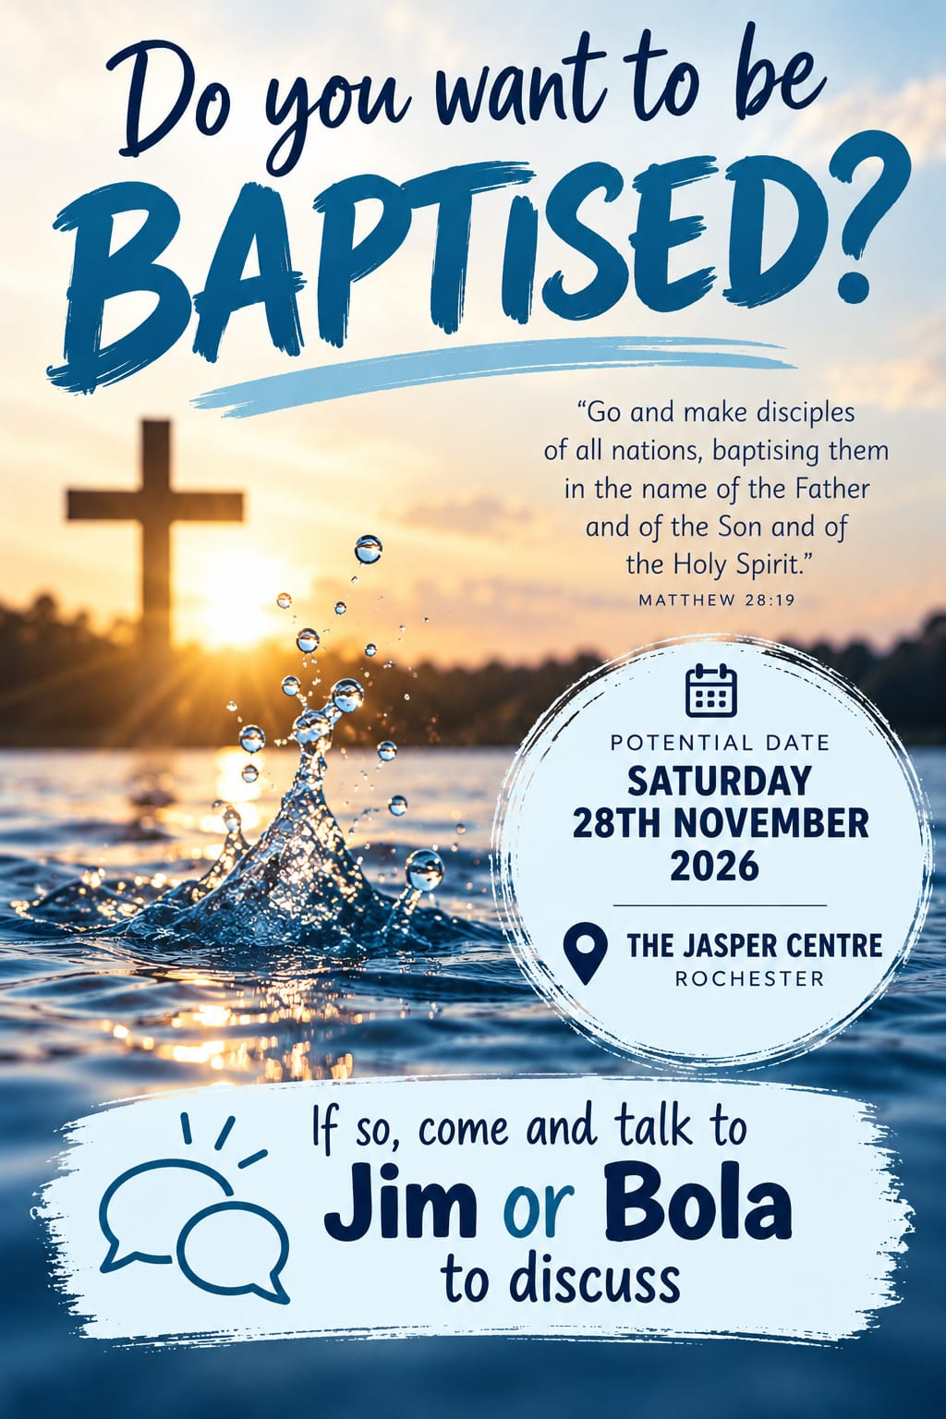

Slide 57
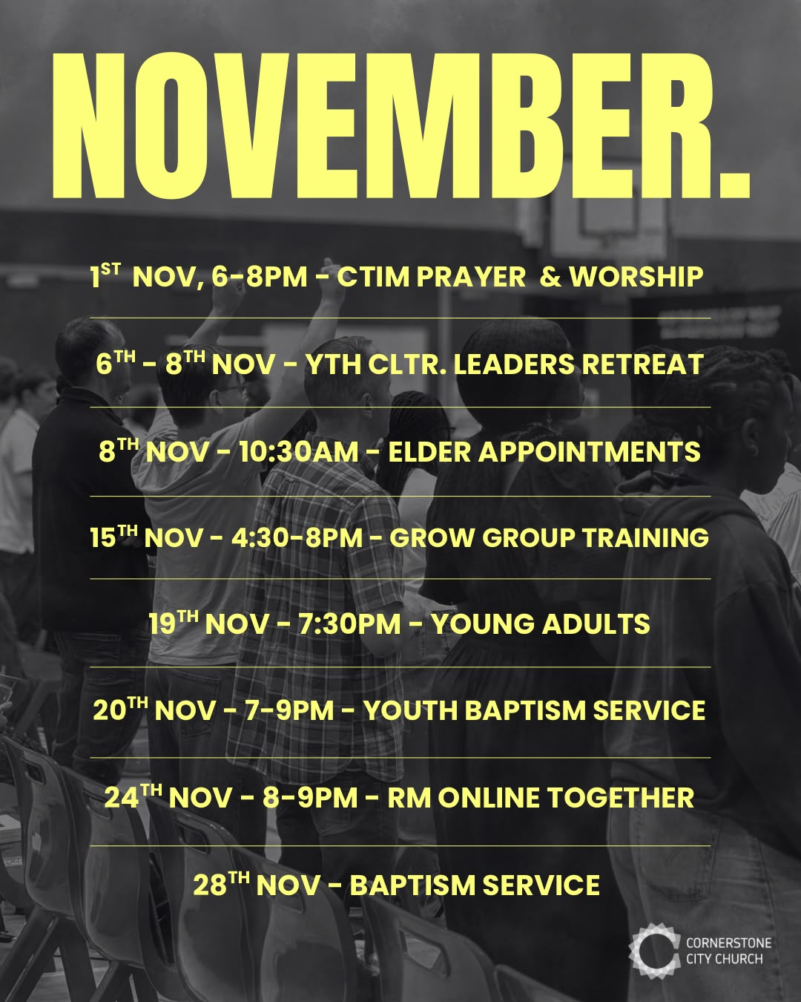

Slide 58
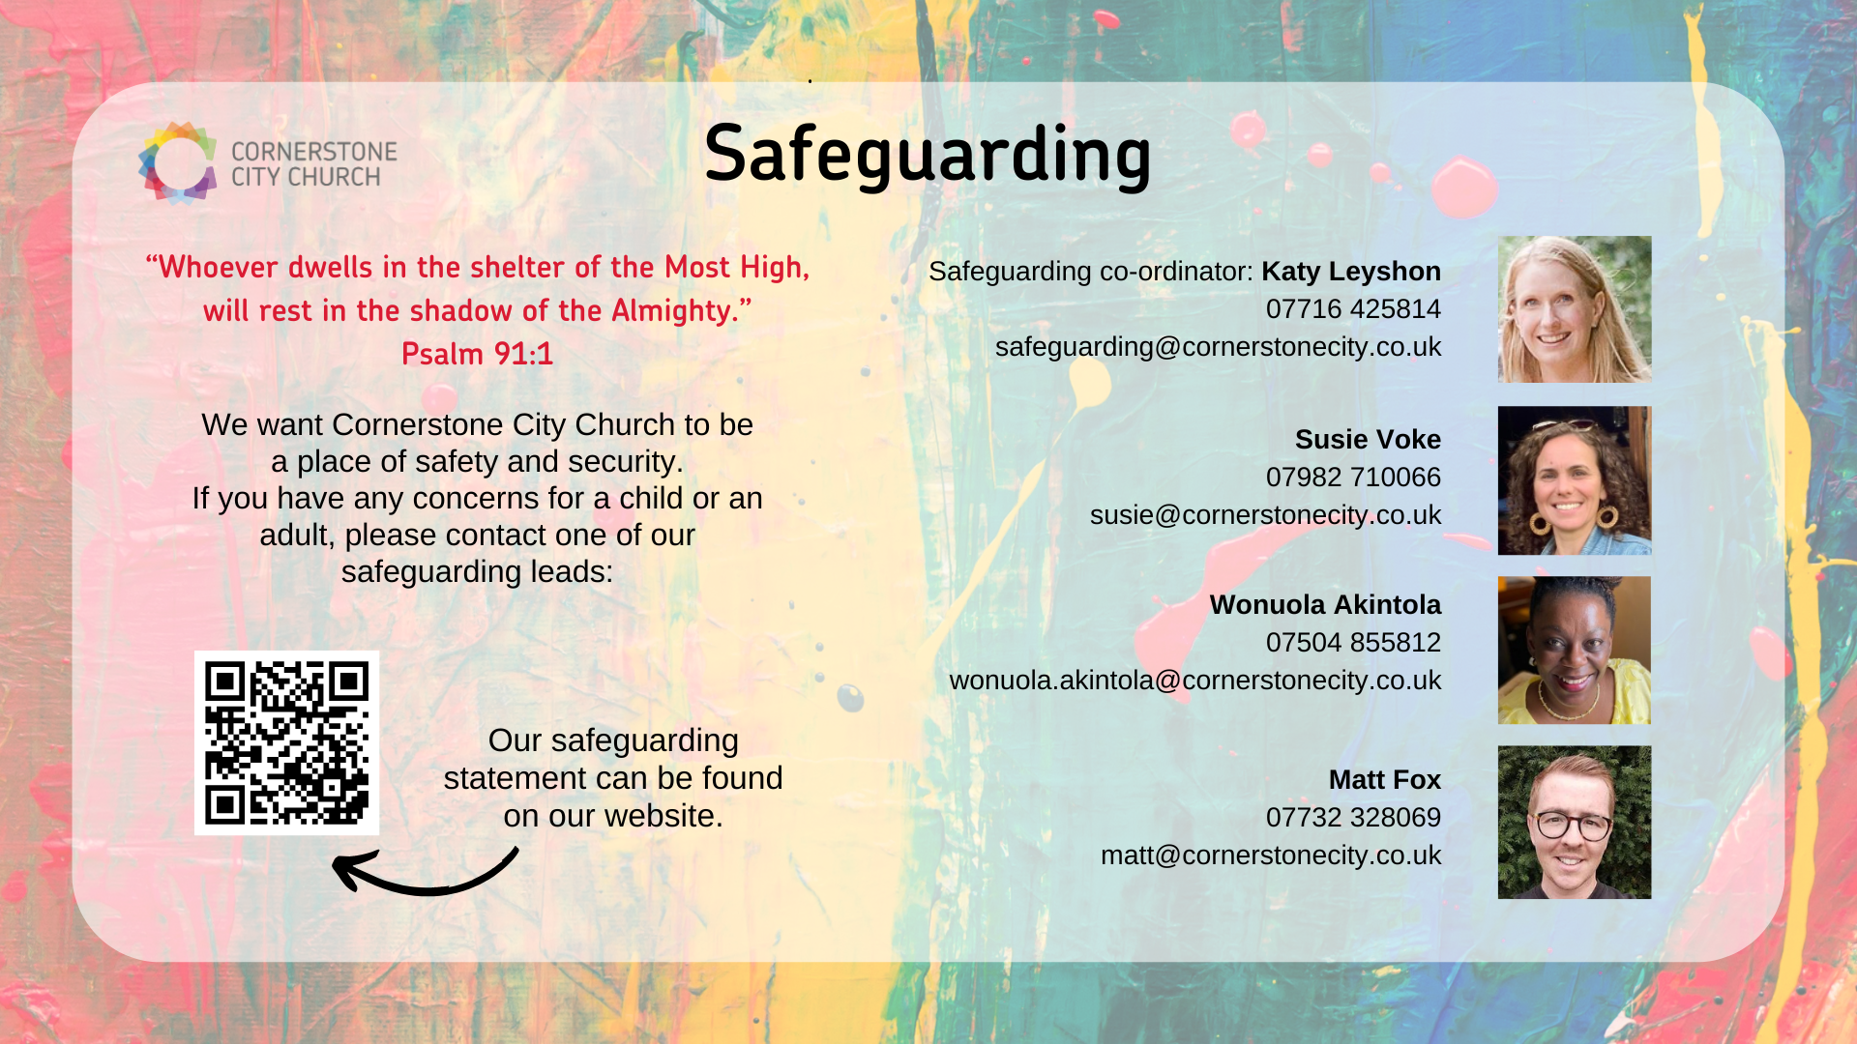

Slide 59
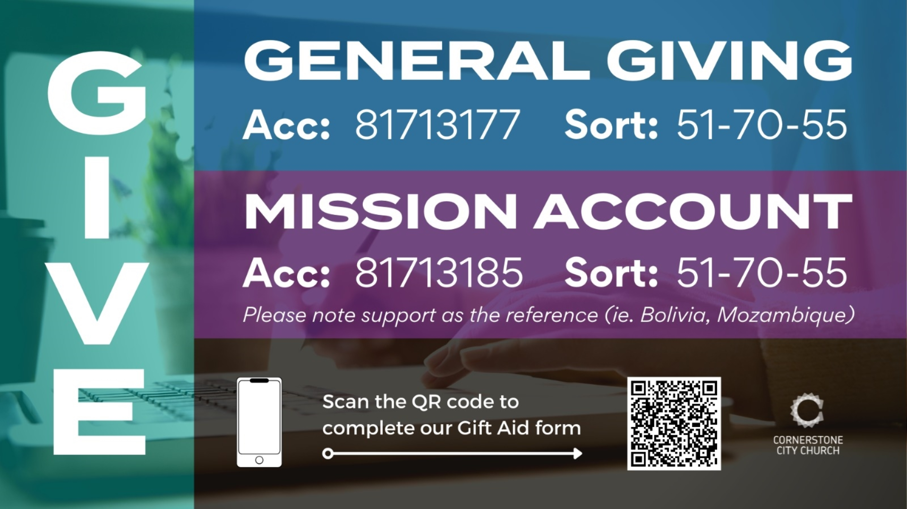

Slide 60
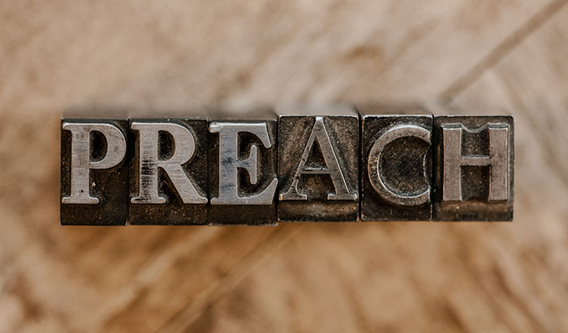

Slide 61
2 Corinthians 14
May the grace of the Lord Jesus Christ, and the love of God, and the fellowship of the Holy Spirit be with us all.
And….
Surely goodness and mercy shall follow us all the days of our lives, and we shall dwell in the house of the Lord forever.

Slide 62
Amen!

