Slide 1
Cornerstone City Church Peninsula Plus Community Hoo Are Ya
23rd August 2026

Slide 2
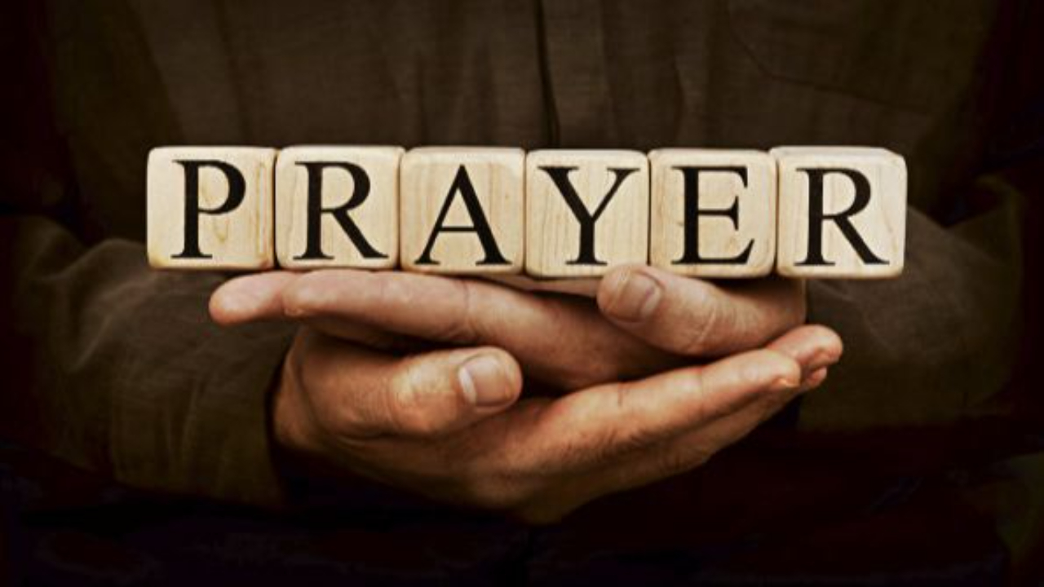

Slide 3
The Joy
CCLI Song # 7209419
Andrew Holt | Mitch Wong
© 2023 Andrew Holt Music Publishing; TBCO Publishing; A Wong Made Write Publishing; Integrity's Praise! Music
For use solely with the SongSelect® Terms of Use. All rights reserved. www.ccli.com
CCLI Licence No. 33265

Slide 4
1/10
This is the day You made
So I’ll rejoice and be glad
Rejoice and be glad in it
This is where I believe
That You are more than enough
More than enough for me

Slide 5
2/10
You are faithful to Your promise
You are strong when I am weak
When I’m standing in Your presence
I have everything I need

Slide 6
3/10
The joy of the Lord
The joy of the Lord is my strength
The joy of the Lord
The joy of the Lord is my strength
O my soul bless His Name
All that is within me say
The joy of the Lord
The joy of the Lord is my strength

Slide 7
4/10
Jesus come what may
You are worthy of all
Worthy of all my praise

Slide 8
5/10
You are faithful to Your promise
You are strong when I am weak
When I’m standing in Your presence
I have everything I need

Slide 9
6/10
The joy of the Lord
The joy of the Lord is my strength
The joy of the Lord
The joy of the Lord is my strength
O my soul bless His Name
All that is within me say
The joy of the Lord
The joy of the Lord is my strength

Slide 10
7/10
Let it rise up like a river
Overflowing Holy Spirit
Let it pour out with no limit
Overflowing Holy Spirit

Slide 11
8/10
The joy of the Lord
The joy of the Lord is my strength
The joy of the Lord
The joy of the Lord is my strength
O my soul bless His Name
All that is within me say
The joy of the Lord
The joy of the Lord is my strength

Slide 12
9/10
I've got the joy
I've got the joy
I've got the joy
It's the joy of the Lord
It's the joy of the Lord

Slide 13
10/10
O my soul bless His Name
All that is within me say
O my soul bless His Name
All that is within me say
O my soul bless His Name
All that is within me say
The joy of the Lord
The joy of the Lord is my strength

Slide 14
This Is Amazing Grace
CCLI Song # 6333821
Jeremy Riddle | Josh Farro | Phil Wickham
© 2012 WC Music Corp. (Admin. by / Small Stone Media BV, Holland (Admin. in the UK/Eire by Song Solutions www.songsolutions.org))
Bethel Music Publishing (Admin. by Song Solutions)
Phil Wickham Music (Admin. by Song Solutions www.songsolutions.org)
Seems Like Music (Admin. by Song Solutions www.songsolutions.org)
Sing My Songs (Admin. by Song Solutions www.songsolutions.org)
For use solely with the SongSelect® Terms of Use. All rights reserved. www.ccli.com
CCLI Licence No. 33265

Slide 15
1/8
Who breaks the power of sin and darkness
Whose love is mighty and so much stronger
The King of Glory the King above all kings

Slide 16
2/8
Who shakes the whole earth with holy thunder
And leaves us breathless in awe and wonder
The King of Glory the King above all kings

Slide 17
3/8
This is amazing grace
This is unfailing love
That You would take my place
That You would bear my cross
You laid down Your life
That I would be set free
Oh Jesus I sing for all that You've done for me

Slide 18
4/8
Who brings our chaos back into order
Who makes the orphan a son and daughter
The King of Glory the King of Glory

Slide 19
5/8
Who rules the nations with truth and justice
Shines like the sun in all of its brilliance
The King of Glory the King above all kings

Slide 20
6/8
This is amazing grace
This is unfailing love
That You would take my place
That You would bear my cross
You laid down Your life
That I would be set free
Oh Jesus I sing for all that You've done for me

Slide 21
7/8
Worthy is the Lamb who was slain
Worthy is the King who conquered the grave
Worthy is the Lamb who was slain
Worthy is the King who conquered the grave
Worthy is the Lamb who was slain
Worthy is the King who conquered the grave
Worthy is the Lamb who was slain
Worthy worthy worthy

Slide 22
8/8
This is amazing grace
This is unfailing love
That You would take my place
That You would bear my cross
You laid down Your life
That I would be set free
Oh Jesus I sing for all that You've done for me

Slide 24
God of Wonders
CCLI Song # 3118757
Marc Byrd | Steve Hindalong
© 2000 Never Say Never Songs; New Spring; Meaux Mercy; Storm Boy Music
For use solely with the SongSelect® Terms of Use. All rights reserved. www.ccli.com
CCLI Licence No. 33265

Slide 25
1/6
Lord of all creation
Of water earth and sky
The heavens are Your tabernacle
Glory to the Lord on high

Slide 26
2/6
God of wonders beyond our galaxy
You are holy holy
The universe declares Your majesty
You are holy holy
Lord of heaven and earth
Lord of heaven and earth

Slide 27
3/6
Early in the morning
I will celebrate the light
When I stumble in the darkness
I will call Your name by night

Slide 28
4/6
God of wonders beyond our galaxy
You are holy holy
The universe declares Your majesty
You are holy holy
Lord of heaven and earth
Lord of heaven and earth

Slide 29
5/6
Hallelujah (to the Lord of heaven and earth)
Hallelujah (to the Lord of heaven and earth)
Hallelujah (to the Lord of heaven and earth)

Slide 30
6/6
God of wonders beyond our galaxy
You are holy holy
The universe declares Your majesty
You are holy holy
Lord of heaven and earth
Lord of heaven and earth

Slide 31
I Could Sing Of Your Love Forever
CCLI Song # 1043199
Martin Smith
© 1994 Curious? Music UK
For use solely with the SongSelect® Terms of Use. All rights reserved. www.ccli.com

Slide 32
1/7
Over the mountains and the sea
Your river runs with love for me
And I will open up my heart
And let the Healer set me free

Slide 33
2/7
I'm happy to be in the truth
And I will daily lift my hands
For I will always sing
Of when Your love came down

Slide 34
3/7
I could sing of Your love forever
I could sing of Your love forever
I could sing of Your love forever
I could sing of Your love forever

Slide 35
4/7
Over the mountains and the sea
Your river runs with love for me
And I will open up my heart
And let the Healer set me free

Slide 36
5/7
I'm happy to be in the truth
And I will daily lift my hands
For I will always sing
Of when Your love came down

Slide 37
6/7
Oh I feel like dancing
It's foolishness I know
But when the world has seen the light
They will dance with joy like we're dancing now

Slide 38
7/7
I could sing of Your love forever
I could sing of Your love forever
I could sing of Your love forever
I could sing of Your love forever

Slide 40
Who Else CCLI Song # 7223119
Abbie Gamboa | Josiah Funderburk | Zac Rowe
© 2023 Gateway Music Global Publishing; Gamboa World, LLC
For use solely with the SongSelect® Terms of Use. All rights reserved. www.ccli.com
CCLI Licence No. 33265

Slide 41
1/8
I am an instrument of exaltation
And I was born to lift Your name above all names
You hear the melody of all creation
But there's a song of praise that only I can bring

Slide 42
2/8
Who else is worthy who else is worthy
There is no one only You Jesus
Who else is worthy who else is worthy
There is no one only You Jesus

Slide 43
3/8
You are the infinite God of the ages
Yet You chose to make my heart Your dwelling place
You healed my brokenness showed me Your glory
So I have songs of thanks not even angels sing

Slide 44
4/8
Who else is worthy who else is worthy
There is no one only You Jesus
Who else is worthy who else is worthy
There is no one only You Jesus

Slide 45
5/8
Lamb of God anointed one
Who was and is and is to come
Seated on the throne above
Holy holy

Slide 46
6/8
Righteous One who shed His blood
You proved to us the Father's love
Jesus Christ be lifted up
(Holy holy)

Slide 47
7/8
Who else is worthy who else is worthy
There is no one only You Jesus
Who else is worthy who else is worthy
There is no one only You Jesus

Slide 48
8/8
There is no one only You Jesus
(REPEAT) Who else is worthy who else is worthy
There is no one only You Jesus (REPEAT)

Slide 50


Slide 51
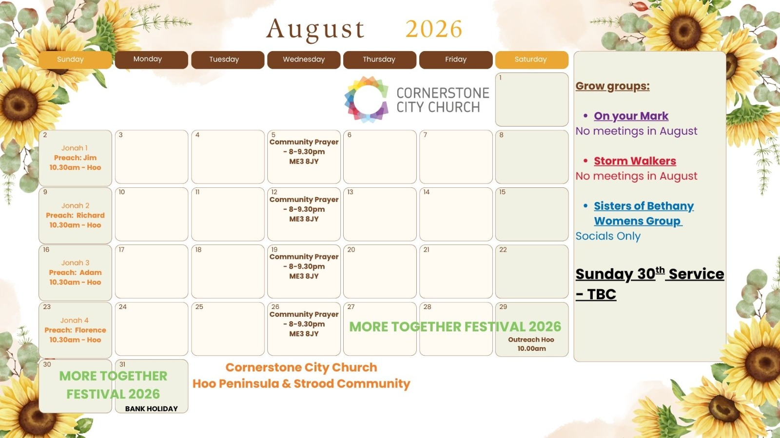

Slide 52
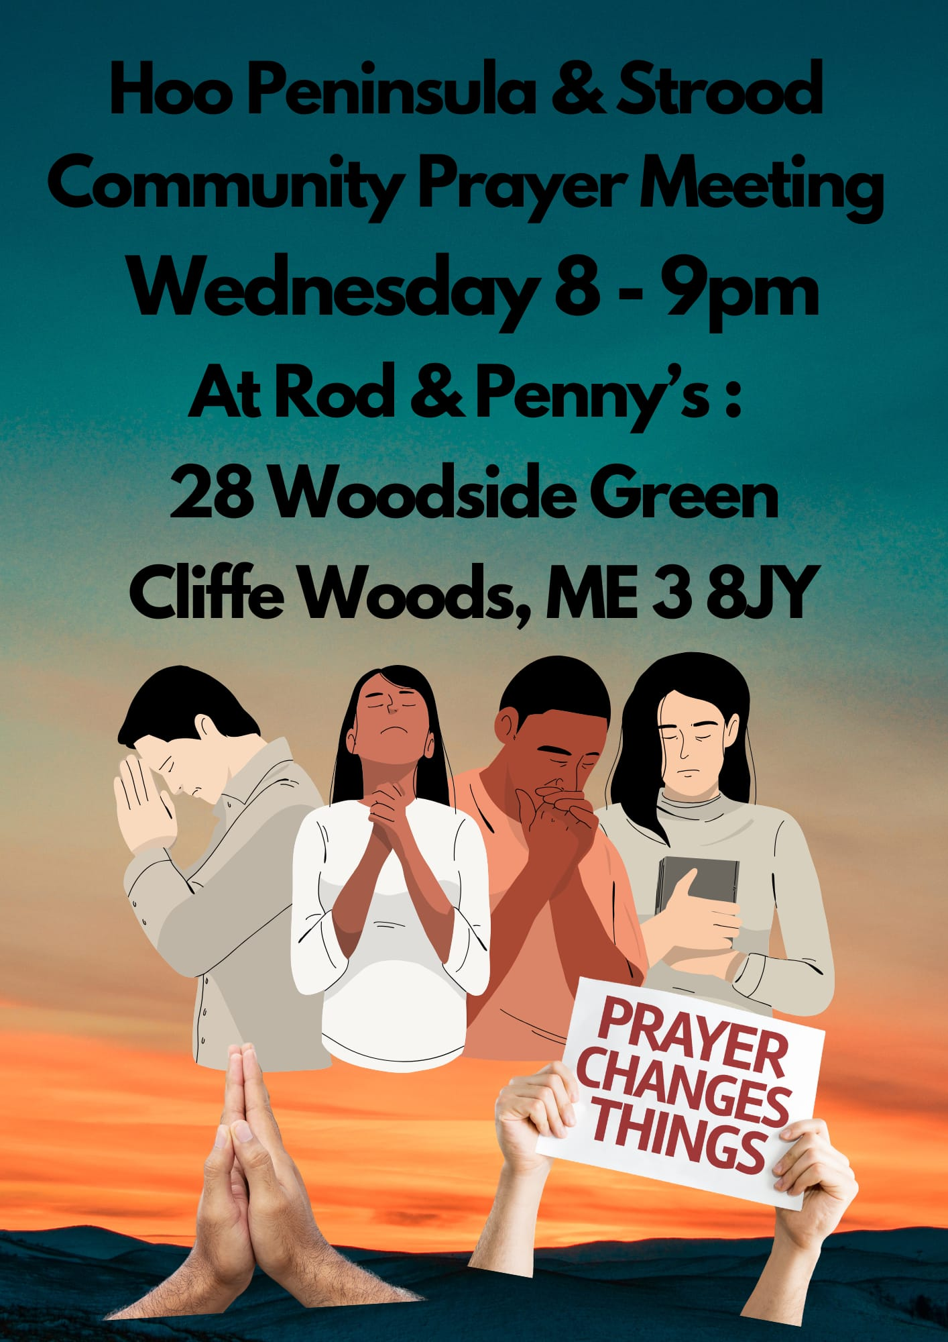

Slide 53
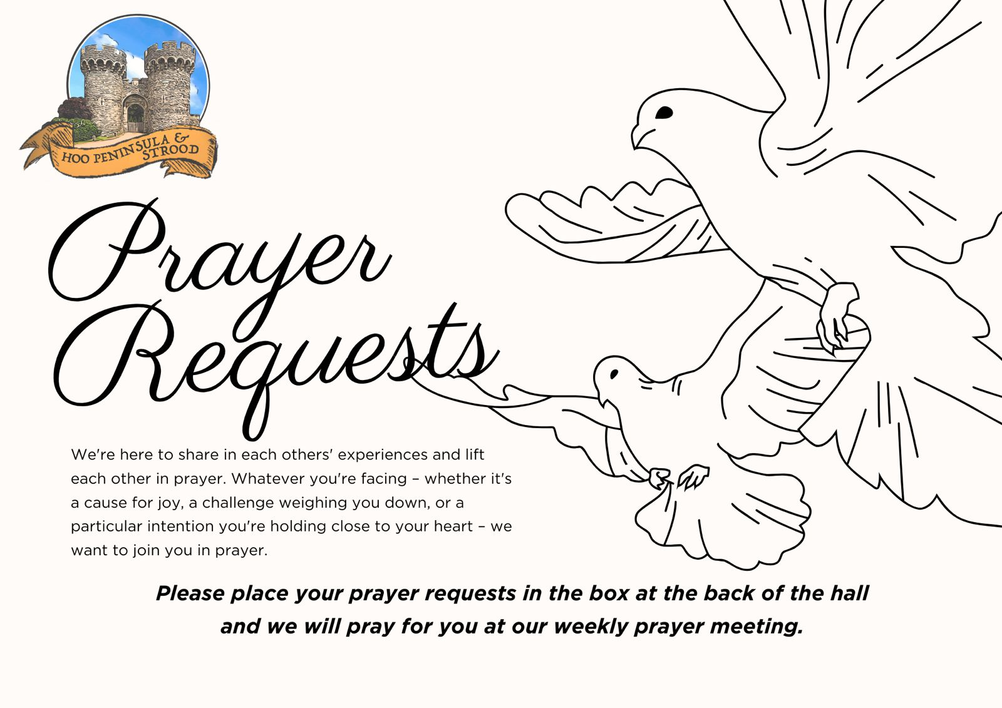

Slide 54


Slide 55


Slide 56
Jonah And The Whale
CCLI Song # 238008
Hugh Mitchell
© 1957 New Spring
For use solely with the SongSelect® Terms of Use. All rights reserved. www.ccli.com
CCLI Licence No. 33265

Slide 57
1/4
Come listen to my tale
Of Jonah and the whale
Way down in the middle of the ocean OCEAN!!

Slide 58
2/4
How did he get there
What ever did he wear
Way down in the middle of the ocean
OCEAN!!

Slide 59
3/4
A preaching he should be
At Ninevah, you see
To disobey's, a very foolish notion
NOTION!!

Slide 60
4/4
But God forgave his sin
Salvation entered in
Way down in the middle of the
Way down in the middle of the
Way down in the middle of the
OCEAN!!

Slide 61


Slide 62
2 Corinthians 14 May the grace of the Lord Jesus Christ, and the love of God, and the fellowship of the Holy Spirit be with us all. And….
Surely goodness and mercy shall follow us all the days of our lives, and we shall dwell in the house of the Lord forever.

Slide 63
Amen!

