Slide 1
Cornerstone City Church Peninsula Plus Community Hoo Are Ya 22-02-2023

Slide 2
How Great Is Our God
CCLI Song # 4348399
Chris Tomlin | Ed Cash | Jesse Reeves
© 2004 sixsteps Music (Admin. by Integrity Music Ltd)
Vamos Publishing (Admin. by Integrity Music Ltd)
worshiptogether.com songs (Admin. by Integrity Music Ltd)
Wondrously Made Songs (Admin. by Song Solutions www.songsolutions.org)
For use solely with the SongSelect® Terms of Use. All rights reserved. www.ccli.com
CCLI Licence No. 33265

Slide 3
1/5
The splendour of the King
Clothed in majesty
Let all the earth rejoice
All the earth rejoice
He wraps Himself in light
And darkness tries to hide
And trembles at His voice
And trembles at His voice

Slide 4
2/5
How great is our God
Sing with me
How great is our God
And all will see how great
How great is our God

Slide 5
3/5
And age to age He stands
And time is in His hands
Beginning and the End
Beginning and the End
The Godhead three in one
Father Spirit Son
The Lion and the Lamb
The Lion and the Lamb

Slide 6
4/5
How great is our God
Sing with me
How great is our God
And all will see how great
How great is our God

Slide 7
5/5
Name above all names
Worthy of all praise
My heart will sing
How great is our God

Slide 8
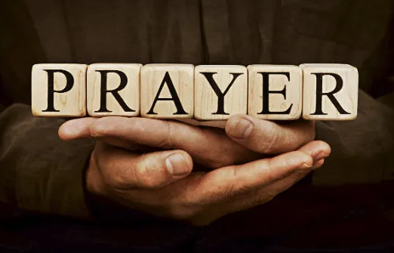

Slide 9
Your Name
CCLI Song # 4611679
Glenn Packiam | Paul Baloche
© 2006 Integrity Worship Music (Admin. by Integrity Music Ltd)
Integrity's Hosanna! Music (Admin. by Integrity Music Ltd)
For use solely with the SongSelect® Terms of Use. All rights reserved. www.ccli.com
CCLI Licence No. 33265

Slide 10
1/4
As morning dawns and evening fades
You inspire songs of praise
That rise from earth to touch Your heart
And glorify Your Name

Slide 11
2/4
Your Name is a strong and mighty tower
Your Name is a shelter like no other
Your Name let the nations sing it louder
'Cause nothing has the power to save
But Your Name

Slide 12
3/4
Jesus in Your Name we pray
Come and fill our hearts today
Lord give us strength to live for You
And glorify Your Name

Slide 13
4/4
Your Name is a strong and mighty tower
Your Name is a shelter like no other
Your Name let the nations sing it louder
'Cause nothing has the power to save
But Your Name

Slide 15
Here I am to Worship
CCLI Song # 3266032
Tim Hughes
© 2000 Thankyou Music (Admin. by Integrity Music Ltd)
For use solely with the SongSelect® Terms of Use. All rights reserved. www.ccli.com
CCLI Licence No. 33265

Slide 16
1/4
Light of the world
You stepped down into darkness
Opened my eyes let me see
Beauty that made
This heart adore You
Hope of a life spent with You

Slide 17
2/4
So here I am to worship
Here I am to bow down
Here I am to say that You're my God
And You're altogether lovely
Altogether worthy
Altogether wonderful to me

Slide 18
3/4
King of all days
Oh so highly exalted
Glorious in heaven above
Humbly You came
To the earth You created
All for love's sake became poor

Slide 19
4/4
And I'll never know how much it cost
To see my sin upon that cross
And I'll never know how much it cost
To see my sin upon that cross

Slide 20
Heart Of Worship CCLI Song # 2296522
Matt Redman
© 1997 Thankyou Music (Admin. by Integrity Music Ltd)
For use solely with the SongSelect® Terms of Use. All rights reserved. www.ccli.com
CCLI Licence No. 33265

Slide 21
1/4
When the music fades all is stripped away
And I simply come
Longing just to bring something that's of worth
That will bless Your heart

Slide 22
2/4
I'll bring You more than a song
For a song in itself is not what You have required
You search much deeper within
Through the way things appear
You're looking into my heart

Slide 23
3/4
I'm coming back to the heart of worship
And it's all about You all about You Jesus
I'm sorry Lord for the thing I've made it
When it's all about You all about You Jesus

Slide 24
4/4
King of endless worth no one could express
How much You deserve
Though I'm weak and poor all I have is Yours
Ev'ry single breath

