Slide 1
Cornerstone City Church
Peninsula Plus Community
Hoo Are Ya
1st November 2026

Slide 2
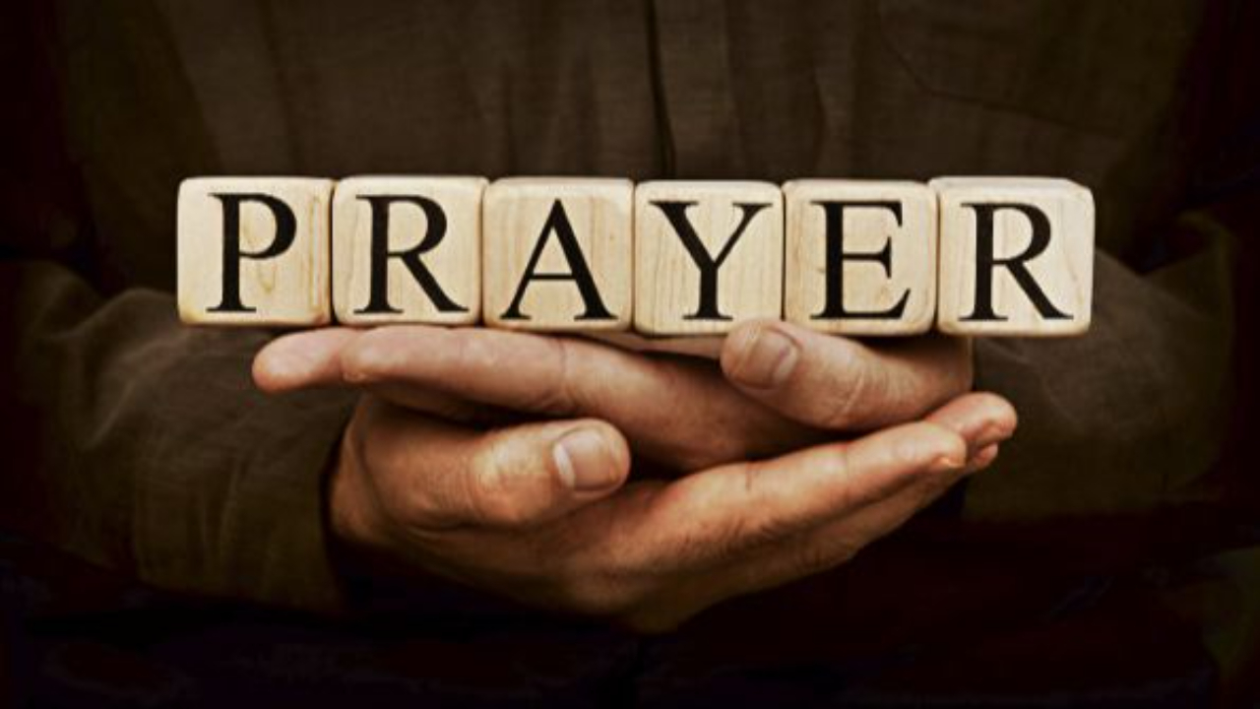

Slide 3
Our God
CCLI Song # 5677416
Chris Tomlin | Jesse Reeves | Jonas Myrin | Matt Redman
© 2010 sixsteps Music (Admin. by Integrity Music)
Thankyou Music (Admin. by Integrity Music)
Vamos Publishing (Admin. by Integrity Music)
worshiptogether.com songs (Admin. by Integrity Music)
Atlas Mountain Songs (Admin. by SHOUT! Music Publishing UK)
For use solely with the SongSelect® Terms of Use. All rights reserved. www.ccli.com
CCLI Licence No. 33265

Slide 4
1/5
Water You turned into wine
Opened the eyes of the blind
There's no one like you
None like you

Slide 5
2/5
Into the darkness You shine
Out of the ashes we rise
There's No one like you
None like you

Slide 6
3/5
Our God is greater,
Our God is stronger
God You are higher than any other
Our God is Healer,
Awesome in power
Our God, Our God

Slide 7
4/5
And if Our God is for us,
Then who could ever stop us?
And if our God is with us,
Then what can stand against?
(REPEAT)

Slide 8
5/5
Our God is greater,
Our God is stronger
God You are higher than any other
Our God is Healer,
Awesome in power
Our God, Our God

Slide 9
How Great Is Our God
CCLI Song # 4348399
Chris Tomlin | Ed Cash | Jesse Reeves
© 2004 sixsteps Music (Admin. by Integrity Music Ltd)
Vamos Publishing (Admin. by Integrity Music Ltd)
worshiptogether.com songs (Admin. by Integrity Music Ltd)
Wondrously Made Songs (Admin. by Song Solutions www.songsolutions.org)
For use solely with the SongSelect® Terms of Use. All rights reserved. www.ccli.com
CCLI Licence No. 33265

Slide 10
1/6
The splendour of the King
Clothed in majesty
Let all the earth rejoice
All the earth rejoice
He wraps Himself in light
And darkness tries to hide
And trembles at His voice
And trembles at His voice

Slide 11
2/6
How great is our God
Sing with me
How great is our God
And all will see how great
How great is our God

Slide 12
3/6
And age to age He stands
And time is in His hands
Beginning and the End
Beginning and the End
The Godhead three in one
Father Spirit Son
The Lion and the Lamb
The Lion and the Lamb

Slide 13
4/6
How great is our God
Sing with me
How great is our God
And all will see how great
How great is our God

Slide 14
5/6
Name above all names
Worthy of all praise
My heart will sing
How great is our God

Slide 15
6/6
How great is our God
Sing with me
How great is our God
And all will see how great
How great is our God

Slide 16
1/1
Then sings my soul,
My Saviour God to thee
How great thou art
How great thou art
(Repeat)

Slide 18
Still The King
CCLI Song # 7244159
Colton Price | Jess Cates | Kaelob Mecum
© 2025 Twenty One Strong Music; We Are TIM Music; Be Essential Songs; Paid The Price Publishing; Wisteria Drive
For use solely with the SongSelect® Terms of Use. All rights reserved. www.ccli.com
CCLI Licence No. 33265

Slide 19
1/12
When I think of the cross
The cross of Christ
Praise begins to rise
Praise begins to rise

Slide 20
2/12
When I look on the Lamb
The wounded Lamb
My hands will lift to Him
My hands will lift to Him

Slide 21
3/12
Isn't He worthy of all our worship
Isn't He worthy of the praises we bring
How could my heart not sing hallelujah
For the blood is still the blood
And the King is still the King

Slide 22
4/12
When I recount the cost
The cost of grace
You bought my sin and shame
I'll never be the same

Slide 23
5/12
When I look at my life
How good You've been
Oh I can't hold it in
I'll never hold it in

Slide 24
6/12
Isn't He worthy of all our worship
Isn't He worthy of the praises we bring
How could my heart not sing hallelujah
For the blood is still the blood
And the King is still the King

Slide 25
7/12
When I think of the tomb
The empty tomb
I'm filled with gratitude
Endless gratitude

Slide 26
8/12
For He defeated death
And He reigns above
No grave could hold His love
No grave could hold His love

Slide 27
9/12
When I think of the tomb
The empty tomb
I'm filled with gratitude
Endless gratitude

Slide 28
10/12
For He defeated death
And He reigns above
No grave could hold His love
No grave could hold His love

Slide 29
11/12
Isn't He worthy of all our worship
Isn't He worthy of the praises we bring
How could my heart not sing hallelujah
For the blood is still the blood
And the King is still the King

Slide 30
12/12
Isn't he worthy of all our worship
Isn't he worthy of the praises we bring
How could my heart not sing
Of all You've done for me
For the blood is still the blood
And the King is still the King

Slide 32
Worthy
CCLI Song # 7111931
Chris Brown | Mack Brock | Steven Furtick
© Music by Elevation Worship Publishing (Admin. by Essential Music Publishing LLC)
For use solely with the SongSelect® Terms of Use. All rights reserved. www.ccli.com
CCLI Licence No. 33265
.replaceAll("-", " ")

Slide 33
1/7
Worthy is Your name, Jesus
You deserve the praise
Worthy is Your name
Worthy is Your name, Jesus
You deserve the praise
Worthy is Your name

Slide 34
2/7
It was my cross You bore
So I could live in the freedom You died for
And now my life is Yours
And I will sing of Your goodness forevermore

Slide 35
3/7
Worthy is Your name, Jesus
You deserve the praise
Worthy is Your name
Worthy is Your name, Jesus
You deserve the praise
Worthy is Your name

Slide 36
4/7
And now my shame is gone
I stand amazed in Your love undeniable
Your grace goes on and on
And I will sing of Your goodness forevermore

Slide 37
5/7
Worthy is Your name, Jesus
You deserve the praise
Worthy is Your name
Worthy is Your name, Jesus
You deserve the praise
Worthy is Your name
(REPEAT)

Slide 38
6/7
Be exalted now in the heavens
As Your glory fills this place
You alone deserve our praise
You're the name above all names
(REPEAT)

Slide 39
7/7
Worthy is Your name, Jesus
You deserve the praise
Worthy is Your name
Worthy is Your name, Jesus
You deserve the praise
Worthy is Your name

Slide 40
Worthy Of it All
CCLI Song # 6280644
David Brymer | Ryan Hall
© 2012 Common Hymnal Publishing (Admin. by Integrity Music Ltd)
Innerland (Admin. by Integrity Music Ltd)
Underground Treasure (Admin. by Integrity Music Ltd)
Wayfinder Music (Admin. by Integrity Music Ltd)
For use solely with the SongSelect® Terms of Use. All rights reserved. www.ccli.com
CCLI Licence No. 33265

Slide 41
1/6
You are worthy of it all
You are worthy of it all
For from You are all things
And to You are all things
You deserve the glory

Slide 42
2/6
All the saints and angels
Bow before Your throne
All the elders cast their crowns
Before the Lamb of God and sing

Slide 43
3/6
You are worthy of it all
You are worthy of it all
For from You are all things
And to You are all things
You deserve the glory

Slide 44
4/6
Day and night,
Night and day,
Let incense arise
(X4)
Day and night
Night and day

Slide 45
5/6
You are worthy of it all
You are worthy of it all
For from You are all things
And to You are all things
You deserve the glory

Slide 46
6/6
I exalt you
I exalt you
I exalt you
O Lord
(Repeat)

Slide 47


Slide 48
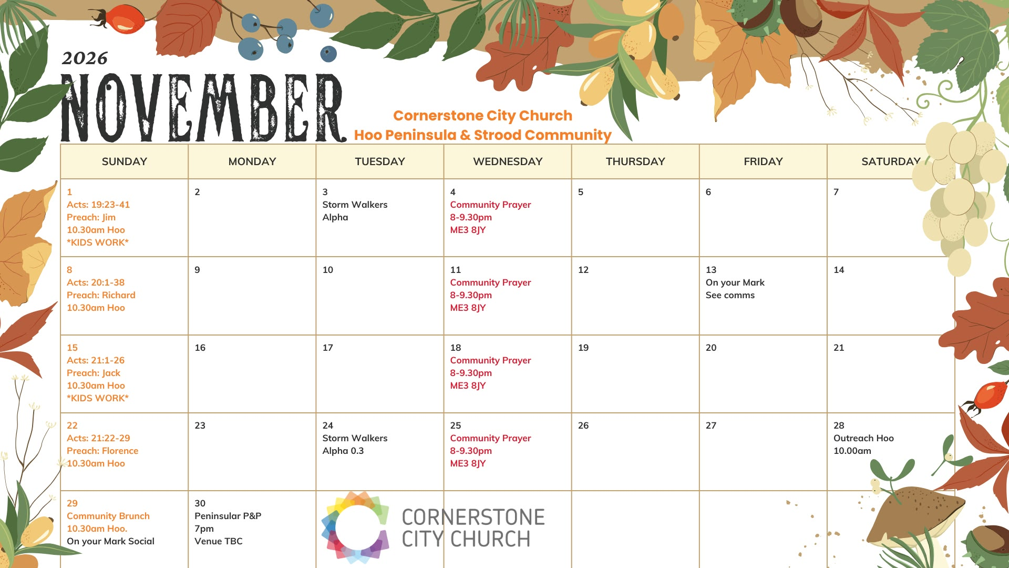

Slide 49
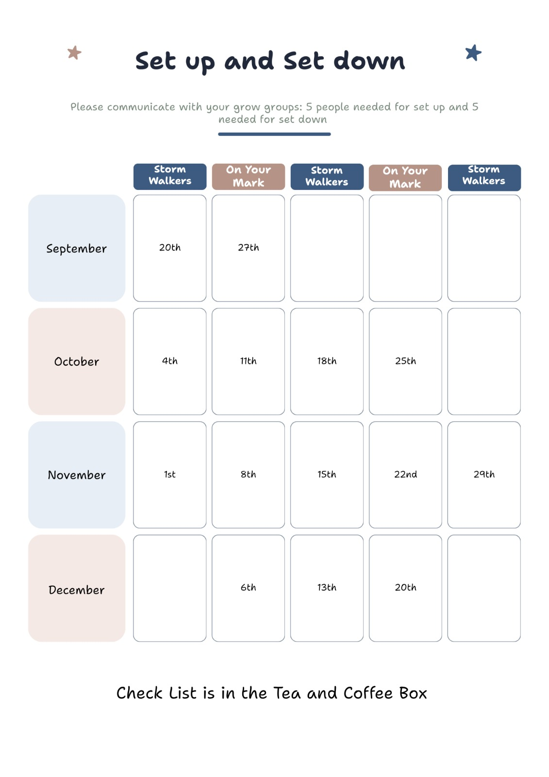

Slide 50
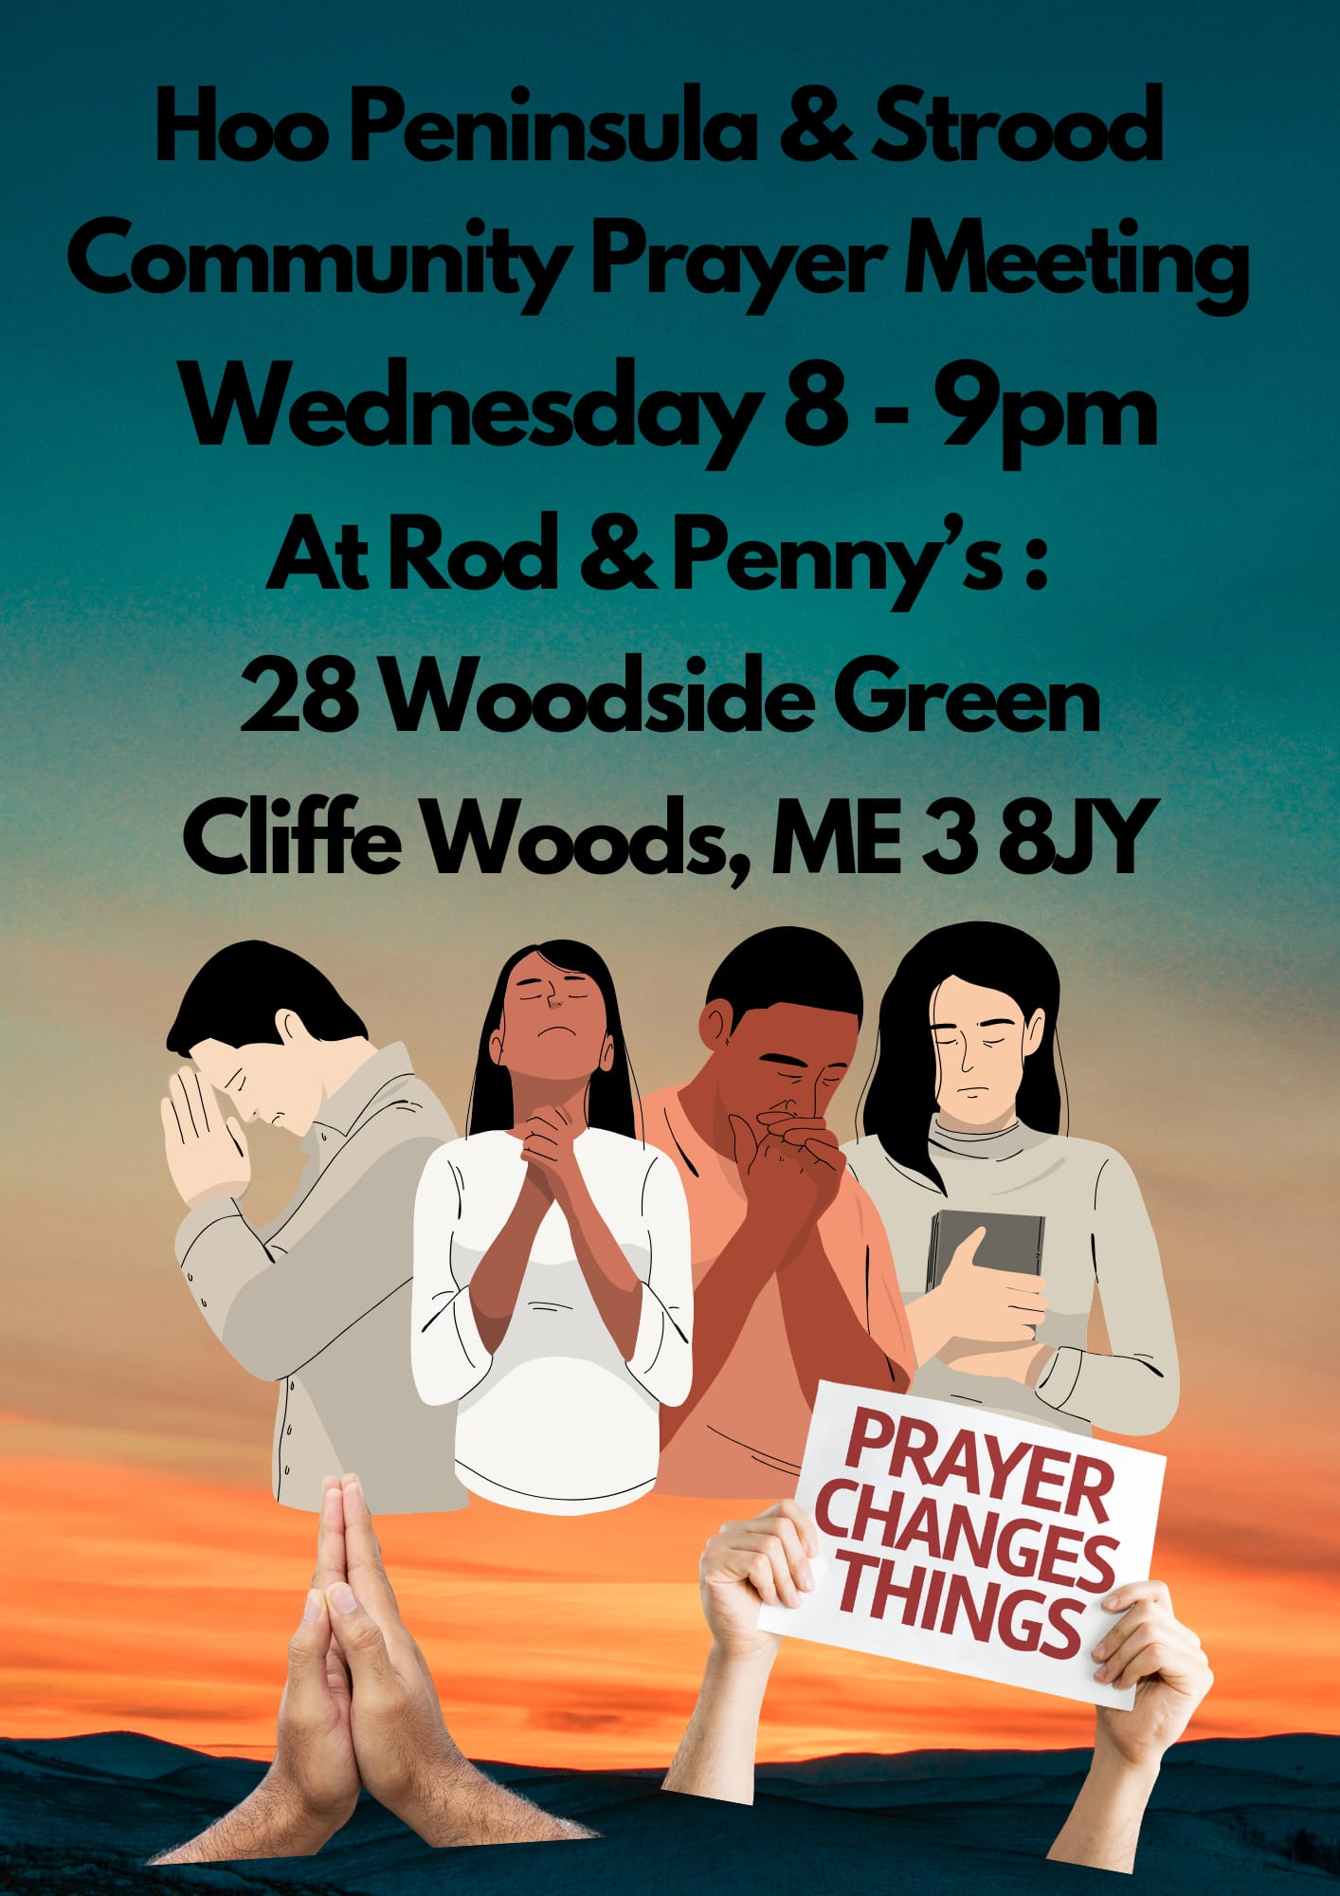

Slide 51
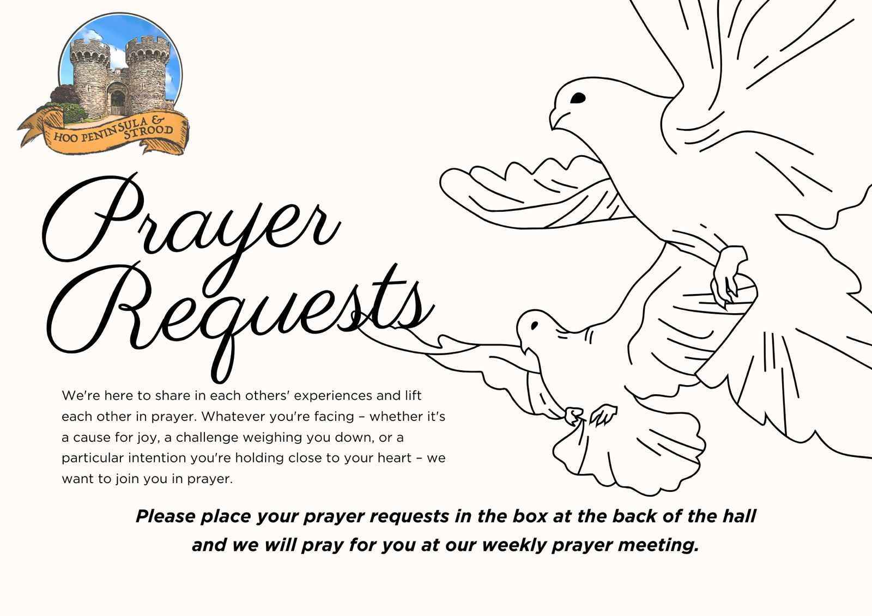

Slide 52
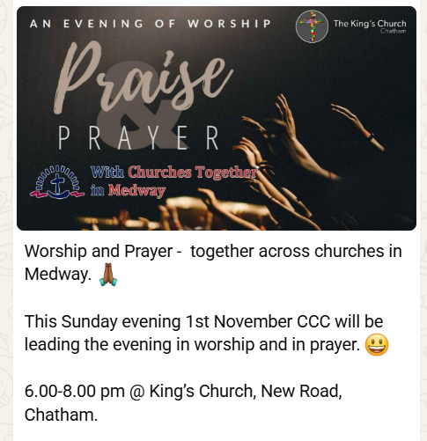

Slide 53


Slide 54
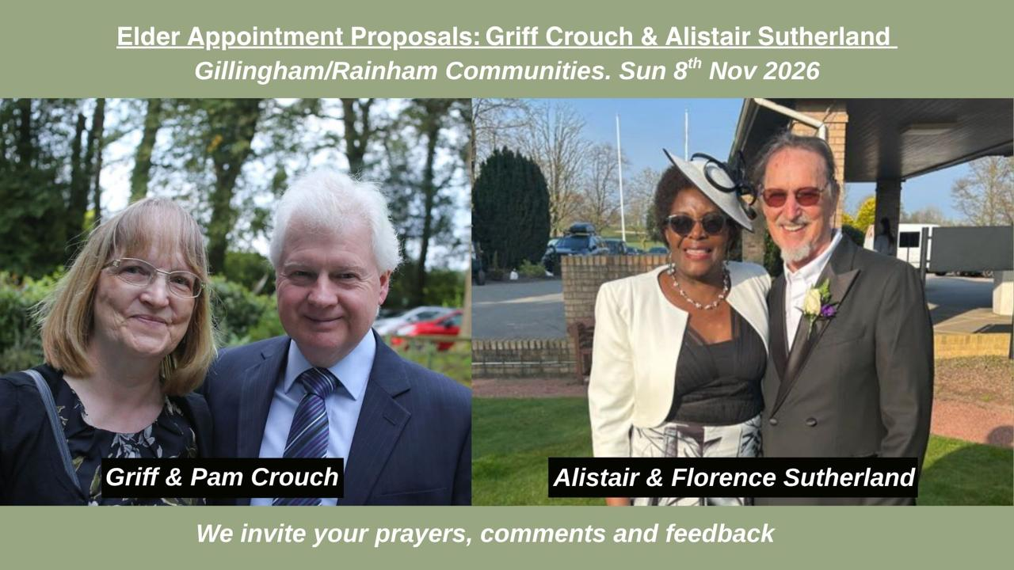

Slide 55
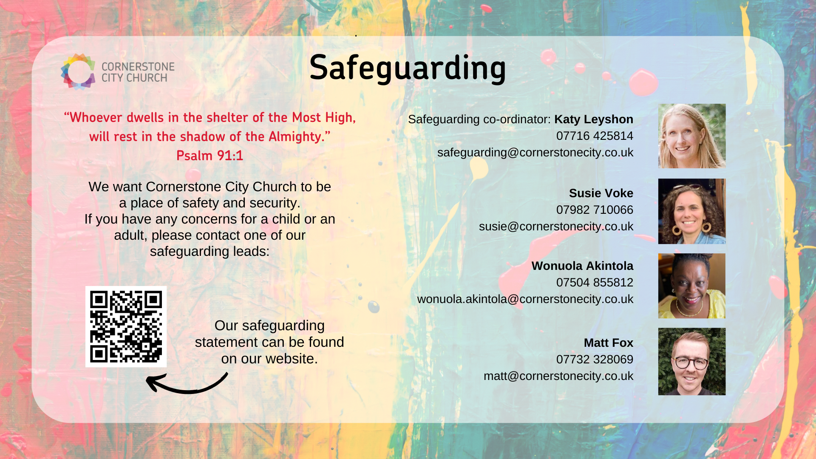

Slide 56
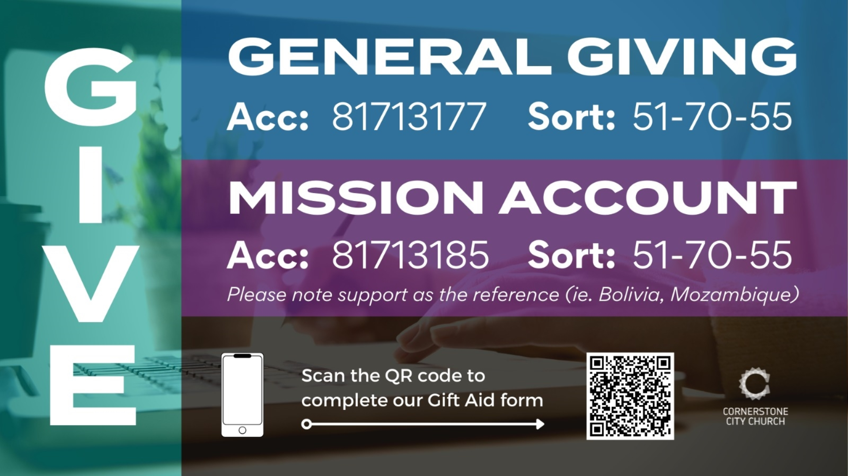

Slide 57
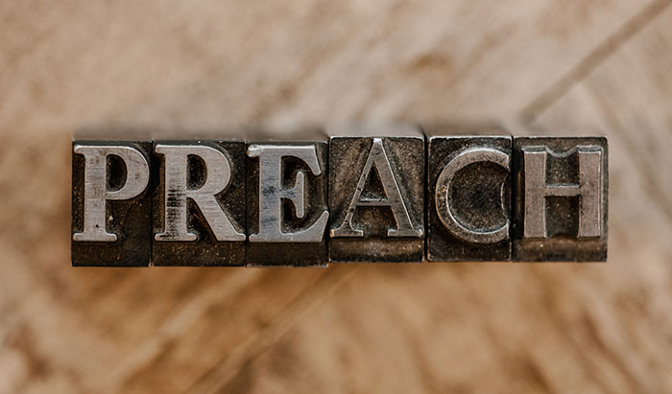

Slide 58
2 Corinthians 14
May the grace of the Lord Jesus Christ, and the love of God, and the fellowship of the Holy Spirit be with us all.
And….
Surely goodness and mercy shall follow us all the days of our lives, and we shall dwell in the house of the Lord forever.

Slide 59
Amen!

